Slide 1
Where abilities have no boundaries.

Slide 2
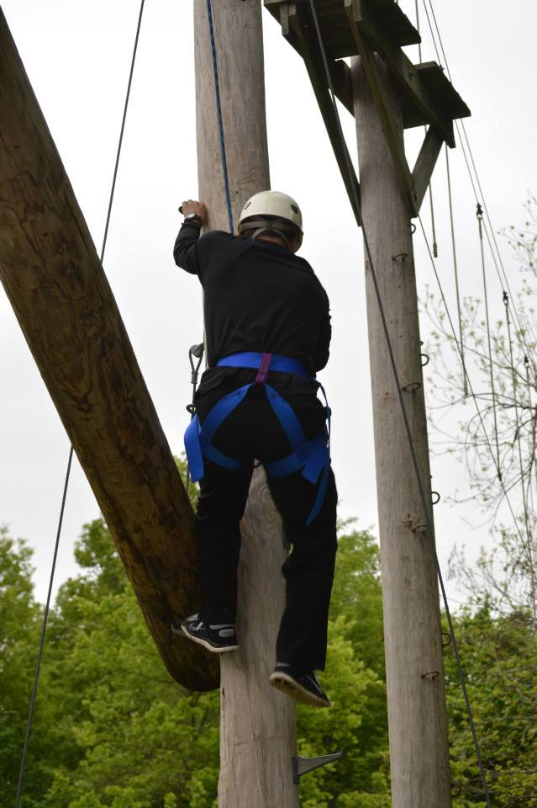
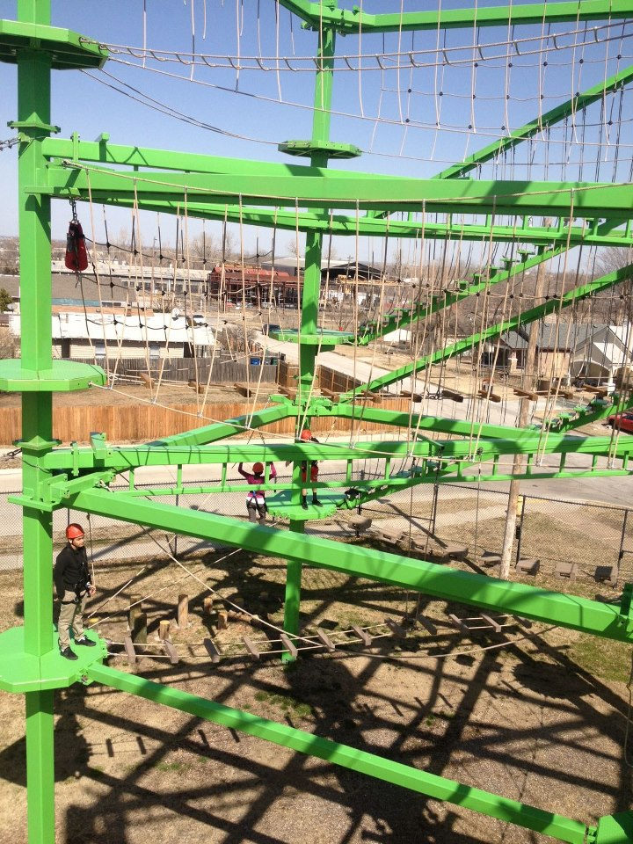
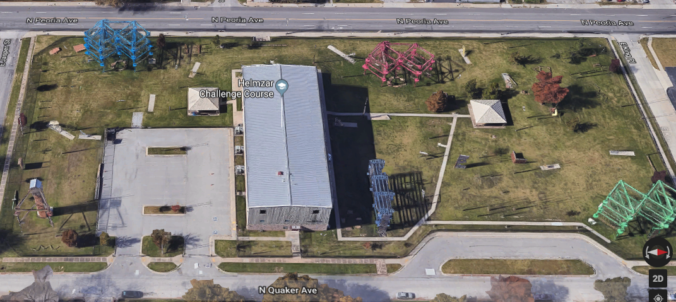
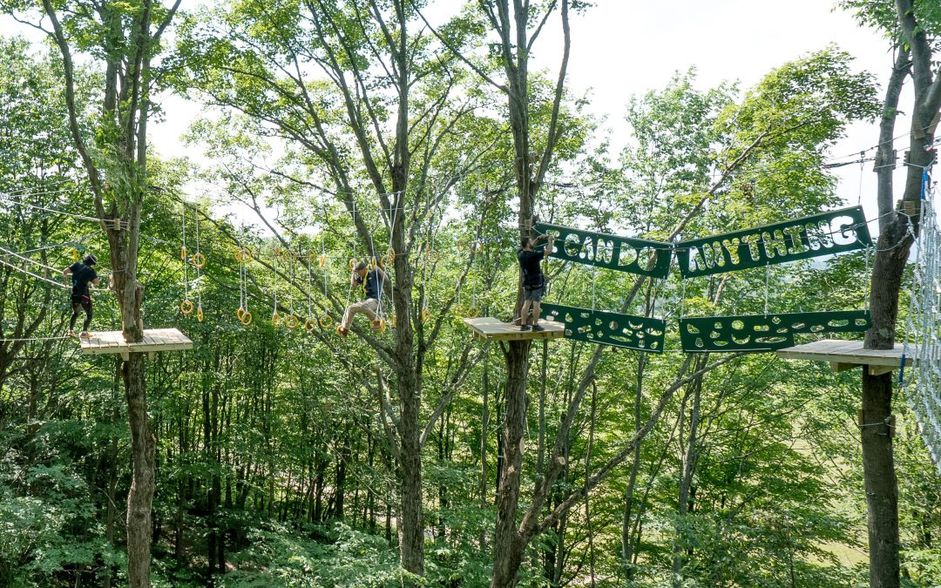
Dr. Carrie Taylor Ed.D
Notes:
8 courses

Slide 3
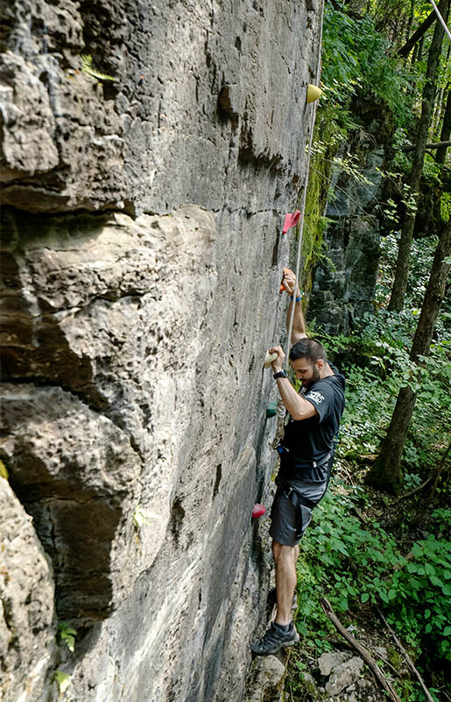
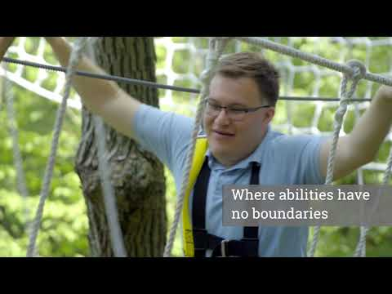
Know No Bounds
No Bounds

Slide 4
Partnerships
Upstate Cerebral Palsy (Jeremy Earl)
New York Department of Health
Dr. Carrie Taylor (Utica College)
NY State Lobbyist for the State Department
Adventure Mas (Mike Barker)

Slide 5
INTERNAL & EXTERNAL RELATIONSHIP
Facility Availability & Diversity
Internship, Volunteer & On-the-Job Training to Future Jobs
Training & Certification

Slide 6
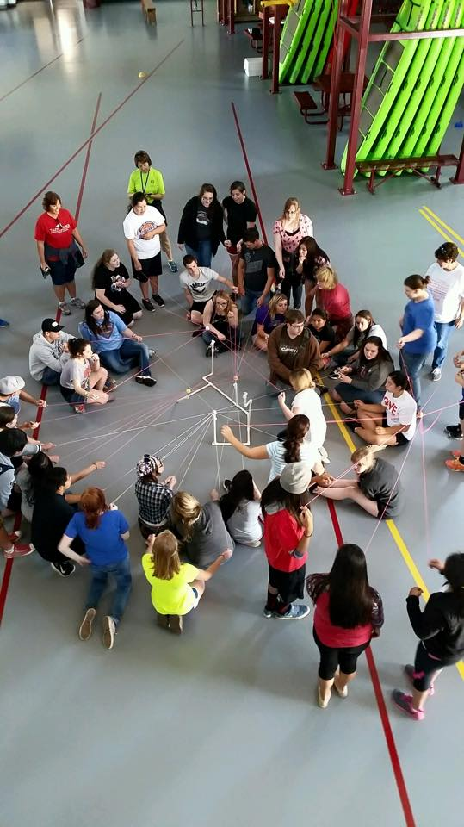
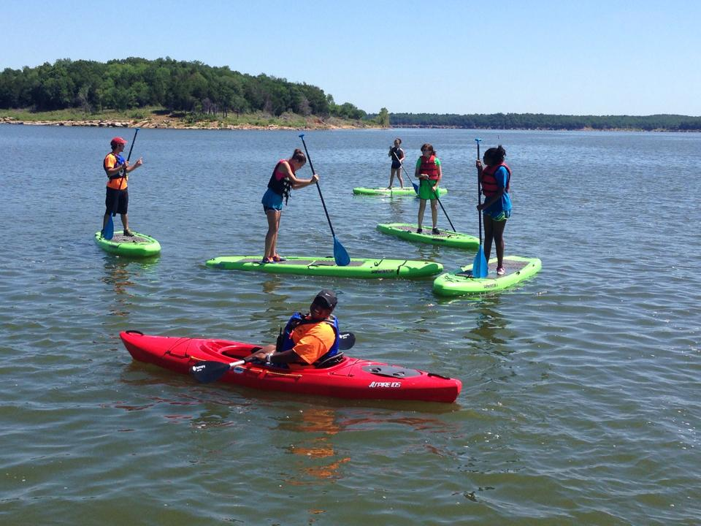
Educational Innovation
Encourages and Recognizes Innovation and Creativity
Link Curricula in Sports Management Programs to a Variety of Classrooms
Sports Management, Physical Education, Corporate Training, Camps, Recreation Therapist, Parks & Recreation and more
Experiential Learning Throughout all Levels

Slide 7
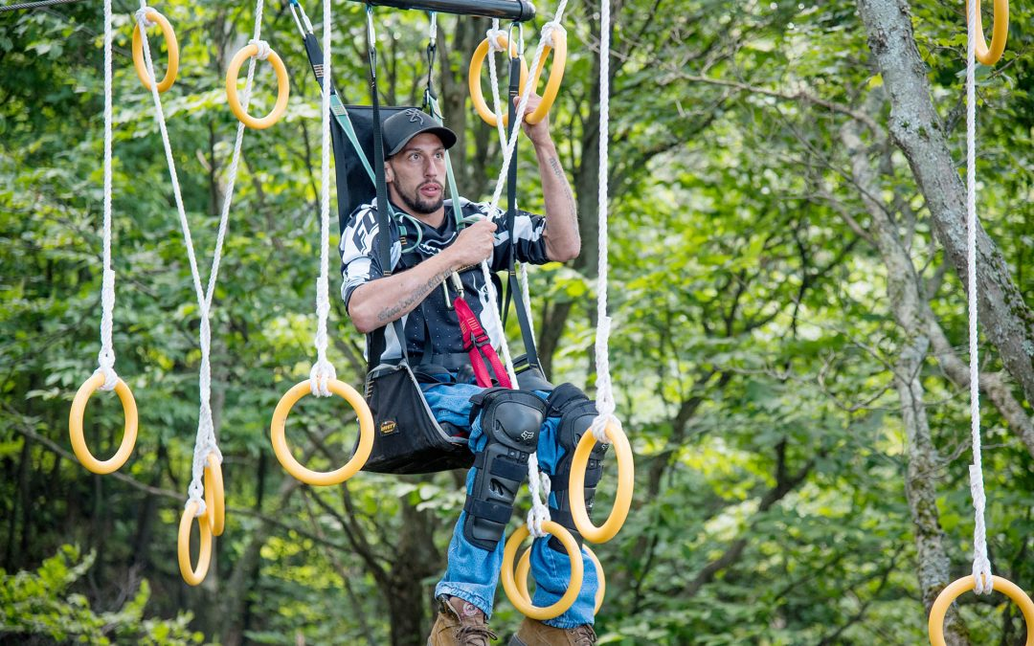
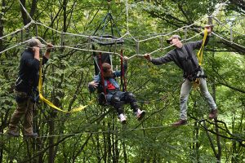
What Makes This Special
Diversity in Sports
Inclusion/Innovation/Creativity

Slide 8
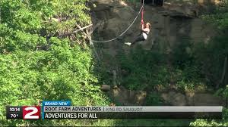
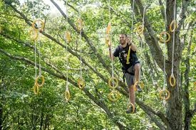
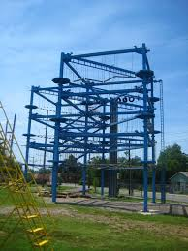
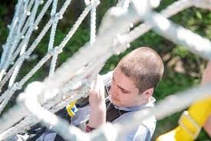
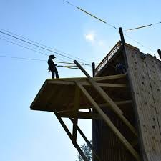
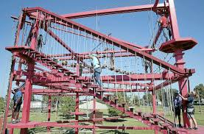

Slide 9
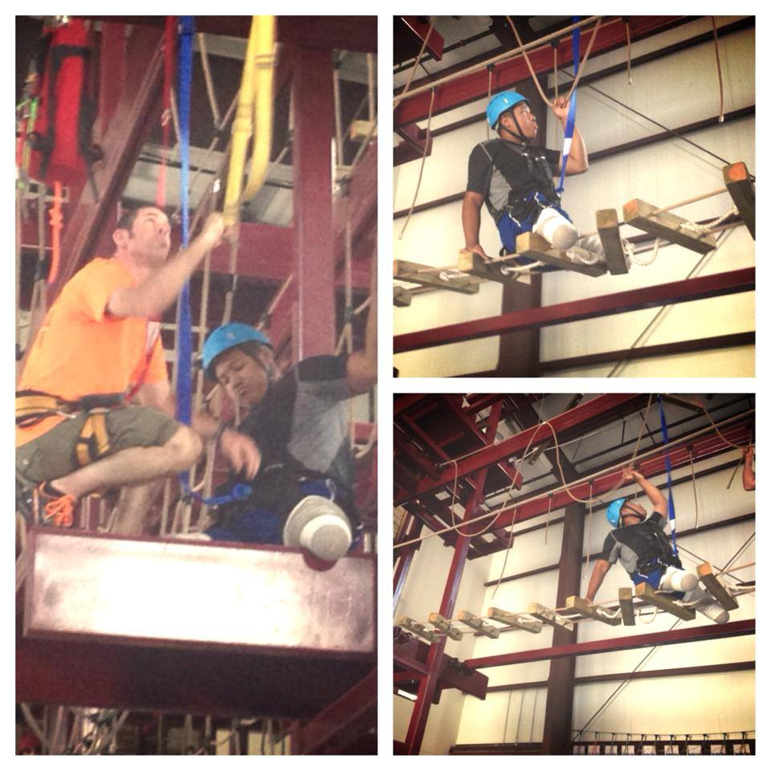
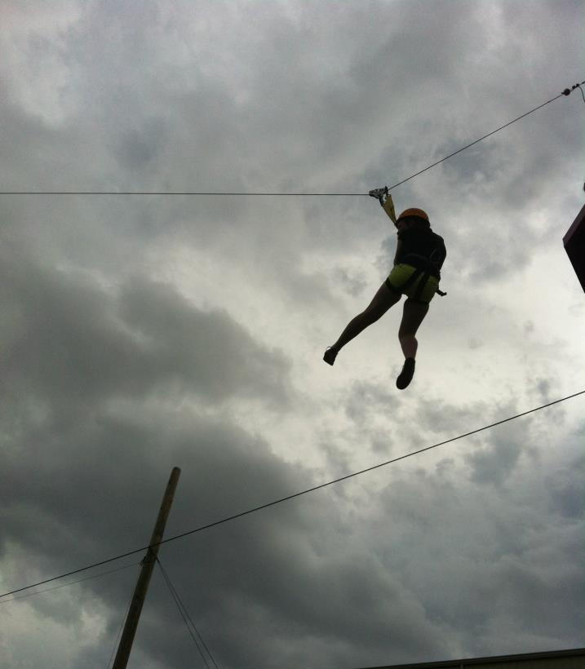
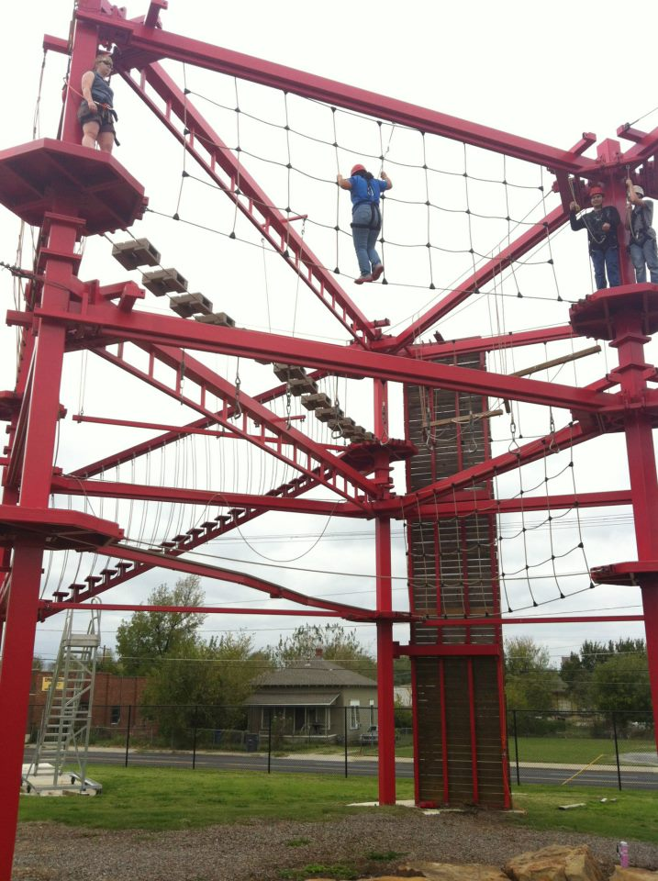
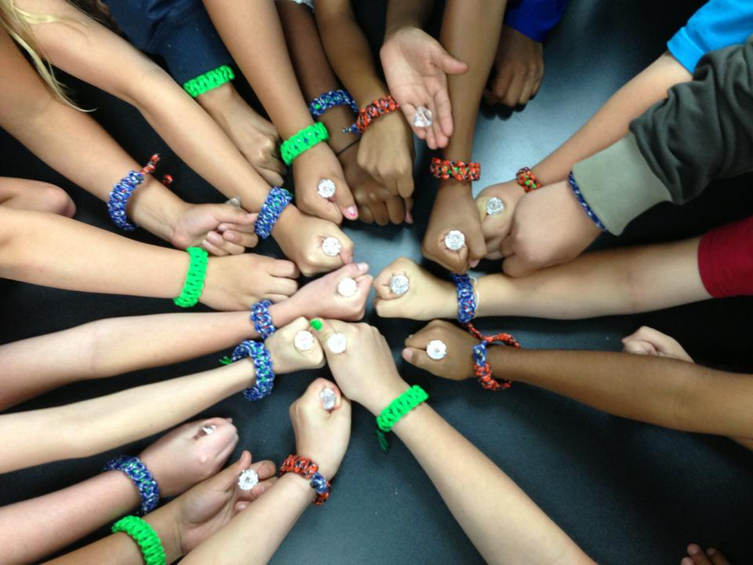
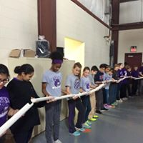
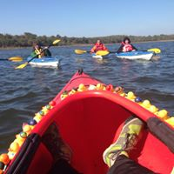
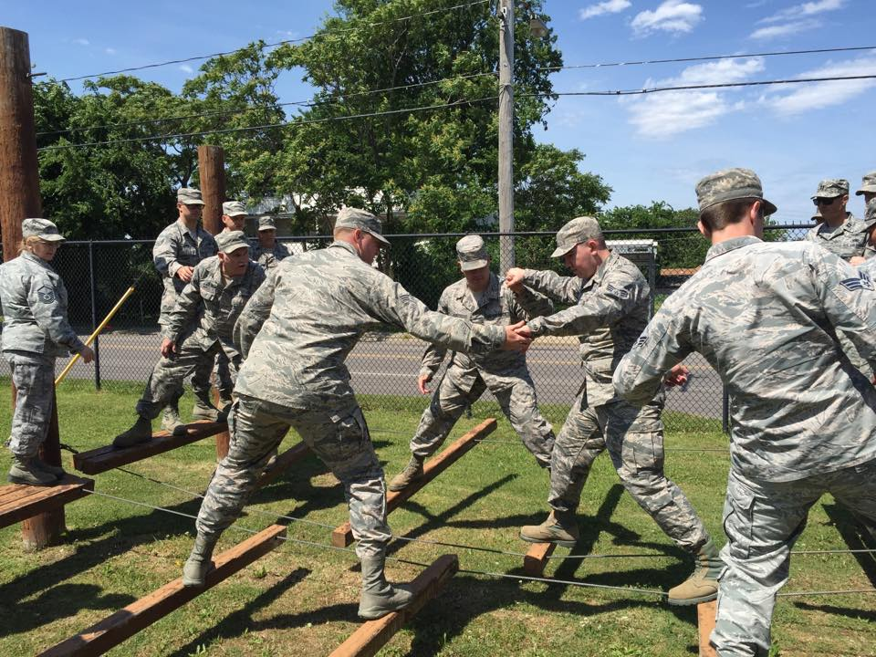

Slide 10
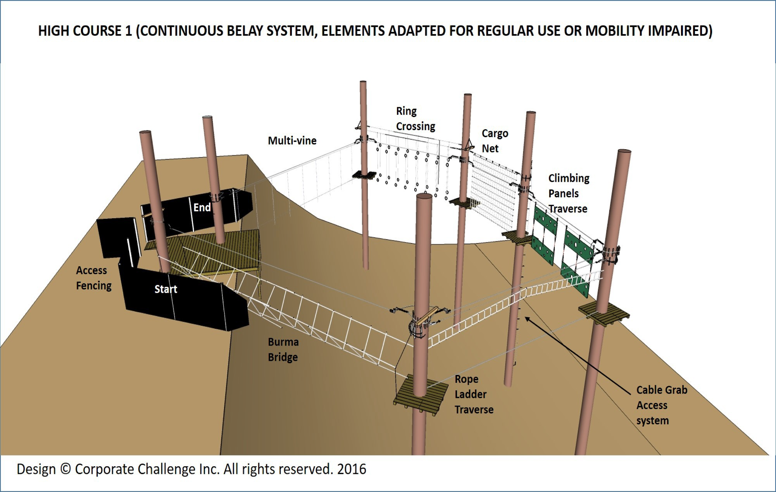
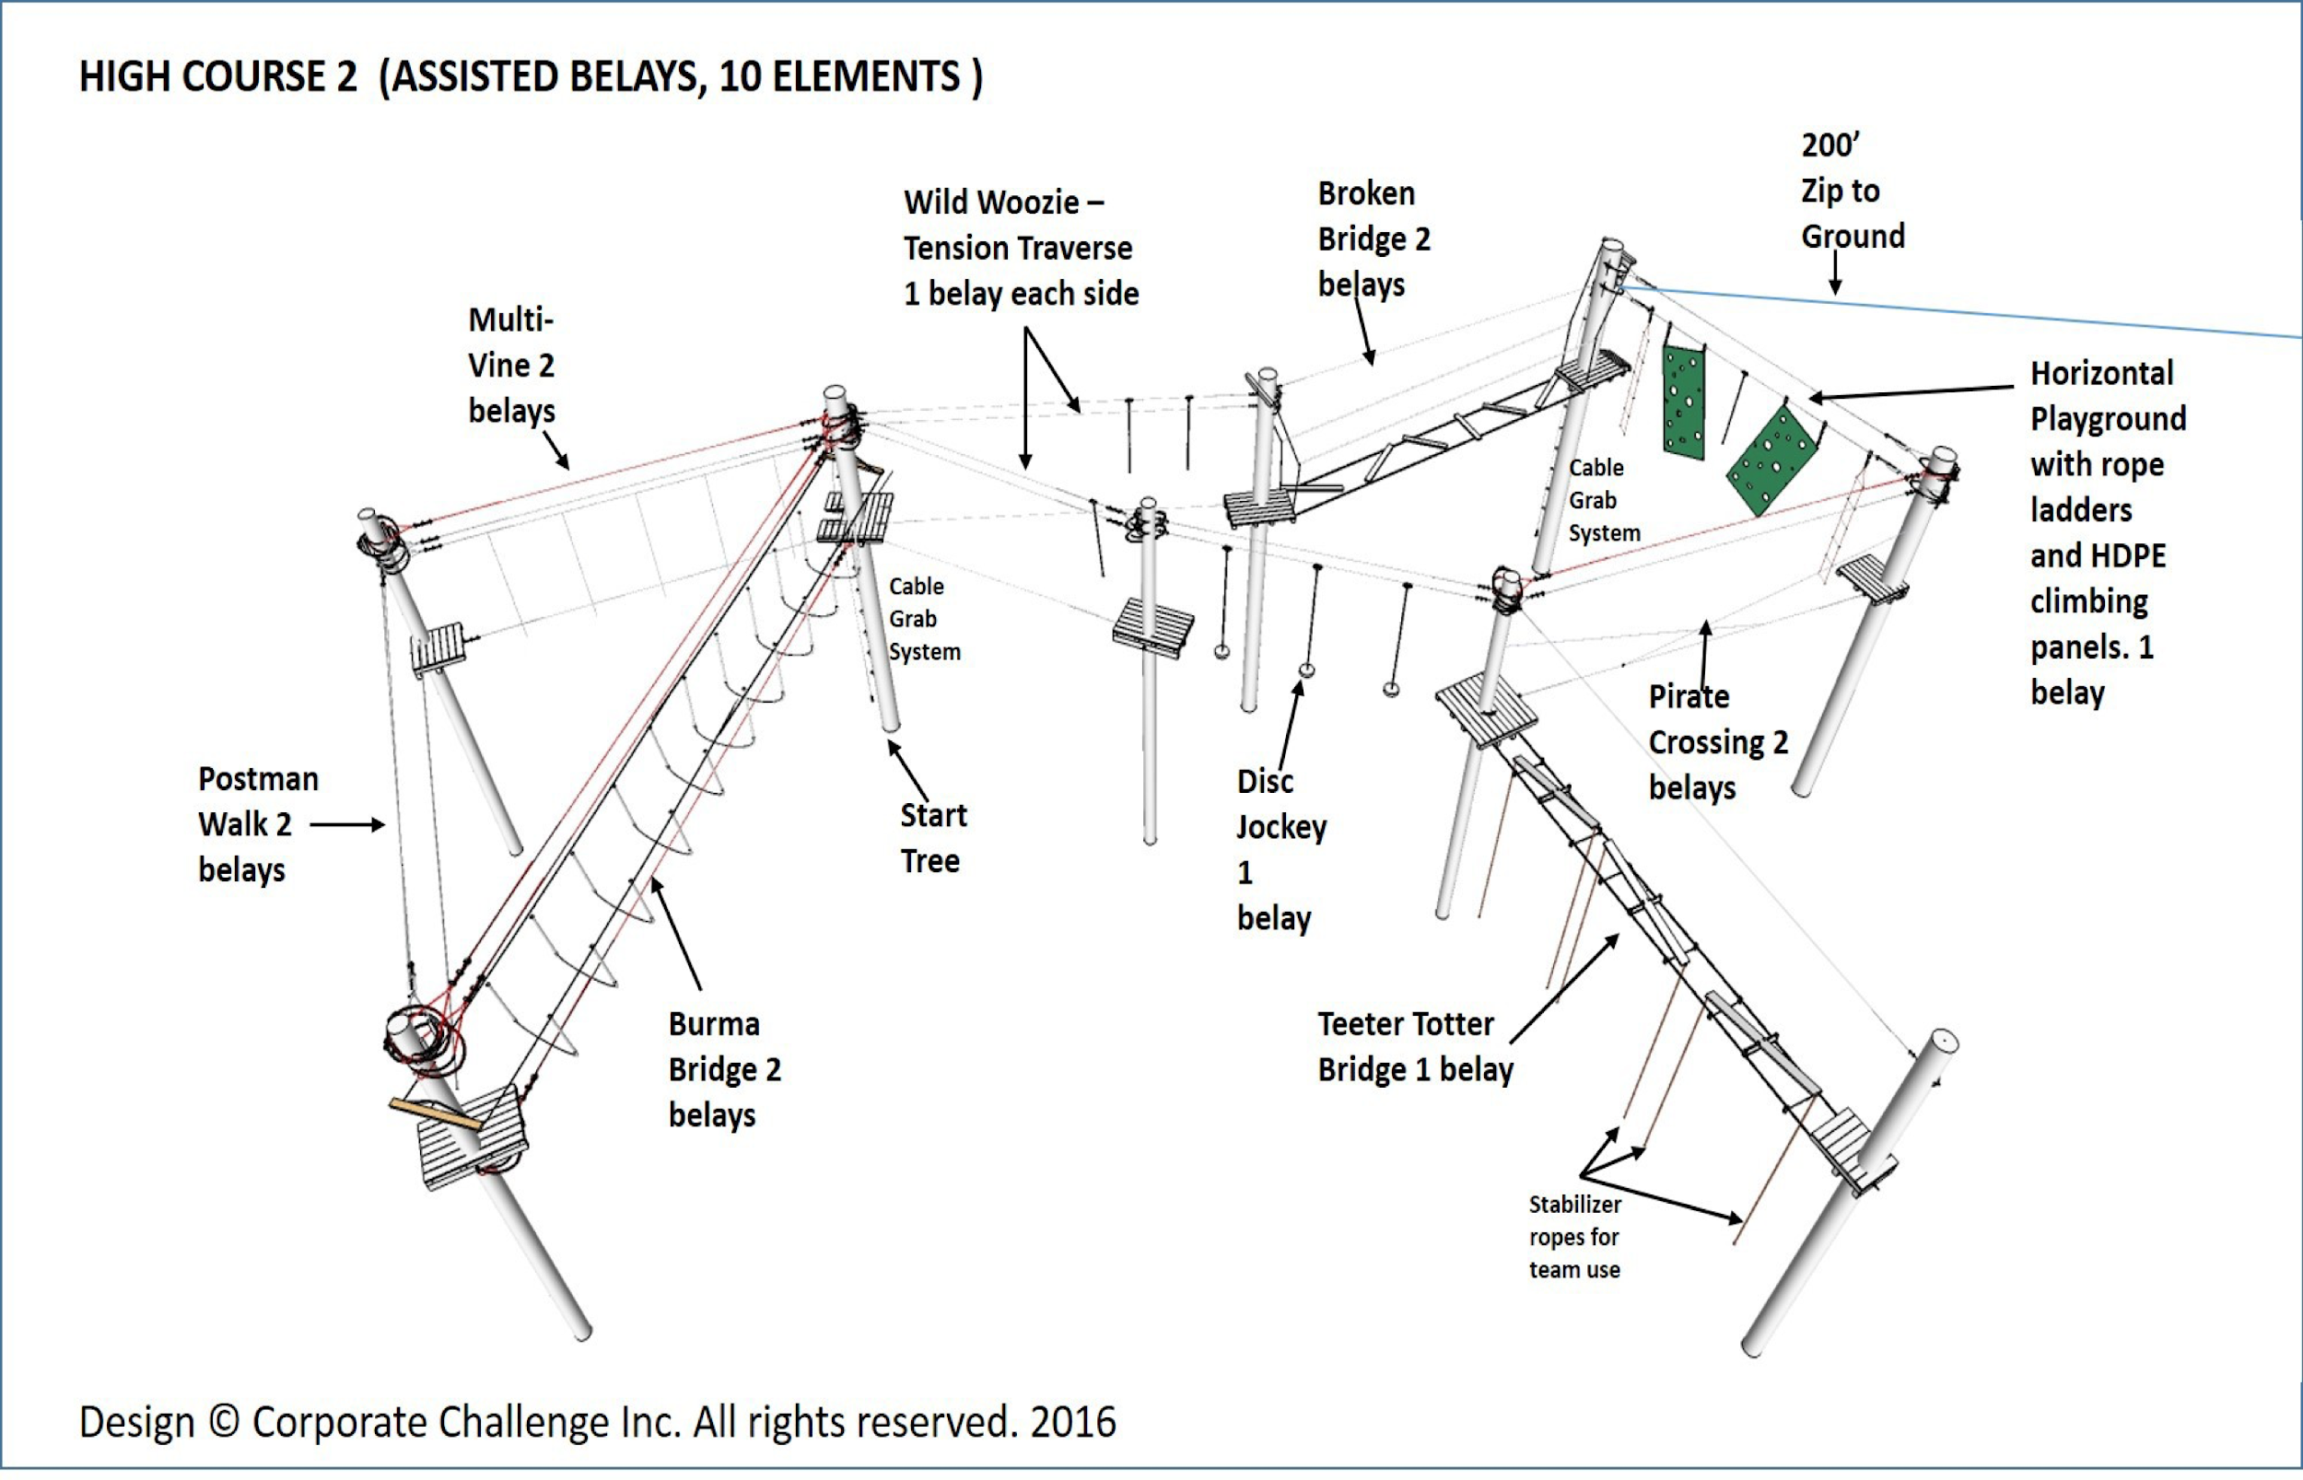
The Root Farm (example)

Slide 11
Questions? ? ? ? ? ? Comments ? ? ? ? ? ?

Slide 12
Where abilities have no boundaries.

