Slide 1
Community Colleges – Universities Together: We are the Champions
A Session on Relationships, Accreditation, and Cooperation
Michael Pfahl, Owens Community College
Scott Bradshaw, Bucks County Community College

Slide 2
Today’s Pathway
THE BIG QUESTION
Is there a pathway from community colleges to four-year institution graduation paved by accreditation?
THE BIG ANSWER
Focus on a process that develops relationships, aligns transfer processes, and uses COSMA accreditation standards to link the two and to grow the relationship.
THE BIG CONTEXT
Specific aspects of community college and four-year institution partnership needs.

Slide 3
Context
Public Health Situation
(Harris, Liu, Oliver, Balfe, Slaughter, & Mattei, in process)
Meaningful Relationships
(Bailey, Jaggars, & Jenkins, 2015; Kisker, 2007; Xu, Xiaotao Ran, Fink, Jenkins, & Dundar, 2018)
Permanent Enrollment Challenges
(Levine & Van Pelt, 2021; Pfahl, 2017; Schwartz, 2022)
Global Marketplace for Sport Education
Changes in Skill Sets for Graduates
(Jackson, 2009)
The Big Other(s)
Accreditation as Differentiation
(Lawrence-Benedict, Pfahl, Walton, Smith, & Wright, 2016; Yiamouyannis, Bower, Williams, Gentile, & Alderman, 2013)

Slide 4
Trust the Process
The future….
The next several slides are informative, but also ask you to do a bit of work today.
Grab a pencil and paper, and let’s get started.
Take stock of your situation and identify how your institution can get started as early as today.

Slide 5
Relationships (e.g., Bailey, Jaggers, & Jenkins, 2015)
Who has active partnerships with community colleges right now? If not, then is it on your radar?
Cultural Connections
Cooperative Socialization

Slide 6
Transfer Alignment (e.g., Kisker, 2007; Xu, Xiaotao Ran, Fink, Jenkins, & Dundar, 2018)
What two year college program would you want to partner?
What would facilitate that partnership ?
What might keep it from happening?
What is one aspect of your current program that you do really well?
What might be an area of improvement?
How might partnerships facilitate ways to address either or both?
How would you bridge the gap between two and four year institutions in your area?

Slide 7
Accreditation
What does accreditation look like for you? What if it involves two year colleges? Would things change?
Classes
Collaboration
Socialization
Culture
Success
Onboarding
Experiences
What areas do you need help with? Accreditation? Faculty development? Content?

Slide 8
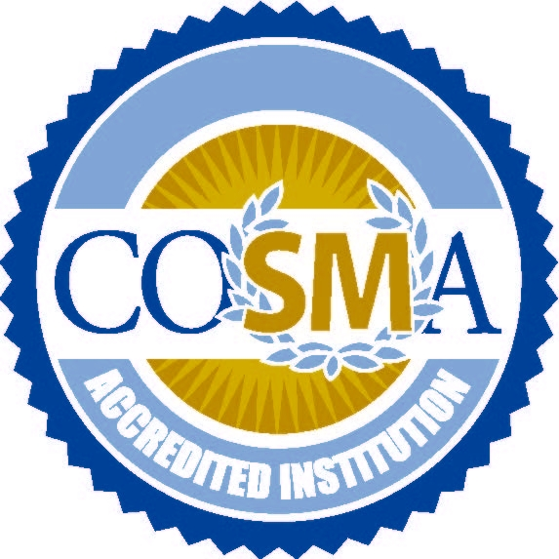
Trust the Process
Relationships
Accreditation
Transfer Alignment
The COSMA Factor

Slide 9
References
Bailey, T.R., Jaggars, S.S., & Jenkins, D. (2015). Redesigning America’s Community Colleges: A clearer path to student success. Harvard University Press.
Harris, D.N., Liu, L., Oliver, D., Balfe, C. Slaughter, S., & Mattei, N. “How America's Schools Responded to the COVID Crisis.” Working paper July 2020.
Jackson, D. (2009). Profiling industry-relevant management graduate competencies: The need for a fresh approach. International Journal of Management Education, 8(1), 85-98.
Kisker, C. B. (2007). Creating and sustaining community college—university transfer partnerships. Community College Review, 34(4), 282-301.
Lawrence-Benedict, H., Pfahl, M., Walton, K., Smith, S., & Wright, A. (2016). An exploration of a community of inquiry in graduate online sports administration education. North American Society for Sport Management. Orlando, Florida, 31 May – 5 June 2016.
Levine, A., & Van Pelt, S. J. (2021). The Great Upheaval: Higher Education's Past, Present, and Uncertain Future. Johns Hopkins University Press.
Pfahl, M. (2017). How to talk about accreditation with students and employers. Commission on Sport Management Accreditation (COSMA). Tampa, Florida, 31 January – 3 February 2017.
Schwartz, N. (2022, 13 September). Transfer enrollment declined 13.5% since the pandemic started. Higher Ed Dive.
Xu, D., Ran, F. X., Fink, J., Jenkins, D., & Dundar, A. (2018). Collaboratively clearing the path to a baccalaureate degree: Identifying effective 2-to 4-year college transfer partnerships. Community College Review, 46(3), 231-256.
Yiamouyiannis, A., Bower, G. G., Williams, J., Gentile, D., & Alderman, H. (2013). Sport management education: Accreditation, accountability, and direct learning outcome assessments. Sport Management Education Journal, 7(1), 51-59.

