Slide 1
Sport Court: Connecting Experiential Learning with Adult Learning Theories
Madeleine Herman
Gwynedd Mercy University

Slide 2
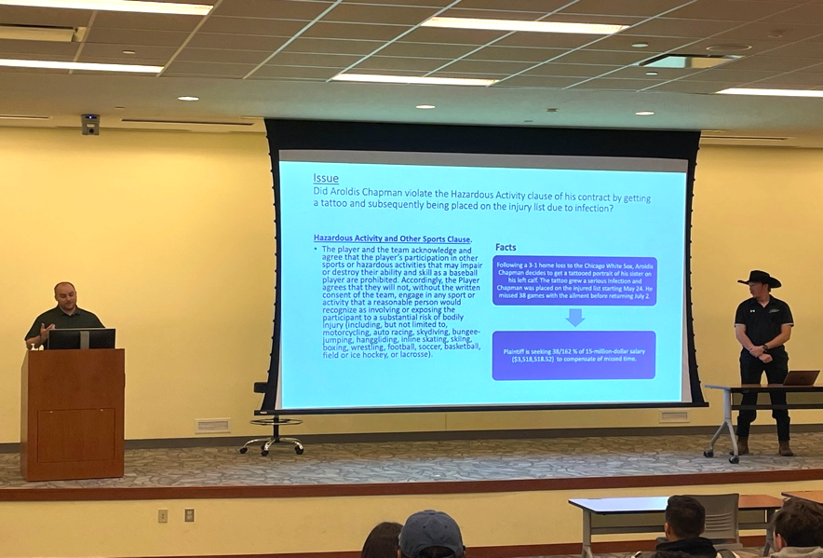
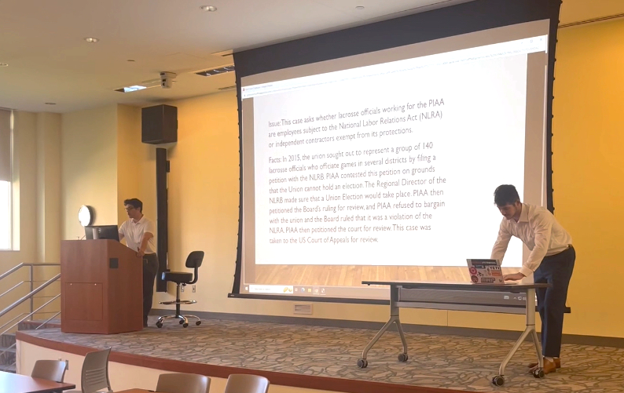

Slide 3
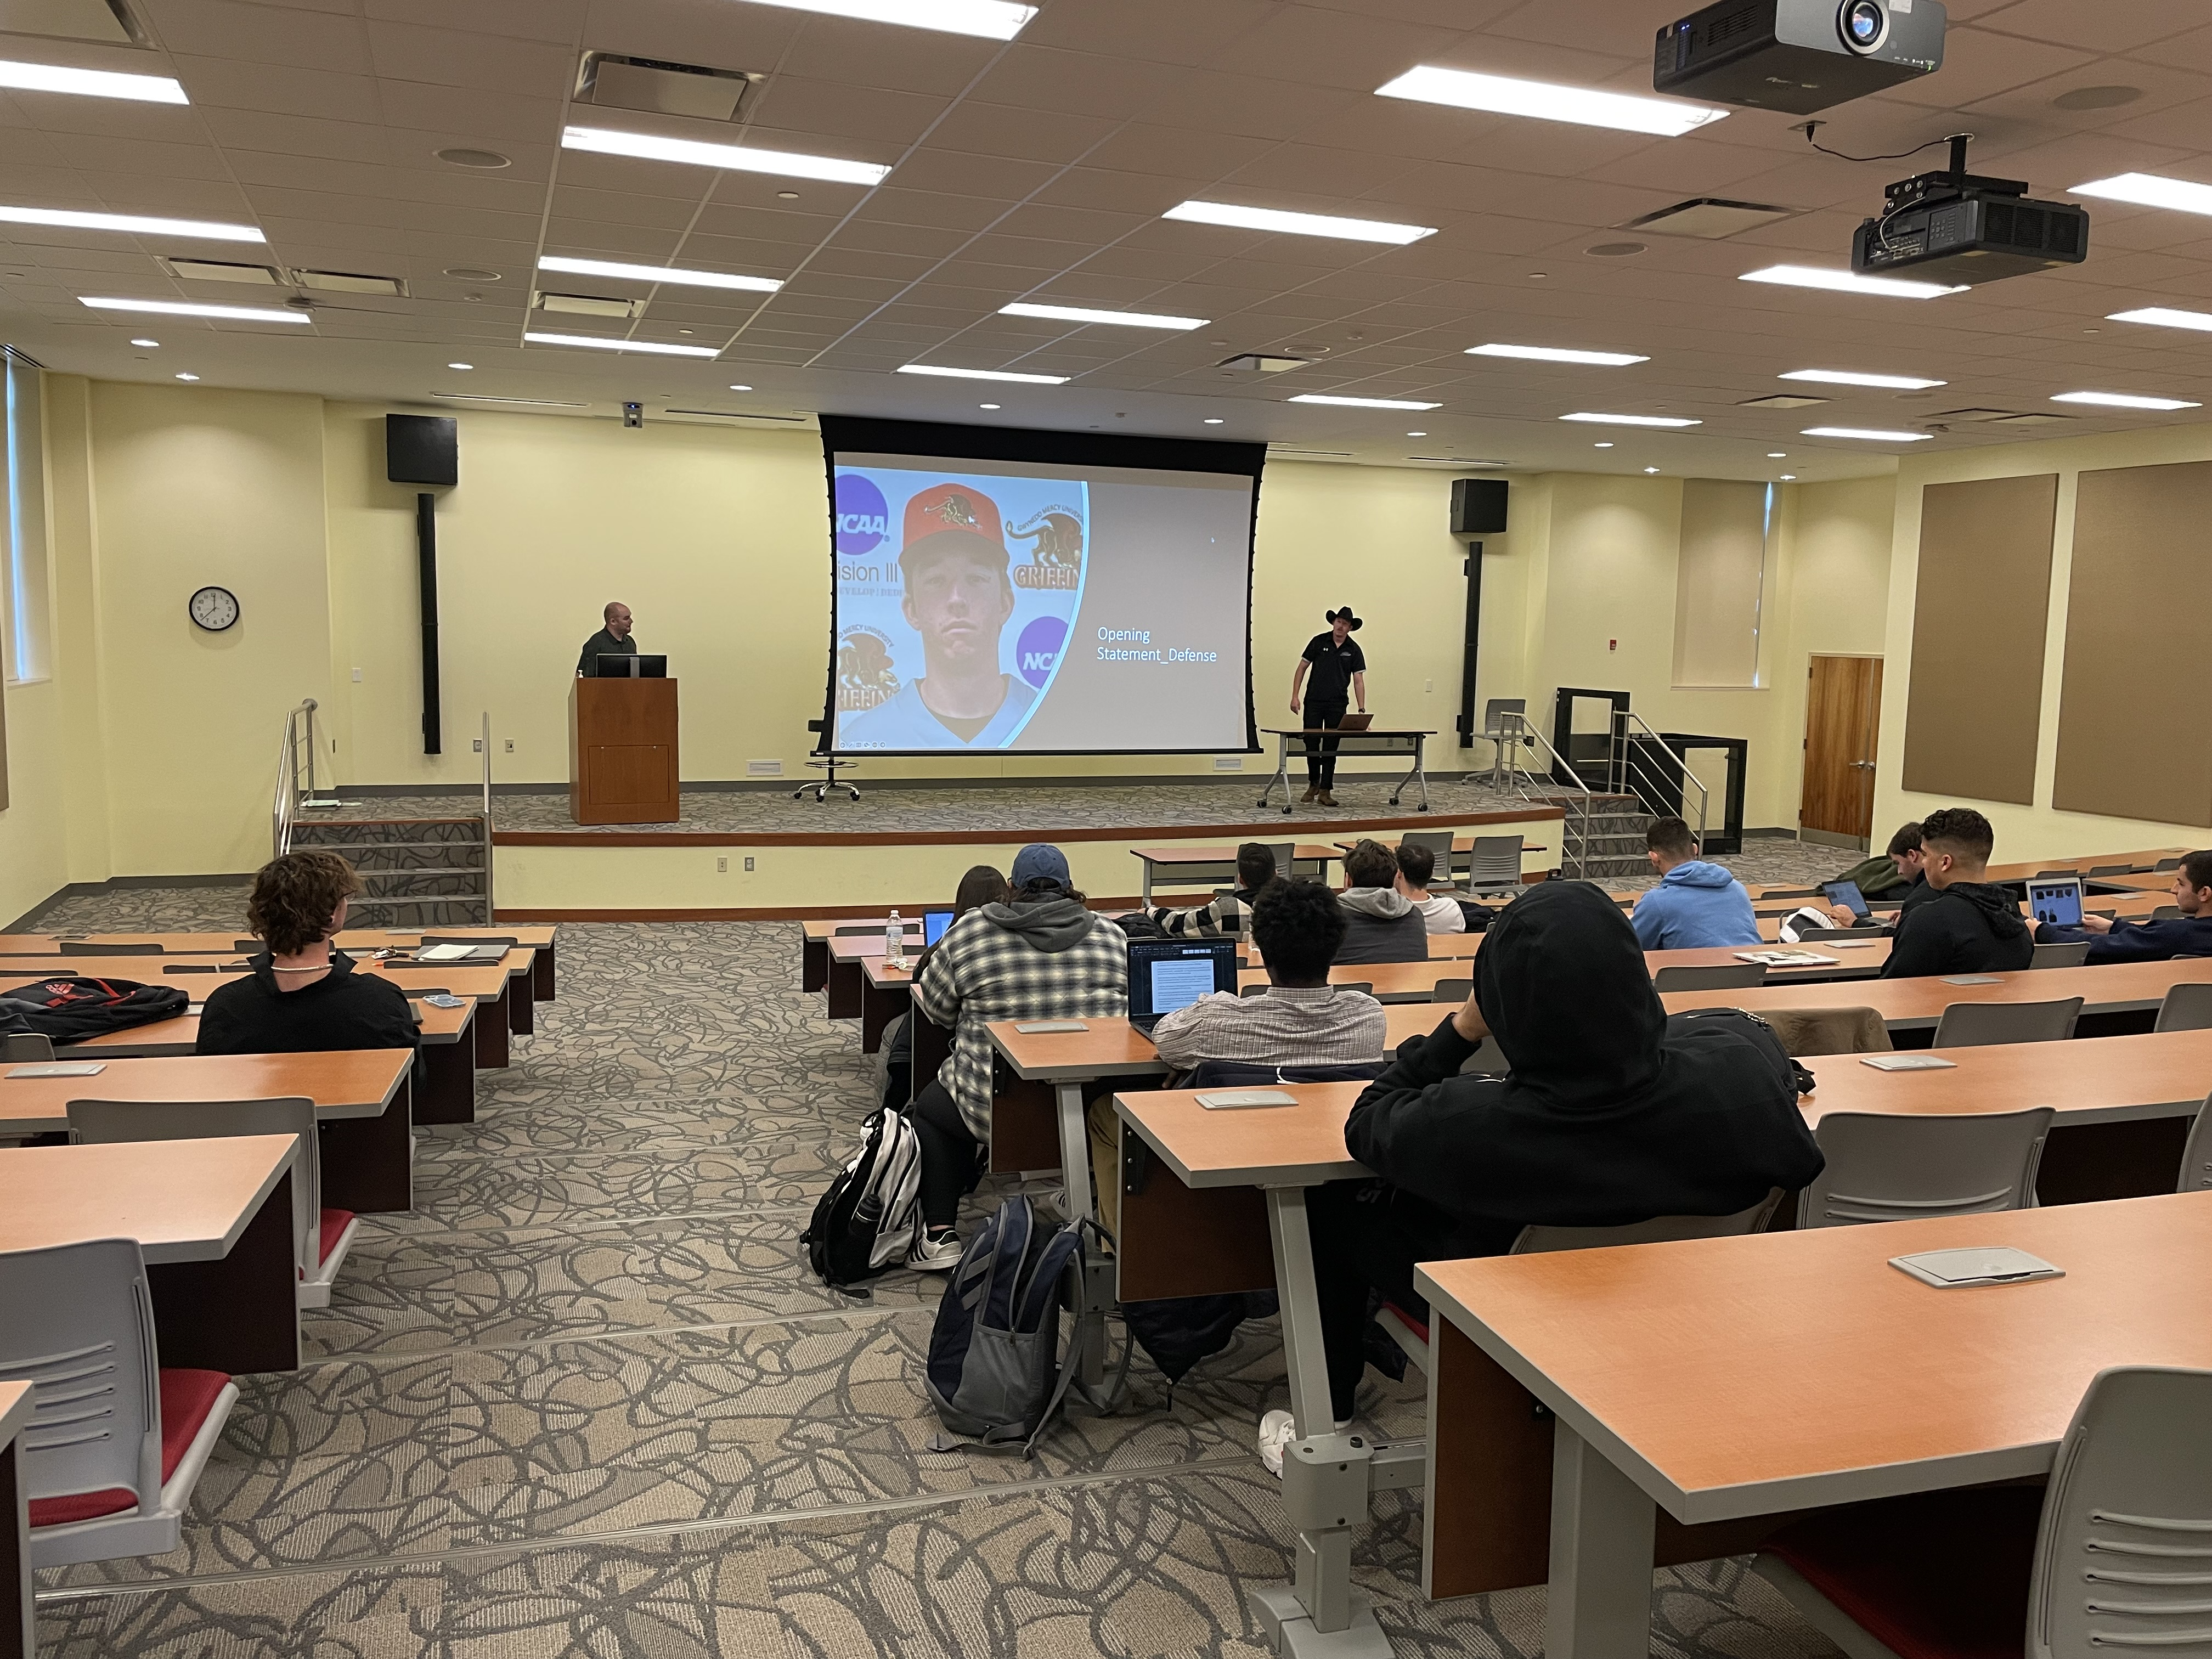

Slide 4
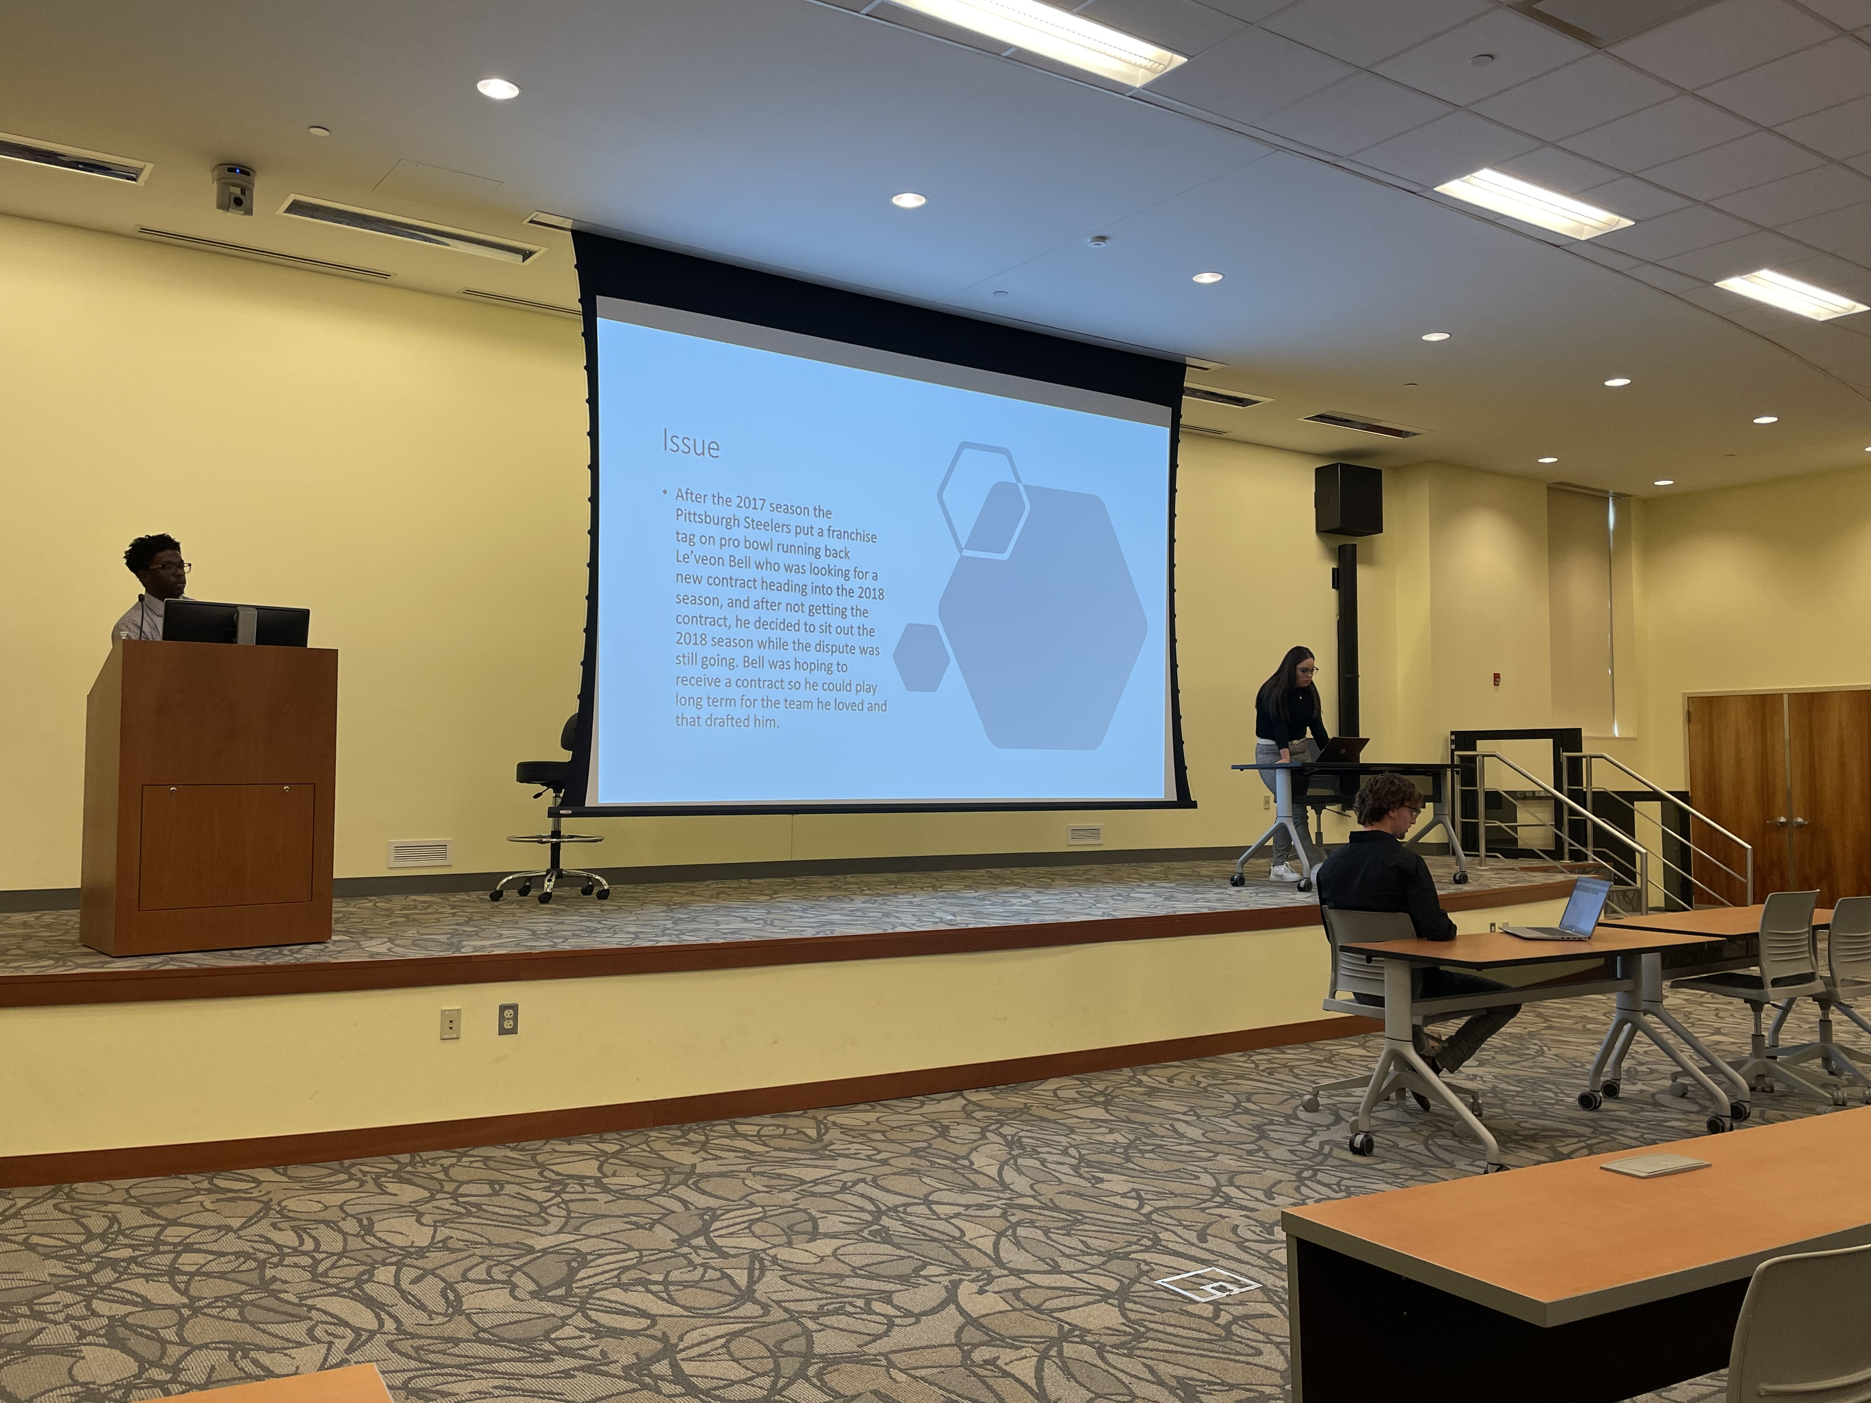

Slide 5
Sport Court Purpose
Sport Court
Adult Learning Theory
Addresses the need for sport managers to be aware of the legal implications of their managerial performance
Students analyze the legal and regularity aspects, elements, and relationships around sport
Designed to provide an experience that replicates a real court case.
Andragogy: through creating a positive learning experience for adult learners to learn about sport law concepts
Experiential learning: “experience is the adult learner’s living textbook.”
Notes:
For all constituents participating in sports: administrators, coaches, athletes, agents, vendors, sponsors, facility managers, and spectators
Experience is significant for adult learners to draw from to help connect the material to their life and make more meaning of it.

Slide 6
How do we get to Sport Court?
Sport Court Topics
Adult Learning Theory
Introduction to Legal Issues in the Strategic Management and Governance in Sport
Venue Operations and Participant & Spectator Liability
Employment and Labor Relations
Contract Law and Agency
Marketing and the Law
Governance of Professional and Olympic Sports
Self-directed and transformative learning: Through Caffarella’s learning in adulthood, each of these topics lend itself to emancipatory learning where students can incorporate and integrate social justice practices into their sport court cases.
Notes:
Transformative learning is sometimes called transformation learning, and focuses on the idea that learners can adjust their thinking based on new information
Self-directed learning is a process where individuals take primary charge of planning, continuing and evaluating their learning experiences
Emancipatory pedagogy refers to a process of teaching that aims to free the teacher and the student from the mental restrictions imposed by the mainstream culture on the way they perceive things.

Slide 7
Examples
Introduction to Legal Issues in the Strategic Management and Governance in Sport
Are NCAA teams allowed to negotiate contracts with other networks? Is the banning of these college athletic teams a direct violation with the Sherman Antirust Act?
Venue Operations and Participant & Spectator Liability
Did Title III of the Americans with Disabilities Act prohibit the PGA from denying a golfer equal access to its tours on the basis of his disability?
Do the actions of the defendant, Kobe Bryant, on November 14, 2005, qualify as a tort of assault, of battery, and or outrageous conduct?
Employment and Labor Relations
This case asks whether lacrosse officials working for the PIAA are employees subject to the National Labor Relations Act (NLRA) or independent contractors exempt from its protections.

Slide 8
Examples cont.
Contract Law and Agency
The prosecution is seeking that Rich Paul pay damages worth up to $3.5 million for a breach of contract and a breach of the duty of good faith for his client Nerlens Noel.
Did Aroldis Chapman violate the Hazardous Activity clause of his contract by getting a tattoo and subsequently being placed on IR due to infection?
Marketing and the Law
Is QIAODAN Sports in violation of trademark infringement?
Dd a game developer have a first amendment defense against the right-of-publicity claims of a former college football players whose likeness was used in a video game?
Governance of Professional and Olympic Sports
Did Trevor Bauer violate the Joint Domestic Violence, Sexual Assault and Child Abuse Policy set forth by the MLB and the MLBPA in his interactions with Ms. Hill?
The plaintiffs are seeking a 25 week or year and a half suspension for Deshaun Watson instead of the 11-game suspension the league instituted at the beginning of the year. Also, seeking increase in the fine amount from 5 million to 20 million dollars for violating league's personal conduct policy.

Slide 9
Sport Court Agenda
Students are paired up to choose a sport-related case or issue that address the Sport Court topic.
After selecting the case or issue, students work together to write the issue and facts for their case to present during their Sport Court trial.
Students then individually complete a written case brief to be submitted prior to Sport Court with their issue, facts, opening statement, argument, eye or expert witness, and closing statement.
Students then present their case brief as a trial to the class, going back and forth between the Plaintiff and Defendant.
While each Sport Court trial is in session, students will complete a rubric evaluating the Plaintiff and Defendant arguments for their jury deliberation contribution.
After both students present their case brief, they will leave the room while the jury (the rest of the class) deliberates. The jury will share their rationale and decision as a group to the Plaintiff and Defendant.

Slide 10
Directions
Case Brief
Adult Learning Theory
Plaintiff and defendant name
Case title
Issue
Facts
Opening statement
Argument
Eye or expert witness script
Closing statement
Walk-off song
Cultural competence: A written case brief and presentation of the case brief orally provides students the opportunity to work on writing and speaking skills.
Embodied learning: Immersion in the case as a member of the court helps facilitate deeper meaning in their learning experience.
Motivation: Help invoke motivation to win their case so their song can be played for the class. It promotes humor and fun in what can be a serious and contentious assignment.

Slide 11
Directions
Jury
Adult Learning Theory
Students act a jury member for peers’ cases and complete a rubric evaluating for jury deliberation contribution.
When Plaintiff and Defendant step out, the jury (the rest of the class) will deliberate and then share the rationale and decision as a group to the Plaintiff and Defendant.
Critical Thinking: The VALUE Rubric enables students to think critically in real time to contribute more to jury deliberation.
VALUE:
Explanation of issues
Evidence
Influence of context and assumptions
Student’s position
Conclusion and related outcomes

Slide 12
Rubric 1: Case selection, Issue, and Facts. Plaintiff AND Defendant
The case selected relates to the Sport Court topic.
The issue clearly states what the court is deciding.
The facts present what happened that brought this to court.
Rubric 2: Opening Statement
The Plaintiff provides a persuasive argument about why and how the facts support the cause of action.
The Defendant provides a persuasive argument about why and how the facts support the cause of defense.
Rubric 3: Arguments for and against
The Plaintiff argument for explains what the cause of action or argument is for the case.
The Defendant argument against explains what the argument against the accusation is.
Rubric 4: Witness
The Plaintiff witness (eye or expert) provides evidence to support argument.
The Defendant witness (eye or expert) provides evidence to support defense.
Rubric 5: Closing Statement
The Plaintiff closing statement covers the proof offered in the case.
The Defendant closing statement covers the proof offered in the case.

Slide 13
Procedures - Trial
Issue: What is the court deciding in this case? The Plaintiff and Defendant will read their 1-2 sentence issue.
Facts: Describe the facts (background) of the case. What happened that brought this to court? Both the Plaintiff and Defendant will speak on the facts of the case.
Opening statements: Both Plaintiff and Defendant make an opening statement introducing their proof of the case.
Arguments: Both Plaintiff and Defendant make arguments before the court.
Plaintiff will present what the cause of action or argument is for the case.
Defendant will present what the argument against the accusation is.
Witnesses (type: eye or expert): Who (name and type), Rationale, Script: call a classmate up to read script
Closing Statement: Both Plaintiff and Defendant make a closing statement covering the proof offered in the case.
Plaintiff and Defendant step out of the room so jury can deliberate.

Slide 14
Procedures - Jury
Jury Deliberation
Adult Learning Theory
The class will talk over their decision using their evaluation rubric completed during trial.
The judge (professor) will ask “All in favor of the…”
Holding: A jury member from the class will speak on what the court decided in 1-2 sentences.
Example: “Yes, a high school athletic association is a place of public accommodation subject to Title III of the ADA.”
Reflects Caffarella’s goals through the aspiration to acquire knowledge and develop skills, become more self-directed in the learning process, and inspire transformative learning with reflection and experience.
Spiritual learning: allows students to pause and deliberate to connect with be present with each other and the material from the case.

Slide 15
Procedures – Jury cont.
Jury Deliberation
Adult Learning Theory
Rationale: A jury member will explain why the court decided the way it did and what the reasons were or the court’s decision.
The court will look at statutes, constitutions, and prior court precedents in describing its rationale.
Reflection: After Sport Court concludes, students reflect and discuss the themes of the cases.
They can share any thoughts and feelings about the trials and cases.
Knowle’s six steps of self-directed learning: creating a supportive environment, identifying learning needs and conveying learning goals of the assignment through feedback and decision-making explanations.
This also provides opportunity for students to provide feedback to their peers and learn from their peers.
Cultural competence: The reflection could either be a written reflection or a verbal discussion depending on comfortability.
Notes:
If a student doesn’t feel comfortable sharing their thoughts and feelings about the various cases with the peers, they can submit a written reflection. Students who would rather have a discussion can participate in the reflection after sport court, and the other students may leave at that point and submit a written reflection.

Slide 16
Evaluation
Rubric
Adult Learning Theory
Criteria | Points
Professional dress | 5
Presentation skills | 5
Issue/case selection and relevance to Sport Court topic | 5
Content of issue, facts, opening and closing statement, argument, witness | 10
Use and knowledge of sport law information | 10
Research to support argument | 10
Jury deliberation input | 5
 | /50
Cultural competence:
Students can visually understand how they are being evaluated for completing Sport Court.

Slide 17
What the Court Thought…
“I think that sport court helped a lot when learning new concepts and applying them to actual situations. I think that alone helped me a tremendous amount. I think sport court is a perfect way to learn things and understand the concepts we learned previously in class. “ - Shylynn C.
“Honestly, before Sport Court I never realized how essential laws were in the sports industry, and the sport courts was an amazing way for me to conduct research on the topic at hand and further understand what we learned in class.”
–Quin D.
“I may not aspire to be a sports agent or attorney but, I feel this class has helped me grow; I know the difference between summary judgment and a trial by jury; I know terms tort and defamation; I have thought have the importance of contracts or disclaimers. All of this gained knowledge will help me possibly have a common interest with another person/ peer to build a relationship.” –Josh M.

Slide 18
What the Court Thought…
“This class has helped me refine my ability to research. I believe that college does not necessary prepare a person by telling them everything they need to know about being in a field, but it shows them how to find the answers. Our situations and circumstances are all unique and the problems we face in our careers will be too. Being prepared and knowing how to use a variety of tools like research and communication will be greatly beneficial.” – Michael Z.
“By doing all these sport courts, it made me think critically on how to prepare myself for something like this if a lawsuit occurred, how to gain a competitive advantage over the opponent, how to research cases and facts and use past cases and rulings to my advantage when presenting my evidence.” –JD R.

Slide 19
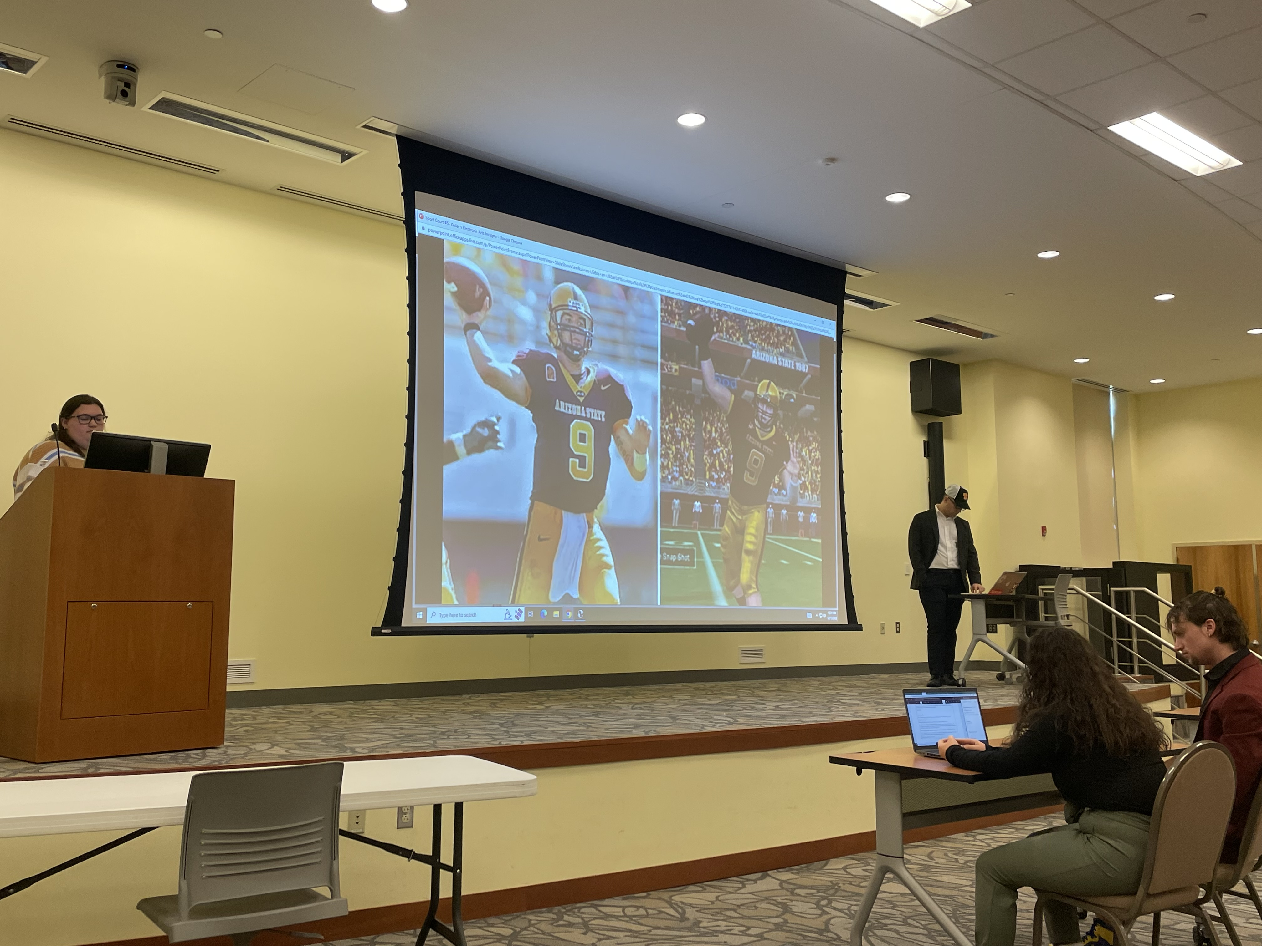
Questions?

