Slide 1
Guidelines to Adequately Prepare for the Self-Study Document
Dr. Ashley Bowers, Southeastern Louisiana University
Dr. Dee Jacobsen, Louisiana State University

Slide 2
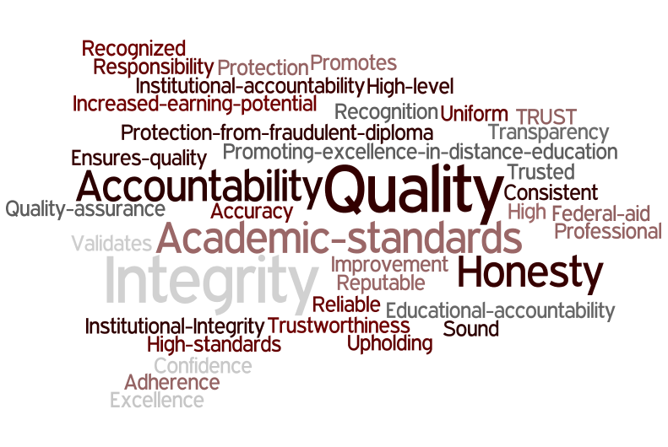
Where are you in the process?

Slide 3
COSMA Self-study: overview
Outcomes Assessment Plan
Strategic Planning
Curriculum
Faculty
Scholarly Resources & Professional Activities
Resources
Internal & External Relationships
Educational Innovation

Slide 4
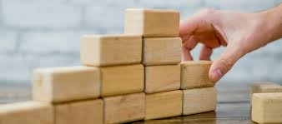
Before you Begin The process: Tips
Attend relevant workshops and webinars
Prepare a solid candidacy status document
-Developing a sound outcomes assessment plan
-Developing a thorough SWOT analysis
-Developing a strategic checklist
Assign faculty roles
Develop a reasonable timeline
Ensure that you have a “solid foundation” [faculty, curriculum, resources, etc.]

Slide 5
Preparing the Principles
Compartmentalization
Time management
Communication
Delegation
Continuous proof-reading
Collaboration
Stress management techniques

Slide 6
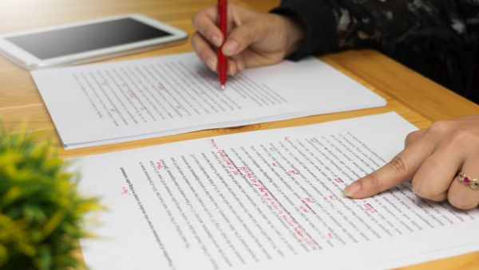
Writing the document
Have a team approach to writing the self-study, yet have a small group/individual pull the narrative together
Having a single person write the entire self-study will result in a report that does not accurately reflect the totality of the institution or program
Having too many people without having someone bring all the sections together as a whole will result in a disjointed/inconsistent report
Have a “go-to” proof-reader
Have a time-management system of writing small pieces daily/weekly

Slide 7
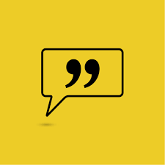
Advice From the eXPERTS:
“The self-study is a reflection of the continuous quality improvement that institutions are already working on.”
“Read the standards and directions before you start, & then follow the directions….meet the deadline….do a little everyday, & don’t take a day off until it’s done.”
“The self-study should be started early; however, in reality, the self-study should never end; self-reflection should always be occurring.”
“Actively seek individuals or an individual who has/have participated in institutional assessment studies or reviews in the accreditation process to impart insight & direction.”
The self-study should be a product of the whole institution….use diverse working groups that represent the broad reaches of the institution.”
“You want to build a quality team of leaders to review, refine, & strengthen the process.”

