Slide 1
Hard or Soft: What Skills are Sport Management Students Developing?
Dr. Ashley Ryder, Ph.D.
Dr. Jillian McNiff Villemaire, Ed.D.
Dr. Taylor Behl, Ph.D.

Slide 2
Introduction – Sport Management
Experiential learning
Internships
Hard & soft skills among graduating seniors
Notes:
Previous scholarship regarding sport management education has focused on topics such as on curricular design (Braunstein-Minkove & DeLuca, 2015; Zimmer & Keiper, 2021), general student preparedness & curriculum (DeLuca & Braunstein-Minkove, 2016), experiential leaning practices (Deluca & Fornatora, 2020; Sattler, 2018), and employability skills
cause for concern as Chan (2011) called for educators “to produce graduates who are knowledgeable in technical and human skills, both of which are equally important for the graduates to become a better human resource in the work force” (p. 2).

Slide 3
Hard vs. Soft
Hard skills: Highlight the knowledge of the profession which are often acquired though education and can be shown through specific qualifications
Often referred to as technical skills
Soft skills: Refer to personal competencies and attributes
Hard Skills | Soft Skils
Photoshop | People
Adobe | Communication
Database management | Conceptual
Data mining | Decision making
(de Schepper et al., 2020; Lussier & Kimball, 2014; Miller et al., 2022; Weber et al., 2020)
Notes:
Technical skills are often called hard skills;Technical skills are those that enable you to use methods and techniques to perform a task.
people, communication, conceptual, and decision-making skills are called soft skills. Organizations seek employees with soft skills who can communicate clearly, take initiative, problem-solve, and work well with coworkers.
People skills enable you to work well with people. Today, people want partnership relationships with their managers rather than the outdated superior–subordinate relationship. Not only do employees want to participate in management; management encourages group decision making (see chapter 3). Your people skills are what will make athletes, parents, employees, and other coaches want to work with you and for you. Communication skills are the skills that enable you to get your ideas across clearly and effectively. Without communication skills, you cannot be an effective team member or manager.18 With the increased use of teams comes the need for good people skills. The combination of people skills and communication skills is called interpersonal skills, and they are becoming more important than technical skills.19

Slide 4
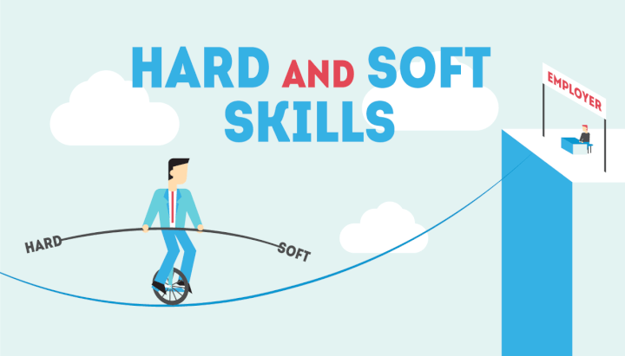
The Misconception
Industries such as sport, hospitality, and tourism are regarded as “people business” = prone to place people skills as being more important than hard skills
However, other research found while soft skills may take a higher priority than hard skills, the two serve in a complimentary role
(Crawford et al., 2020; Tsitskari et al., 2017; Weber et al., 2013)

Slide 5
Purpose
Determine the what skills (both hard & soft) are perceived by internship site coordinators to have the most importance as well as need the most improvement among students

Slide 6
Methodology
The data was collected between 2017-2022 via a questionnaire that included open-ended questions
Internship site supervisors completed the open-ended questionnaires the student’s completion of their internship.
Where can the intern improve professionally? (n= 41)
Thematic Analysis (Braun & Clarke, 2006)
Deductive & inductive coding

Slide 7
Preliminary Findings
Notes:
Interpersonal: The combination of people skills and communication skills is called interpersonal skills, and they are becoming more important than technical skills.
People skills enable you to work well with people. Today, people want partnership relationships with their managers rather than the outdated superior–subordinate relationship. Not only do employees want to participate in management; management encourages group decision making (see chapter 3). Your people skills are what will make athletes, parents, employees, and other coaches want to work with you and for you.
Communication skills are the skills that enable you to get your ideas across clearly and effectively. Without communication skills, you cannot be an effective team member or manager.18 With the increased use of teams comes the need for good people skills.
-source: book?
Problem solving/ critical thinking: Recruiters seek job candidates with conceptual skills who can make decisions that solve problems.22
Conceptual skills refer to the ability to understand abstract ideas through critical thinking. Another term for conceptual skills is systems thinking, or the ability to understand an organization or department as a whole and the relationships between its parts. Sport managers regularly run projects and special events that require project management conceptual skills to pull everything together.
Decision-making skills are those that enable you to select alternatives to solve problems. The decisions you make affect you today and in your future.
source- book?
Self-management: self-awareness and knowledge, self-confidence, time management, self-motivation, realistic self-assessment and self-regulation, work-life balance, responsibility, accountability, goal-setting, workplace organisation, use of electronic tools, personal values, flexibility and adaptability, curiosity, openness to change, CV writing and continuous learning and upgrading of skills
-De Villiers, Rouxelle. "The incorporation of soft skills into accounting curricula: preparing accounting graduates for their unpredictable futures." Meditari Accountancy Research 18.2 (2010): 1-22.

Slide 8
Hard Skills (1/41)
Technical competencies; education
“The student needs more experience with budgeting.”

Slide 9
Interpersonal Skills (8/41)
People skills, communication
“The student needs to work on the right place right time comments. He has a great personality, however, sometimes his "funny" comments are not meant for the time and place.”
“One thing I have noticed that the student could work on is his attitude towards the person who he reports to. There have been some incidents where back talk was negative. If he fixes his attitude, then he could have a bright future in the sports industry.”

Slide 10
Critical Thinking (6/41)
Conceptual skills, decision making, attention to detail
“The student can improve on his attention to detail and his problem-solving skills when things may not go exactly as planned.”

Slide 11
Self Management (27/41)
Confidence, initiative, adaptability, time-management, organization
“The student is awesome! I think the one thing he could work on is not procrastinating. He always finished his work on time here and completed the work correctly. I think it would save him some stress if he didn't procrastinate.”
“The student did an incredible job with us this summer. Looking back, he could have been more outgoing and helpful during his first few weeks. As time went on he felt more comfortable in his role with other team members but especially with members and guests. If he could break through that period in his next role, he will be immediately more valuable for that organization.”

Slide 12
Interpretation
Despite pressures to teach hard skills,
there is an overwhelming request to improve soft skill preparation
Notes:
Hard skill needs were not supported by data
Soft skills are needed for sports industry positions
Limited sample size but data collected over 5 years, consistent

Slide 13
What now?
How can we incorporate more soft skills into the curriculum?
Notes:
Add more explicit training in soft skills: list them
Practice more in seminar
Required volunteering/interaction in the community z

Slide 14
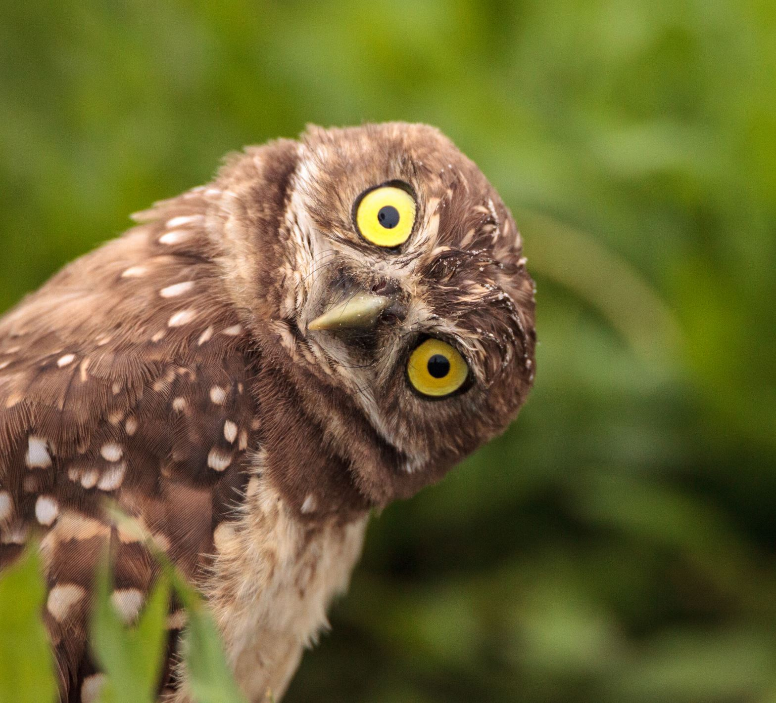
Thank you!
Questions or comments? Please email anryder@flagler.edu

