Slide 1
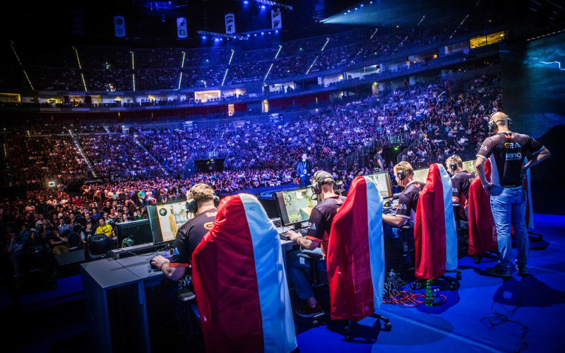
Integrating Digital Sport into the Sport Management Curriculum
Drs. Andrew Smith, Brittany Jacobs, Priscila Alfaro-Barrantes

Slide 2
Purpose
Reinforce curricular concepts through esport and fantasy sport
(1) highlight the value of including digital sport in the sport management curricula
(2) suggest integration strategies
(3) create a dialogue regarding metaliteracy and digital sport.

Slide 3
Sport in a Digital Age
“Sport management academics should devote increased attention to eSport and embrace its commercial, educational, and research potential” (Funk, Pizzo, & Baker, 2017, p. 6)

Slide 5
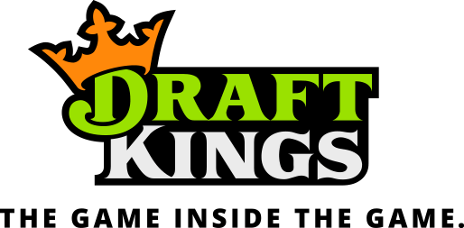
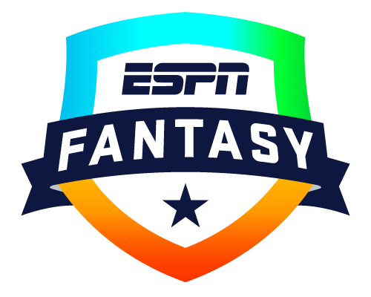
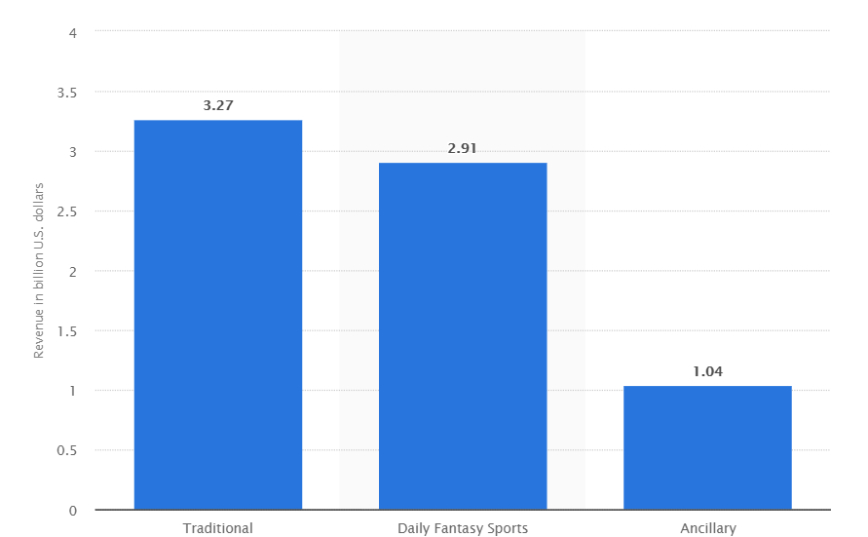
2017 Fantasy Sport Revenue - USA
Notes:
in the United States and Canada an estimated 59.3 million people play fantasy sports with 70% of those players paying a league fee. (FSTA, 2017).

Slide 6
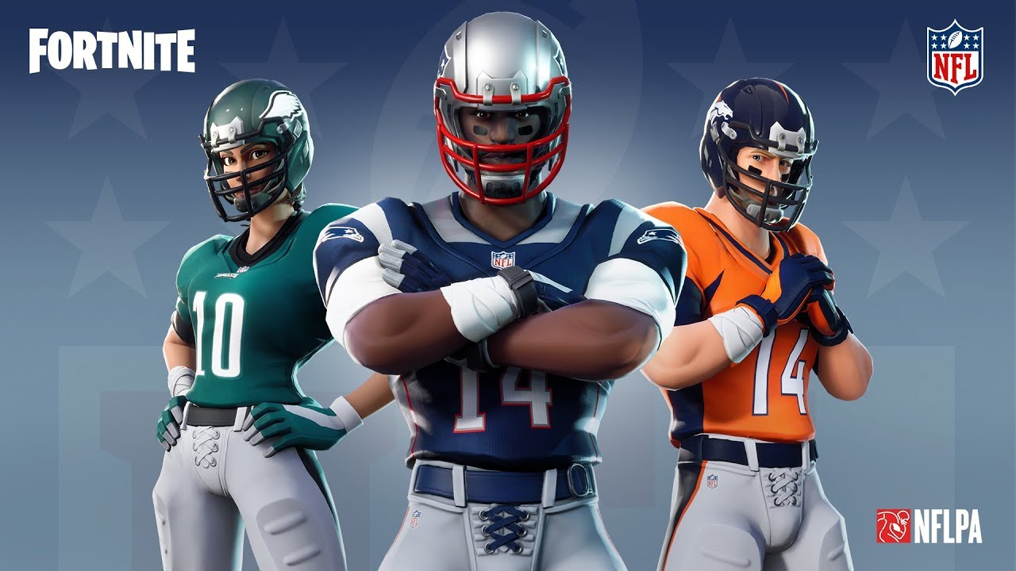
The Rise of Esport
Notes:
https://www.youtube.com/watch?v=6Jffp5jwtqY
NFL sees the value proposition and has begun integrating itself into the esports landscape
Also shows value of esports to tradional sports and therefore sport managers - finding wasy to leverage these partnerships will be an avenue of the future

Slide 7
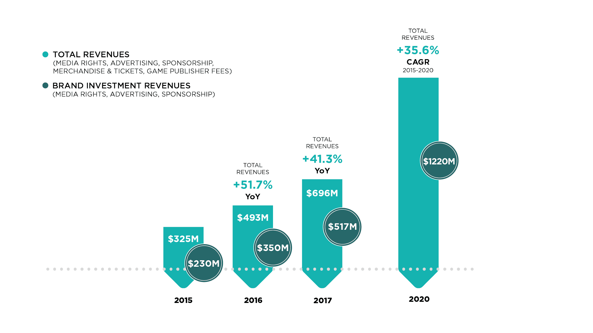
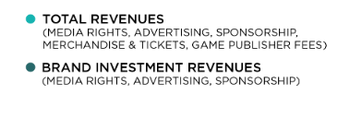
Esport Revenues
Notes:
ESPN reports that there are currently more than 50 varsity eSports programs housed within NCAA and NAIA athletic departments (Morrison, 2018)

Slide 8
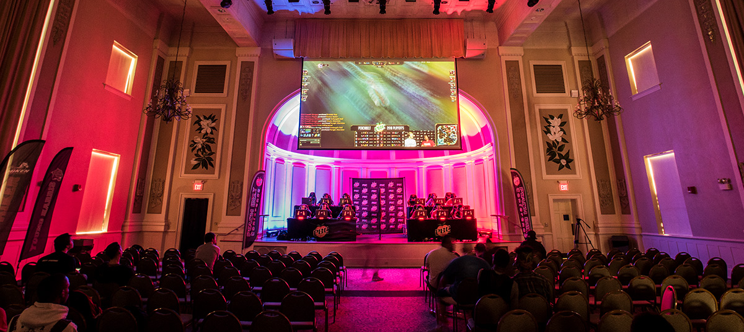
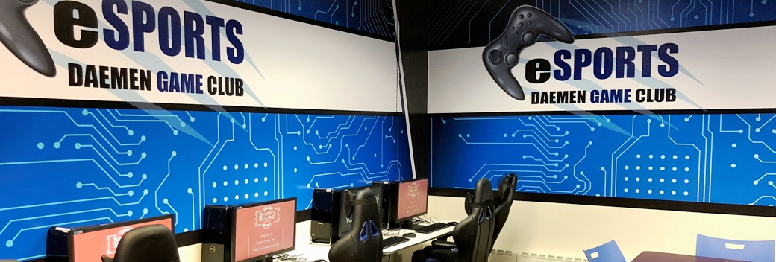
Collegiate Esport
27 million watched 2014 LoL Championship, more than Stanley Cup, NBA Finals
50+ Varsity Esports teams
(Morrison, 2018)
NACE [National Association of Collegiate Esports]
Notes:
Now 63 esports teams
NBA finals 19 million
Stanley cup 4 million

Slide 9
Value of Fantasy Sport & Esport in Curriculum
This industry is rapidly growing and jobs will follow. Video games are only becoming more popular and advanced and the number of players is increasing as well. Twitch and MSG are becoming a billion dollar industry from streaming video games streams and from a teenager perspective and having little cousins, these kids love this stuff. Fortnite and Call of Duty are becoming video game powerhouses and every kid in the world is playing them. Esports is just getting started....
- First year Sport Management student at Nichols College

Slide 10
Information Literacy (IL) is driven by librarians and accreditors in the 1980s
Increasingly adopted/assessed in college classrooms through 21st century
Teaching and measuring students’ ability to find and evaluate information
Initially focused on print sources, expands to incorporate “technological literacy” and “media literacy”

Slide 11
New conception of “literacy” for digital age students (Mackey & Jacobson, 2011)
“reframing” our teaching and assessment toward “metaliteracy” (ML)
ML accounts for new and emerging sources of information
ML reorients the objectives
Emphasizes competency, collaboration, and creation
Notes:
Image courtesy https://metaliteracy.org/
Rather than adding new forms of literacy to the IL model, they suggested reframing

Slide 12
Benefits of ML for Sport Management Graduates
Not just literate in traditional sport industry - prepared for new and emerging industries
Competency in navigating multiple sources of information across various media, collaborating in physical and digital groups, and creating original content

Slide 13
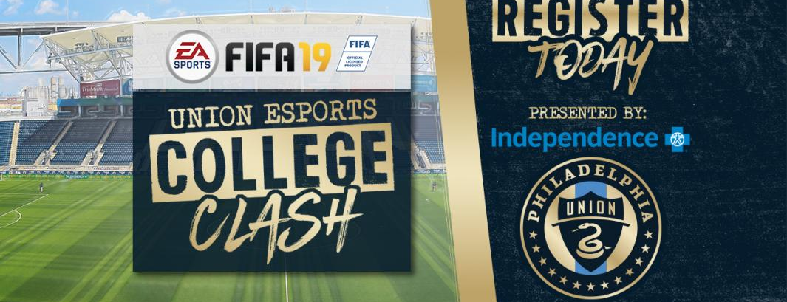
Means of integration
Integration into existing class **
Subject of study for existing class
Topic for non-major class
Stand-alone major course
Notes:
Fantasy sport for crit
Esport as subject of study in marketing or event management
Fantasy and esport integration into existing class – PAB activities

Slide 14
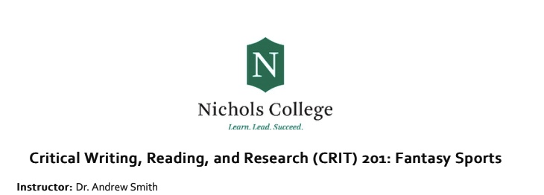

Slide 15
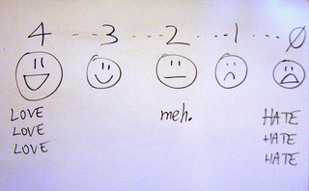
Student Evaluation of “Fantasy Sport” course at Nichols College
100% agree/strongly agree the course material was engaging, and the course was academically challenging
93% agree/strongly agree the course provided key skills (including technology) and provided opportunities for practical engagement

Slide 16
Student responses evidence this is a topic that speaks to multi-media research, in-class and virtual collaboration, as well as some digital content creation – it is a course that can practice and measure ML competencies
Adding a social media or web presence (blog/vlog) component could enhance the creative element for new content in digital environments

Slide 17
Means of integration
Esport Management Programs

Slide 18
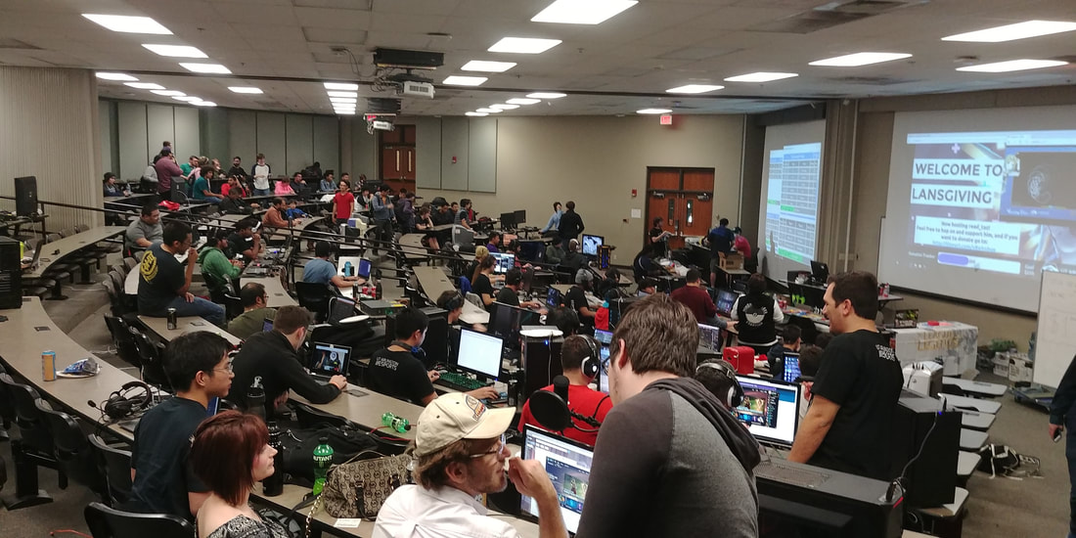
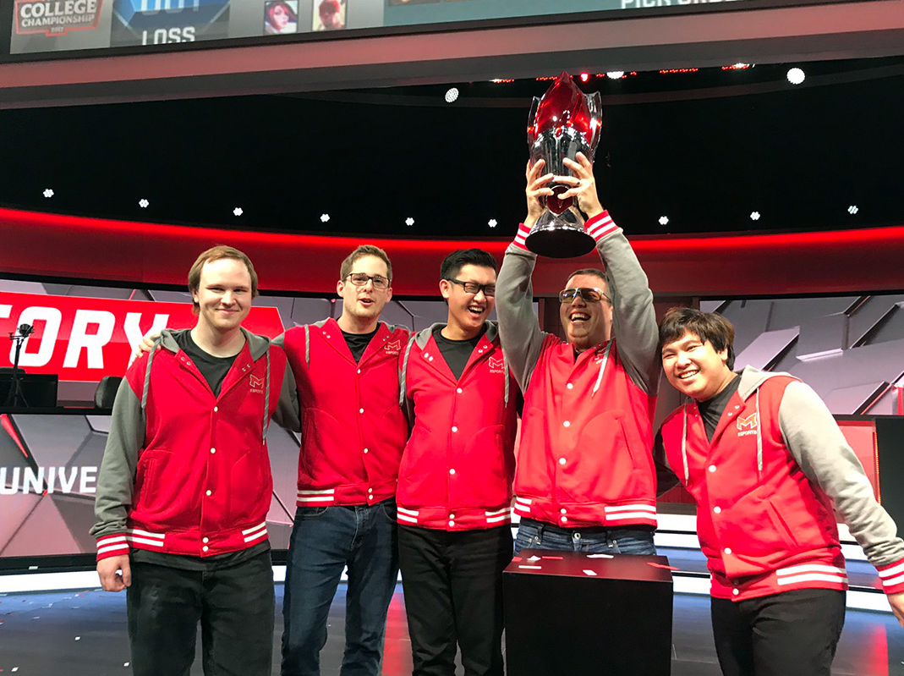
Means of integration
Outside of the classroom -
Teams
Clubs
volunteer opportunities
internships
Notes:
UT Arlington Esports Club
Maryville University Team

Slide 19
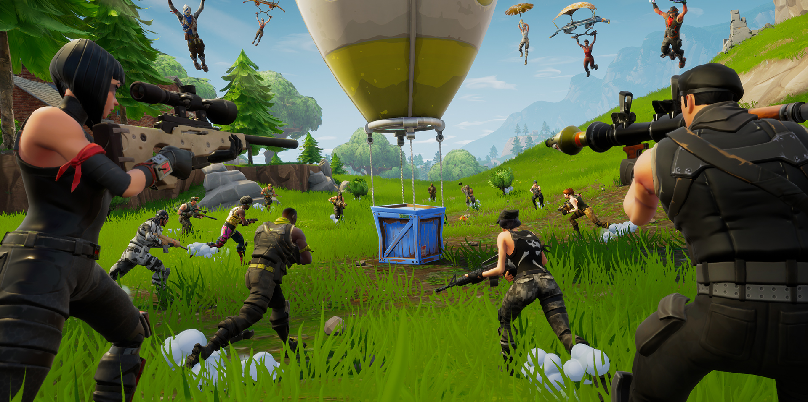
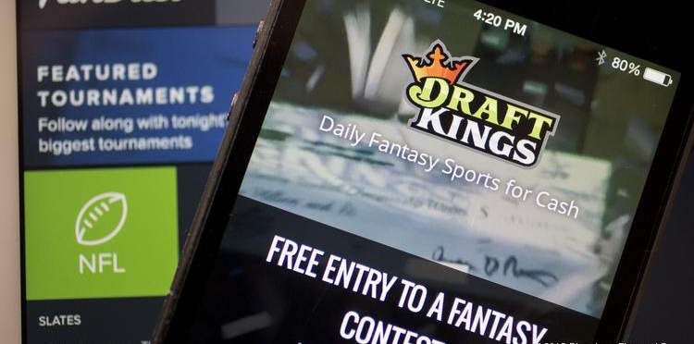
Concerns
Costs
Shooter games
Relationship with Gambling
NCAA violations
Dilution of traditional sporting product
Impact on participants - screen time, reduced outdoor activity etc.

Slide 20
References
Bowman, N.D., Spinda, J.S.W., and Sanderson, J. eds. (2016). Fantasy Sports and the Changing Sports Media Industry: Media, Players, and Society. Lexington: Lexington Books.
Bowman & Splinda. (2016). Fantasy sports and the changing sports media industry.
Einolf, K. W. (2001). Turn Fantasy into Reality: Using fantasy football in an economics of sport course. Teaching Economics: Instruction and Classroom Based Research.
Funk, D. C., Pizzo, A. D., & Baker, B. J. (2017). eSport management: Embracing eSport education and research opportunities. Sport Management Review.
Gersch, B., Lampner, W. and Turner, D. (2016). Collaborative Metaliteracy: Putting the New Information Literacy Framework into (Digital) Practice. Journal of Library and Information Services in Distance Learning 10(3-4), 199-214.
Gillentine, A., & Schulz, J. (2001). Marketing the fantasy football league: Utilization of simulation to enhance sport marketing concepts. Journal of Marketing Education, 23(3), 178-186.
Industry demographics. (2017). Retrieved from https://fsta.org/research/industry-demographics/
Kane & Spradley. (2017). Recognizing Esports as a sport. The Sport Journal.
Morrison, S. (2018, March 15). List of Varsity Esports Programs Spans North America. Retrieved from http://www.espn.com/esports/story/_/id/21152905/college-esports-list-varsity-esports-programs-north-america
Mackey, T. P., & Jacobson, T. E. (2011). Reframing information literacy as a metaliteracy. College & research libraries, 72(1), 62-78.
Tacon, R. and Vainker, S. Fantasy Sport: A Systematic Review and New Research Directions. (2017). European Sport Management Quarterly 17(5), 558-590.
Warman, P. (2017). Esports revenues will reach $696 million this year and grow to $1.5 billion by 2020 as brand investment doubles. Retrieved from https://newzoo.com/insights/articles/esports-revenues-will-reach-696-million-in-2017/
Witek, D. and Grettano, T. (2014). Teaching Metaliteracy: A New Paradigm in Action. Referecne Services Review 42(2), 188-208.

