Slide 1

Sharing stories: Social Justice Conversations in the Sport Management classroom
Jennifer VanSickle, University of Indianapolis
Aaron Livingston, grambling state

Slide 2
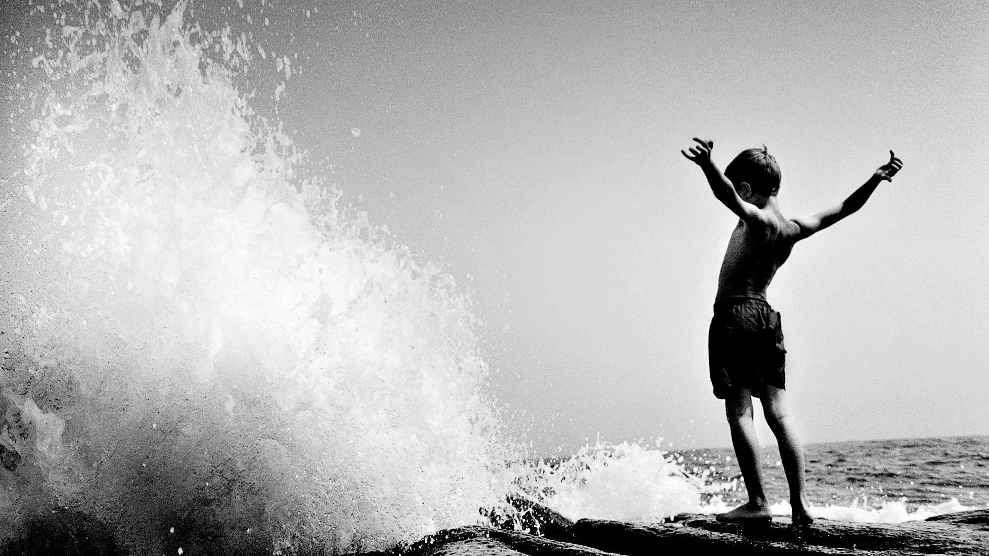
purpose
To share ideas about how to have social justice conversations in a sport management classroom.

Slide 3
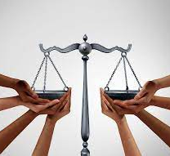
Why social justice?
WHY NOW?
Notes:
Aaron

Slide 4

Preparing for conversations
  1. Lead with your goals
  2. Provide pre-discussion assignments
  3. Establish guidelines
    -Listen respectfully
    -Be open-minded
    -Allow everyone to speak
    -Avoid inflammatory language
    -Ask questions
    -Don’t expect a student to speak on behalf of their group
Notes:
Jennifer

Slide 5
Preparing for conversations
  4. Admit this may be difficult or awkward
    -Explain why it is important
    -Be vulnerable yourself
  5. Be careful about sharing your views as the
  instructor
  6. Provide structured opportunities for
  input/reflection
    small group discussions; thought papers
  7. Be ready for inappropriate language or
  microaggressions
Notes:
Jennifer

Slide 6
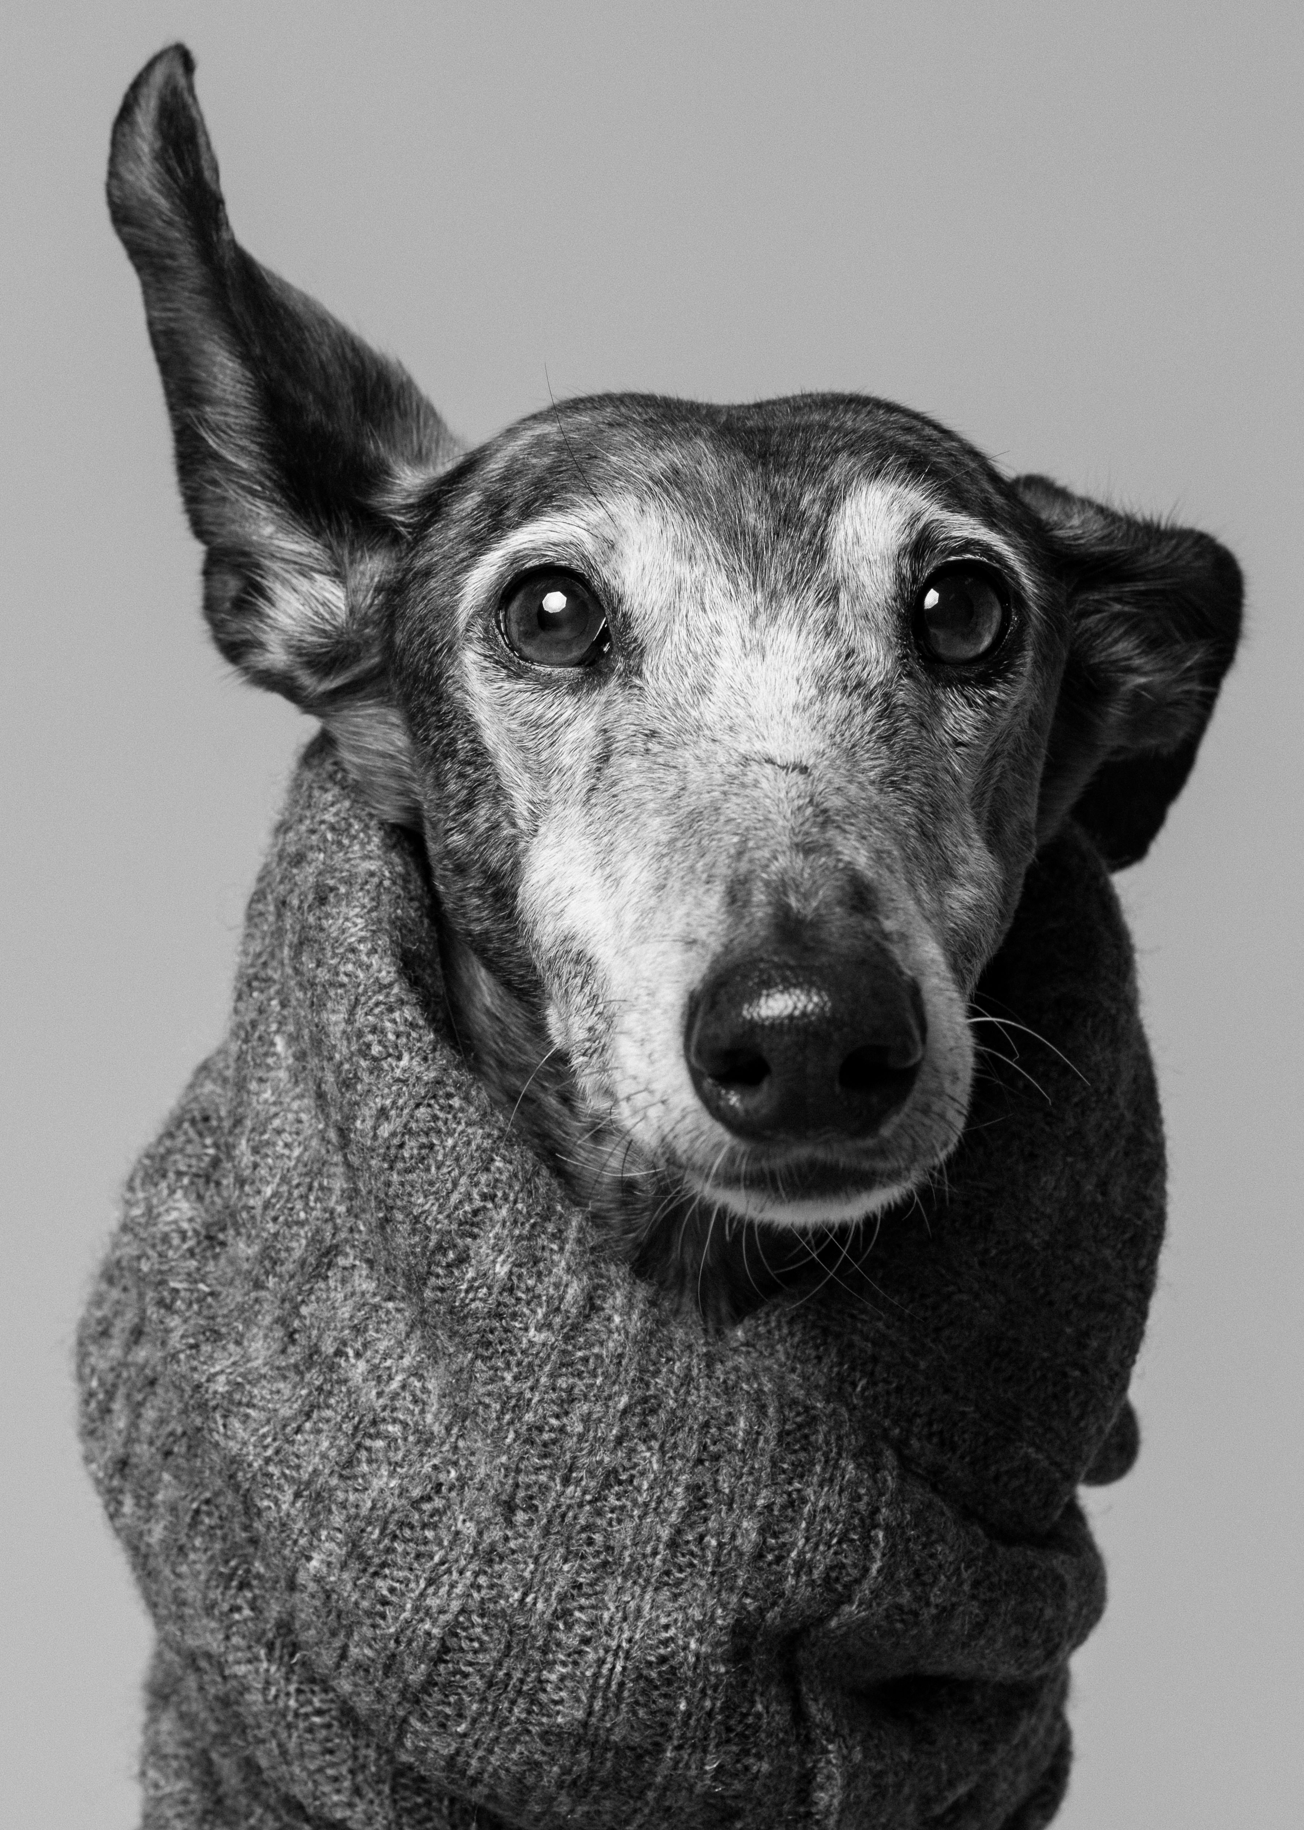
Social Justice
    Effective Strategies
      Debate
      Discussion
      Seminar
Notes:
Aaron, Jennifer, and audience discussion

Slide 7
Sport and Social Justice
    Sport and Social Justice
      The Intersection:
      Race
      Racism
      Social Injustice

Slide 8
Techniques to Address sensitive Issues
      Body language
      Eye contact
      Summarizing
      Paraphrasing
      Responding

Slide 9

Students’ perspectives
What do you believe are the most important when addressing social justice issues in the classroom ?
What do you feel a key components to consider addressing the intersection of sport?
Race
Racism
Social Injustice
Notes:
Aaron’s students share ideas

Slide 10
THANK YOU
JVANSICKLE@UINDY.EDU
LIVINGSTONA@GRAM.EDU

