Slide 1
Using Technology to Facilitate Active Learning COSMA Conference February 11, 2016
Saint Leo University Founded in 1889
Dr. Steven Carney
Dr. Judy Holcomb
Dr. Susan Foster
Phil Hatlem
Dr. Leon Mohan
Dr. Dene Williamson

Slide 2
Using Technology to Facilitate Active Learning
Saint Leo University Founded in 1889
Using technology to Facilitate Active Learning
Technology in the Sport Business Classroom
The Sales Game
AwareManager
Poll Everywhere
Turning Point
Smartboard applications
Technology in the School of Business
Conclusions and Recommendations

Slide 3
Using Technology to Facilitate Active Learning
Saint Leo University Founded in 1889
“Technology is embedded into students’ lives, and students are generally inclined to use and to have favorable attitudes toward technology. However, technology has only a moderate influence on students’ active involvement in particular courses or as a connector with other students and faculty.”
(Dahlstrom & Bichsel, 2015)

Slide 4
Using Technology to Facilitate Active Learning
Saint Leo University Founded in 1889
Sivin-Kachala and Bialo (2000) reported positive and consistent patterns when students were engaged in technology-rich environments.
Even so, reports indicate that faculty members are not using technology in ways that make a difference in student learning (Anderson, 2000; Cuban, 2001; McCannon & Crews, 2000).

Slide 5
Technology in the Sport Business Classroom
Saint Leo University Founded in 1889
The Sales Game
AwareManager
Poll Everywhere
Turning Point
Smartboard Applications

Slide 6
The Sales Game
Saint Leo University Founded in 1889
By 2020,
50% of ‘millennials’
will have logged
over 10,000 hours
on some type
of gaming platform
before the age of 21.
(Shore, 2011)

Slide 7
Saint Leo University Founded in 1889

Slide 8
The Sales Game
Saint Leo University Founded in 1889
“Only recently tertiary educators have become interested in gamification as a means to increase engagement” (Cronk, 2012)

Slide 9
The Sales Game
Saint Leo University Founded in 1889

Slide 10
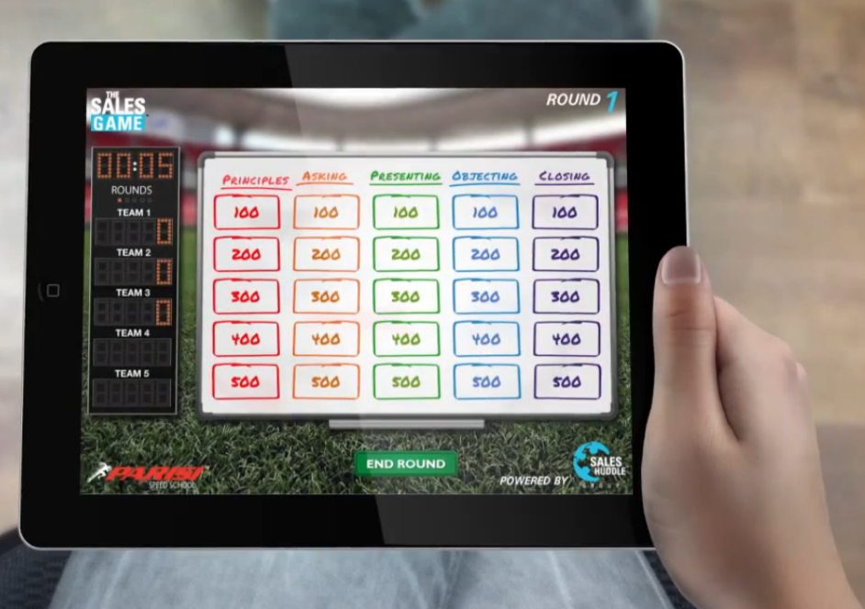
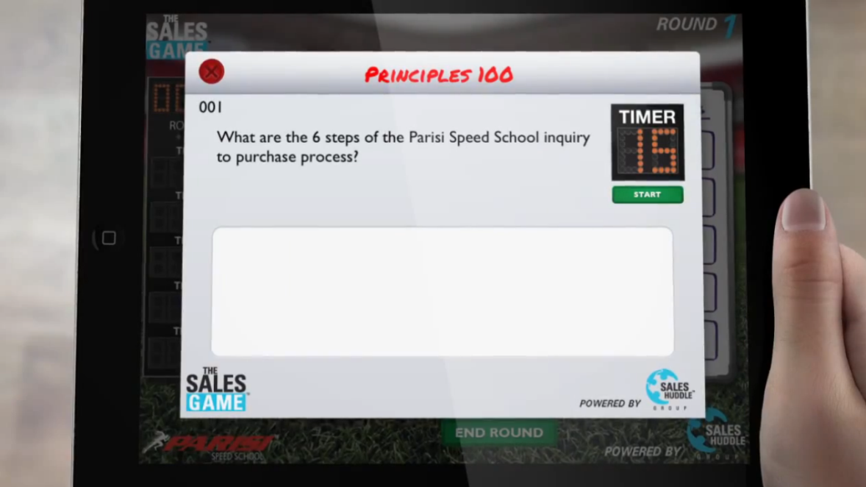
Saint Leo University Founded in 1889

Slide 11
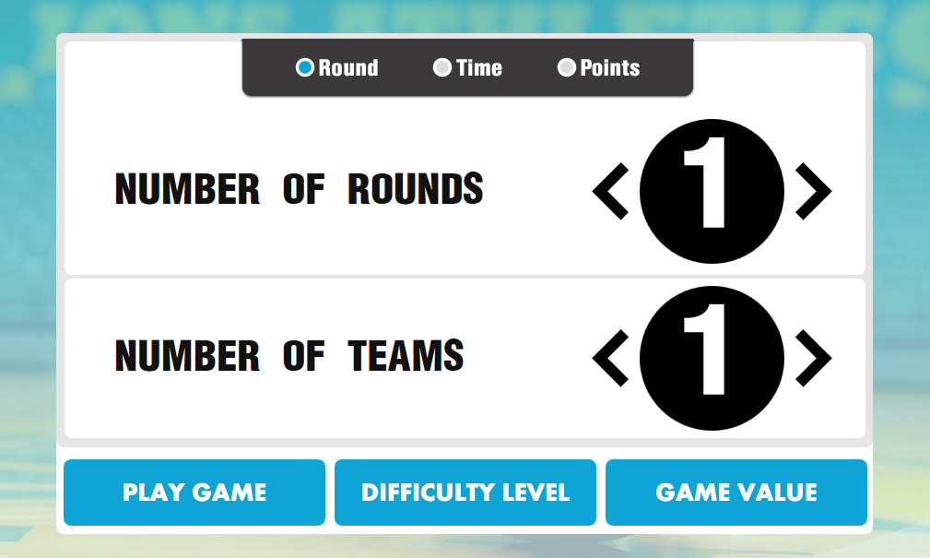
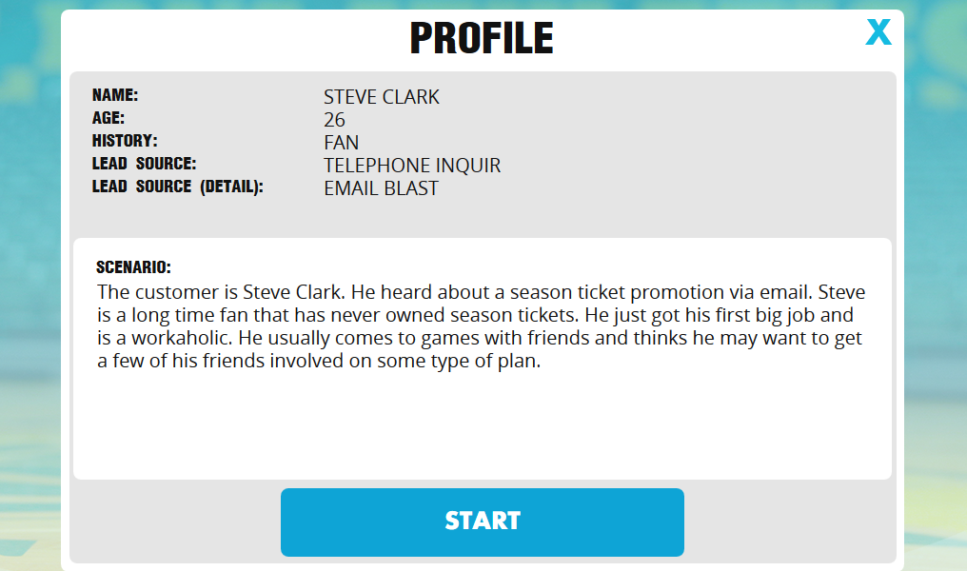
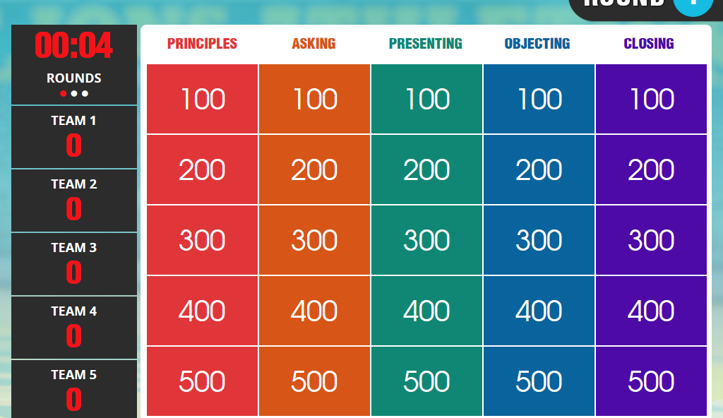
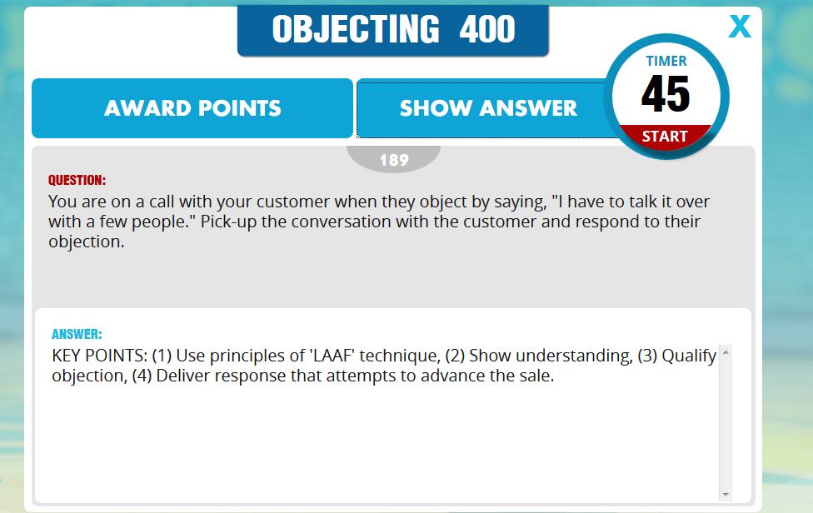
Saint Leo University Founded in 1889

Slide 12
Saint Leo University Founded in 1889
What is AwareManager?
Facility management software

Slide 13
Saint Leo University Founded in 1889
Benefits for our Sport Business students
Sport industry-specific software
Applications for:
customer service,
housekeeping and maintenance,
facility scheduling and management, and
liability and risk management
Gets the students out of the classroom
Notes:
Finding a way to deliberately prepare students to be ready to work for a sport property should be considered a top priority for academicians. Implementing and training students to understand and use sport industry specific software could be considered one way to bridge this disconnect.

Slide 14
Saint Leo University Founded in 1889
How do I use AwareManager?
Introduce the students to the app
Assign each student an inspection
Students submit a work request
Assign the request to another student
Students complete the work request
Students are asked to generate a list of ways the software and app can be used to manage facilities
Introduce the students to the software

Slide 15
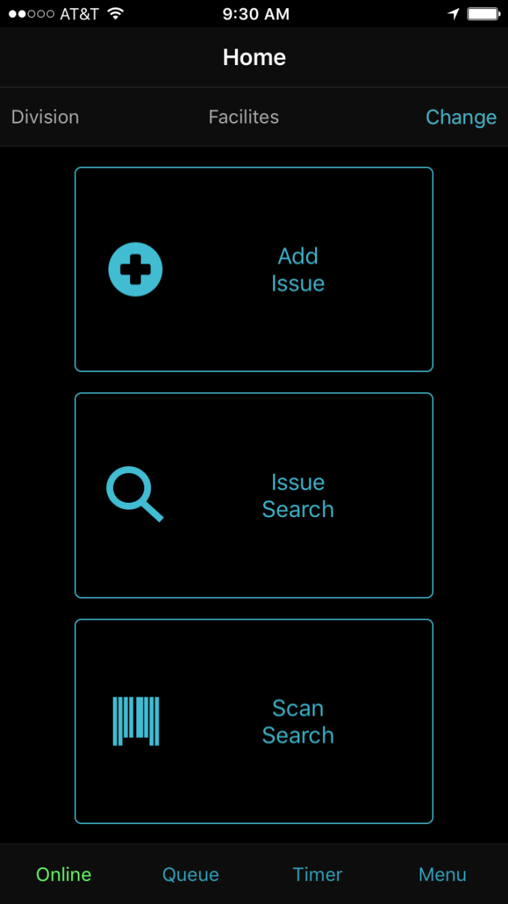
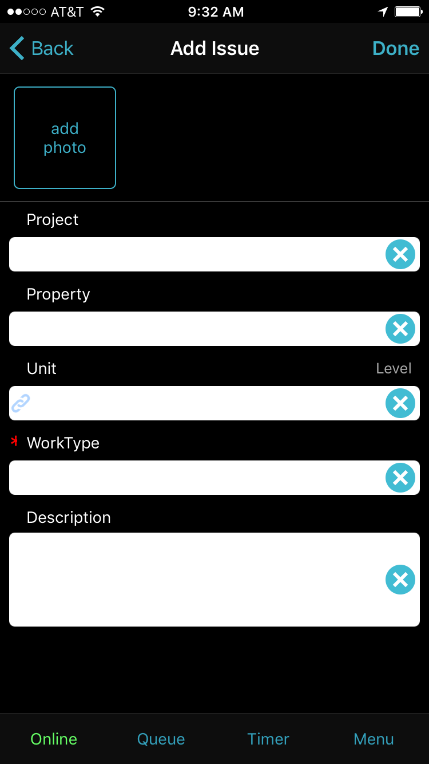
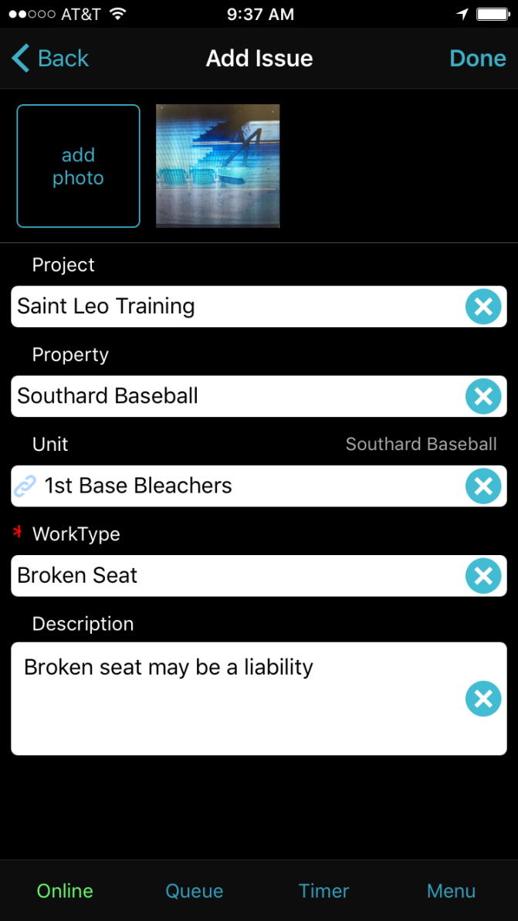
Saint Leo University Founded in 1889

Slide 16
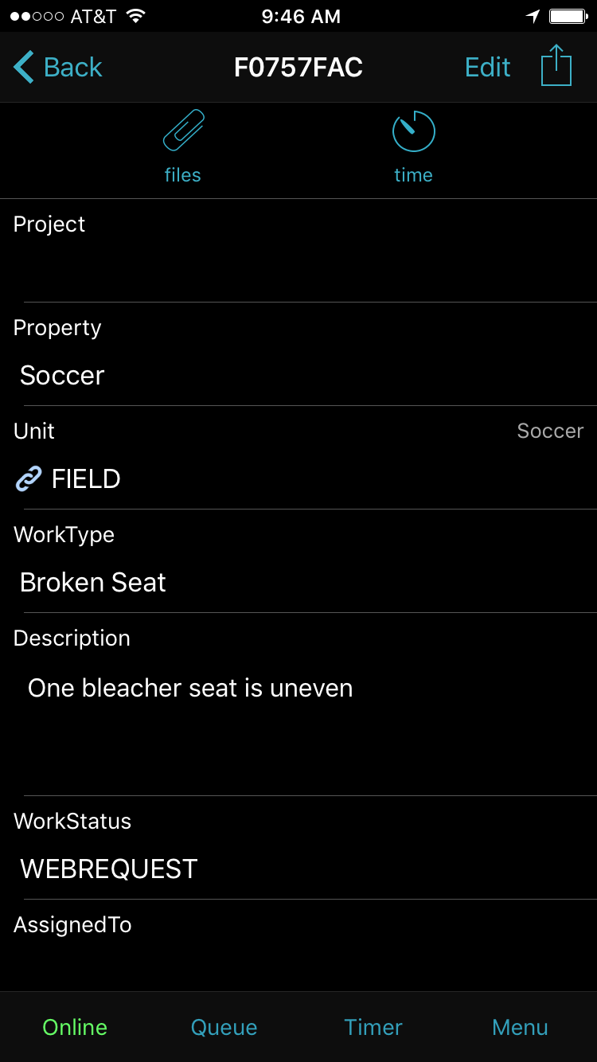
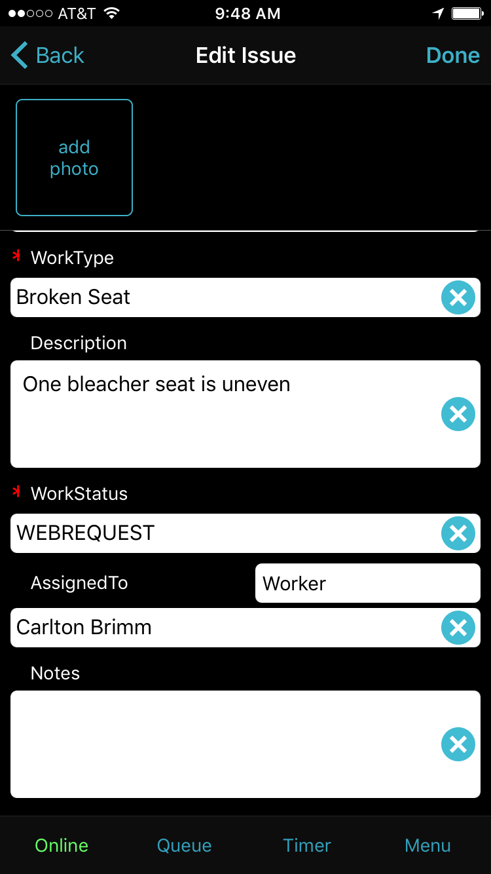
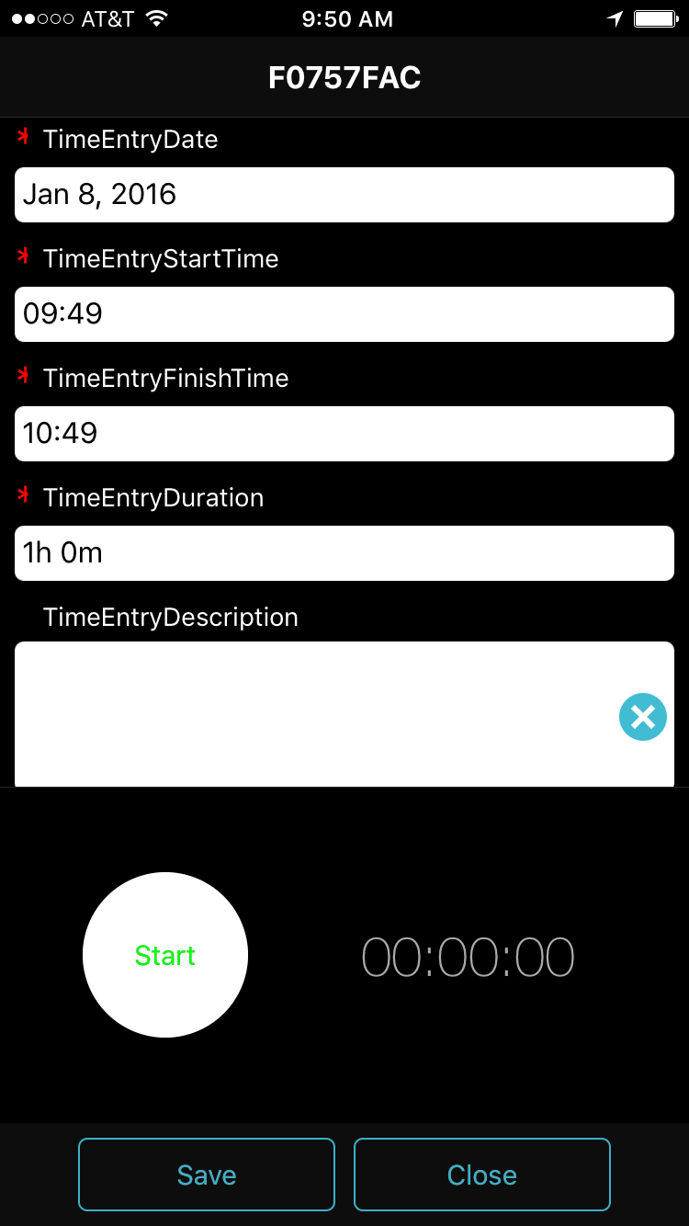
Saint Leo University Founded in 1889

Slide 17
Poll Everywhere
Saint Leo University Founded in 1889
Simple free-text message voting application for live audiences
Benefits
Enhances active student learning
Allows professors to assess concepts that need more discussion
Allows students to assess their knowledge compared to classmates
Re-emphasis of certain concepts
Students get to use their cellphones in class!!!

Slide 18
Poll Everywhere
Saint Leo University Founded in 1889
Sport Marketing Course
Begin class with a simple question to determine level of knowledge
Midway through class, ask students to text a free-response specific to a concept
What is the best sport marketing campaign that went viral?
This leads to class discussion as we pick a few response to discuss
End class with a couple of questions to test certain important concepts

Slide 19
Poll Everywhere
Saint Leo University Founded in 1889
Sample Polls
Word Cloud
https://www.polleverywhere.com/free_text_polls/67hKPIK0ioIJRld
Text LEONMOHAN766 to 37607 then text response
Multiple Choice
https://www.polleverywhere.com/multiple_choice_polls/jdndosLh4I0Qs8J
Text LEONMOHAN766 to 37607 then text response

Slide 20
Using Turning Point and Clickers
Saint Leo University Founded in 1889
Turning Point is a software package – uses Powerpoint
Clicking devices tied to a student’s name
Exam Review
Active learning tool to keep students engaged – Opinion polls
Jeopardy style gaming
Fill-in-the-blank
Essay

Slide 21
Using Turning Point and Clickers
Saint Leo University Founded in 1889

Slide 22
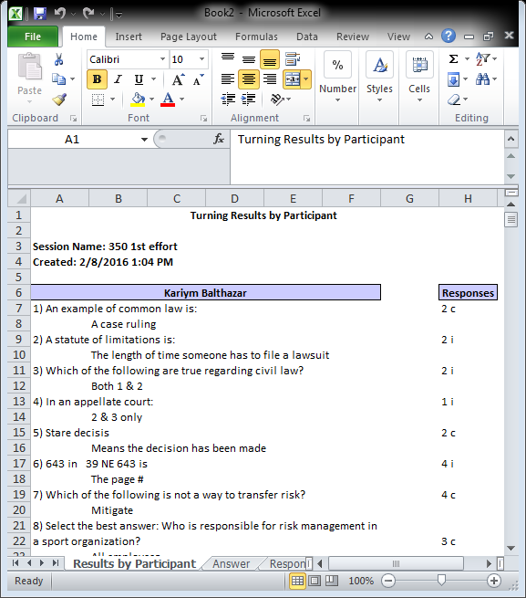
Saint Leo University Founded in 1889

Slide 23
Saint Leo University Founded in 1889

Slide 24
Smartboard Applications
Saint Leo University Founded in 1889
All Saint Leo Classrooms have 2-4 Smartboards
Element of Learning – Repetition/Visual learning exercises
Students like going to the board and playing with them
I use them for class review after a lecture or section

Slide 25
Smart Board Applications
Saint Leo University Founded in 1889
Insert Video of Active Learning
Notes:
If you have a particular project or exercise and are tying it to a particular outcome, exercises such as this use of technology may increase adherence to a particular learning outcome especially if individuals are visual learners vs. just writing down lecture notes.

Slide 26
School of Business Technology
Saint Leo University Founded in 1889
SMARTboard (Hardware)
Meeting ProPlus (Software)
Whiteboard
Convert to text
Draw on Applications
Screen Shot
Bridgit (Interactive Conferencing Software)
Remote Control
Content Sharing/Collaboration

Slide 27
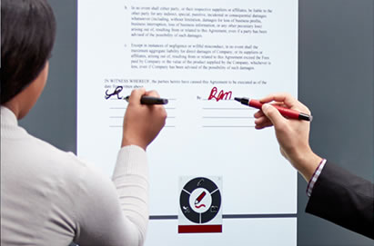
Saint Leo University Founded in 1889
Silktouch™
Responds to your lightest touch accurately from corner to corner.
Pen ID™
Two people can write in different colors at the same time.
Object awareness™
Fingers select. Pens write. Palmsrase - knows the difference.

Slide 28
Conclusions and Recommendations
Saint Leo University Founded in 1889
Finding ways to purposefully prepare students to work in an increasingly technology-reliant sport industry should be considered a top priority.
Constructing contexts where sport business students can learn to use sport industry specific software should be considered.
The new millennial student, and the upcoming next wave of students – Generation Z – learn very differently as compared to previous generations.
The use of technology and Gamification can provide sport business students with a more authentic learning context to develop critical thinking and communication skills – and prepare for a future in the global sport industry.

Slide 29
Saint Leo University Founded in 1889
Questions?

