Slide 1
How to Determine the Value of a Championship
Applying Analytics to the classroom in a Non-intimidating way
COSMA 2018, Jacksonville, Florida

Slide 2
Sports Market Analytics: Who We Are
SMA (http://sportsmarketanalytics.com) provides one-stop online access via university subscription for researchers, instructors, and students studying the business of sports:
Proprietary Research
Industry-developed Market Research
Government Statistics
Facility Reports and News
International Market Publications
Directories
Started in 1999 (as Sport Business Research Network, or SBRnet), only SMA provides nationwide analysis of statistical trends in each major segment of the sports market and the extent to which they interrelate.

Slide 3
Sports Market Analytics: Who We Serve
All of you! (at my count, ~69% of you)
All types of sport management programs, and all types of business departments/schools:
Sport Management in Business Department (56 schools)
Sport Management, Not in Business Department (92 schools)
Business Department, No Sport Management (35 schools)
From Ivies to internationals,
from large state to small private schools, student bodies from 1,000 to 70,000,
even other disciplines—since EVERYONE is interested in reliable data

Slide 4
COSMA: Who You Are
Committed college instructors who want the best for your students and your programs
“Purpose to promote and recognize excellence in sport management education”
You provide this through different pedagogical methods using many formats.
In the field of Sport Management and COSMA’s approach, that variety is a strength.
Regardless of your comfort level with market analytics, the topic is not going away. To prepare your students to succeed, they need a basic understanding of analytics and how to apply it, no matter what area they study and go into as professionals.
You are the experts. We want to be a tool, a source of support, to help you do your job.

Slide 5
COSMA and Sports Market Analytics
To clarify: Market analytics … not performance analytics
SMA (the company) is a unique resource. Reliable real-world data, longitudinal, through our own nationwide survey.
In a moment, I’ll provide just one example out of millions you could create for classroom use.

Slide 6
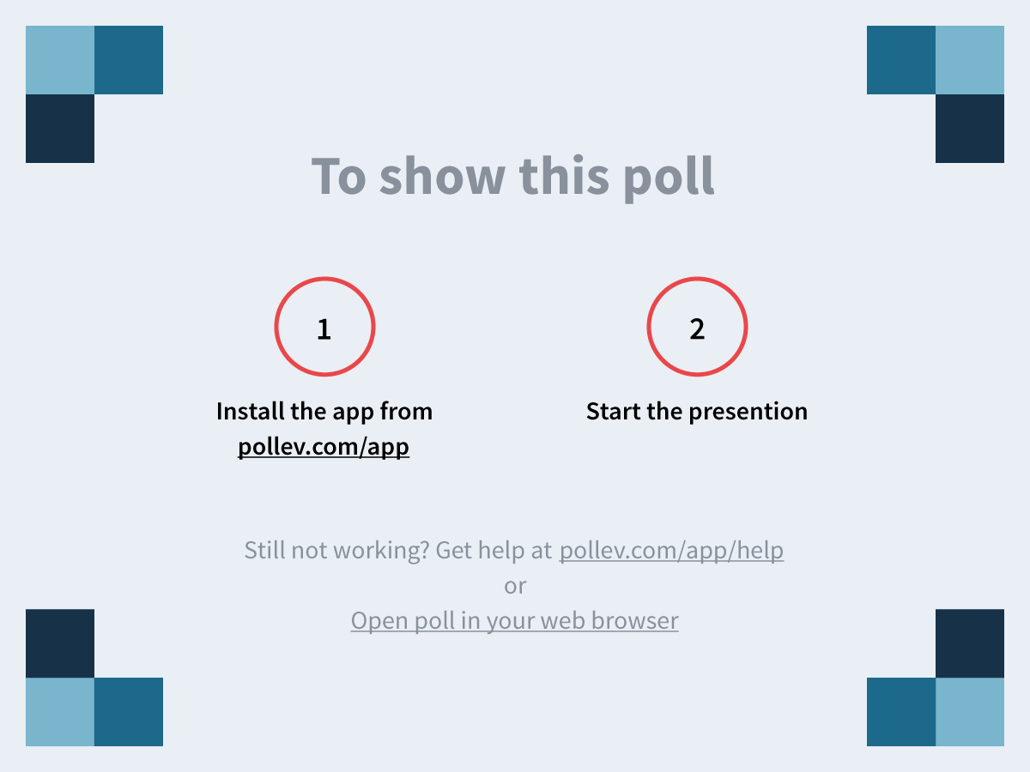
Notes:
Sports market analytics contributes to sport management education in many ways. From this list, select the top five areas that could benefit your program the most. https://www.polleverywhere.com/multiple_choice_polls/3wSIC69m9P5ZG4T

Slide 7
Notes:
Sports market analytics informs many topic areas in sport management/business. From this list, list the top five areas that are most useful for your program. https://www.polleverywhere.com/multiple_choice_polls/JqId7vA1Jjlw5Ze

Slide 8
Hotspots
Regular—free—newsletter courtesy of SMA
Go to http://sportsmarketanalytics.com, click on SMA Hotspot in upper right corner
Single topic introduced and then discussed using several charts from the SMA database, followed by a short commentary and questions for classroom discussion.
Handout: What is the value of a championship?
A practical, provocative, fun—not intimidating—question for students to grapple with. To do so with reliable data will only make them better researchers and professionals
Hotspot is just a miniscule part of the SMA site, but if you aren’t aware of it, it is a free tool you can take home with you. If you are aware of it, this is a reminder that each month we have new material for you

Slide 9
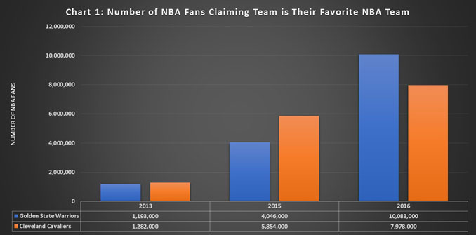
Winning is Important …
This is not surprising, at a broad level. First chart overwhelmingly shows that.

Slide 10
…But HOW is it Important?
That is the question, for students and then as professionals, at a detailed level. The other four charts delve into that.
We want to help you get in the weeds with your students, but not get lost when you’re there.
We provide SMA charts for
Age (older GS fans)
Household Income (growth in less affluent fans for GS)
Gender (more female fans for both)
Region (outside of home territory growth for both teams)
Most Popular Jersey Sales (another way to measure fan interest and monetization of it)
Questions are not always cut and dried; great for discussion. Our questions and commentary can help you prepare for it.

Slide 11
Conclusion
Hotspot is one small aspect of SMA—one question with one example from one sport. You can do so much more.
I haven’t talked about
SMA Interactive,
Sponsorship Influence Index,
our complementary product Brand Share Index,
or the upcoming Consumer Brand Index (great for your business department colleagues, et al.)
If you choose to get deeper into the SMA site, you will find many opportunities to enhance your students’ education, which is why you all are here eating lunch together right now.

Slide 12
Sports Market Analytics: Your Partner in Sport Management Education
Thank you
SMA is proud to sponsor COSMA!
http://sportsmarketanalytics.com/
Richard Lipsey, Founder-Owner, richard@sbrnet.com
Myles Schrag, Educational Consultant, mylesschrag@yahoo.com

