Slide 1
Social Work in Sport Management Curriculum
Amy Cox, LMSW
Lauren Beasley, LMSW

Slide 2
What is Social Work?
Notes:
Lauren facilitates

Slide 3
NASW Code of Ethics
Service
Social Justice
Dignity & Worth of the Person
Importance of Human Relationships
Integrity
Competence

Slide 4
Macro:
Social Justice/Policy
Micro:
Mental Health
Case Management

Slide 5
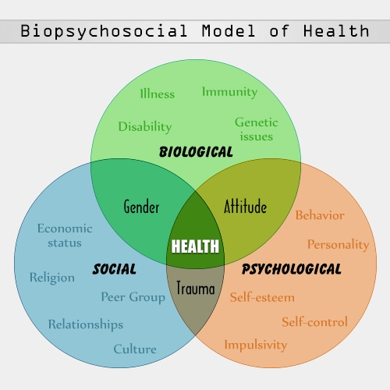
What is a Biopsychosocial Assessment?
Bio - physical aspects of a person’s life
Psycho - individuals’ functioning and cognitive or thought processes
Social - interactions with others and the social environment
(Zastrow, Kirst-Ashman, & Hessenauer, 2016)
Notes:
Amy - Impacts & challenges to athletes and athletic performance are as diverse as the individual athletes themselves. Physical injury, depression, substance abuse, exploitation and eating disorders are just the tip of the iceberg in regards to possible impacts that could damage a student or elite athlete (Gill, 2014). These concerns can impact a multitude of environments (e.g. personal, home, school, occupational). Is the current sport management curriculum adept at managing issues outside the sports arena as a part of a holistic perspective?

Slide 6
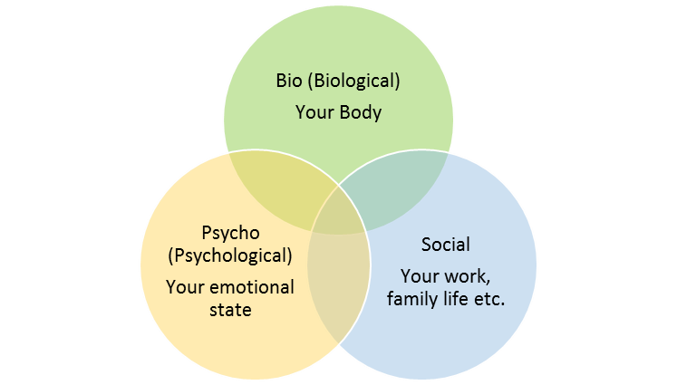
Biopsychosocial Assessment - Example
Athlete with an Eating Disorder
BIO - weight, height, malnutrition, dehydration, kidney failure, low bone density, dry skin, hair loss, etc.
PSYCHO - maladaptive eating-related behaviors, depression, anxiety, guilt, etc.
SOCIAL - external pressures to be thin (coaches, media, teammates)
Notes:
There are an unlimited number of examples that can be provided. Being able to appropriately recognize and manage mental and social impacts to vulnerable athletes, organizations and communities would entail a more holistic approach that can be of great benefit to all levels of sport management. While it is not the expectation for sport management curriculum to include instruction on how to diagnose, counsel and create treatment plans for athletes, each individual within sport organizations can do their part in rducing issues and risk factors for athletes.

Slide 7
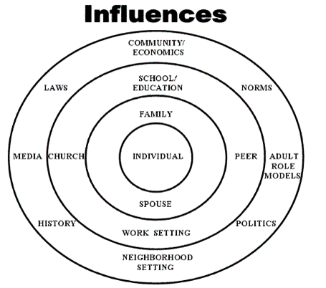
Person-In-Environment
Notes:
*Lauren
Micro, mezzo, macro

Slide 8
Why is this important for sport management?
Notes:
Amy facilitates :)
Let’s discuss and come up with a consensus. My thoughts on why it is important is it is “an opportunity create a set of armor for coaches, faculty members, athletic directors, and other sport management leaders with the appropriate tools to combat mental and social issues among their athletes” (from my abstract) which I feel they are unprepared for when confronted with in everyday scenarios
teach a sound theoretical base of holistic care to students/preparing students

Slide 9
Two Ways to Incorporate Social Work Theory into Sport Management Curriculum
Speciality Courses
Provide specialized courses within Sport Management curriculum that address specific instances of need within the realm of sports
Mental health & social issues, advocacy, self-efficacy,and more
Integrating into Existing Curriculum
Holistic Care
Intercollegiate Athletics
Sport Ethics
Sociology of Sport

Slide 10
Potential Specialty Courses
Mental Health Awareness in Sports - designed to assist in the recognition of general warning signs & symptoms of common mental health concerns for athletes; provide general assessment skills to identify issues/concerns with athletes that would hinder their overall well-being
Self-Care in Sport Management - designed to teach the practice of self-care for leaders in Sport Management; increase awareness & decrease stress, anxiety, tension, depression, etc.
Social Justice in Sports - designed to explore the concepts of justice, social change, and conflict within the realm of sports; examine political, economic, media, educational and institutional challenges
Research in Resources - designed to increase knowledge needed to research resources that promote overall health & well-being for athletes on a micro, mezzo, and macro level; assist in recognition of applicable resources for varied sets of circumstances that impact athletes, teams, organizations & communities
Notes:
Aim is to create awareness, education, and skill sets that will allow Sport Management leaders to better assist athletes with mental and social issues as part of a holistic approach to overall wellness and health (Maybe use under Importance slide?)

Slide 11
Case Example
You are an academic advisor working with an African American male basketball player. He is struggling with classes, and expresses anxiety about his performance on the court.

Slide 12
Questions?

