Slide 1
How to Talk about Accreditation with Students and Employers
Michael Pfahl
(Ohio University, COSMA BOC)

Slide 2
Pathway for Today
Pulling ideas and examples together
Integrating assessment work beyond curricular development
Identify practices for comparison rather than best practices
Making COSMA (and other accreditation areas) part of the culture versus something we do

Slide 3
Integrating Assessment Work Beyond Curricular Development
Rationale: It is not DNA unless it is language.
COSMA requirements for public disclosure
Narrative elements within recruitment
Industry dialogue driving COSMA standards
(as standard)

Slide 4
COSMA Elements Within Recruitment
Telling a story that is reinforced with accreditation
The following three (3) slides were taken directly from the prospective student presentations I gave as undergraduate program director (four years)

Slide 5
Accreditation Becoming Common
The COSMA accreditation ensures:
Our program meets industry standards for
learning, faculty, teaching, and pedagogy as
established by leading sport management
programs worldwide.
We are part of an elite group of sport management
and administration programs that demonstrated
the required academic excellence and
outstanding learning outcomes necessary for
accreditation.
Upon graduation, students can be assured they
will be prepared for success and ready to
make a meaningful impact on the sport industry.
AACSB Accreditation
The Association to Advance Collegiate Schools of Business is a global, nonprofit membership organization of educational institutions, businesses, and other entities devoted to the advancement of management education. Established in 1916, AACSB International provides its members with a variety of products and services to assist them with the continuous improvement of their business programs and schools.” – (AACSB, 2014, paragraph 1)

Slide 6
What the data tells us
Why we’re chosen: Reputation, Rankings, Strength of Program
Important items to first year students: Networking Opportunities, Applied Experiences, Developing Professional Skills
How did we do?: A- or greater ratings (DSA), B+ or greater ratings (College)
(DSA First Year Experience Survey January 2015)

Slide 7
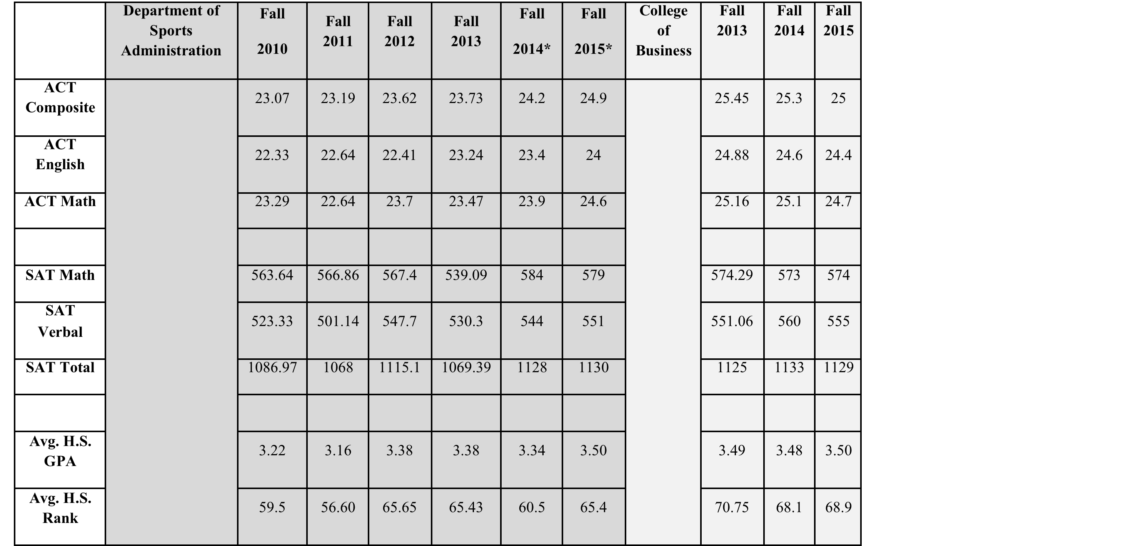
What the data tells us
Augmented with online annual report and encouraged the students and families to visit our webpage and that of COSMA.

Slide 8
Connecting to the Campus
Understanding?
In what ways can you connect to the campus to open the discussion?
Website and handout material including video descriptions on website
Prepared talking points for non-department personnel
Understanding
Campus community knows of your COSMA work
Volunteer
Offer to go on visits
Offer to speak at events
Please note I forced my way into university and college level prospective events.

Slide 9
Industry Dialogue Driving COSMA Standards
This area is still in development
Engaging with industry personnel will be necessary to explain the COSMA work

Slide 10
Connecting to the Industry
Understanding?
In what ways can you connect to the industry to open the discussion?
COSMA push, Program push,
Career Management personnel push
Understanding
Partners, alumni, other industry personnel begin to expect to see COSMA with you and all of us.
Finding alumni
This is one key way to spread the word.
Advisory Boards are a start, but all contact and materials that industry personnel see should have a COSMA element (e.g., logo in email, brochures)

Slide 11
Rough Waters Ahead
Today is only the start
COSMA has a role to play to find ways to promote its accreditation to prospective sport management students as well as to the industry.
Challenge for AY2017-2018
Find three (3) ways to integrate COSMA accreditation into your recruitment efforts, especially the on-campus visits
Find one (1) way to integrate COSMA accreditation into your introduction class
Find one (1) to promote COSMA accreditation to your industry partners
Find one (1) to promote COSMA accreditation to your industry internship partners

