Slide 1
Think Globally and be Inclusive: How to Successfully Cover Principle 7.5. (Diversity) and Principle 7.6 (International Sport) in your Self-Study
B. Nalani Butler, Ph.D. – Kennesaw State University Daniel Kelly , Ph. D. – New York University

Slide 2
Purpose
How to include and international component to your curriculum
In the classroom
Making connections to a global network
Discuss ways to implement diversity and inclusion practices within your program
How to be creative
How to be strategic

Slide 3
Why is this important?
Research shows that there are many advantages of implementing diversity practices, like student satisfaction and inter and intra cultural acceptance (Rizvi, Naqvi & Batool, 2019).
There is a significant relationship between student growth on various educational outcomes and activities during college associated with having a diverse student body and faculty (Hurtado, 2001)
Globalization is about the interconnectedness of people and businesses across the world that eventually leads to global cultural, political and economic integration (Fox & Hundley, 2011).
Within the self-study principles 7.5 (Diversity) and 7.6 (International Sport) are a requirement for accreditation

Slide 4
7.5 International Sport Management
Describe the institution’s and academic unit/sport management program’s orientation toward the global sport management environment.
Provide specific examples of curricular, co-curricular and operational activities that prepare students to understand and appreciate the global sport management environment.
Describe general conclusions drawn regarding the quality and effectiveness of your international activities in supporting excellence in sport management education, identify any changes and improvements needed and describe proposed courses of action to make those changes and improvements.

Slide 5
How do you create a global sport management environment
Implement a study abroad programs
Cover international sport management topics within the course
Work with the international office
Look into opportunities to work with diverse faulty
Look for funding opportunities for professional development
Work with diverse communities within the area
Collect data on student perceptions on international sport

Slide 6
Global/International Opportunities
US Department of State
US Embassy’s & Consulate Generals
Bureau of Educational and Cultural Affairs
The Fulbright Program
IVLP
Leadership opportunities
Exchange Programs
(https://exchanges.state.gov/us)

Slide 7
International Visitor Leadership Program
IVLP
The International Visitor Leadership Program (IVLP) is the U.S. Department of State’s premier professional exchange program. Through short-term visits to the United States, current and emerging foreign leaders in a variety of fields experience this country firsthand and cultivate lasting relationships with their American counterparts. Professional meetings reflect the participants’ professional interests and support the foreign policy goals of the United States.

Slide 8
Tokyo Olympics 2020
Length of stay – 10 days (January, 2020)
US Embassy to Japan – Using Olympics as diplomacy mission to reintroduce the US to Japan.
Foreign Service Officers visiting each of Japan’s prefectures to spread sports diplomacy
Sports United – State Department’s Global Diplomacy agency

Slide 9
Tokyo Olympics – Residency (NYU)
Length of stay – 10 days (January, 2020)
Opportunities for engagement…
Tokyo Olympic Committee
Japan Sports Association
Japan Anti-doping
Intel – Olympic Top Sponsor
Octagon – Global presence
Court of Arbitration for Sport (CAS)
Chiba Jets
FC Tokyo
Sumo Wrestling Championships

Slide 10
7.6 Diversity in Sport Management
Describe the institution’s and academic unit/sport management program’s policies regarding diversity and encouraging diversity.
Provide specific examples of curricular, co-curricular and operational activities that prepare students to understand and appreciate the diversity of the sport environment.
Describe general conclusions drawn regarding the quality and effectiveness of your diversity activities in supporting excellence in sport management education, identify any changes and improvements needed and describe proposed courses of action to make those changes and improvements

Slide 11
Don’t limit yourself
Race
Ethnicity
Gender
Gender Identity
Sexual Orientation
Age
Social Class
Ability
Religion
Nationality
Political Beliefs

Slide 12
Be Mindful
Images used in your presentation
Stay up-to-date on language
Be up-to-date on current events
If your not comfortable, that is okay- find a colleague that is!
Meet with office of diversity and inclusion
Professional Development survey
Class Climate survey
YOU NEED TO BE THE LEADER AND INITIATE THE DISCUSSION- BE PROACTIVE!

Slide 13
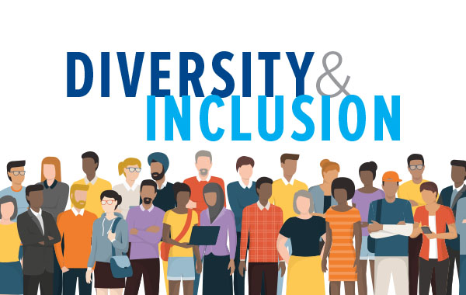
Example: NCAA and Diversity and Inclusion
Gender Equity and Title IX
Senior Women Administrators
Emerging Sports for women
LGBTQ
Race and Ethnicity
SA’s with disabilities
International Student Athletes
Creating and Inclusive Culture
Notes:
http://www.ncaa.org/about/resources/inclusion

Slide 14
Where do you find them?
Four-day conference that has become the largest gathering of minority doctoral scholars in the country.
Gives the issue of faculty diversity a national focus
Provides minority scholars with the strategies necessary to
Survive the rigors of graduate school
Earn the doctoral degree
Succeed as a member of the professoriate.

Slide 15
Inclusion
Empowerment
Respect
Belonging
Mentorship
Resources
Leadership opportunities

Slide 16
Educate Yourself!
Racial and ethic groups
Politics
Pronunciation
Regions
Religious beliefs

Slide 17
Discussion
How can COSMA support global and international engagement for member institution?
How can COSMA can be proactive in identifying faculty diversity and inclusion within the self-study and accreditation process?
How can COSMA promote and integrate progressive strategies to create dialogue within the sport management departments and on faculty diversity and inclusion?
How can departments effectively recruit and mentor minority faculty and students within sport management?

Slide 18
B. Nalani Butler – Nalani.Butler@Kennesaw.edu Daniel Kelly – Dgk2@nyu.edu

