Slide 1
TURNING YOUR ABSTRACT INTO A PUBLICATION:
SEEKING PUBLICATIONS ADDRESSING SPORT MANAGEMENT EDUCATION
DR. JASON W. LEE
DR. ELIZABETH A. GREGG
MS. HEATHER ALDERMAN
DR. JENNIFER J. KANE

Slide 2
THE COMMISSION ON SPORT MANAGEMENT ACCREDITATION
The Commission on Sport Management Accreditation (COSMA) was established in 2008 to oversee the quality of sport management programs.
Over the last 12 years, sport management accreditation has increased and been incorporated into research papers ranging from the conceptual (Newman, 2014) to the methodological (Shapiro & Pitts, 2014).
Various pedagogical research projects (e.g., Jones, Brooks, and Mak, 2008; Laird, Johnson, & Alderman, 2015) cite COSMA accreditation principles as a framework in which innovation and transformation are recognized and encouraged.

Slide 3
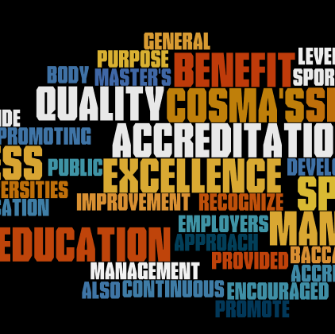
STATEMENT OF PURPOSE
The purpose of this session is to provide a forum for the discussion of the type of scholarship and research associated with sport management accreditation – what we are doing and in what areas we need new or additional research and scholarship.
Discuss and debate the rationale for conducting research addressing sport management accreditation while examining the interest and feasibility for a special issue on sport management accreditation.
Explore avenues for publishing sport management accreditation research – specifically, ways to turn your abstract into a publish-ready article.
Identify ways in which sport management accreditation research can be used to enhance programs and the profession.

Slide 4
BENEFITS OF PROGRAM ACCREDITATION
Program accreditation conveys to internal and external stakeholders an awareness that an academic program of study engages in a cycle of continuous improvement, is of high quality, and exhibits overall excellence
As the Sport Management discipline advances, accreditation is progressively more widespread and essential (Yiamouyiannis, Bower, Williams, Gentile, & Alderman, 2013)
Confirms that programs have processes to meet changes in thinking within the academic field and industry expectations and signals employers an educational program has met widely-accepted educational standards
Documenting a phenomenon that pervades sport management’s understanding of “characteristics of excellence” is challenging as programs use COSMA Principles to shape curricula prior to or without going through the accreditation process itself

Slide 5
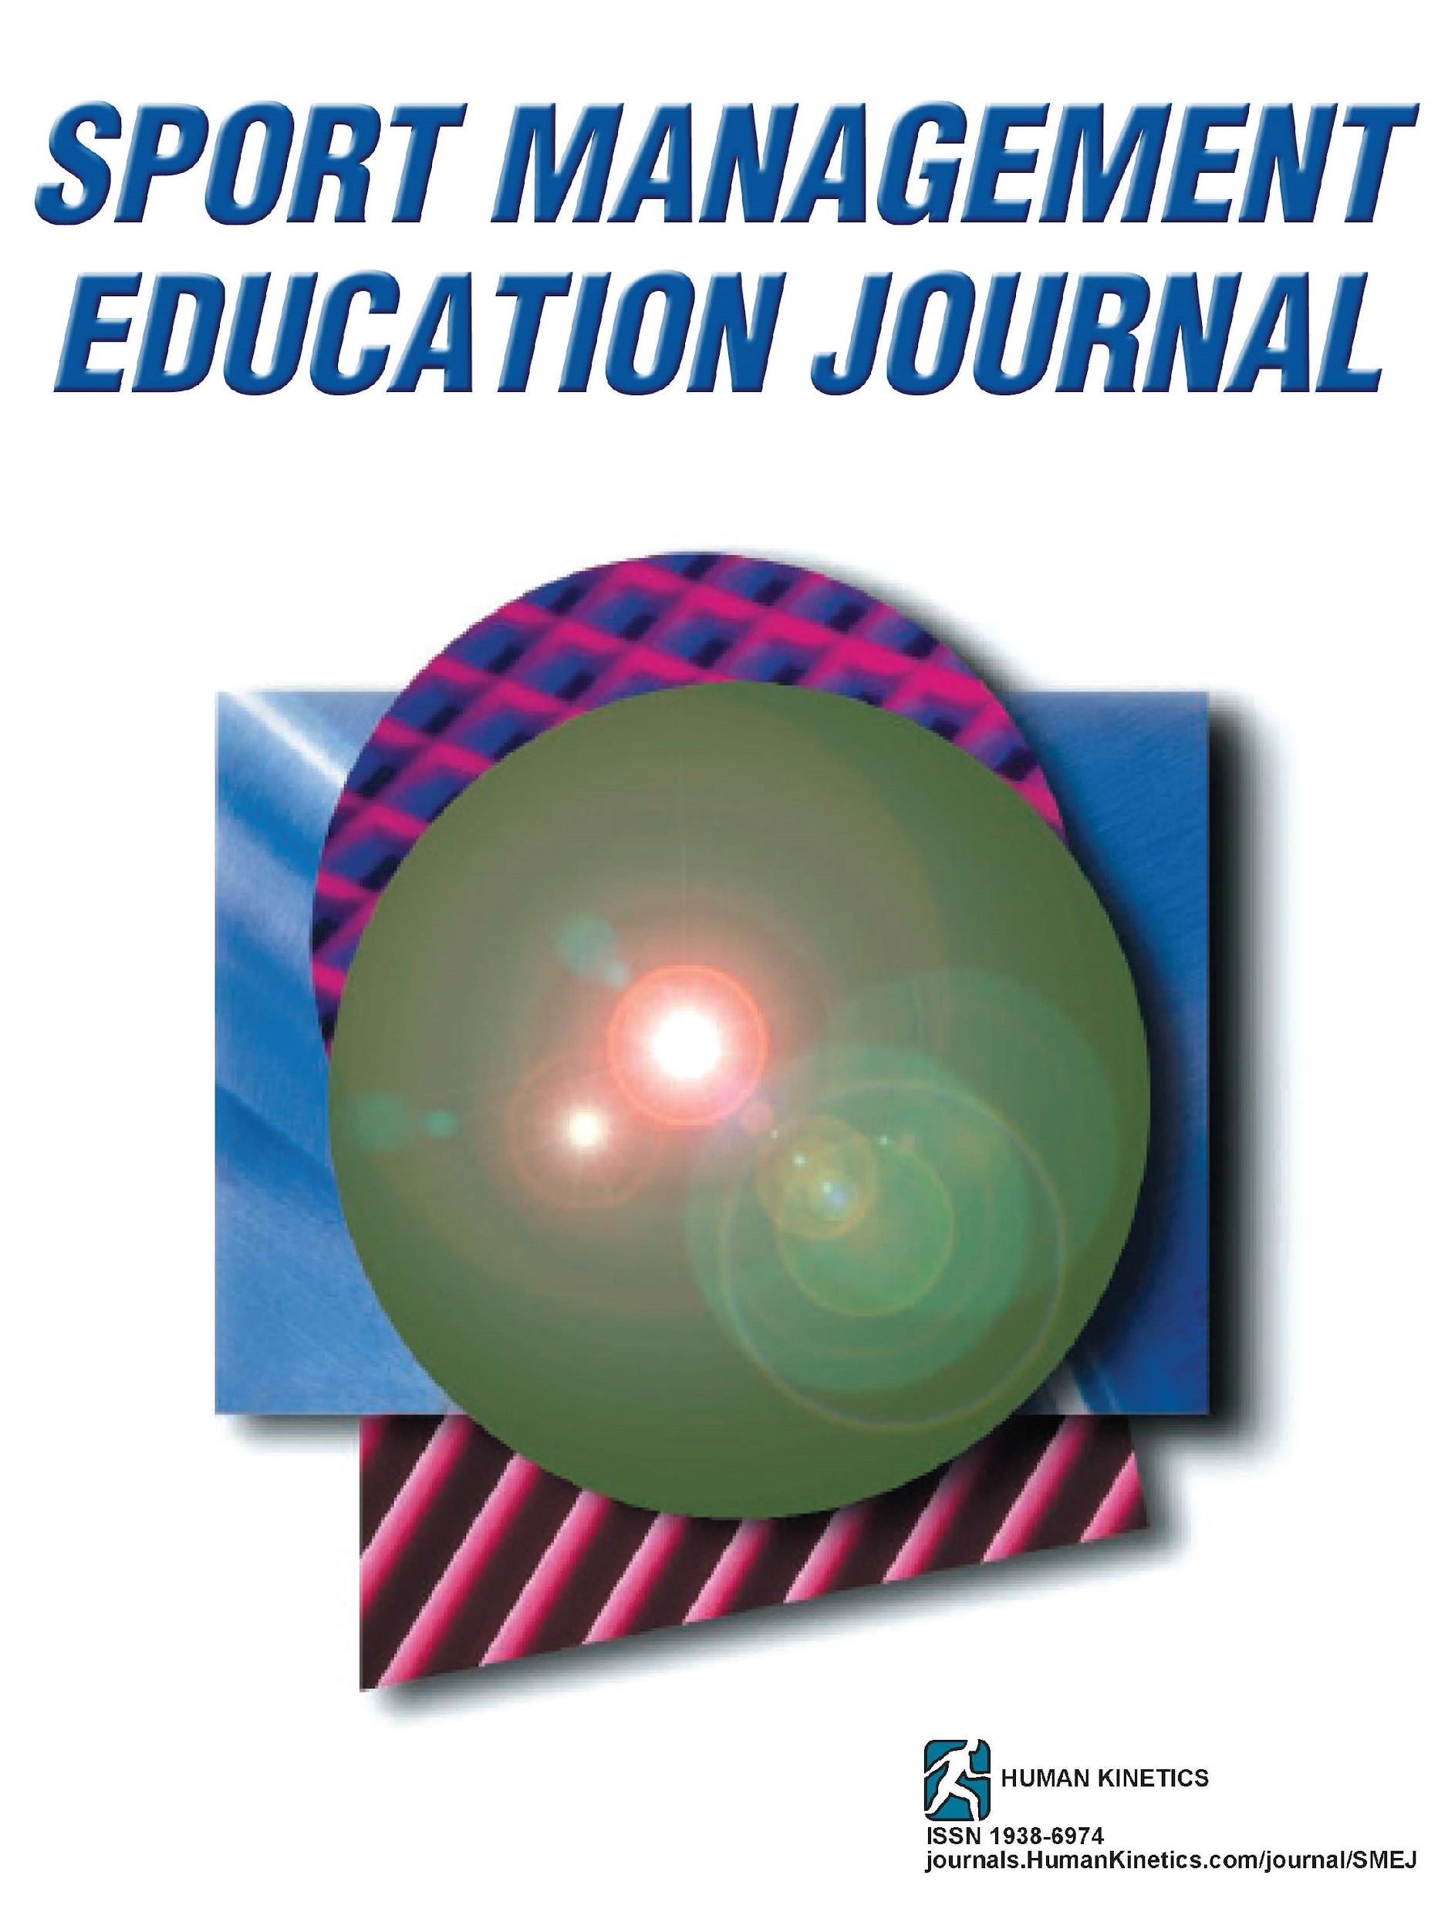
PUBLISHING OUTLETS NOT MEETING DEMAND
Over the years, faculty have inquired about creating additional outlets for the publication of research addressing sport management programs. This demand has sparked discourse ranging from establishing special issues in existing publications to requesting that COSMA start a journal to support the research, pedagogical and best practices-related articles (i.e., presentations) delivered at annual COSMA Conferences.
This demand gave rise to the proposal of a special issue on accreditation for the Sport Management Education Journal.
Inquiries were sent out to COSMA membership seeking input on accreditation-related research that members were working on that could be turned into a manuscript. The subsequent strong response represented encouragement that such an issue would receive sufficient interest and submissions.

Slide 6
BENEFITS OF A SPECIAL SMEJ ISSUE AND POTENTIAL TOPICS
A special issue would allow for the dissemination of a variety of research and conceptual examinations of accreditation, its role and value for sport management and areas in which it could improve or assist programs in the ever-changing landscape of sport industry.
Possible topics, in the call for prospective manuscripts, included:
The role of outcomes assessment in program improvement
Strategic planning
Pedagogical innovations
Faculty diversity and its impact on student body diversity
Resource allocation for sport management programs
The role of program accreditation and campus reputation
Internships and experiential learning
The impact of the global sport industry on sport management education
Faith-based institutions and mission-based accreditation
Accreditation and sport management pedagogy
Recruitment and retention of students in sport management

Slide 7
TURNING YOUR ABSTRACT INTO A PUBLICATION
Sections commonly included in traditional research publication:
Title Page
Abstract
Literature Review
Methodology and Theoretical Framework
Results
Discussion
Conclusion

Slide 8
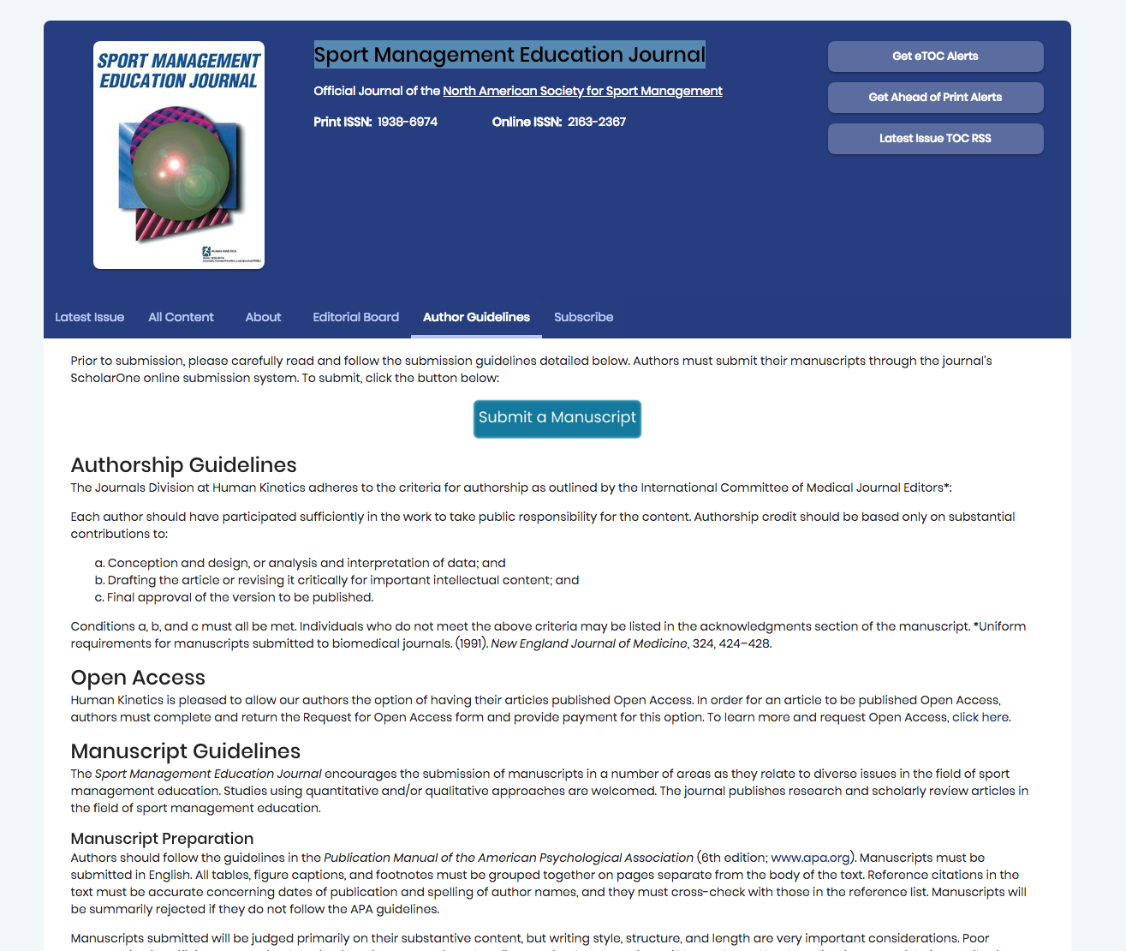
Consider SMEJ...

Slide 9
POINTS OF DISCUSSION
How can we strengthen our proposal for a special issue focused on accreditation?
What topics could be included that were not covered in this presentation?
Who is engaging in research related to the special issue?
Who would consider engaging in research related to the special issue?
Who is interested in reviewing potential articles? (those not submitting articles for publication)

Slide 10
QUESTIONS?

