Slide 1
Using CATME to Evaluate Team Performance in Project-Based Learning (PBL) Courses
David Pierce, Indiana University-Purdue University Indianapolis
Elizabeth Gregg, University of North Florida

Slide 2
The Challenge
Soft skills desired by employers are hard to measure
Measuring the collaboration and teamwork skills is challenging
Most group work happens when the professor isn’t there
Grading students on what we don’t see is uncomfortable
How do students demonstrate to employers they are good collaborators?
How can we help groups if we don’t know what’s wrong?
Notes:
Soft skills:
Communication skills
Teamwork and collaboration
Adaptability
Problem solving
Conflict resolution

Slide 3
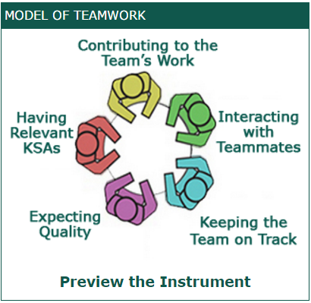
Purpose Today
Show how the Comprehensive Assessment of Team-Member Effectiveness (CATME) system can be utilized to help faculty address these challenges.
“The CATME system enhances team learning by teaching students how to contribute effectively to teamwork and creating accountability for team-member contributions. The system facilitates communication among teammates and between students and their instructor” (CATME, 2017)

Slide 4
Project-Based Learning (PBL)
“Systematic teaching method that engages students in learning knowledge and skills through an extended inquiry process structured around complex, authentic questions and carefully designed projects and tasks” (Markham, 2003)
PBL allows faculty to engage students in meaningful team-based classroom activities.
Emphasizes soft skills such as critical thinking, problem-solving, collaboration, working well with others, and self-management

Slide 5
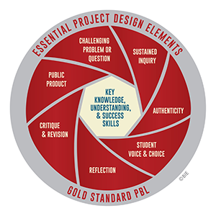
Project-Based Learning (PBL)
Benefits
Facilitates student mastery of key competencies essential for employment in the global economy.
Improved problem-solving skills as compared to traditional classes
Ability to apply theory to practice in real-life scenarios
Ability to work collaboratively and solve conflicts
(English & Kitsantas, 2013)
Notes:
The Buck Institute for Education identified seven key project design elements for successful PBL assignments:
Challenging problem or question to frame the project
Sustained inquiry for an extended period of time
Student input and/or control over project design and management
Reflection through dialogue and knowledge checks
Use of constructive peer feedback to revise and improve student work
Public presentation by students of final product or solution

Slide 6
Class Setting
Intro to Sport Management
Groups of 4-5
Design a new youth sports experience to thwart the trend of declining sport participation.
Using the lens of social entrepreneurship, groups developed a product, service, experience, organization, or idea to combat the fundamental problems with youth sports participation

Slide 7
Peer Evaluation
Peer evaluation is a process in which students evaluate their peers’ performance during group work because it provides a lens into the inner dynamics of student group work not visible to instructors.
In the course evaluated, CATME was the peer evaluation system employed to build teams, conduct peer evaluations, and offer constructive feedback to students and groups throughout the course of the semester.

Slide 8
Students Rate Each Other On
Contributing to the team’s work
Interacting with teammates
Expecting quality
Keeping the team on track
Having relevant knowledge, skills, and abilities
Likeability
Future working with student

Slide 9
Students Rate the Group On
Team conflict
Team satisfaction
Team interdependence
Team cohesiveness
Team action processes
Notes:
Team conflict – relationship, task process
Cohesiveness – interpersonal, task commitment, task attraction
Transition – monitor progress to goals, monitor resources, monitor team member performance, coordinate work

Slide 10
CATME Tells You Which Students Are
Underconfident
Overconfident
High performers
Low performers
Cliquish
In Conflict

Slide 11
CATME Helps You
Find problems before its too late
Identify loafers – who isn’t engaged?
Evaluate a student’s contribution to the group
Identify specific weakness area for students
Have clear guidelines for how peer evaluations turn into points
Find the groups that are struggling – and pinpoint where things are falling apart
Develop action plans to improve group performance
Assess SLOs related to collaboration
Obtain rich qualitative feedback from students

Slide 12
Future Research
Collect enough data to understand
What team factors best predict team performance?
What individual factors best predict class performance?

Slide 13
Conclusions
CATME peer evaluation tool provides instructors with a behind the scenes view of student group work.
Through the use of CATME, faculty can provide students with timely feedback and constructive criticism. This is particularly useful for groups experiencing strife in their group work.
CATME allows faculty to assess learning outcomes, evaluate student contributions to projects, analyze team processes, and determine how students best interact in group settings.

