Slide 1
An Integrated Communications Approach to Engaging Sport Management Students
Mark Vermillion, Mike Ross, Kayla Jasso, & G. Clayton Stoldt

Slide 2
Overview
Student engagement as a multifaceted process
Student recruitment
Student retention
“connecting” with student constituencies
Presentation: Case study of SMGT at Wichita State University
R & R efforts
Explicit goals: 2020 projections
Our recommendations based upon OUR situation

Slide 3
Background
Dynamic, competitive (educational) market places (Wildavsky, Kelly & Carey, 2011; Anderson, Boyles & Rainie, 2012)
Industry-specific content, focus (Hancock & Greenwell)
Attracting and retaining students is an outgrowth of the interaction of markets and need (content)
Applied learning
Recruitment & retention
Communications efforts, then, should be integrated and highly variegated

Slide 4
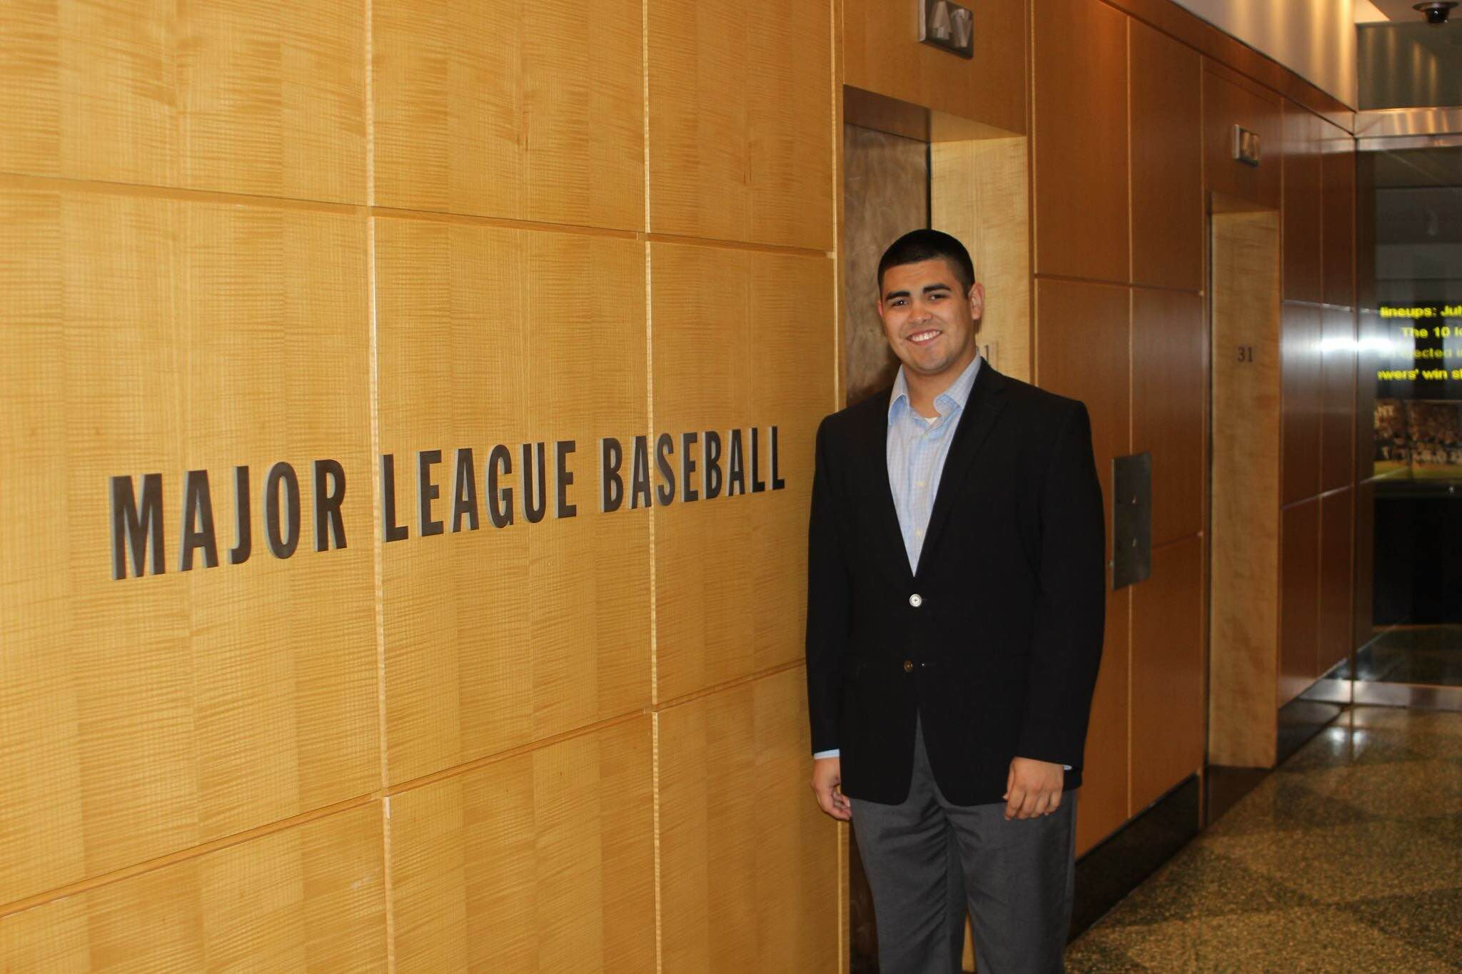
Background
“Stewardship of Place Through Civic Learning and Engagement”
Domagal-Goldman (2014):
Civic Learning & Engagement must be enacted across an entire curriculum to impact students
Communities must be socially, economically, and civically viable

Slide 5
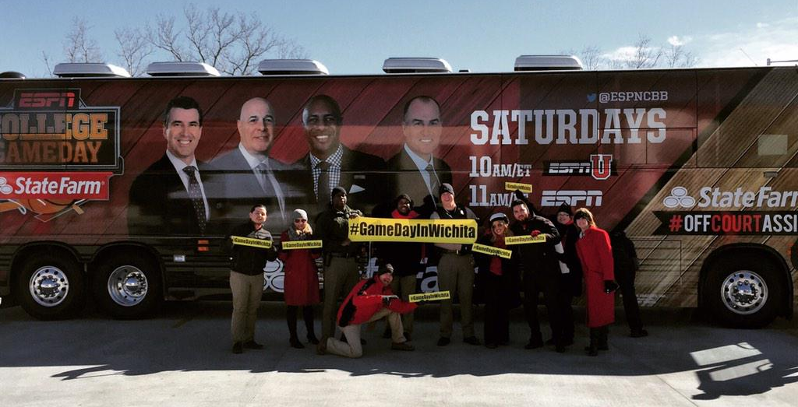
Wichita State University: Change
Mission: “…..essential educational, economic, and cultural driver for Kansas and the greater public good.”
College of Education:
Both emphasize
Applied learning
Student engagement

Slide 6
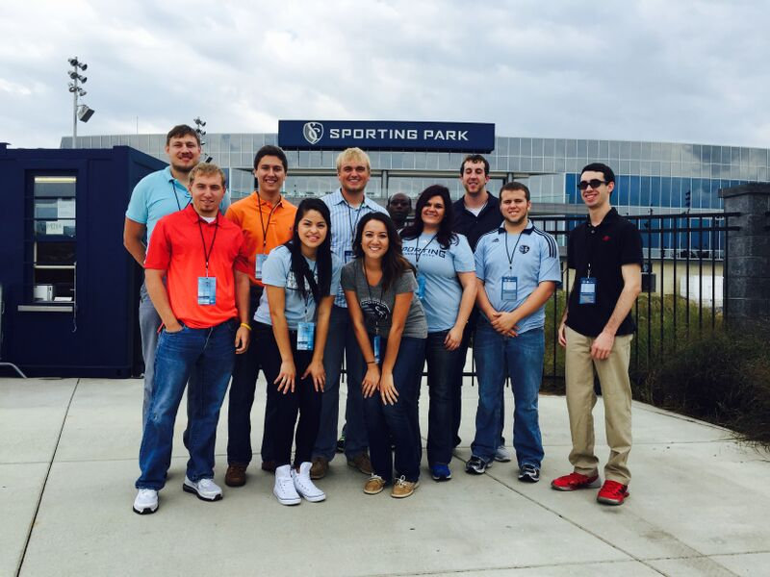
Department of Sport Management
Strategic Planning
Approved Spring 2014
Emphasizes:
Expanding partnerships
Technology
Student research
Had to learn WHO comprised our student body…

Slide 7
2015:
Conducted a content analysis of our annually updated alumni directory.

Slide 8
General issues & Philosophy
Situational appraisal
Increasingly competitive environment
Business model:
positive growth is key
stagnation is negative growth
Philosophy
Recruit family
Recruit “person”
“put your money where your mouth is…”
Stay active, stay relevant

Slide 9
Student Retention
Initiatives
Student Recruitment
Initiatives
Highlight, maintain, & expand (technology)
Current
Humanize, highlight, & interact
Current
Inform, (re)connect
Future
Inform, evolve, & advocate
(others speak)
Future

Slide 10
Student Recruitment
Current: Humanize, highlight, and interact
On-campus presence
Jr/Sr Days, student ambassadors
One-on-one
Personal follow-ups
Spotlights: monthly student/alumni spotlights; alumni directory
Future: Inform (re)connect
Compile student, alumni data
Newsletters to potential students
Connect:
Examples: Newsletters
&
Student Highlight: Horizon

Slide 11
Student Retention
Current: Highlight, maintain, and expand
One-on-one
Advising & enrollment emails; reminder to enroll emails
Individual outreach
Social media
Connection, updates, academic career, professional opportunities
Mentoring
Career information & opportunities
Future: Inform, evolve, and advocate
Networking & events
Have others advocate for our program

Slide 12
Overarching philosophy moving forward….
Change is constant
Technology is a means to an end, not an end itself
“humanistic approach” to numbers
Show community and students (current or potential):
Learning is a process
Education is simply a curriculum, should evolve
Change is worth pursuing
“classrooms” are not always in a building
Recruitment and retention are issues for EVERYONE
Everyone is a “teacher;” everyone is constantly learning

Slide 13
Recommendations:
Think through the process:
Strategic planning
Student Recruitment & Retention Report
Process is not static, but changes constantly
“engagement” evolves
Technology: drones and Padcaster systems
Civic learning, social responsibility
Identify values
Engagement is an egalitarian process where the “idea” is the most important
Everyone must buy into the process

