Slide 1
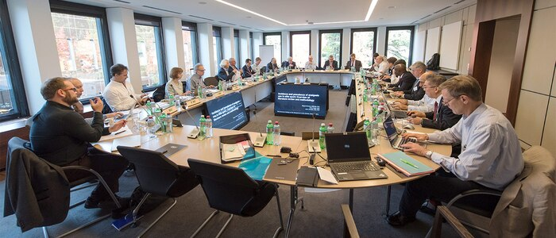
Weaving the intersection of sport and culture throughout the sport management curriculum OR How to integrate intercultural competence with sport management students and curriculum
Darlene A. Kluka, D Phil, Ph D – Sport Management Consultant
COSMA HOF Inaugural inductee 2019

Slide 2
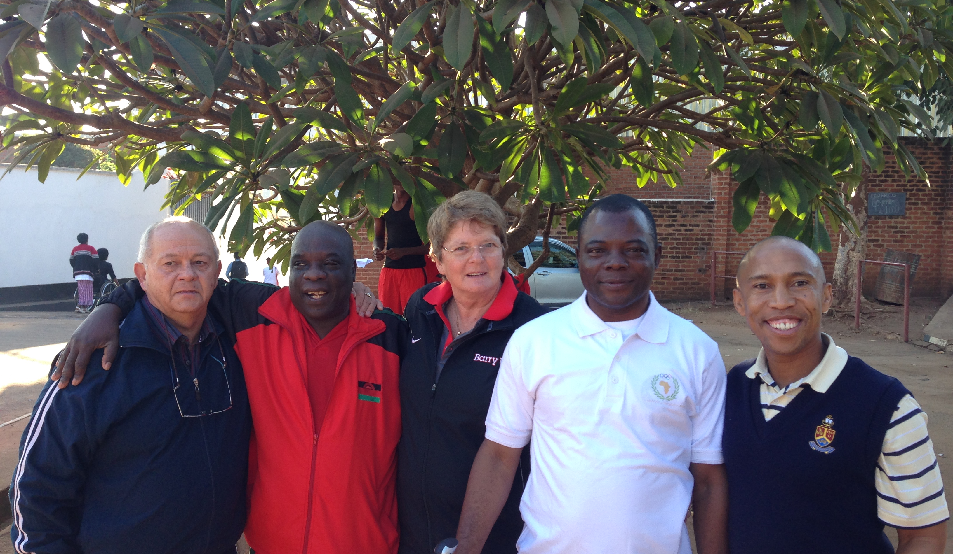
A few fundamental aims of sport management curricula
To respond to:
the changing realities and demands of the sport management labor market
contextual realities of the 21st century related to sport management
Preparation of graduates for intercultural reality and demands in the context of their professional environment

Slide 3
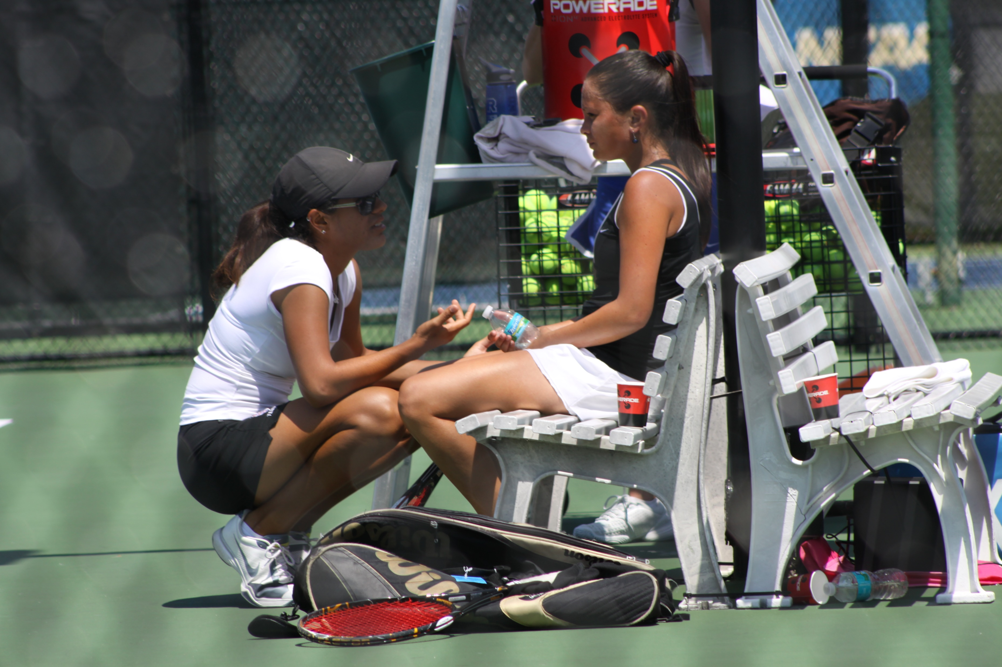
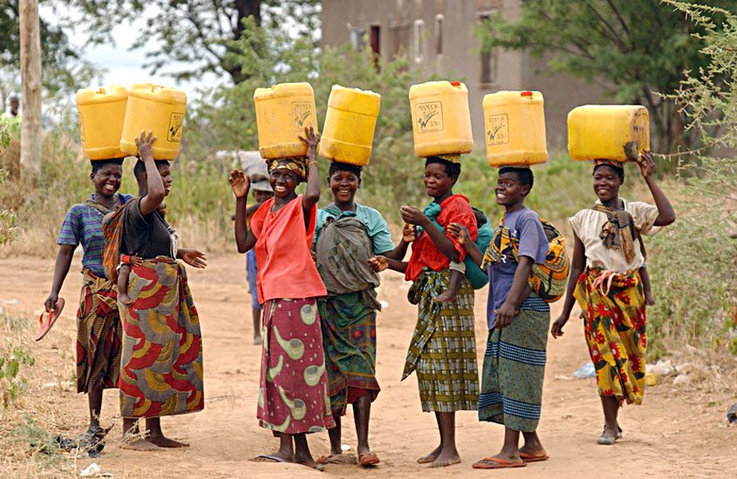
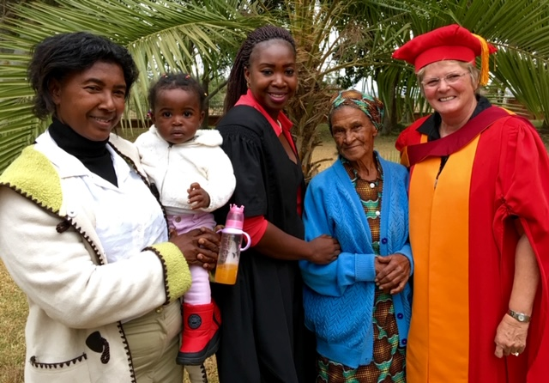
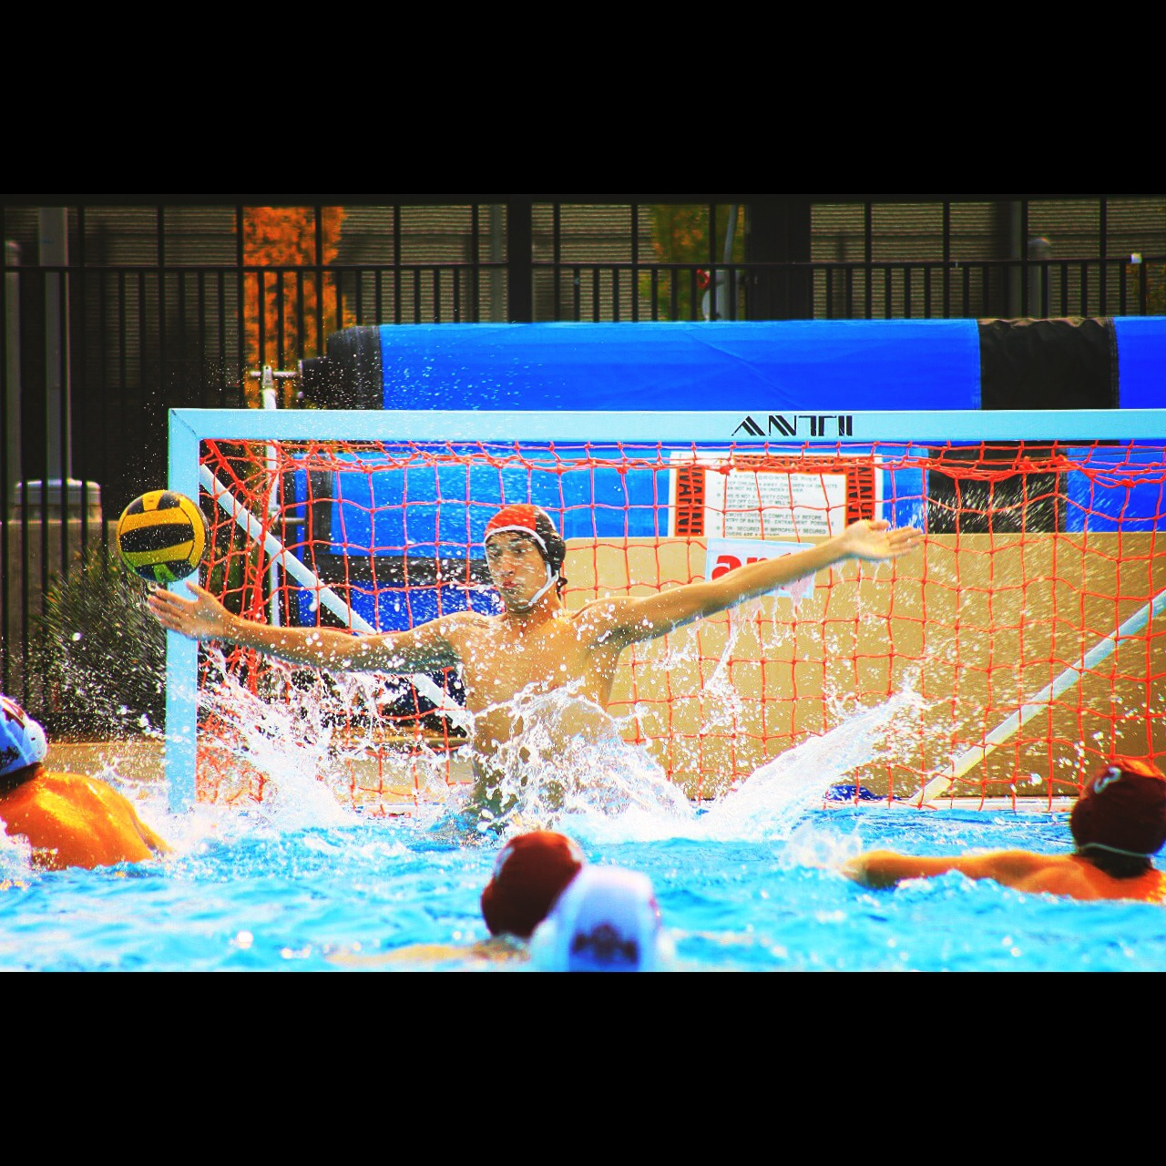
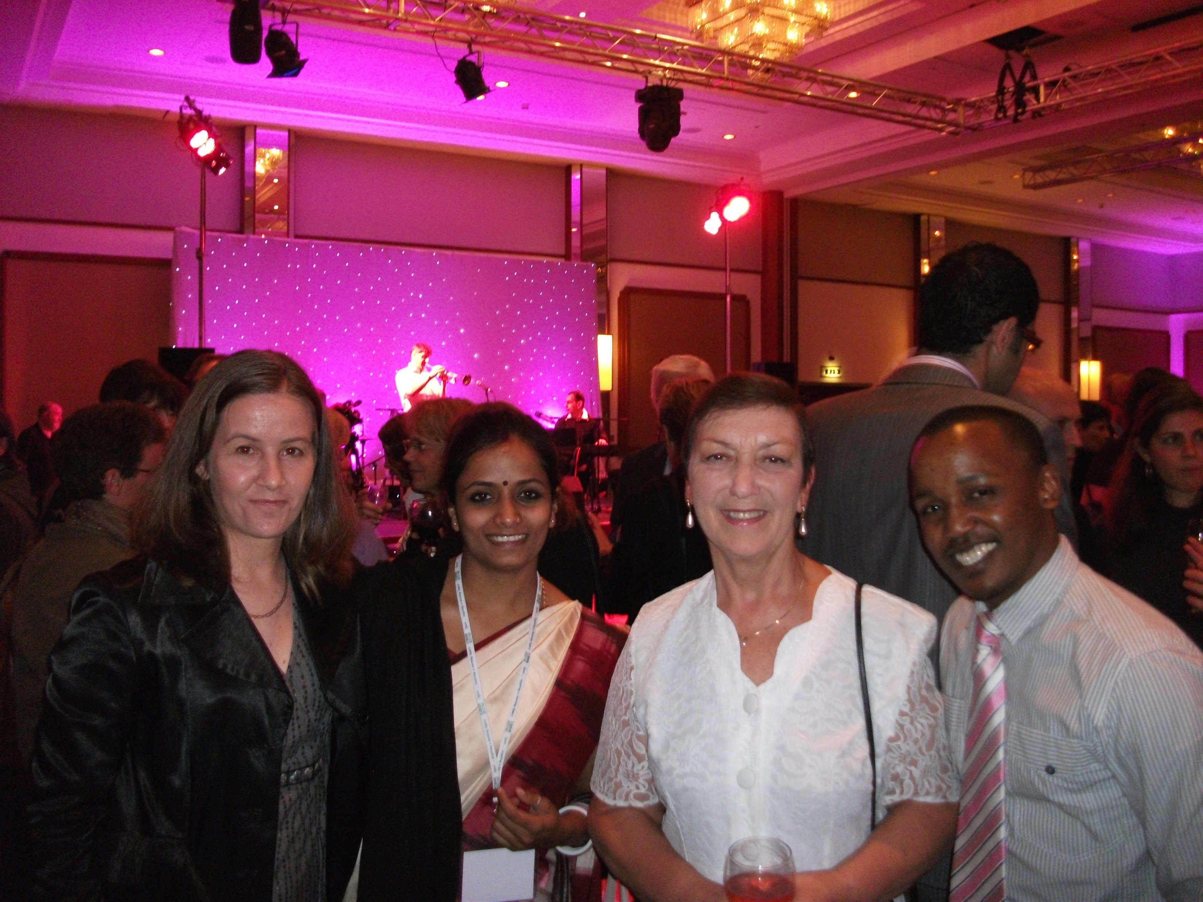
Is it necessary to produce graduates in sport management who can operate in intercultural sport management contexts?

Slide 4
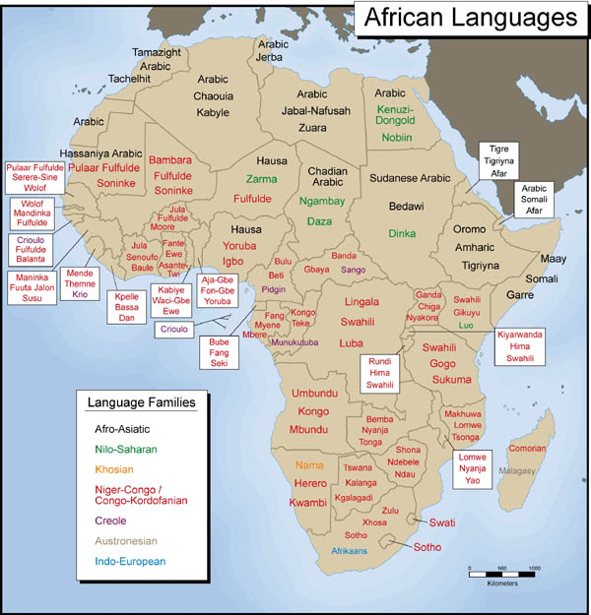
Languages

Slide 5
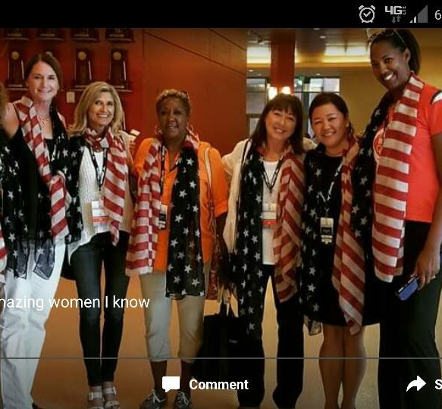
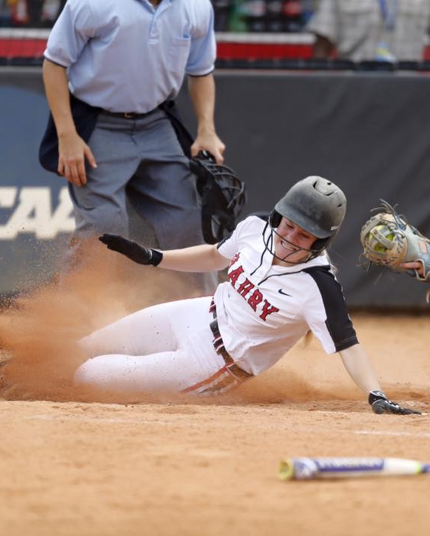
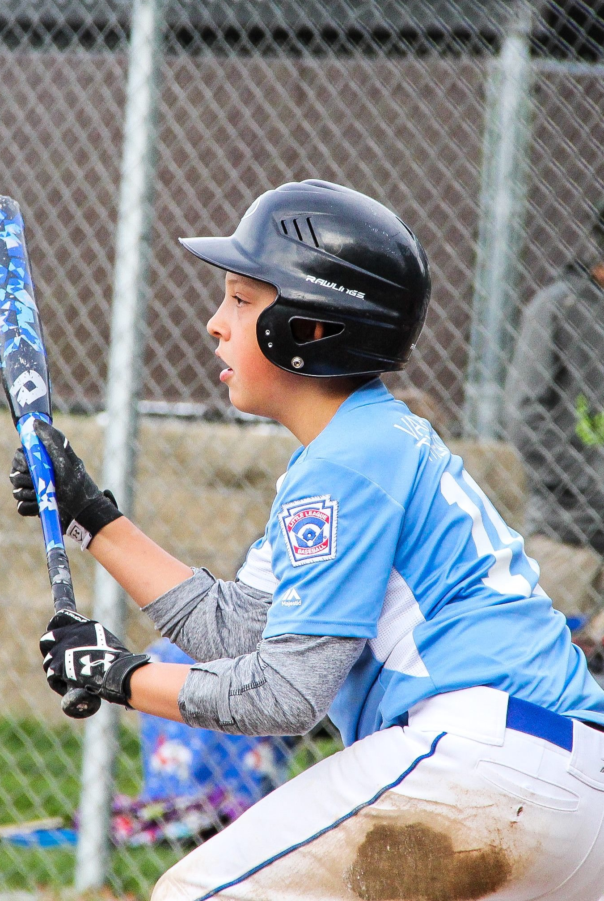
Why is intercultural competence necessary in today’s sport management contexts?

Slide 6
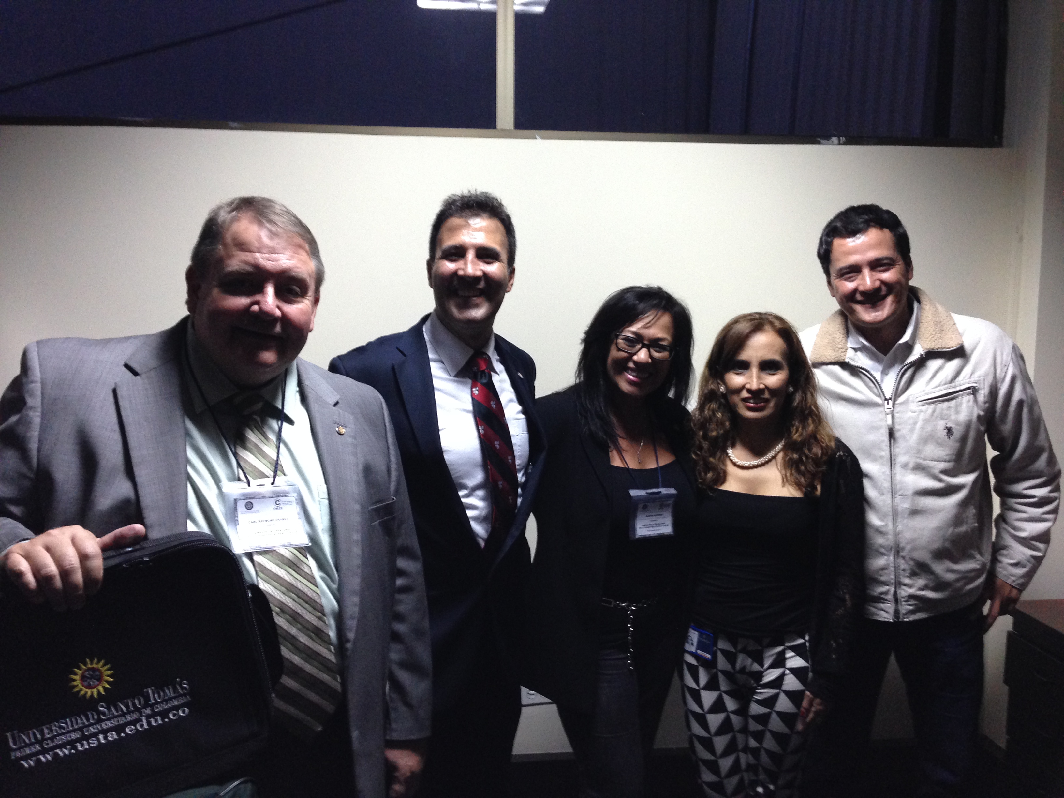
Global Mindset
develop global strategies and translate ideas into business transactions;
change personal ways of thinking from internally to externally oriented;
be creative, learn and transfer knowledge across borders;
operate with a high degree of personal integrity and honesty;
be non-judgmental when confronted with confusing situations.
The competency to:
perform in a team setting;
manage change and transition;
manage work force diversity;
communicate in various cultural settings;
Notes:
(Gooderham & Nordhaug, 2003: 225):
The competency to perform in a team setting;
The competency to manage change and transition;
The competency to manage work force diversity;
The competency to communicate in various cultural settings;
The competency to develop global strategies and translate ideas into business transactions;
The competency to change personal ways of thinking from internally to externally oriented;
The competency to be creative, learn and transfer knowledge across borders;
The competency to operate with a high degree of personal integrity and honesty;
The competency to be non-judgmental when confronted with confusing situations.

Slide 7
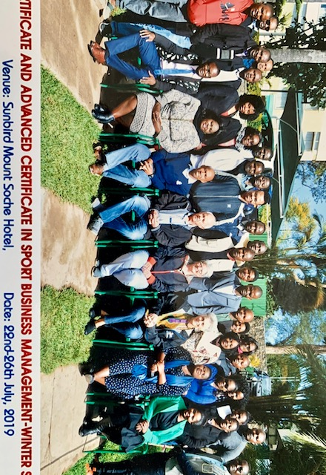
Global Citizenship
development of a global mindset
internationalization of curriculum (begun in 1990s in
USA universities)
Notes:
Let’s take a look at some of the points to consider:
Developing global mindsets
A new framework of sport management competencies is required to direct sport, recreation and physical activity in the 21st century.
That new framework involves the development of a global mindset is needed that combines an openness to and diversity across cultures and marketplaces with the ability to synthesize across this diversity. Two fundamental dimensions underlie a global mindset: cosmopolitan orientation and cognitive complexity. The successful sport manager understands the complexity of sport, can differentiate between numerous dimensions, paradoxes and challenges while at the same time is able to identify links between dimensions and synthesize them into best practices (Boyacigiller, Beechler, Taylor and Levy in Lane, Maznevski, Mendenhall, Mcnett (2006:81-83).

Slide 8
Why is intercultural competence necessary in today’s sport management contexts?
Culture
Sum of a way of life, including expected behavior, beliefs, values, language and living practices hared by members of a society
Intercultural competence (IC)*
Ability to develop targeted knowledge, skills and attitudes that lead to visible behavior and communication that are effective and appropriate in intercultural interactions. Also takes into consideration one's own cultural norms and the best appropriate, comfortable compromise between the different cultures. (WIN-WIN-WIN…Kluka says☺)
*IC – cannot be acquired in one module – lifelong process – critical reflection powerful
Notes:
Culture
Sum of a way of life, including expected behavior, beliefs, values, language and living practices hared by members of a society
Intercultural competence (IC)*
Ability to develop targeted knowledge, skills and attitudes that lead to visible behavior and communication that are effective and appropriate in intercultural interactions. Also takes into consideration one's own cultural norms and the best appropriate, comfortable compromise between the different cultures. (WIN-WIN-WIN…Kluka says☺)
*IC – cannot be acquired in one module – lifelong process – critical reflection powerful

Slide 9
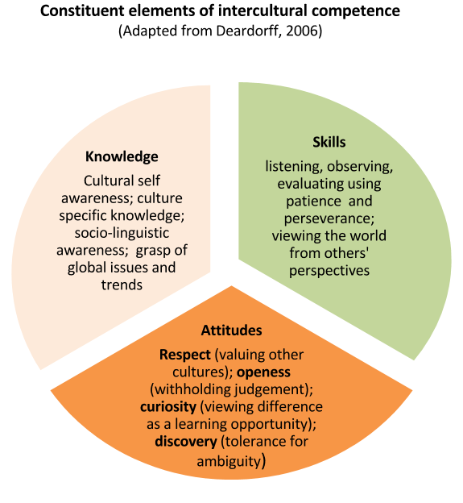
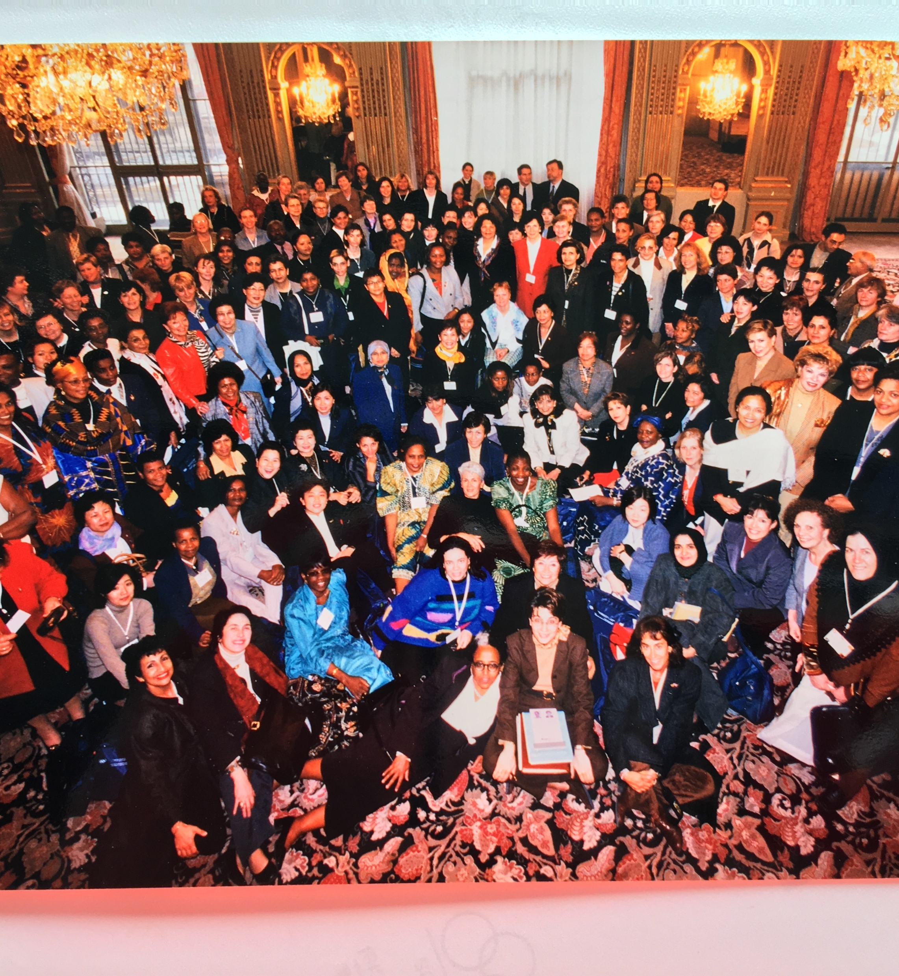
Notes:
Deardorff, D. K. (2006). The identification and assessment of intercultural competence as a student outcome of internationalization at institutions of higher education in the USA. Journal of Studies in International Education, 10, 241-266.
Knowledge:
Cultural self awareness – articulating how one’s own culture has shaped one’s identity and world view
Culture specific knowledge – analyzing and explaining basic information about other cultures
Sociolinguistic awareness – acquiring basic local language skills, articulating differences in verbal/non-verbal communication and adjusting one’s speech to accommodate nationals from other cultures
Grasp of global issues and trends – explaining the meaning and implications of globalization and relating local issues to global forces
Skills:
Listening, observing, evaluating – using patience and perseverance to identify and minimize ethnocentrism, seek out cultural clues and meaning
Analyzing, interpreting, and relating – seeking out linkages, causality and relationships using comparative techniques of analysis
Critical thinking – viewing and interpreting the world from others’ viewpoints and identifying one’s own
Attitudes:
Respect – seeking out other cultures’ attributes; value cultural diversity; thinking comparatively and without prejudice about cultural differences
Openness – suspending criticism of other cultures; investing in collecting evidence of cultural difference; being disposed to be proven wrong
Curiosity – seeking out intercultural interactions, viewing difference as a learning opportunity, being aware of one’s own ignorance
Discovery – tolerating ambiguity and viewing it as a positive experience; willingness to move beyond one’s comfort zone.
Outcomes:
The above knowledge, skills and attitudes lead to internal outcomes which refer to an individual who learns to be flexible, adaptable, empathetic, and adopts an ethno-relative perspective.
These qualities are reflected in external outcomes which refer to the observable behavior and communication styles of the individual. They are the visible evidence that the individual is, or is learning to be, interculturally competent.

Slide 10
What are the intercultural attributes of sport management graduates?
Open-minded/tolerant and acknowledges cultural differences
Able to communicate and function in intercultural settings in sport management contexts
Aware of regional and global differences and consequences in a globalized sport environment
Aware of global ethical issues related to sport
Notes:
Consider the following attributes related to intercultural competence in sport management:
Open-minded/tolerant and acknowledges cultural differences
Able to communicate and function in intercultural settings in sport management contexts
Aware of regional and global differences and consequences in a globalized sport environment
Aware of global ethical issues related to sport

Slide 11
To develop these attributes, graduates must demonstrate the following cognitive, affective, and behavioral skills:
Ability to think globally and consider sport management issues from a variety of perspectives and cultures
Awareness of own culture and perspectives and other cultures and perspectives
Appreciate relation between sport management locally and sport management/participation traditions elsewhere
Recognize intercultural issues relevant to professional practice (role of women in sport in Middle East countries)
Appreciate importance of multicultural diversity to professional sport management and citizenship
Appreciate complex and interacting factors contributing to culture and cultural relationships in sport management working groups, councils, and task teams
Value diversity of language and culture
Appreciate and demonstrate capacity to apply diverse standards and practices within sport management
Demonstrate awareness of implications of local decisions and actions for international sport communities, and international decisions and actions for local communities
Awareness of diverse needs, feelings and view of sport managers, fans, administrators of other cultures
Realize how global issues may affect local sport management practices
Notes:
Display an ability to think globally ad consider sport management issues from a variety of perspectives and cultures
Demonstrate awareness of their own culture and its perspectives and other cultures and their perspectives
Appreciate the relation between sport management locally and professional sport management and sport participation traditions elsewhere
Recognize intercultural issues relevant to their professional practice, et the role of women in sport in the Middle East and Moslem countries
Appreciate the importance of multicultural diversity to professional sport management and citizenship
Appreciate the complex and interacting factors that contribute to notions of culture and cultural relationships in international sport management working groups, councils, and task teams
Value diversity of language and culture
Appreciate and demonstrate the capacity to apply diverse standards and practices within the discipline or professional area of sport management
Demonstrate awareness of the implications of local decisions and actions for international sport communities, and of international decisions and actions for local communities.
Awareness of diverse needs, feelings and view of sport managers, fans, administrators of other cultures.
Realize how global issues may affect local sport management practices.

Slide 12
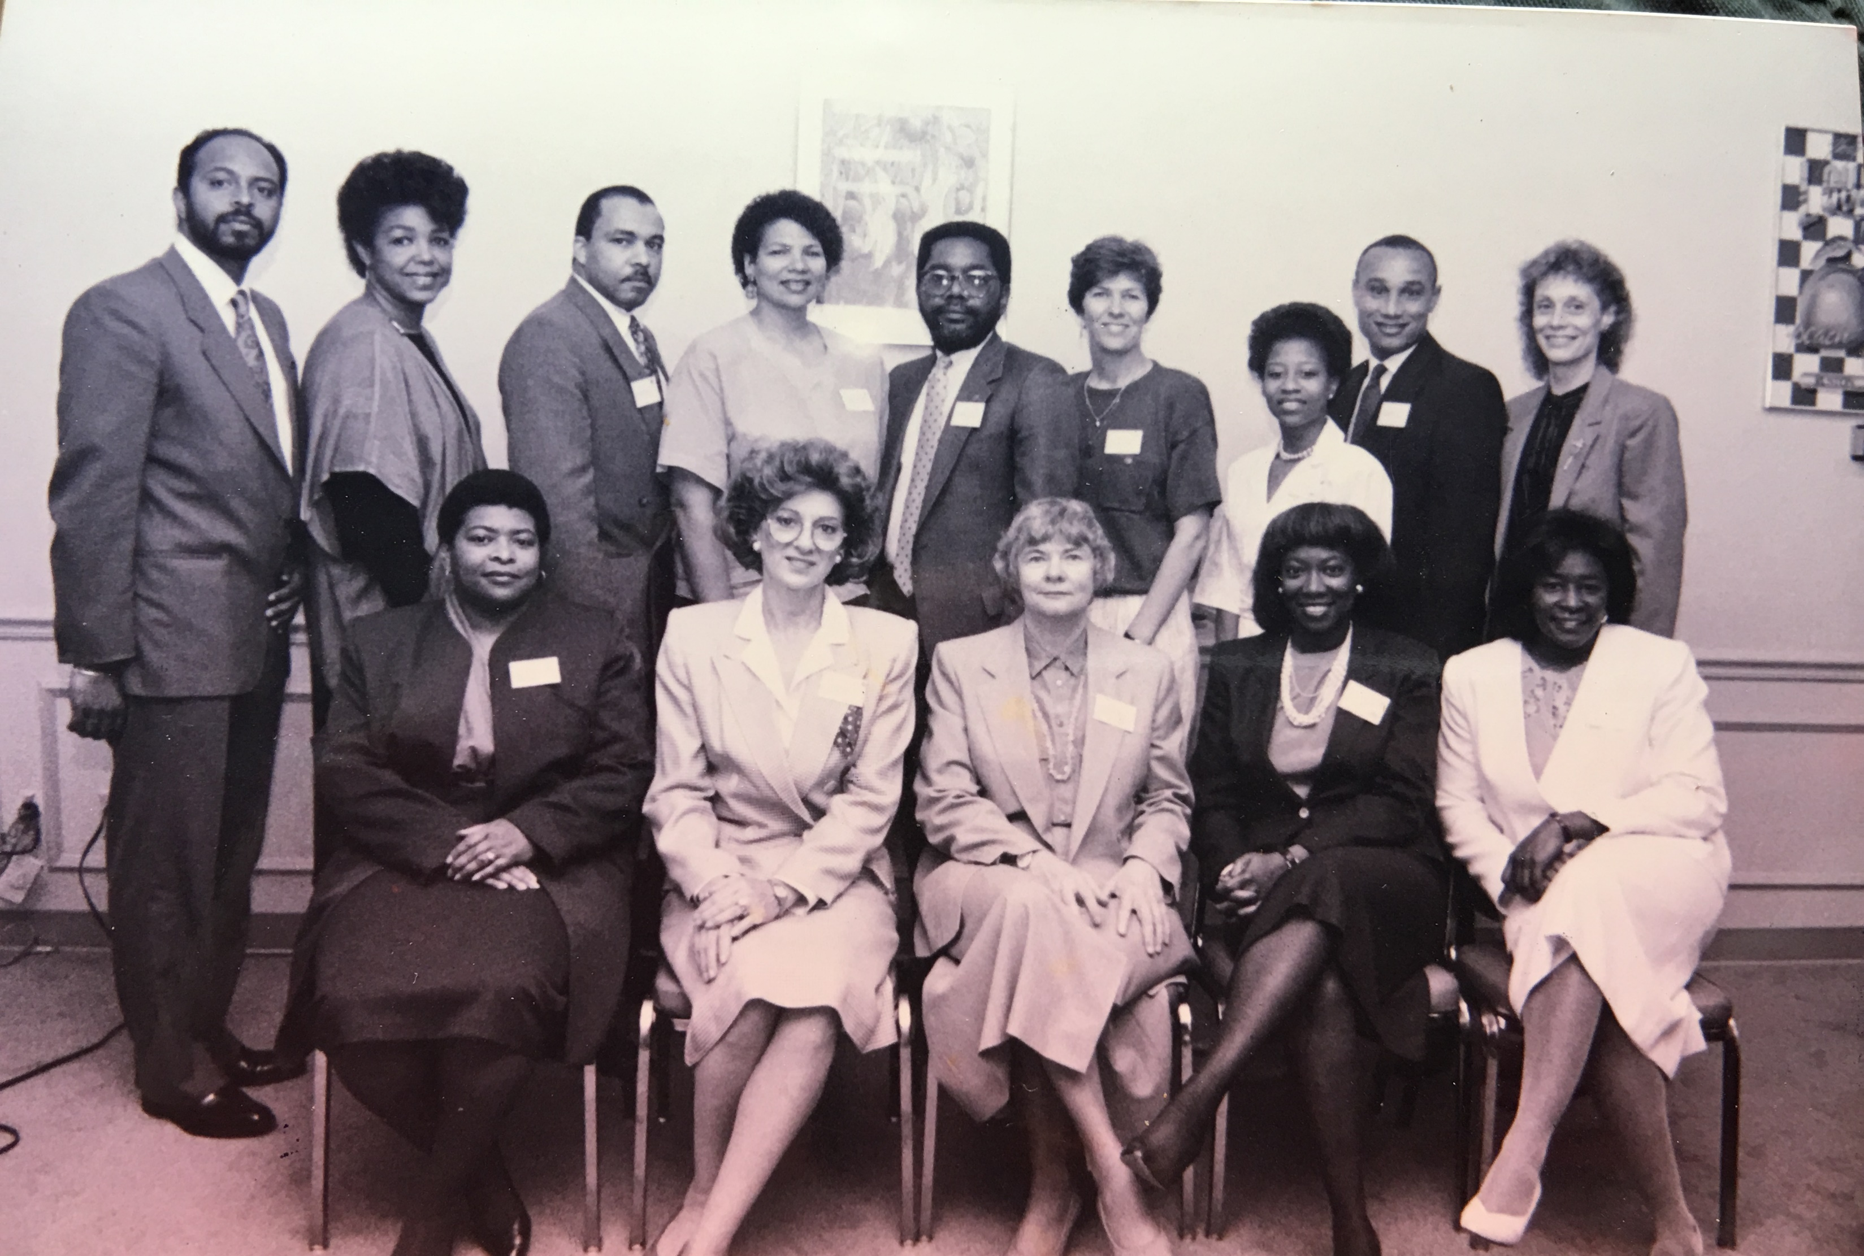
What curriculum topics/themes are needed to develop these skills?
Moving from a mono-cultural mindset to a global mindset
Cultural self-awareness
Culturally-specific knowledge and how it reflects sport governance. Different countries have different sport governance codes.
Socio-linguistic awareness (have a second language)
Global trends and issues in sport
Politics in sport
Emotional intelligence
Social intelligence
Notes:
Moving from a mono-cultural mindset to a global mindset
Cultural self-awareness
Culturally specific knowledge and how it reflects sport governance. Different countries have different sport governance codes.
Socio-linguistic awareness (have a second language)
Global trends and issues in sport
Politics in sport
Emotional intelligence
Social intelligence

Slide 13
What teaching and learning strategies can be helpful in achieving these attributes and skills?

Slide 14
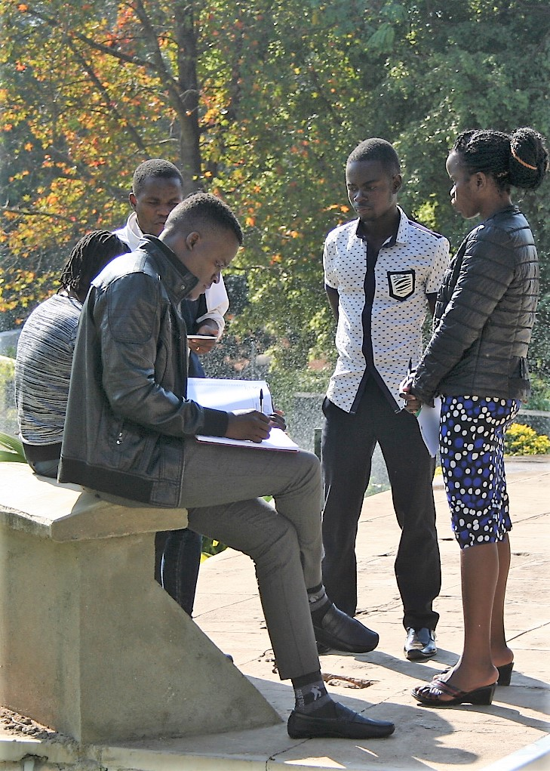
Teaching Strategies
Questioning Styles
Role Playing
Cooperative Learning
Exposure to different languages and cultures
Group discussions
Active learning
Class discussions
Lecturing
Examples
Models
Videos
Podcasts
Webinars

Slide 15
Learning Strategies
Reciprocal questions
Interviews
Muddiest point technique – students write an essay explaining a point/issue they are uncomfortable with
Tests
Debate
Peer teaching
Rotating chair discussions
Assignments
Conceptual/abstract thinking
Ethics, accountability, and integrity
Problem/Challenge solving
Communication
Interpersonal skills
Service to society and community

Slide 16
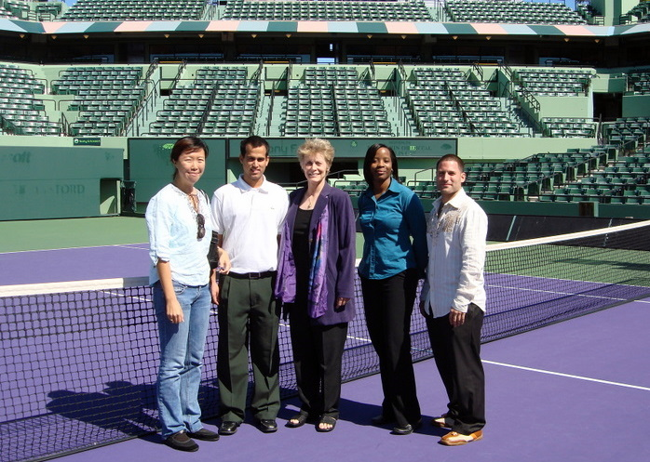
Intercultural sport management competence and curriculum design
How can these topics be incorporated into
sport management curriculum
design?
Theory – Practice
Language

Slide 17
Consideration of Carbon Footprints in a Sport Management Curriculum
Sustainability and the climate crisis – What is the environmental impact of international mobility in sport management students and faculty?
UNESCO data (Rumbley, 2014) – greenhouse gases generated by student mobility were equivalent to Croatia and Tunisia.
Additional research needed on the impact of internationalization on climate change
In the meantime:
Short-term mobility reduction
Erasmus + program (based in Europe) could be used as a model
Education leaders need to be at the forefront – webinars, keynotes online, virtual advisory board and research meetings
Increasing internationalization at home
Notes:
Western societies count large groups of migrants and refugees as opportunities on our own doorsteps.
For UG students, we do not necessarily need to travel far to meet others.
Develop and implement learning strategies that boost internationalization on campuses around the world.
Mobility-driven and elitist internationalization experiences must be shifted to targeting all students through curriculum development and intensive use of technology.
Erasmus+ is the EU's programme to support education, training, youth and sport in Europe. Its budget of €14.7 billion will provide opportunities for over 4 million Europeans to study, train, and gain experience abroad.
Set to last until 2020, Erasmus+ doesn't just have opportunities for students. Merging seven prior programmes, it has opportunities for a wide variety of individuals and organisations.

Slide 18
For more thoughts and discussion, contact: Dr. Darlene Kluka Email: dr_kluka@aol.com

Slide 19
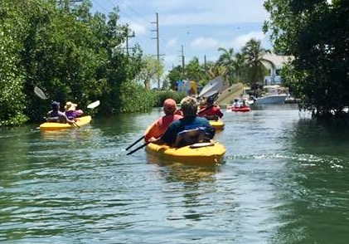
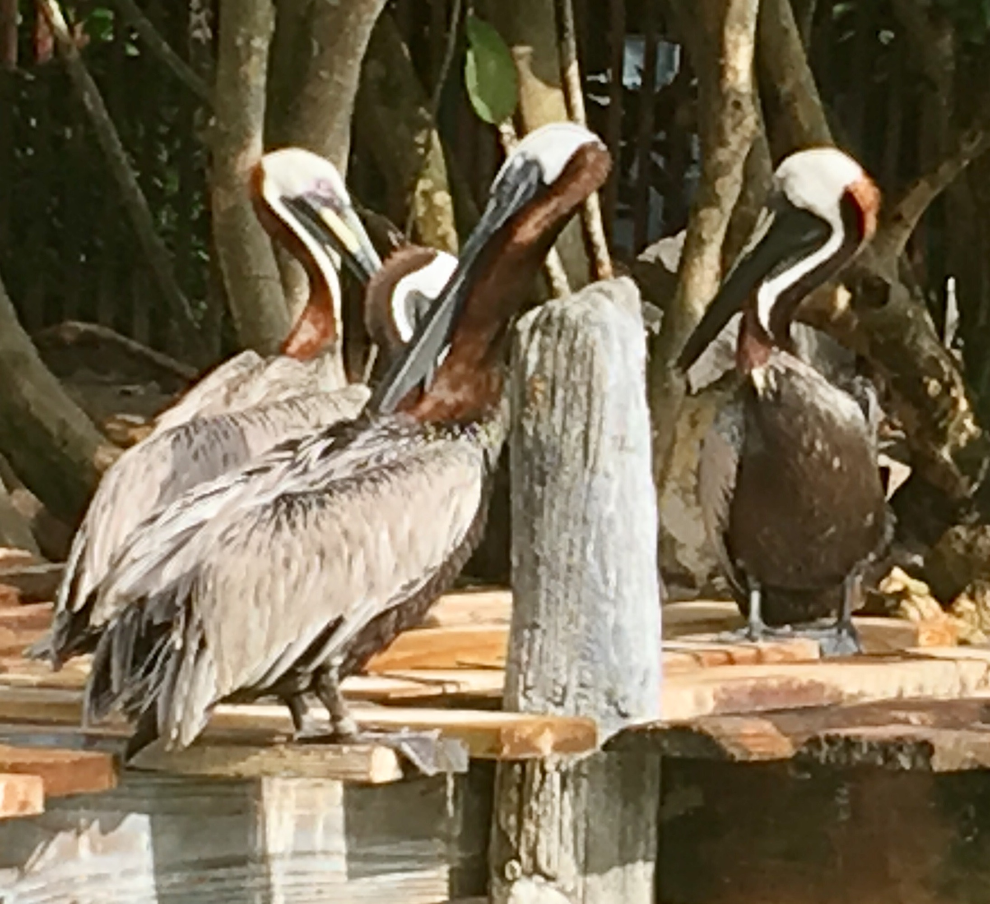

Slide 20
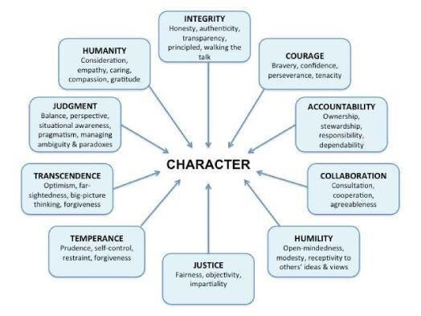

Slide 21
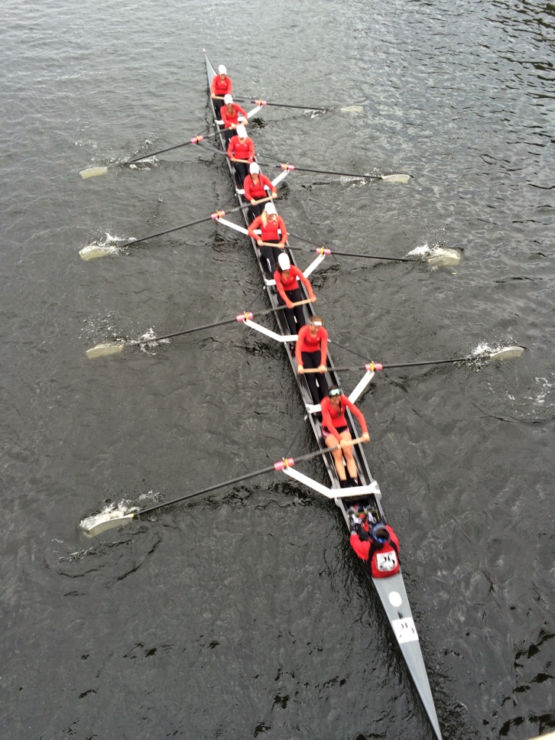

Slide 22
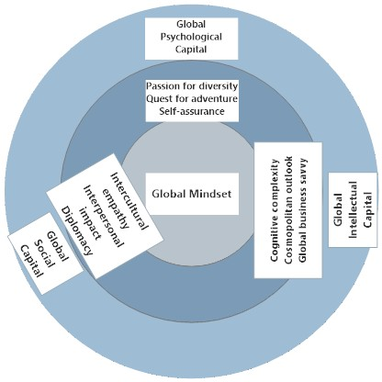
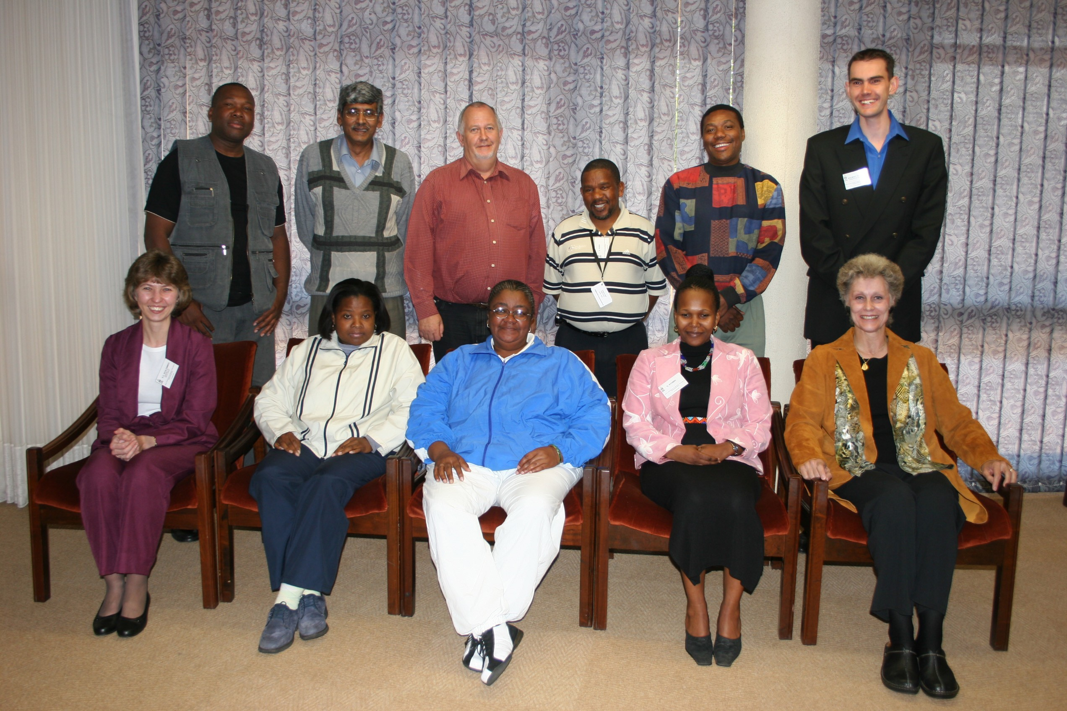

Slide 23
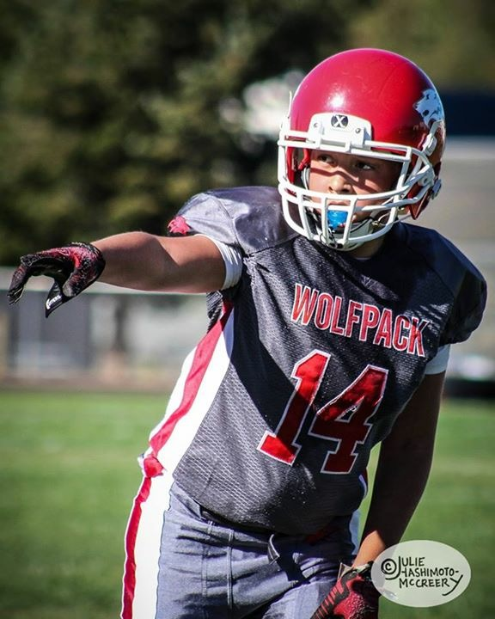
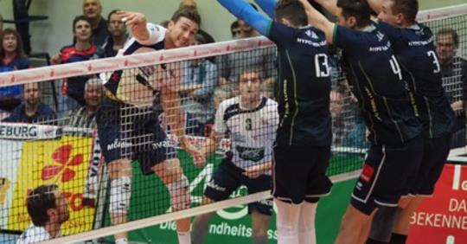
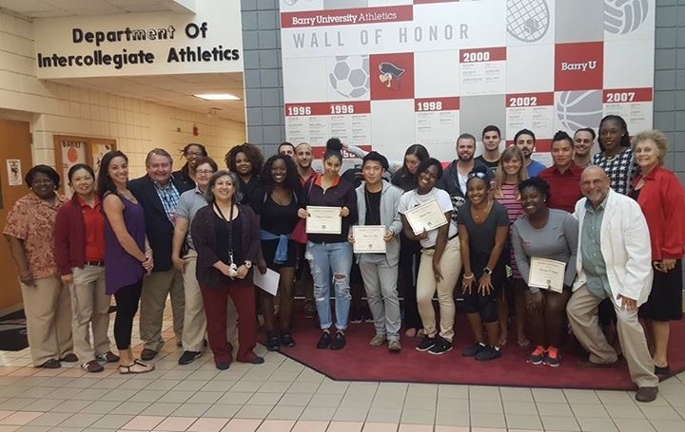
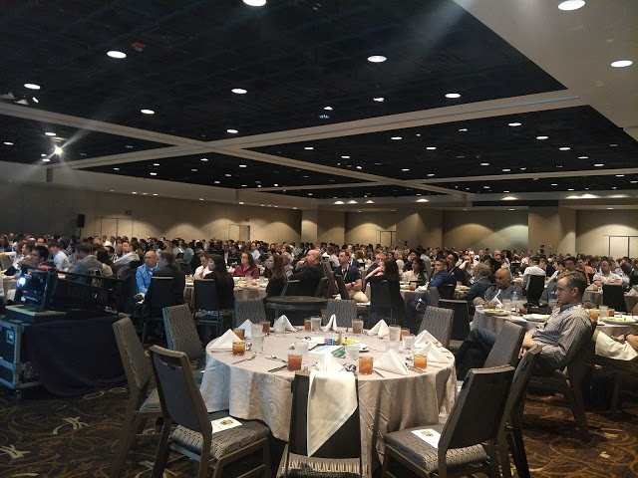

Slide 24
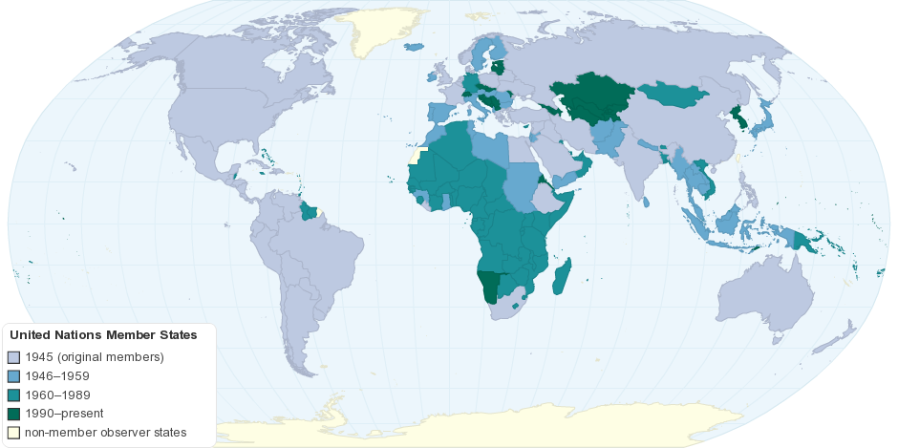
United Nations Member States
Notes:
There is a huge need

