Slide 1
Amanda Zuschmidt February 2022 Houston, TX.
How to Write Student Learning Outcomes like a Pro!

Slide 2
Backwards Design
Process used to design learning experiences & instructional techniques to achieve specific goals

Slide 3
Backwards Design in 3 steps
1. Identify desired outcomes
2. Determine acceptable evidence
3. Plan learning experiences and instruction

Slide 4
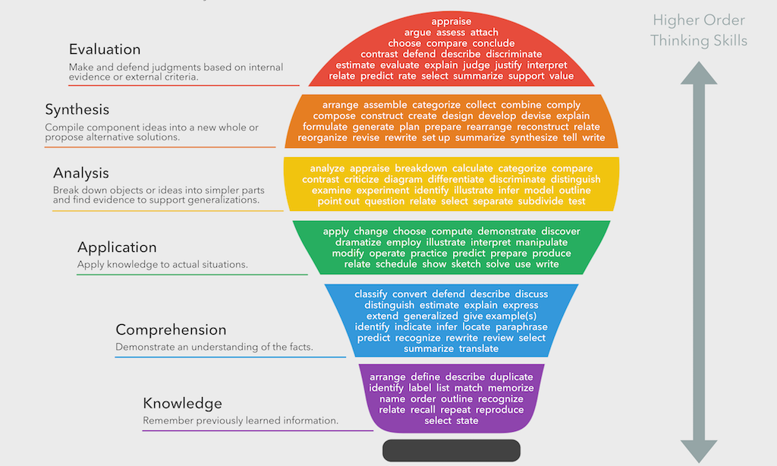
Bloom’s Taxonomy

Slide 5
Revised Bloom’s Taxonomy

Slide 6
Best Practices
Keep them simple and succinct (The student will, etc.)
For COSMA, no more than ten programmatic SLO’s
Avoid the following verbs:
Understand
Know
Remember

Slide 7
LBC Student Learning Outcomes
1. Plan, create and implement a comprehensive sport program for private and public sectors utilizing biblical principles of stewardship and discipleship
2. Demonstrate and apply knowledge of the fundamental principles of sport management
3. Distinguish individual differences and describe all dimensions of diversity.

Slide 8
LBC SLO’s Continued
4. Apply critical and analytical creative thinking skills to solve problems through the integration of management theories
5. Develop the communication skills necessary to disseminate information in a variety of oral, written and electronic formats
6. Interpret regulations and legal aspects relative to the sport profession

Slide 9
Thank you!
Questions?
azuschmidt@lbc.edu

