Slide 1
FOURTH INDUSTRIAL REVOLUTION
HOW CAN WE PREPARE OUR STUDENTS TO LEAD?
Notes:
Higher education, in response to 4IR, must support professors in developing individual student potential and preparing students to become self-learners so they can innovate the world.
The continuous exchange of knowledge between disciplines must be made to facilitate the advancement of human health and well being.

Slide 2
Darlene A Kluka, D Phil, Ph D
Research Associate, University of Pretoria, South Africa
COSMA Board of Directors
Presentation at 2023 COSMA Conference, Tampa, Florida USA
Notes:
The beginning of the Fourth Industrial Revolution is an unrepeatable moment of human history, just as it was with the First, Second and Third Industrial Revolutions. The one who knows and accepts, use and multiply the supporting trends is the one who gains.
Sport sciences, because of their dynamics, must also be prepared to analyze and evaluate processes to find answers to new questions and to address possible negative consequences of the Fourth Industrial Revolution.

Slide 3
Overview
What is the Fourth Industrial Revolution?
Why is it important to prepare our sport management students to lead in this era?
What are emerging jobs and jobs on the decline?
What skills are needed for them to succeed in 4IR?
Is there a theoretical model for 4IR intelligence?
Is their mapping for transformation?
How does 4IR intelligence combine with the Sustainable Goals 2030 from the United Nations?
What are some key takeaways for teaching/learning?
A Call to Action….
Notes:
In 2023, the World Economic Forum’s annual meeting held at Davos was the largest in history. Leaders around the world recognize that globalization needs reimagining, not junking, for two reasons. First, the global economy is highly unlikely to come undone. The McKinsey Global Institute’s recent report finds that the economic ties that bind us are strong and may be impossible to unwind.
Second, today’s biggest challenges are global in nature. Countries everywhere are troubled by the challenges of building resilience in the face of massive disruption (including anticipating future pandemics) and building a system in which everyone prospers. There are no solutions to the world’s largest challenges that do not involve the leaders of the world’s largest companies and national and international policy makers. This includes those of us in the industry of sport management throughout the world.

Slide 4
“We stand on the brink of a technological revolution that will fundamentally change the way we live, work, play, and relate to one another.” - Klaus Schwab (2016)
Notes:
Klaus Schwab is the originator of the term, Fourth Industrial Revolution. He has spurred much excitement and scholarship involving theoretical perspectives and pragmatic solutions to 4IR.

Slide 5
Notes:
This can be used to explain the frontiers of knowledge that can be derived from sport management.

Slide 6
From Industry 1.0 to Industry 4.0 (Industrial Revolutions)
First
1784
Second
1870
Third
1969
Fourth
2015
Based on introduction of
mechanical production
equipment driven by water
and steam power
Based on use of cyber-physical systems
Based on mass production
By division of labor and use of electrical energy
Based on electronics and IT use to further automate production
Source: numerous historical texts discussing the concept of industrial revolution
Notes:
So what is the Fourth Industrial Revolution and why is it important for students in sport management to learn what it is and how to lead?

Slide 7
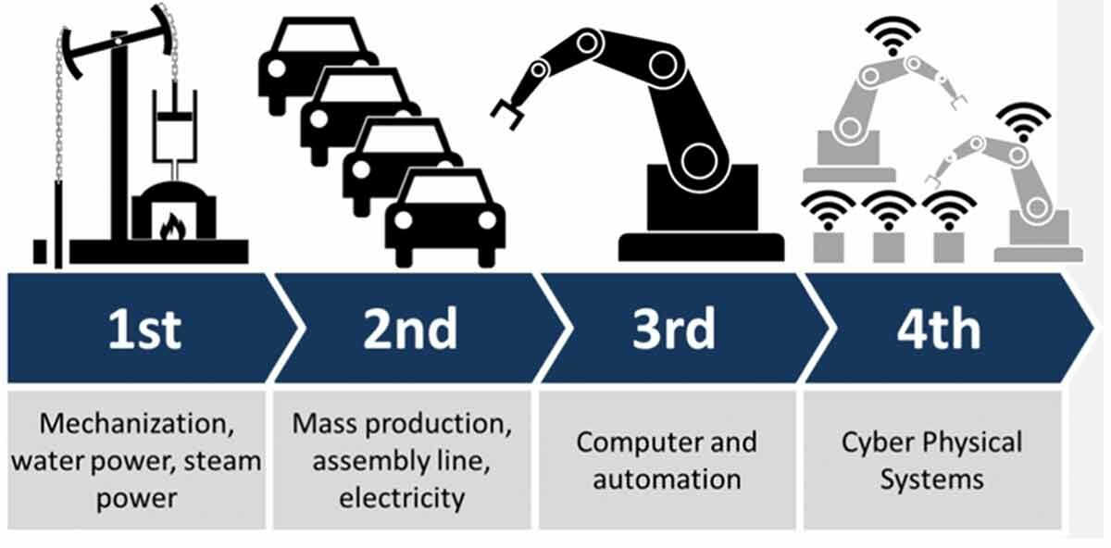
Elements of Your Subject
Another way of looking at 4IR
Cat
Dog
Mouse
Gorilla
Notes:
This is another way of representing the industrial revolutions.

Slide 8
And another way of looking at it…

Slide 9
Rate of Automation
Human Machine
2018 71% 29%
2022 58% 42%
2025 48% 52%
Source: Future of Jobs Report, 2018
World Economic Forum
Notes:
Because automation continues to progress, all sectors of the world are affected. This includes sport and its management. From information on this slide, human labor time dropped from 71 % in 2018 and is predicted to drop to 48 % in 2025. Again, it is predicted that more than half of job-related functions will be conducted by machines and their algorithms by 2025.

Slide 10
World Economics Forum (2022)
Top ten skills in 2015
Top 10 skills in 2020
Complex problem solving
Critical thinking
Creativity
People management
Coordinating with others
Emotional intelligence
Judgment and decision making
Service orientation
Negotiation
Cognitive flexibility
Complex problem solving
Coordinating with others
People management
Critical thinking
Negotiation
Quality control
Service orientation
Judgment and decision making
Active listening
Creativity
Notes:
The latest information, according to the World Economics Forum in 2022, define skills that are related to economic sectors look like this.
What skills will change most?
Creativity will become one of the top three skills people will need. With the avalanche of new products, new technologies and new ways of working, people are going to have to become more creative in order to benefit from these changes.
Robots may help us get to where we want to be faster, but they cannot be as creative as humans (yet).
Negotiation and flexibility are high on the list of skills for 2015, in 2020 they have begun to drop from the top 10 as machines, using masses of data, begin to make decisions for us.
A survey done by the World Economic Forum’s Global Agenda Council on the Future of Software and Society shows people expect artificial intelligence machines to be part of governance of sport boards of directors as early as 2026.
Active listening, considered a core skill today, is predicted to disappear from the top 10. Emotional intelligence will become one of the top skills needed by all as we transform into the future.
Disruption in industry
The nature of change will depend very much on sport and its management. Global media and sport entertainment, for example, has already seen a great deal of change in the past five years.
Financial services and its investment sector, however, has yet to be radically transformed. Those working in ticket sale sales, for example, will need new skills, such as technological literacy.
Some advances are ahead of others. Mobile internet and cloud technology are already impacting the way we work. Artificial intelligence, 3D printing, and advanced materials are still in their early stages of use, but the pace of change will be fast.
Change will not wait for us: sport leaders, educators, and governments need to be proactive in up-skilling and re-educating people so everyone can benefit from the Fourth Industrial Revolution.

Slide 11
Top 10 emerging jobs Data analysis and scientists AI and machine learning specialists General and Operations managers Software/Applications Developers and Analysts Sales and Marketing Professionals Big Data Specialists Digital Transformation Specialists New Technology Specialists Organizational Development Specialists Information Technology Services Top 10 jobs in decline Data Entry Clerks Accounting, Bookkeeping and Payroll Clerks Administrative and Executive Secretaries Assembly and Factory Workers Client Information and Customer Service Workers Business Services and Administration Managers Accountants and Auditors Material-Recording and Stock-Keeping Clerks General and Operations Managers Postal Service Clerks
Emerging – more jobs
Declining – less jobs
(Based upon 2018 information)
Source:
Future of Jobs Report (2018)
World Economic Forum
Notes:
The demand for human skills is not, however, in decline. There is a net positive outlook for jobs despite significant job disruption; skills with distinctly human traits are still in demand. According to the Future of Jobs Report (2018), 75 million current jobs will be displaced by the shift in the division of labor between humans, machines, and algorithms, but 133 million new jobs will also be created.

Slide 12
Theoretical Model of 4IR Intelligence (Klaus, 2016)
Contextual intelligence (Sternberg, 1985) – the ability to quickly and intuitively recognize and diagnose the dynamic contextual variable inherent in an event or circumstance and results in intentional adjustment of behavior to exert appropriate influence in that context (i.e., people, ideas, values, experiences, cultures, political alliances, organizations, religious alignment, social contexts, and private context). Awareness of interactions between sport managers that inform behavior in a socially complex environment – (Kutz & Bamford-Wade, 2013)
Emotional Intelligence (Goleman, 2004) – subset of social intelligence that involves the ability to monitor one’s own and others’ feelings and emotions, to discriminate among them and to use this information to guide one’s thinking and actions. (1) self awareness; (2) self regulation; (3) motivation; (4) empathy; (5) social skill.
Inspired Intelligence (Schwab, 2016) – continuous search for meaning and purpose. Nurturing the creative impulse and lifting humanity in a new collective and moral consciousness based on shared sense of destiny. Forward-looking; possibilities
Physical Intelligence (Postle 1989) – fitness and health, enjoyment of physical activities, pride in manual skills and dexterity, sensible and balanced diet, love of the outdoors, and good at household tasks.
4IR intelligence
Contextual intelligence
Emotional intelligence
Inspired intelligence
Physical intelligence
Notes:
Let’s look at a theoretical model of 4IR that was developed by Klaus in 2016 to think about what is needed to adapt, shape, and harness the potential of disruption by nurturing and applying four different types of intelligence:
Contextual (the mind) – how we understand and apply our knowledge
Emotional – (the heart) – how we process and integrate our thoughts and feelings and relate to ourselves and to one another
Inspired (the soul) how we use a sense of individual and shared purpose, trust, and other virtues to affect change and act towards the common good
Physical (the body) – how we cultivate and maintain our personal health and well-being and that of those around us to be in positions to apply the energy required for both individual and systems transformation.
4IR intelligence – how do I engage in the behavior described as it relates to the four intelligence constructs on this slide?
Sport managers must understand the value of diverse networks across boundaries and develop capacities and readiness to engage with all those related to matters at hand.
I will use the example of emotional intelligence today to give you an idea of how this can be incorporated into lessons. You need to check, however, that all four of the constructs in the theoretical model of 4IR intelligence is included in coursework.

Slide 13
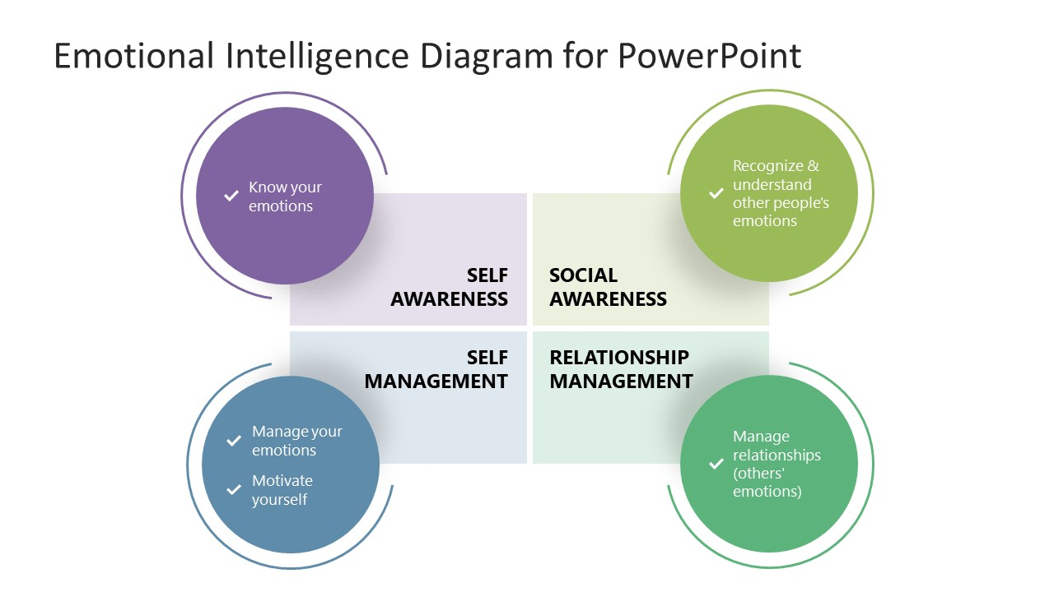

Slide 14
KEY TAKEAWAYS for Sport Managers
TWO: Emotional Intelligence
Understanding, processing, and expressing your feelings. Paying attention, empathizing, and understanding others’ feelings.
ONE: Intercultural Communication
Multicultural context where collaboration required. Self-awareness, active listening and assertiveness, and attitudes like embracing and appreciating differences and similarities between cultures and identities.
FOUR:
Teamwork
The experience is perfect for being part of the creation and fast development of a team. Commitment, trust, acceptance, warmth, confidence, and development of roles affects how a team performs daily and under extreme conditions.
THREE: Critical Thinking
Listening to, understanding, and being able to question viewpoints. Articulating, testing, and clarifying values and beliefs and engaging directly with those of others.
FIVE:
Leadership
Leadership dynamics involve decision making. Voice, participation, engagement, decision making, and empowerment are part of this.
SIX: Responsibility
Everything we do affects the environment. Everything others do can affect us. Training mindfulness helps in this process.
SEVEN:
Courage
Fear can be your worst enemy or your best friend. Cultivate humility and vulnerability, to acknowledge fear. Learn how and when to face it. Tame it and use it to your advantage.
EIGHT:
Resilience
The world is dynamic where plans get constantly altered. Learn to embrace uncertainty, cope with changes and adapt to them.
Notes:
There are numerous activities that have been designed for emotional intelligence and related skills work that have been designed by sport psychologists. Whatever you select, should be enforce understanding, processing, and expressing feelings as well as paying attention, empathizing, and understanding others’ feelings.

Slide 15
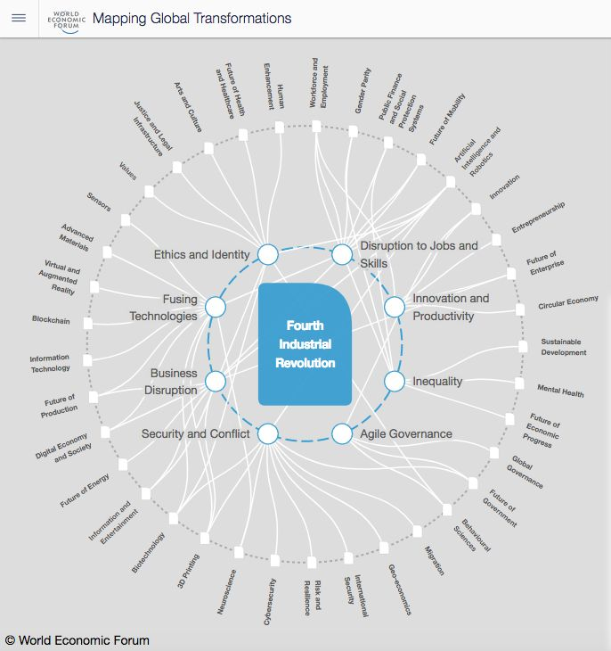
2023 at Davos Factors that impact Areas impacted by
Notes:
This is an example of mapping global transformations created by the World Economic Forum. As you can see, there are many categories that can be used by sport management emerging professionals. I have used this map to provide students with critical thinking exercises. For example, I ask them to select areas that are appropriate for sport management work and ask them to discuss why they have selected each. Or I select those as I have here and ask them to provide examples of how the outer ring can be used in sport management as they relate to the inner ring.

Slide 16
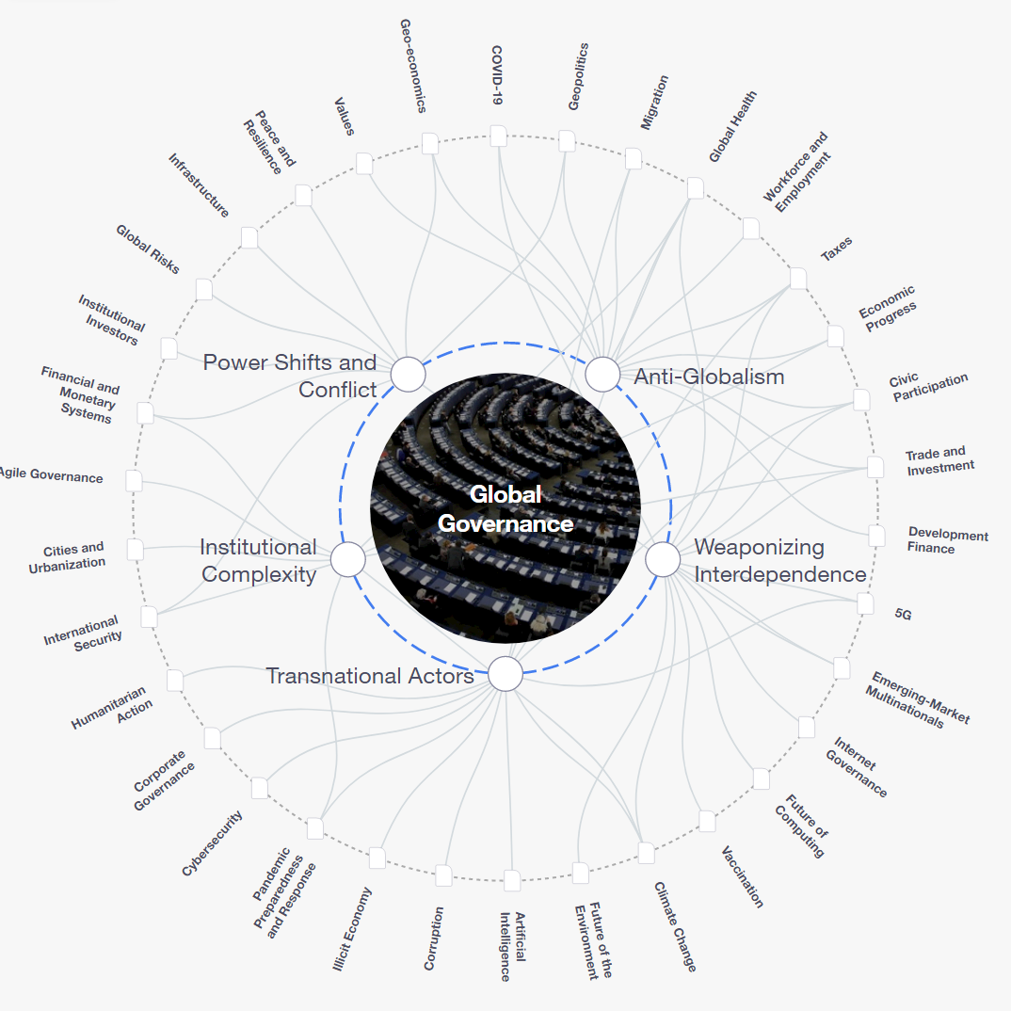
2023 at Davos Factors that impact Areas impacted by
Notes:
This is a sample of what I use in a governance of sport course. You can choose to discuss any of the areas. I have just placed red rectangles around those that are the easiest to apply to sport management.
GO THROUGH AN EXAMPLE

Slide 17
4IR impact on sport for future sport managers to consider
Artificial Intelligence – electronic resources to achieve fitness goals without human-to-human communication
Freeletics
Zwift
Peloton
Mirror
Unique diet plans
Real-time and personalized feedback on exercise and food plans based on needs and situations
Player performance and predictive analysis – wearables, strategies, tactics, and maximization of strengths
Connexion kiosk – health data, including injuries and setbacks
Arccos Caddie – virtual caddie for golfers: wind direction, which club to use, what direction to hit, etc.
Sport Scouting and Recruitment – swings in baseball/softball, runs in football, blocks in basketball are tracked
Sports vision using computers to track players’ movements and body orientation during play (object tracking)
Algorithms – aggregated data to evaluate players’ skills and overall potential by ranking in categories
Sport match prediction – global sport betting (2020: 66.98 billion USD; > 10.1% from 2021 – 2028)
fantasy sports expected to increase 6.11 billion USD between 2022 – 2026
Sport Ticketing – facial recognition technology (Cleveland Browns use Wicket touchless entry system)
Automated sports journalism – so much to cover. AI-driven platforms (Wordsmith) helped AP increase reporting to cover
13 leagues and 14 MLB-affiliated teams
Notes:
These are examples of what is perceived as the possible impact of 4IR on sport for future sport managers to consider.

Slide 18
4IR impact on sport for future sport managers to consider (continued…)
Virtual Reality (VR) –
Much improved experience through VR at home
Will be able to identify with their heroes through VR
Will provide coaches and trainers with a great new coaching tool
Performances will be improved through VR
Sport participation will increase through gamification
Referees will be trained with VR
Blockchain technology – Cryptocurrencies and their use have played a role in partnerships and sponsorships. This will need to be further watched and discussed to determine crypto’s future.
Decentralized autonomous organizations – member-owned communities without centralized leadership
E-sports has topped one billion USD in 2022.
MetaClan pools funds via a DAO bank called the War Chest
Members determine how funds are spent within the gaming communities to explore new games.

Slide 19
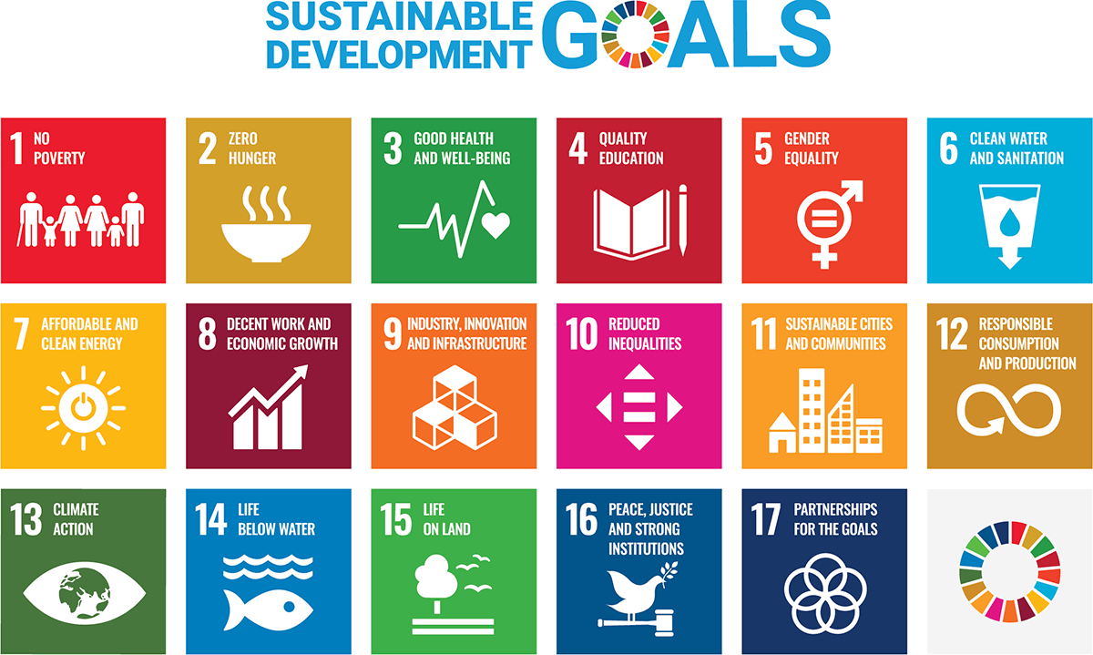
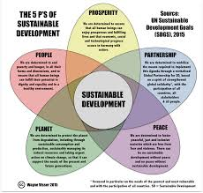
KEY TAKEAWAYS
Notes:
I would like to add one other important pieces of information for us as sport management professors to include as we prepare students to be leaders in the 4IR. The SDGs of the United Nations. How many of you are familiar with these? Sustainable Development Goal Four (SDG4) focuses on quality equitable and all-inclusive education and promotion of lifelong learning opportunities for all. The purpose of this goal is to establish a nation that will facilitate a realization of the full potential of each youngster so that each could contribute to building a just, tolerant, and egalitarian society. The vision of an inclusive quality education is anchored on the understanding of education for all, especially those groups who are seen as vulnerable.
Education is perceived as the first step of sustainable development, lessening poverty, gender equality, and women’s empowerment, as well as human growth. By repositioning all-inclusive education, changes in values, world view, and behavior can be achieved (UNESCO, 2016).
SDG 4 recognizes that “…all people should have access to lifelong learning opportunities.” The right to participate in quality sport, physical activity and physical education: Sport and physical activity are enshrined as a fundamental right in documents such as the International Charter of Physical Education and Sport. High-quality physical education is important to children’s physical literacy and can also create other learning outcomes.
Improved education outcomes: Physical activity is compulsory in schools in 97% of countries but has a lower status than other subjects in more than half of them. This contradicts research showing that well-run sport activities and physical education have positive impacts on learners, including improved academic performance.
Engaging disenfranchised learners: Sport projects can provide an education for people without access to formal education and those who do not perform well or enjoy more traditional approaches.
Prioritizing holistic education: The UN’s targets for SDG 4 expand the concept of education, not only focusing on school-aged students or strict definitions of curricula. Improved health and wellbeing – and the recognition that physical activity is important within that – should be central to any definition of holistic and inclusive education.

Slide 20
Challenges for future sport management leaders
4IR has been evolving in a deeply unequal world. In the Global South, for example, the second or third industrial revolutions are still incomplete.
Unequal trends have emerged.
Increased sport participation, in materially poor communities, can be achieved. Difficult questions must be asked by those who lead.
What is the continued and changing nature of sport?
Who controls the means of sport production?
What inequalities emerge?
What forms of resistance can be mobilized against these inequalities?

Slide 21
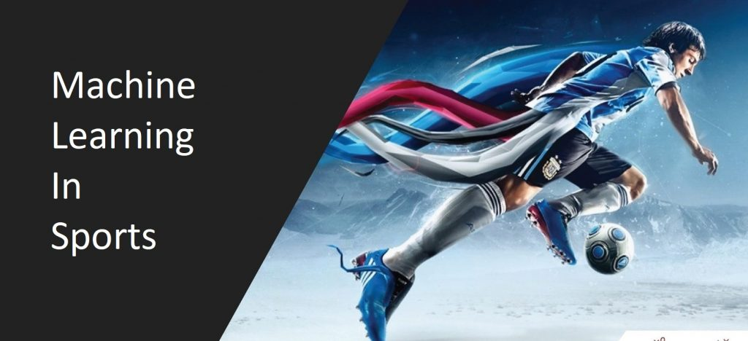
Call to Action for future sport managers
Adapted from Staurowsky and Hart (eds.) (2023) Diversity, Equity, and Inclusion in Sport
Acknowledge the need for learning about 4IR | Dialogues, scrutiny, reflections; challenging assumptions; addressing uncomfortable truths; planning for the future
Develop a compelling vision that includes valuing 4IR | Authentic engagement and commitment; trust, civility, respect; cultivation of excellence
Socialize the acceptance of the vision of 4IR | Embrace technological and human plurality; belief in 4IR as a value that is principle-driven
Manage to actualize the vision of 4IR | 4IR competencies and capacity; integrated into systems, policies, practices; measurable outcomes; accountability, recognition

Slide 22
Additional Resources
Cybersecurity of Olympic Sports, New Opportunities – New Risks. Center for Long-Term Cybersecurity (2018).
Kluka, D. A., Goslin, A. E., & Hsu, N. (2022). Governance of sport: Aspects and insights. Morgantown, WV: FiT Publishing.
Mun, J. H. (2022). Special issue on biotechnology and sport engineering. Applied Science, 12, 7859. https://doi.org/10.3390/app12157859
Oosthuizen, HJ. H. (2018). An assessment of 4IR intelligence of South African management practitioners through the lens of the 4IR. http://www.researchgate.net/publication/308785077.
Ossai, A. G. (2022). Sustainable development goal four: Challenges and the way forward. Article 4839. https://doi.org/10.20935/AL4839.
Report of Cybersecurity of Olympic Sports (2017). World Economic Forum
Report of the Future of Jobs (2018). World Economic Forum

