Slide 1
Best Practices in Assessment in Sport Management Education
Heath Hooper, Ph.D. Shorter University
Bob Stinchcomb, Ed.D. CMAA, Shorter University
Lauren Duplantis, Ph.D, Shorter University
Notes:
NOTE:
To change the image on this slide, select the picture and delete it. Then click the Pictures icon in the placeholder to insert your own image.

Slide 2
Introduction
Shorter University Department of Sport Management Mission
The Department of Sport Management and degree program at Shorter University is a product of a very robust College of Business. The Department of Sport Management is built upon sound business principles with an emphasis in the sport industry sector. We are committed to the relationship between sport and business through learning avenues that engage and prepare future leaders in our industry. We strive to enhance character, Christian values, diversity, and professionalism throughout the curriculum and experiential learning activities.
The Purpose
To effectively practice and develop an assessment plan for the departmental and students in order to promote excellence in sport management education.
The objective is to effectively assess four departmental and four student learning outcomes on a year to year basis.
Assessment Areas
Departmental Outcomes
Student Learning Outcomes (SLO’s)

Slide 3
Department of Sport Management
Goals for Assessment
Develop departmental outcomes evaluation to better assess our responsibilities and duties.
Develop measures and criteria for Student Learning Outcomes evaluation in order to asses student progression towards stated objectives.
Integrate strategies for continuous improvement in accordance with COSMA Principals.
Create a developmental approach to excellence in Sport Management Education.
Assessment – 2015-2016 Academic Year (Traditional students enrolled in the traditional Bachelor of Business Administration (BBA) in Sport Management.

Slide 4
Assessment Cycle for Sport Management Program
Establish Set of Outcomes
Generate improvement
Align objectives with outcomes
Evaluate data and assessment
Assess Outcomes and measures
Gather and assess the data

Slide 5
Departmental Assessment Pieces Defined
Advising
During the 2015-2016 academic year, traditional students enrolled in the traditional BBA in Sport Management will be academically advised by the Department of Sport Management Faculty. After the completion of the advising, the student will then be sent a satisfaction survey via email.
Teacher Evaluations
During the 2015-2016 academic year, faculty will be evaluated by the students at the completion of every course. Students will complete end of course evaluations for each course on the instructor of the course. Evaluations will be studied to show improvements needed to be made for courses and self-evaluations for each instructor.
Community Relations
During the 2015-2016 academic year, the faculty will develop strategies and outreach opportunities to communicate and gain new opportunities for students outside of Shorter University. Community relations outcome will be measured on how many new sport organizations as a department we can establish a relationship with for future opportunities
Student Communication
During the 2015-2016 academic year, the faculty of the Department of Sport Management will develop and implement communication strategies for current traditional students. Student communication will be measured on the amount of students we have sign up for Remind 101 Text Message Application, in which we send out Sport Management news, updates and opportunities for our students.

Slide 6
Student Learning Outcomes Assessment Pieces Defined
Writing Assessment
Students enrolled in B.B.A. Sport Management traditional program should exhibit excellent writing skills upon graduation of the program. During the 2015-2016 academic year, students will be assessed in several classes based on writing specific assignments. A writing rubric has been developed by the faculty and will be used to measure this learning outcome.
Presentation Assessment
Students enrolled in B.B.A. Sport Management traditional program should exhibit excellent professional presentation skills upon graduation of the program. During the 2015-2016 academic year, students will be assessed in several classes based on professional presentation specific assignments. A presentation rubric has been developed by the faculty and will be used to measure this learning outcome.
Experiential Learning
Students enrolled in B.B.A. Sport Management traditional program should exhibit a transfer of classroom knowledge during experiential learning activities required during the program. During the 2015-2016 academic year, students will be assessed during final evaluations of experiential learning activities (Internship or Practicum). A final experiential learning rubric has been developed by the faculty and will be used to measure this learning outcome.
Creative & Critical Thinking
Students enrolled in B.B.A. Sport Management program should exhibit excellent creative thinking skills and competencies upon graduation of the program. During the 2015-2016 academic year, students will be assessed in several classes based on creative thinking assignments. A Creative Thinking Value rubric developed by the Association of American Colleges and Universities has been chosen by the faculty to measure this learning outcome.

Slide 7
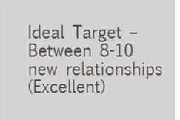
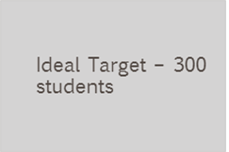
Assessment #1: Departmental Outcomes
1) Advising Satisfaction
Advising satisfaction survey
Acceptable Target –100% satisfaction with a 70% response rate from advising appt.
Ideal Target – 100% Satisfaction with an 85% response rate from advising appt.
2) Teaching Evaluations
End of Couse Evaluation
Acceptable Target – Average score of 4/5
Ideal Target – Average score of 4.5/5
3) Community Relations
Establishing relationships within local community
Acceptable Target – 8-10 new relationships (excellent)
4) Student Communication
Remind 101 Text Sign up
Acceptable Target – 100 students
Assessment Piece:
Acceptable Target:
Ideal Target:

Slide 8
Departmental Outcomes: Methods of Assessment
Advising Satisfaction Survey
https://docs.google.com/forms/d/e/1FAIpQLSdRunbatpnCjn6dbgFJi3hUIz3a7eNKzkoc_Pl26nx2Z33BlA/viewform

Slide 9
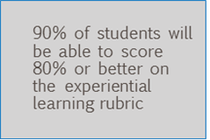
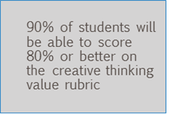
Assessment #2: Student Learning Outcomes
1) Writing Assessment
College of Business Writing Rubric
80% of students will be able to score 80% or better on the writing rubric.
90% of the students will be able to score 80% or better on the writing rubric.
2) Presentation Assessment
College of Business Presentation Rubric
90% of students will be able to score 80% or better on the presentation rubric
3) Experiential Learning
Experiential Learning Rubric for internship/practical experience.
80% of students will be able to score 80% or better on the experiential learning rubric
4) Creative & Critical Thinking
Creative Thinking Value Rubric
80% of students will be able to score 80% or better on the presentation rubric.
80% of students will be able to score 80% or better on the creative thinking value rubric
Assessment Piece:
Acceptable Target:
Ideal Target:

Slide 10
Student Learning Outcome Assessment Rubrics

Slide 11
Assessment #2: Student Learning Outcomes

Slide 12
Departmental Outcome Assessment Results
Advising Satisfaction
N = 36 out of 41 (88%) students took survey
Results indicate 100% of students stated their advisor more than adequately met the students’ needs and provided ample time.
Acceptable Target Met
Teaching Evaluations
N = 43 students assessed
Avg. satisfactory score (N = 4.88 out of 5.0)
Ideal Target Met
Community Relations
Number of new relationships established
N = 11 new partnerships with sport organizations.
Ideal Target Met
Student Communication
Remind 101 Sign up
2014-2015 (N = 34)
2015-2016 (N = 133)
Acceptable Target Met

Slide 13
Student Learning Outcomes Assessment Results
Writing Assessment
N = 52 students assessed in SPM 4350 Sport Ethics & SPM 4700 Event & Facility Management.
88% of students scored 80% or higher on the assessment .
Acceptable Target Met
Presentation Assessment
N = 34 students assessed in SPM 1500 Intro to Sport Management.
85% of students scored 80% or higher on the assessment.
Acceptable Target Met
Experiential Learning
N = 20 students assessed in SPM 3901 Sport Practicum & SPM 4050 Internship.
100% of students scored 80% or higher on the assessment.
Ideal Target Met
Creative & Critical Thinking
N = 38 students assessed in SPM 3600 Sport Marketing & SPM 3360 Sport Communication.
79% of students scored 80% or higher on the assessment.
Acceptable Target not met

Slide 14
Conclusions
Indication of areas in which the Sport Management Faculty is thriving with the students and opportunities.
Enrollment growth as a program
Communication
Establishing relationships
Areas in need of improvement
Creative & critical thinking skills
“Norming session”
New method of assessment can help alleviate the low %
Student Development
Practical Experience
International Exposure
Going forward….
Produce evidence of basic skills development through the curriculum and evidence of personal development within each student

Slide 15
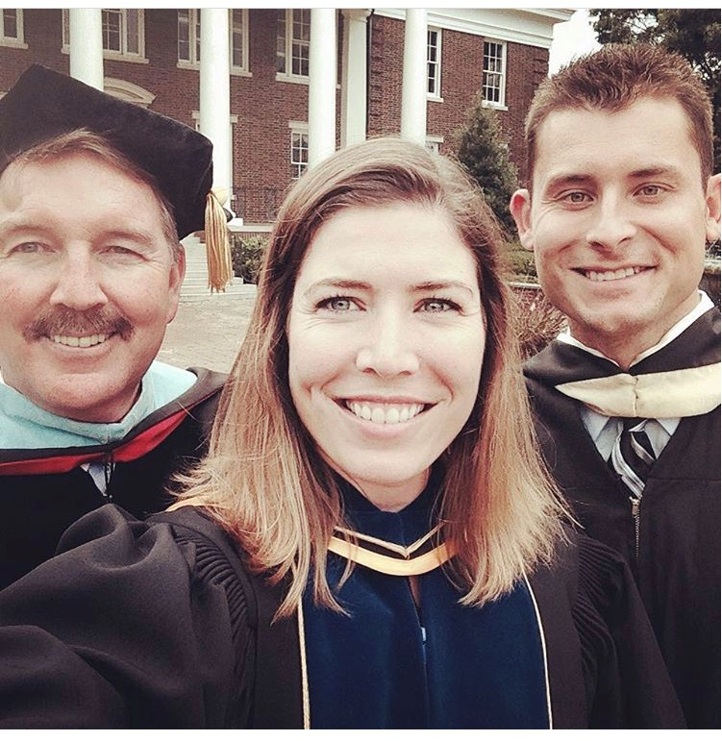
The End THANK YOU!!!
Heath Hooper
hhooper@shorter.edu
706-292-3906
Bob Stinchcomb
rstinchcomb@shorter.edu
Lauren Duplantis
lduplantis@shorter.edu

