Slide 1
Can Sharing a Meal with Your Students Make a Difference?
Presenter
Dr. Kevin Ayers
Radford University

Slide 2
Introduction
    The purpose of this study was to determine if a social intervention (breakfast or lunch) between a faculty member and students could improve student learning outcomes, student averages, student effort, and improve overall course perceptions.
    Studies of high impact practices cite the importance of direct contact between the college professor and the student.
    Students who attain a sense of belonging through a positive faculty/student relationship are more likely to be retained and can experience positive effects on student learning (Klingo et al, 2014; O’Keefe, 2013; Swecker, Fifolt & Searby, 2013; Morrow, et al., 2012).

Slide 3
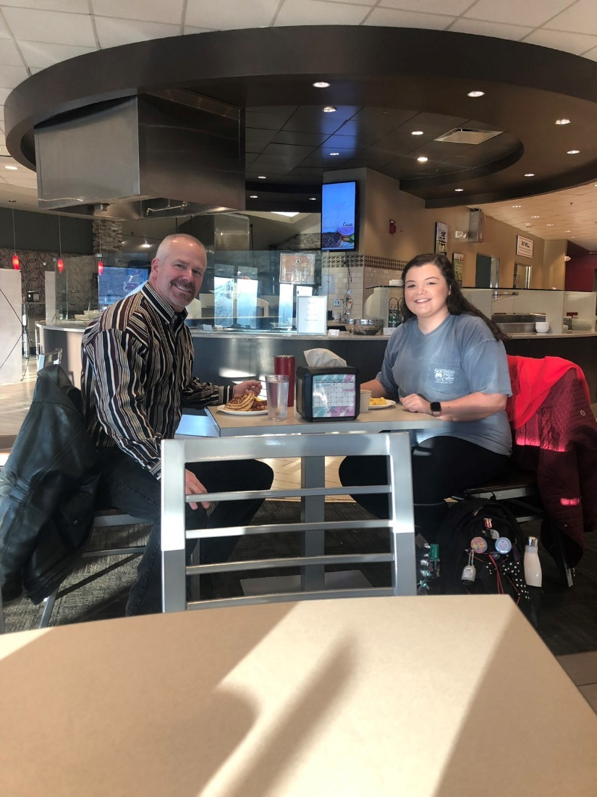
Introduction
Will a social intervention improve:
Learning (class average)
Effort
Retention
Enjoyment

Slide 4
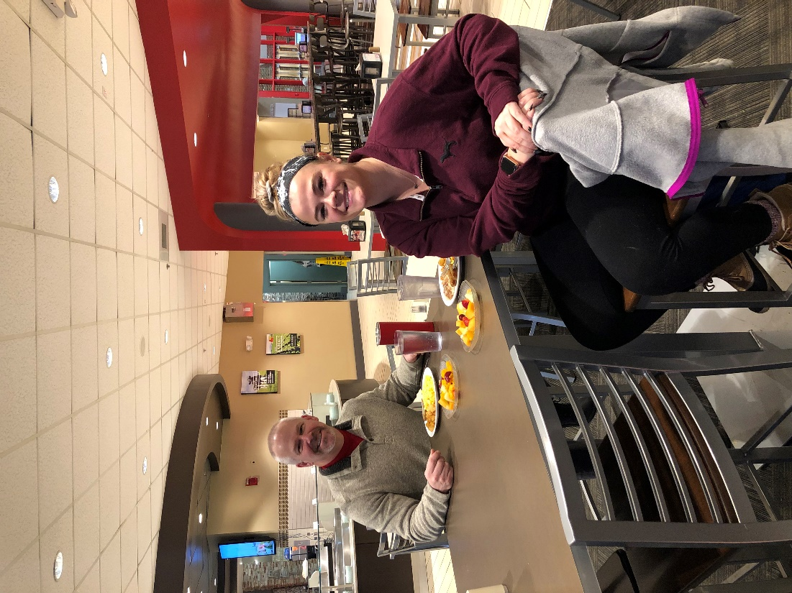
Class Description
Introductory course in Sport Management
Mostly majors (65%)
Minors (20%)
Undecided and elective (15%)
Two sections taught each fall and spring semester
Males (70%)
Female (30%)
~40 to 60 students per semester

Slide 5
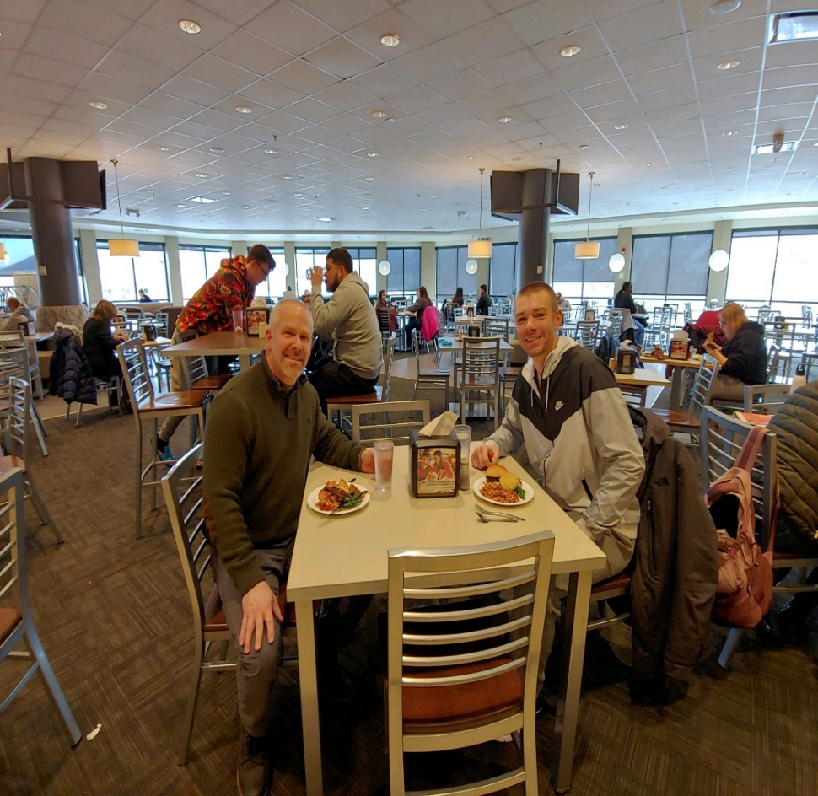
Class Description
Course historically has a high Withdrawal, Grade of D and Grade of F (WDF) rating.
Most often cited complaint by students is the amount of work required
Attendance policy is strict and ~50-60% of students who complete course never miss a class.

Slide 6
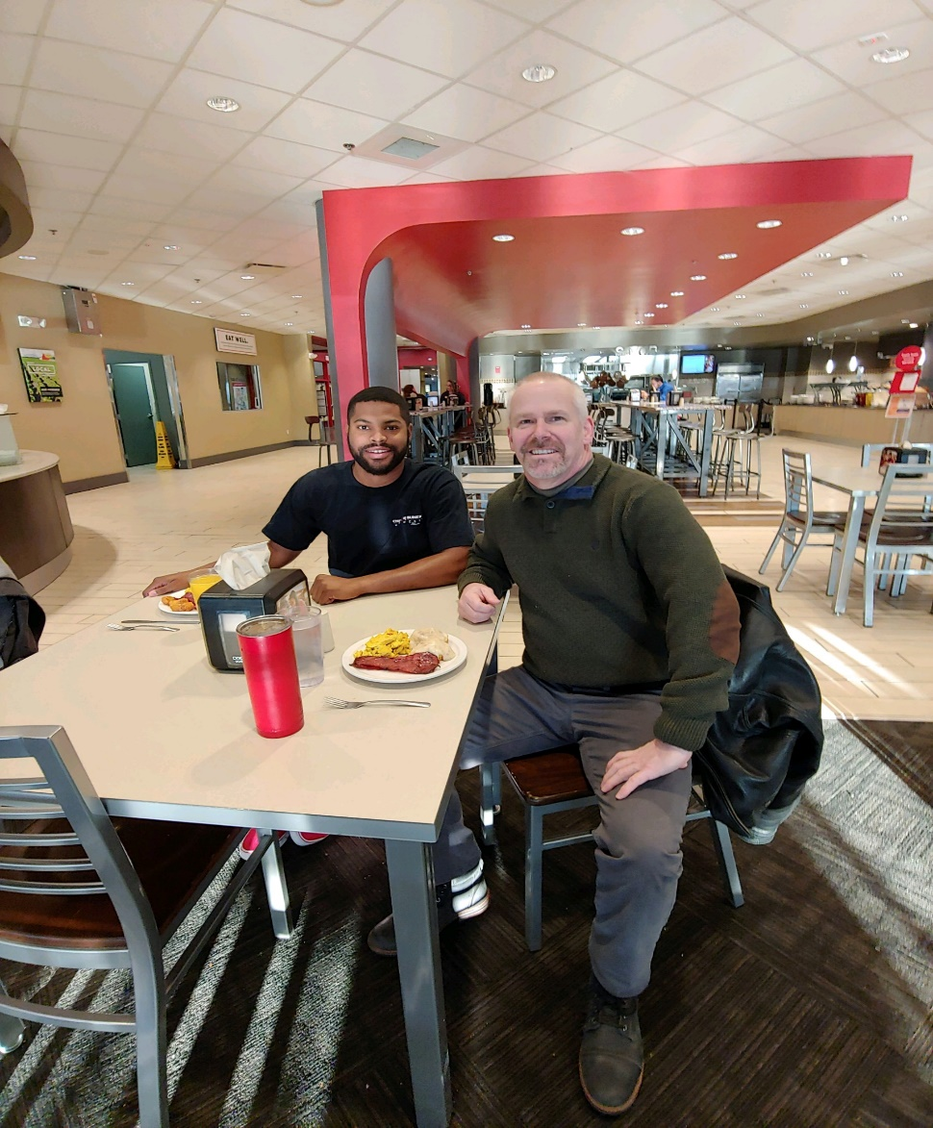
The Meal
Sign up for breakfast or lunch in week 1 of semester
Lunch on Dr. Ayers
Students can talk about anything
I ask questions and listen
Topics generally about family and future plans
Rarely talk about classes or specific assignment

Slide 7
Methodology
Fall 2017 one class section had meal intervention (N-27) while the other section did not (N-25).
Student evaluations were evaluated.
Student evaluations cover three primary areas
  Global Index Score (Course and Professor)
  Instructor Evaluation (Professor 7Q’s)
  Course Evaluations (Course 5Q’s)
Student perceptions are recorded on a five point Likert scale

Slide 8
Methodology
In addition to the three general evaluation areas, the author analyzed two questions specifically.
  “I learned a great deal in the course”
  “I put in a great deal of effort into this course”
Additionally, class averages were compared to analyze any impact on learning outcomes.
The two sections for fall 2017 were compared and the intervention section was also compared to historical data dating back to the spring 2012 semester.

Slide 9
Results (Table 1)
Semester Year Section | N | Global Index | Instructor Evaluation | Course Evaluation
*F17 02 | 14 | 4.72 | 4.70 | 4.73
F17 01 | 19 | 4.47 | 4.49 | 4.47
Collective Evaluation Averages S12-S17 *(5 years total) | 466 | 4.38 | 4.41 | 4.36

Slide 10
Results Students Self-Reporting and Class Averages Table 2)
Semester Year Section | N | Learned a lot | Great Effort | Class Averages | Absolute Deviations
*F17 02 | 14 | 4.71 | 4.50 | .838 | .157
S17 01 | 19 | 4.47 | 4.26 | .834 | .118
Collective Evaluation Averages S12-S17 *(5 years total) | 466 | 4.32 | 4.24 | .821 | .112

Slide 11
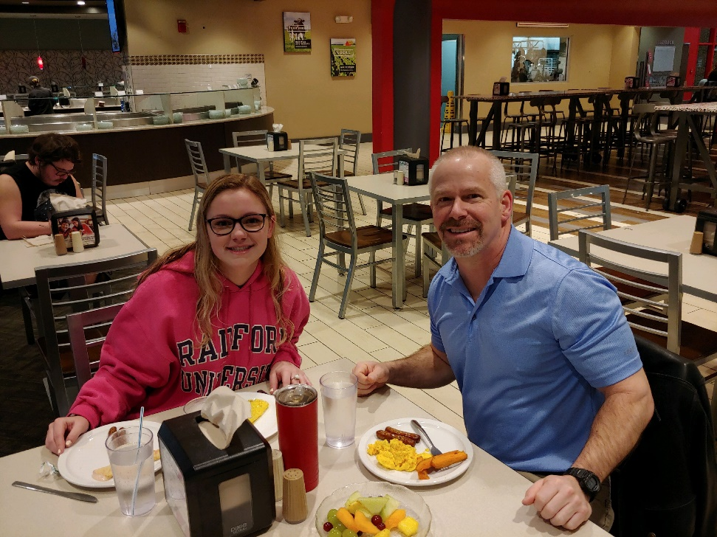
Results
Student perception rankings for the intervention course were higher on the Global Index Score (4.72), the Instructor Evaluation Score (4.70), & Course Evaluation Score (4.73) as compared to the control class section which rated these areas (4.47, 4.49, and 4.47) respectively & the historical ranking scores of (4.38, 4.41 and 4.36) respectively.
Notes:
52% Not sure or answered no

Slide 12
Results
Student perception rankings for the items; I learned a great deal in this course (4.71) and I put a great deal of effort into this class (4.50) were also higher in the intervention class as compared to the nonintervention class which scored (4.47) and (4.26) respectively and the historical ranking average of (4.32) and (4.24) respectively.
The class average for the intervention class was (.838) and was slightly higher than both the nonintervention class (.834) and the historical average of (.821).

Slide 13
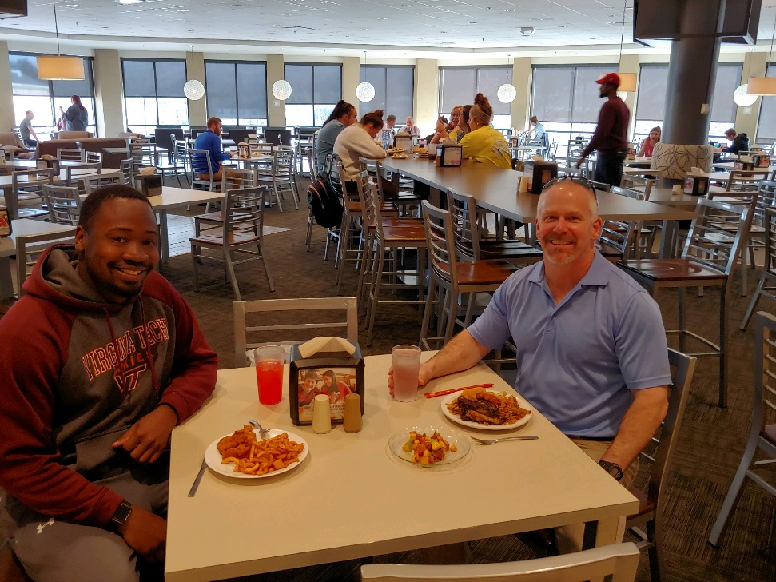
Results
Unfortunately, class averages were not significantly higher in the intervention course.
The instructor continued the experiment for the next four semesters.
Results were similar to the initial study.

Slide 14
Results (Table 3)
Semester Year Section | N | Global Index | Instructor Eval | Course Eval | Learned a lot | Great Effort | Class Average
F1801 | 11 | 4.65 | 4.64 | 4.65 | 4.55 | 4.73 | 0.835
F1802 | 16 | 4.5 | 4.62 | 4.38 | 4.56 | 4.56 | 0.837
S1801 | 15 | 4.58 | 4.62 | 4.56 | 4.47 | 4.42 | 0.836
S1802 | 14 | 4.51 | 4.65 | 4.52 | 4.67 | 4.45 | 0.824
F17 01 | 19 | 4.47 | 4.49 | 4.46 | 4.47 | 4.26 | 0.834
F17 02 | 14 | 4.72 | 4.70 | 4.73 | 4.71 | 4.50 | 0.838
S17 01 | 5 | 4.31 | 4.24 | 4.38 | 4.5 | 4.2
S1702 | 10 | 4.6 | 4.56 | 4.64 | 4.5 | 4.5 | 0.749
F1601 | 23 | 4.42 | 4.53 | 4.31 | 4.21 | 4.37
F1602 | 24 | 4.32 | 4.39 | 4.23 | 4.19 | 4.26 | 0.842
S1601 | 20 | 4.23 | 4.21 | 4.25 | 4.17 | 4.35
S1602 | 25 | 4.18 | 4.19 | 4.16 | 4.08 | 3.96 | 0.785
F1501 | 22 | 4.44 | 4.38 | 4.49 | 4.53 | 4.21
F1502 | 18 | 4.36 | 4.38 | 4.33 | 4.22 | 4.11 | 0.82
F1401 | 15 | 4.05 | 4.08 | 4.01 | 4 | 4.29
F1402 | 27 | 4.47 | 4.48 | 4.46 | 4.35 | 4.38 | 0.806
S1401 | 23 | 4.23 | 4.31 | 4.21 | 4.22 | 4.19
S1402 | 23 | 4.17 | 4.22 | 4.26 | 4.09 | 4.16 | 0.834
F1301 | 19 | 4.33 | 4.42 | 4.24 | 4.21 | 4.11
F1302 | 22 | 4.37 | 4.42 | 4.36 | 4.32 | 4.21 | 0.862
S1301 | 26 | 4.41 | 4.49 | 4.4 | 4.21 | 4.18
S1302 | 25 | 4.55 | 4.6 | 4.5 | 4.5 | 4.3 | 0.817
F1201 | 23 | 4.38 | 4.44 | 4.32 | 4.3 | 4.17
F1202 | 27 | 4.46 | 4.55 | 4.37 | 4.58 | 4.19 | 0.824
S1201 | 29 | 4.39 | 4.47 | 4.31 | 4.36 | 4.13
S1202 | 27 | 4.45 | 4.46 | 4.45 | 4.35 | 4.17 | 0.845
Total N | 522
Intervention |  | 4.572 | 4.620 | 4.550 | 4.572 | 4.487 | 0.834
Nonintervention |  | 4.378 | 4.410 | 4.358 | 4.321 | 4.236 | 0.821

Slide 15
Discussion
This study suggests that student perceptions of courses and instructors can be positively influenced by a social intervention with the instructor. It also indicates that students perceive that they work harder and learn more when a social intervention with the course instructor takes place. Unfortunately, there was no significant improvement on final grades with the introduction of a social intervention.

Slide 16
Discussion
Another important outcome of this study was how much the instructor enjoyed getting to know his students better. It was one of the most enjoyable semesters this instructor has ever had in his twenty plus years of teaching at the collegiate level. Currently, all students enrolled in the Introduction to Sport Management class are invited to share a meal with their instructor.

Slide 17
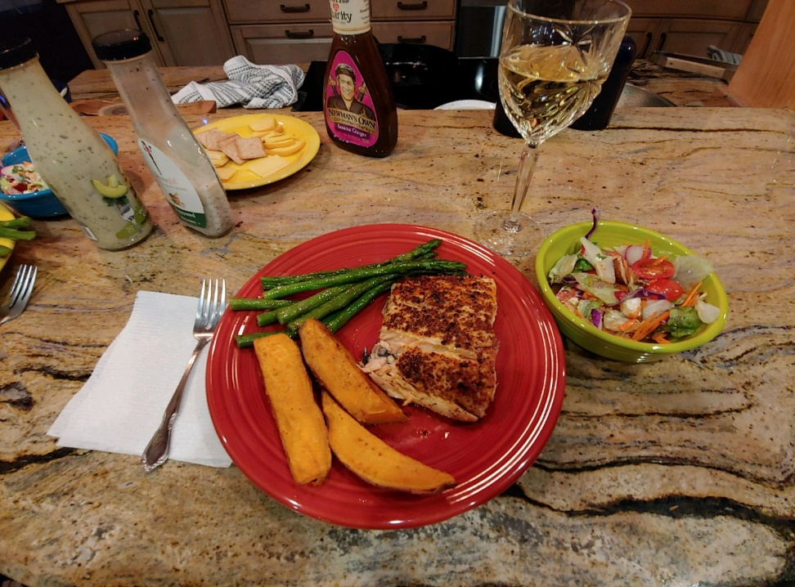
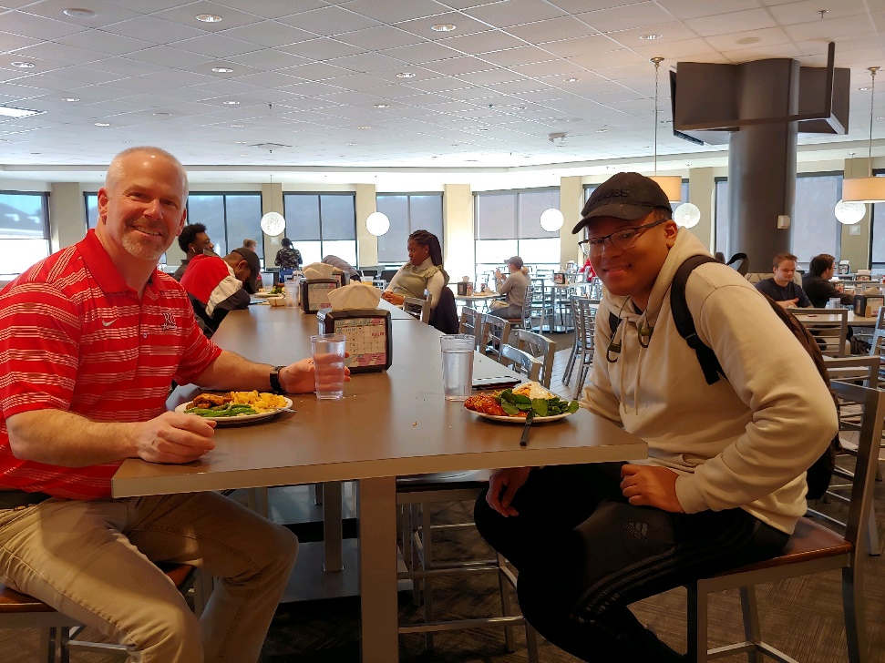
Bon appetit!
Questions?

