Slide 1
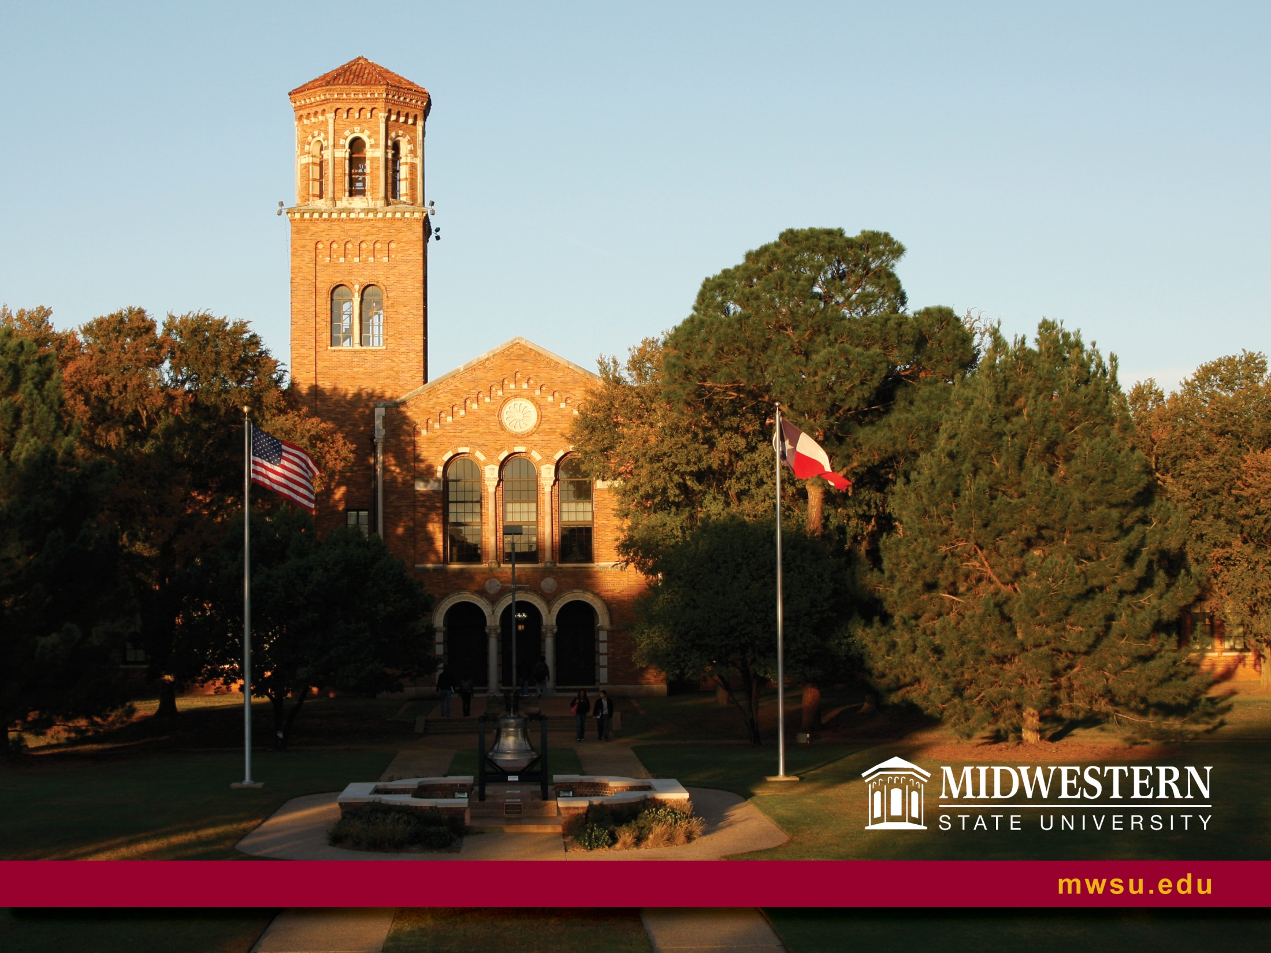
Community Partnerships for Experiential and Service Learning
Dr. Sandra Shawver
COSMA Conference
February 7 – 9, 2019

Slide 2

Outcomes
Describe benefits and challenges of providing a field experience in cooperation with a public school district special needs population.
Identify practical approaches, challenges and insights to facilitating undergraduate learning to work with special needs population as an instructor.
Identify practical approaches, challenges and insights to facilitating undergraduate learning to work with special needs population as an instructor.

Slide 3
Purpose
To bring to our student population hands-on practice with a diverse population (grades, abilities and prior experience) in a low risk setting.
To gain experience in assessment, planning, leading and adapting as a teacher or coach.
Working with classroom teachers and para professionals in the field of adapted physical education.
Learning that someone with a special challenge is really no different from them.

Slide 4
Program Goals
Increase the quality of education provided to the Kinesiology students to ensure they have essential competencies in chosen careers.
Foster skill building and increase knowledge for planning and leading physical education, fitness, and sport activities for special needs population.
Engage undergraduates to volunteer with Special Olympics locally.

Slide 5
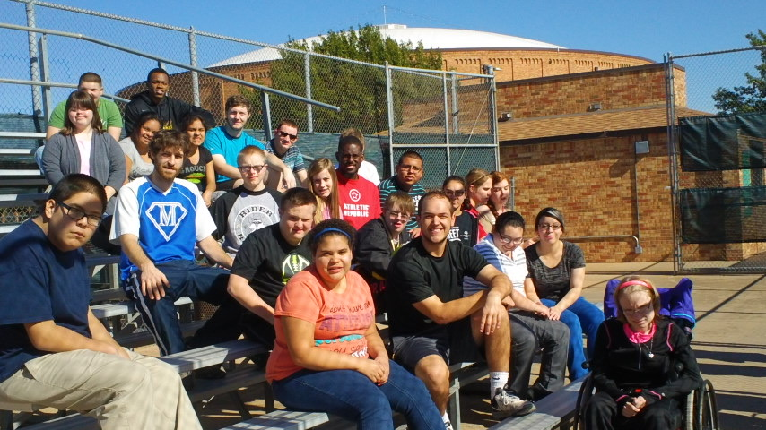
Adapted Physical Activity
-Kinesiology and Sport and Leisure Studies Majors
Local Middle and High School Special Needs Students
8 week teaching experience on campus providing appropriate games, fitness and sport activities
Partnership with Wichita Falls ISD and Wichita Falls Special Olympics

Slide 6
Partnerships
Campus Collaboration
Local School District
Local Special Olympics
Connecting & Networking
Notes:
Application of verbal & written communication skills at different levels

Slide 7
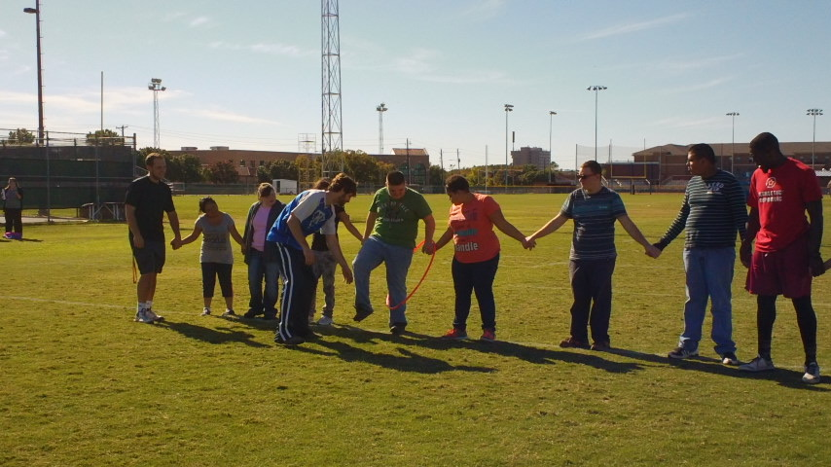
Methods
Undergraduate students- Research
  Prior to working with students researched specific disabilities and presented information to class.
  Administered the TGMD-2 to ISD students for a baseline of abilities and challenges.
Undergraduates as Teachers
  Developed individual lesson plans for small and large group participation using information gained from research and TGMD-2 administration.

Slide 8
Students as Volunteers
Working with WFISD special needs coordinator 2 students helped coached a SO sport in 2018
(Bocce & soccer)
This past fall our MSU athletes volunteered 85 hours for the Special Olympics of North Texas. Of the 40 volunteers 22 had been a student in the Adapted Physical Activity course.

Slide 9
Student Reflections
  S1 “…coming from my Adapted Physical Activity class, I gained a valuable lessons and information that I believe would not have been taught or acquired anywhere else. This excellent experience was given to me and I believe it opened my eyes to many obstacles in this feel, but also how rewarding it feels to be able to assist others in the art of physical education.”
  S2 Moving forward I have to be willing to go outside my comfort zone. I was so depended on my past experiences with disabilities that I relied on those experiences to get me through. I had to realize that every disability is different and no two individuals with disabilities are alike. “

Slide 10
Conclusions
Valuable experience for the Kinesiology & sport & Leisure Studies students
  Enhanced teaching skills
  Gained practical knowledge
  Learned more about themselves
  Took
  Through observational assessments and student experienced reflections show that they learned and/or improved knowledge and skills to work with special populations either as a teacher, coach or volunteer.

Slide 11
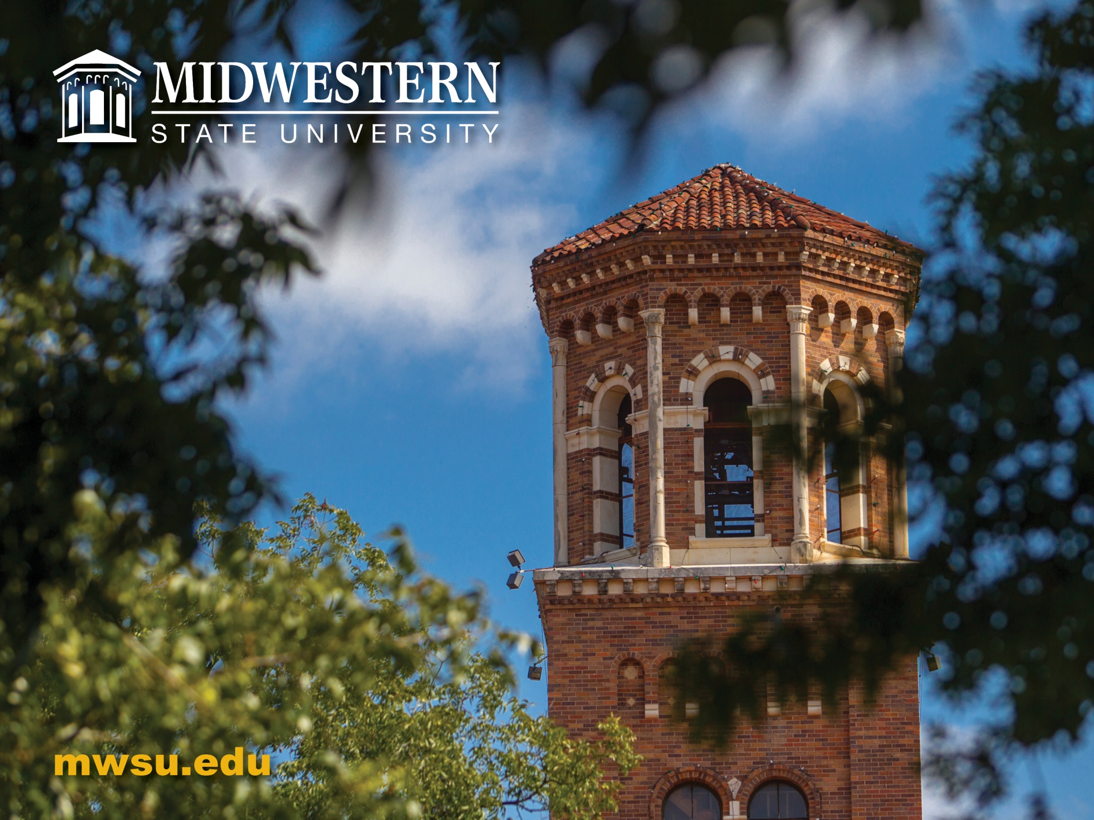
Questions
Notes:
Make sure to let folks know e-mail address is Sandra.shawver@msutexas.edu

