Slide 1
The Development of a Career-Savvy Sport Professional: Effectively Using Outcomes Assessment, Curriculum Planning, and Innovative Teaching Practices
Dr. Molly Hayes Sauder & Dr. Susan S. Klinedinst
York College of Pennsylvania
Notes:
Welcome audience. Each presenter introduces herself.

Slide 2
Why?
12.6% Growth
But…
7.2% Unemployed & 14.9% Underemployed
And…
11.7 Different Jobs!
Notes:
Why has our program decided to place so much emphasis on developing career management competencies in students? Well, let’s look at some numbers.
CareerBuilder tells us there’s been a 12.6% increase in jobs in sport-related industries between 2010 and 2014. Great!
But, the Economic Policy Institute tells us that the 2015 unemployment and underemployment rates for college grads were 7.2% and 14.9%. Not so good. Especially with the accountability movements we see happening in higher education.
And, the Bureau of Labor and Statistics tells us that the most recent longitudinal study of workers showed an average of 11.7 jobs from ages 18-48. And these were Babyboomers.

Slide 3
Career Management Competency
The college graduate can…
Identify and articulate skills, strengths, knowledge, and experiences relevant to the position desired and career goals, and identify areas necessary for professional growth.
Navigate and explore job options; understands and can take the steps necessary to pursue opportunities, and understands how to self-advocate for opportunities in the workplace.
(NACE, 2016).
Notes:
Bottom line: We want to see our grads competent in career management. NACE recently defined the concept of “career readiness” and identified key competencies associated with it. “Career readiness is the attainment and demonstration of requisite competencies that broadly prepare college graduates for a successful transition into the workplace.” When this came out we saw it as a great summary of what we’ve been working to do.
For discussion: How are you currently delivering career management instruction? Specifically, in these areas: Career exploration? Resumes? Cover letters? Interviewing? Professionalism?
Who delivers the instruction? How is it delivered (for credit, not for credit, through the program, in a discreet course, etc.) and by whom (faculty or career development)?

Slide 4
Agenda
Detail our outcome assessment plan for career development competencies….
Discuss the current curriculum map with respect to career development and explain opportunities and challenges to this...
Share several innovative teaching techniques for skills such as career exploration, resume/cover letter writing, and interviewing...
Notes:
The goal of the presentation is to both disseminate innovative ideas that may be of interest to attendees while simultaneously providing an example of effective teaching and learning practices within the context of assessment and accreditation. Specifically, we promised to…

Slide 5
Teaching, Learning and Assessment as a Continuous Four-Step Cycle
Establish Learning Goals
Provide Learning Opportunities
Assess Student Learning
Use the Results
Suskie (2009)
Notes:
Really our agenda walks through how our program has gone through Suskie’s description of teaching, learning and assessment as a continuous cycle with respect to career management.

Slide 6
Outcomes
Student Learning Outcome: Develop knowledge and skill in key career and professional development competencies for the sport management field.
Indicators | Assessment Tools | Benchmarks
Demonstrate proficiency in writing resumes and cover letters. | Professional Development Resume/Cover Letter Rubric | 100% of students will achieve a 38/50 or higher on the resume/cover letter rubric.
Demonstrate competency in professional interviews. | Professional Interview Scoring Rubric | 100% of students will achieve a “competent” or higher in all 9 categories of the interviewing rubric.
Notes:
First, for good assessment, teaching and learning, it’s key to establish learning goals. This is our outcomes assessment plan related to career management. It was created initially by…

Slide 7
Abbreviated Curriculum Map
Career Management Competencies
 | Career Self-Assessment | Occupational Research | Experiential Learning | Resume/Cover Letter Writing | Interviewing Skills | Portfolio Development
Courses & Learning Activities
Intro to Sport Management |  | Introduce
Practicum I | Introduce | Introduce | Introduce | Introduce
Practicum IV | Reinforce | Reinforce | Introduce |  | Introduce | Introduce
Sport Marketing |  | Reinforce | Reinforce
Facility/Event Management |  | Reinforce | Reinforce
Professional Development | Reinforce | Reinforce |  | Master | Master | Master
Work Experience | Master | Master | Master
Notes:
Next, provide learning opportunities. From a big picture view, a curriculum map helps with this.
We are still improving upon this, but here’s an abbreviated version of one for career management competencies. There are some things missing from it like job searching, professional etiquette items we teach, etc. but I wanted to show it and there isn’t room on the slide. Similarly, there are other classes involved as well.
There are challenges to this: faculty turn over, admin changes, time, syllabi
There are opportunities: cohesive experience, connected learning, more buy-in for faculty, exciting
Possible audience engagement: Do you use curriculum maps? What are your experiences with them? Do you have a career management aspect to your curriculum that is mapped out? What do you see on our map that suggests we might improve?

Slide 8
Career Management Learning Activity
The Career Exploration Map
Notes:
To provide a closer view, here are a few learning activities we use with our students.

Slide 9
MY POTENTIAL JOB: ________________________________
I selected this job because________________________________
ENTHUSIASM FACTOR
What are 2 duties/tasks that excite me about this job?
a)____________________________
b)____________________________
What are 2 duties/tasks that are unappealing about this job?
a)____________________________
b)____________________________
TRANSFERABLE FACTORS
What are 2 other jobs that might also have these similar duties/tasks?
1)____________________________________
2)____________________________________
REFLECTION: What have I learned by completing this map?____________________
DEAL BREAKERS
What percentage of the job will be spent completing unappealing aspects?__________
Is it worth it?__________________________
EXPERIENCE FACTOR
What are 2 experiences that this job requires that I need to obtain?
a)____________________________
b)____________________________
EXPERIENCE DEVELOPMENT
What can I do as a YCP student to gain some of these experiences?
a)____________________________________
b)____________________________________
SKILLS FACTOR
What are 2 skills that I currently possess that this job requires?
a)____________________________
b)____________________________
What are 2 skills that I do NOT possess that this job requires?
a)____________________________
b)____________________________
SKILLS DEVELOPMENT
What are 2 things I will do during the next year to help develop these skills?
a)___________________________________
b)___________________________________
What are some resources (classes, people, organizations, etc.) that I can leverage to help me develop these skills?
a)___________________________________
b)___________________________________
Notes:
Collaborate with Career Development and have students take FOCUS, a self-assessment that looks at skills, interests, values, leisure needs, and personality. Then, they use FOCUS, ONET, and What Can I Do With This Major to research careers and complete this map with some additional reflection questions like what what more information they need and where they could get it. The thing about this map is that it teaches students a systematic foundation for evaluating careers based on data. It’s also done in the same semester as their first real world informational interview so that gives them another exposure to how knowing about yourself and the world of work simultaneously is key.

Slide 10
Career Management Learning Activity
The “Google Doc” Resume

Slide 11
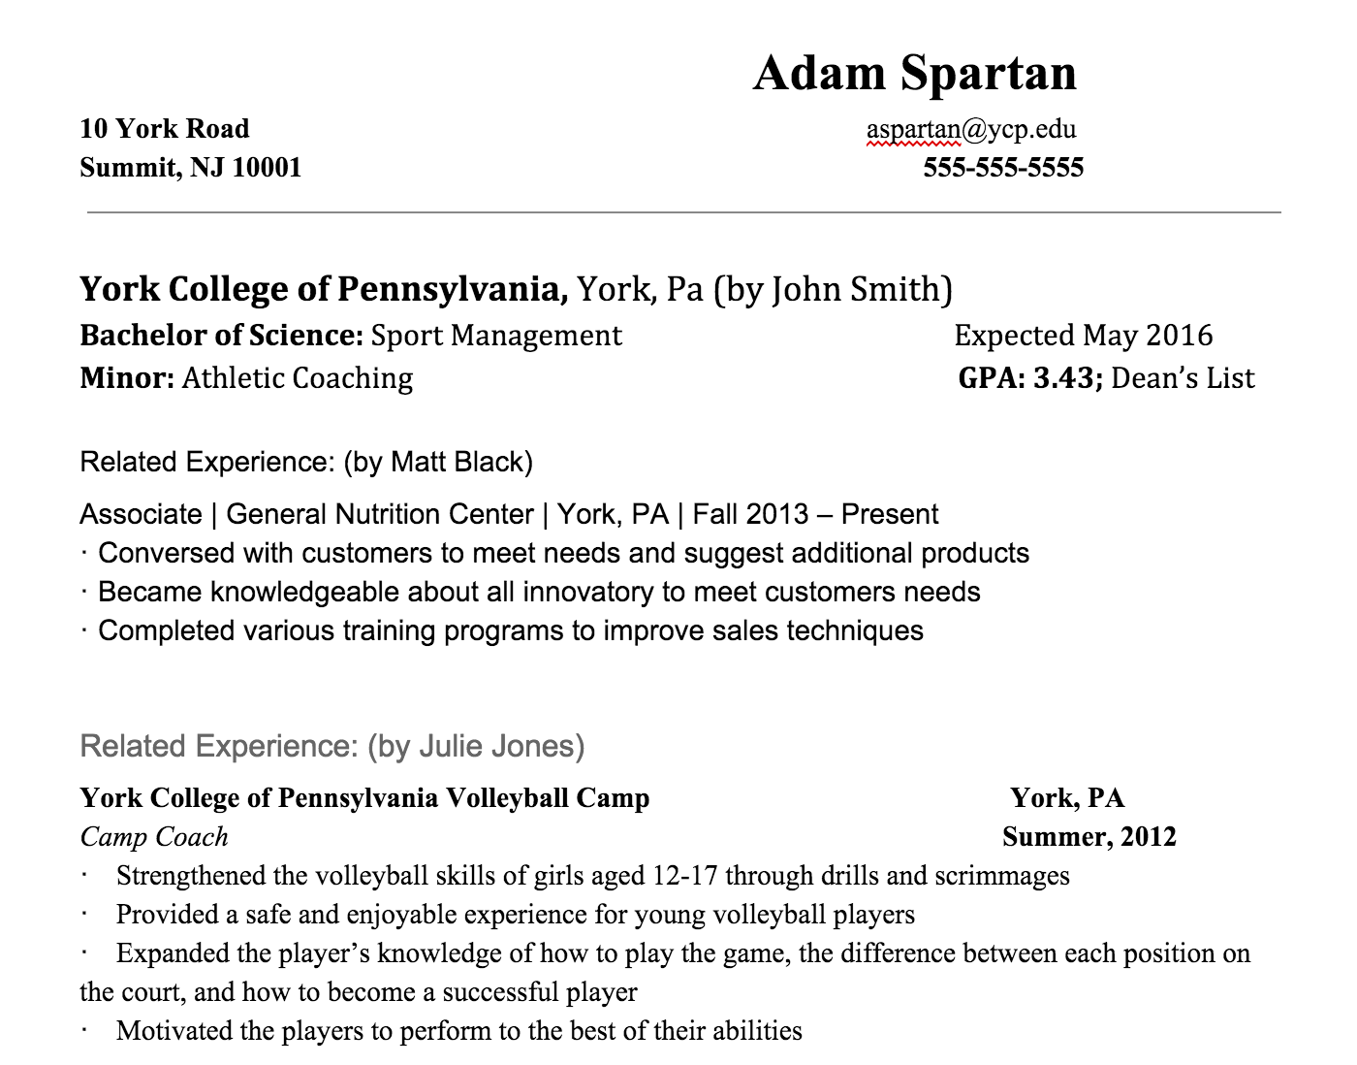
The “Google Doc Resume”
Notes:
If you are looking for an activity that will be more interactive than lecture, that requires students to take ownership, that encourages critical thinking through critique, and that helps student think from different perspectives, this is a good one.

Slide 12
Career Management Learning Activity
Interviewing Strategy Podcast + “Round Robin” Practice Stations

Slide 13
Open-Ended Questions
Negative Questions
Behavioral Questions
Hypothetical Questions
Notes:
Borrowing from my experience instructing at sport camps back in the day, I wanted to come up with a way to maximize practice time and understanding of strategy so I decided to try a podcast to talk about different types of interviewing questions and the strategy for them, followed by a round robin style of interviewing with different practice stations.
If using a podcast for anything, my experience is…
To do the round robin activity, just....

Slide 14
Assessment Tools
Resume & Cover Letter Rubric
Interviewing Rubric
Notes:
To assess student learning and complete the third aspect of Suskie’s cycle, we have a few rubrics.

Slide 15
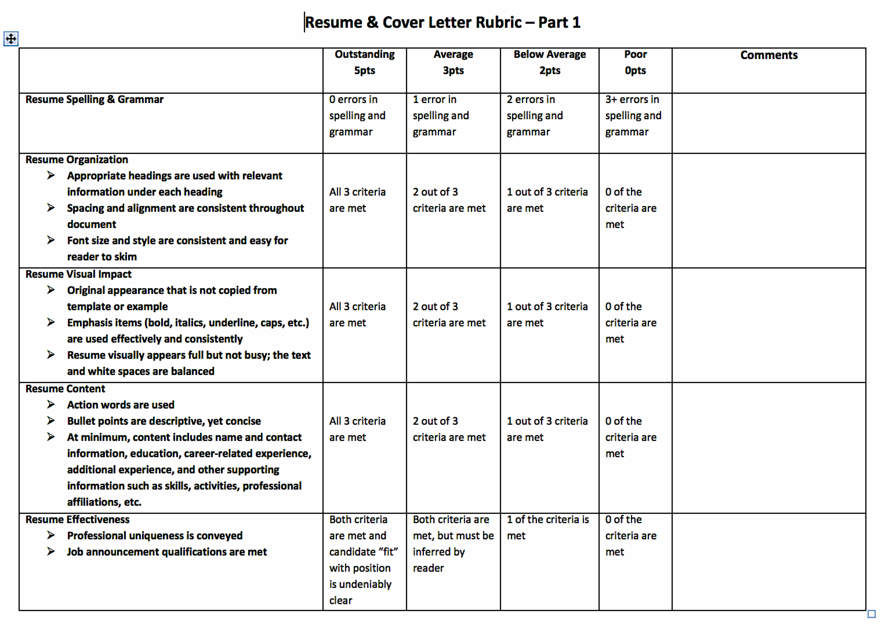

Slide 16
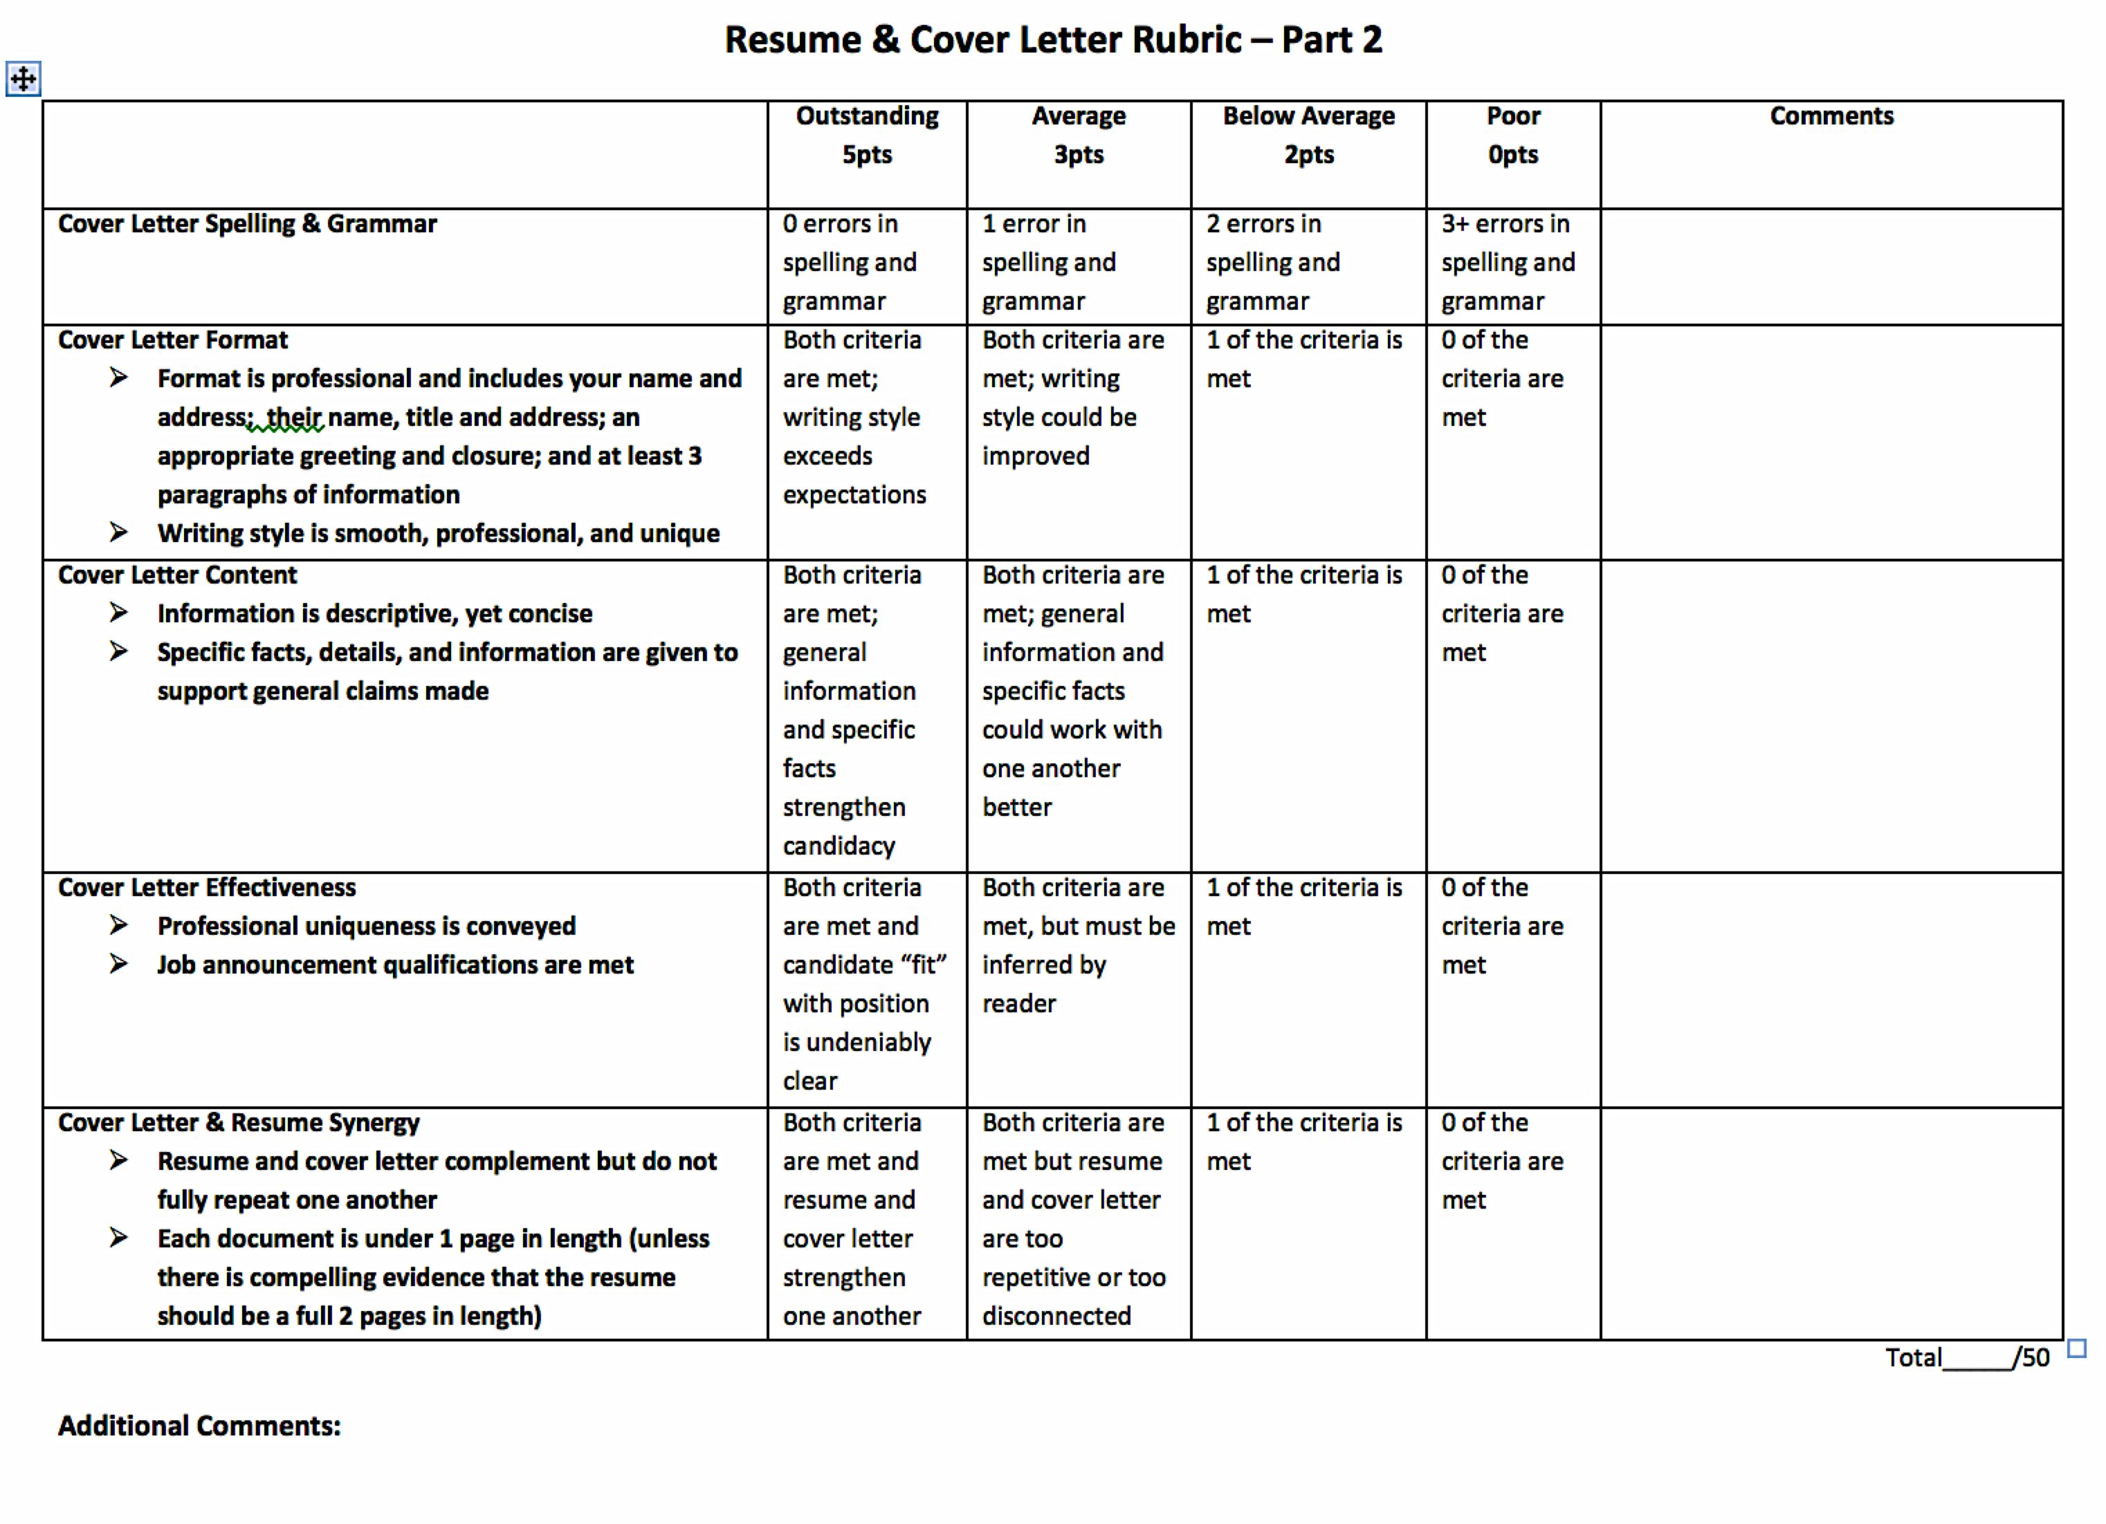

Slide 17
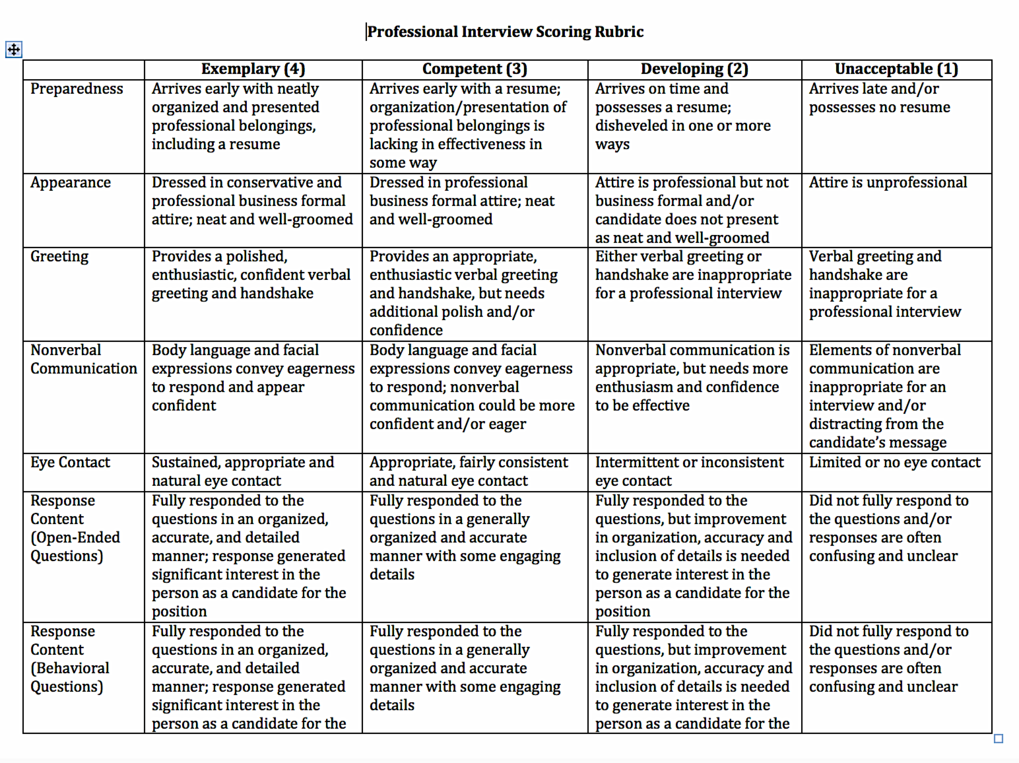

Slide 18
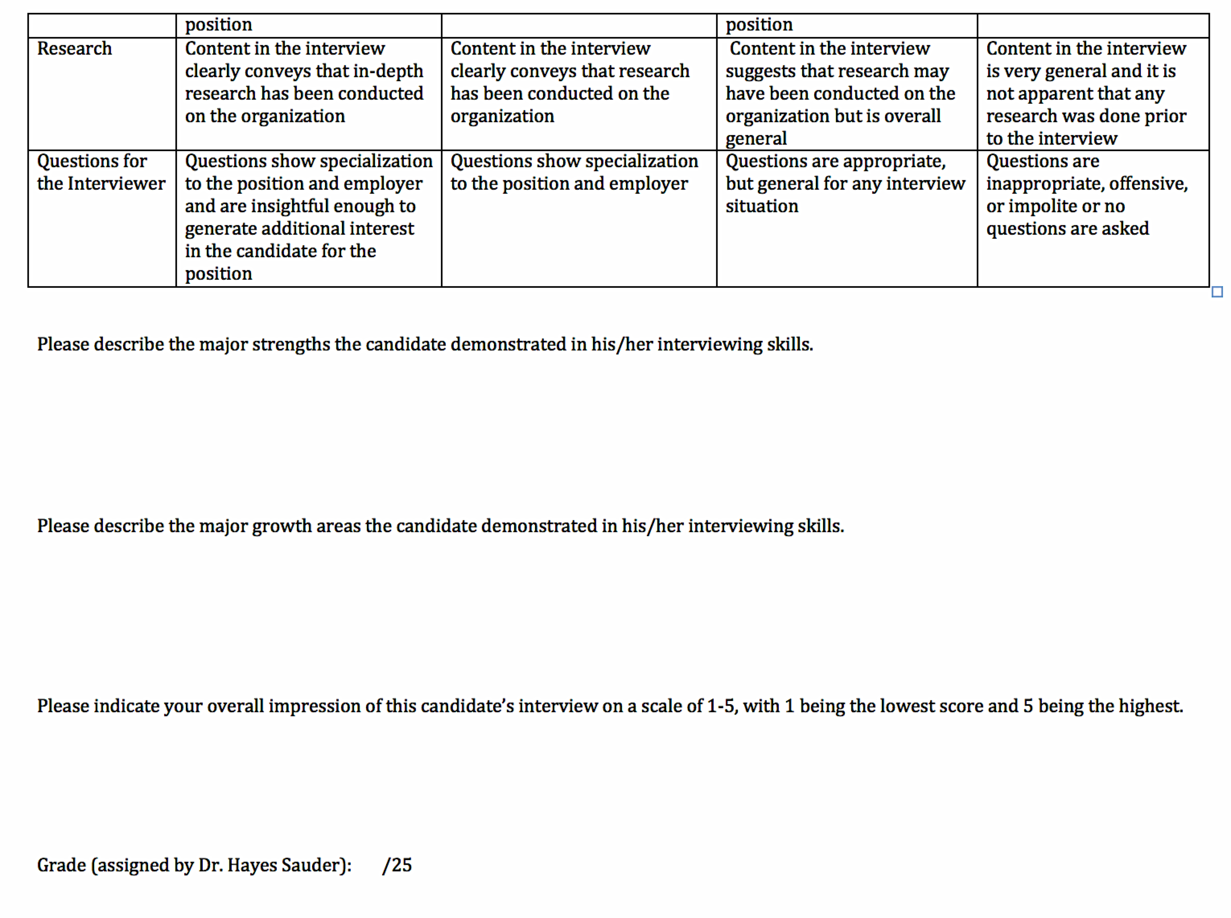

Slide 19
Data & Decisions
Individualized appointments for resume and cover letter
Interviewing introduced earlier in the curriculum
Enhanced rubric for interviewing skills
More difficult benchmarks
Notes:
We’ve made changes over the years based on our results. Just to mention this idea of closing the loop, here are a few of the changes we’ve made.

Slide 20
Concluding Activity:
Take a few minutes to consider everything just discussed. What is one interesting new idea you have about developing a career-savvy sport management professional that you could share with the group?
Notes:
To conclude, we’d like to make a few points:
We hope this generated ideas for you.
Find what works for your culture.
3) Be planned, sequential, cohesive-need to value these competencies.
If Time: Do a debrief activity about what they’d like to implement and ask for each person’s thoughts.

Slide 21
Credits
Image Citations
References
http://www.dynamicleasing.com/
http://www.data.gov.bc.ca
http://www.consultaclick.ro/
http://www.ycp.edu
http://www.nomensa.com/blog/sites/
Bureau of Labor Statistics (March, 2015). Number of jobs held, labor market activity, and earnings growth among the youngest Baby Boomers: Results from a longitudinal study. Retrieved from http://www.bls.gov/news.release/pdf/nlsoy.pdf
CareerBuilder (August, 2014). Sports-related employment is on the rise and creating jobs in other industries, according to new research from CareerBuilder and Economic Modeling Specialists. Retrieved from http://www.careerbuilder.com/share/aboutus/pressreleasesdetail.aspx?sd=8%2F28%2F2014&id=pr839&ed=12%2F31%2F2014
Davis, A., Kimball, W., & Gould, E. (May 2015). The class of 2015: Despite an improving economy, young grads still face an uphill climb. Economic Policy Institute. Retrieved from http://www.epi.org/publication/the-class-of-2015/
NACE: National Association of Colleges and Employers (2015). Career readiness defined. Retrieved from http://www.naceweb.org/knowledge/career-readiness-competencies.aspx
Suskie, L. (2009). Assessing student learning: A common sense guide (2nd ed.). San Francisco, CA: Jossey-Bass.

