Slide 1
Analysis of Philanthropic Missions in Professional Houston Sports Teams
COSMA Case Study

Slide 2
Intro
duction
Introduction
Faculty Advisor: Dr. Aaron Livingston
Team Captain: Vanecia Lewis
Additional Speakers: Jesslyn Reed & Justin Richard
Research Team : Karleisha Coleman & Jalen Livingston

Slide 3
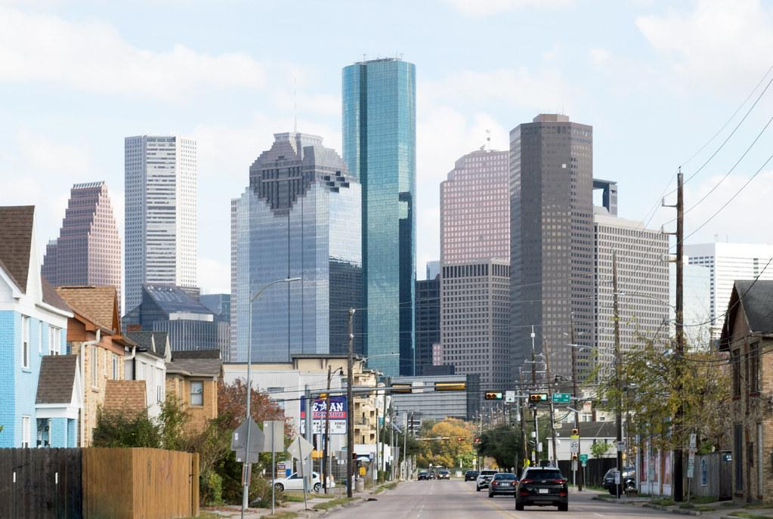
Context
Socially responsible and ethical business operations
What makes Houston a unique community?
Houston is a very diverse city
Home to many job opportunities
There are over 40 colleges and universities in the Houston area
Academic achievement is valued with at least 28.7% with a bachelor’s degree
A sports business’s duty to make the right decisions to positively impact a community.
Think about how their actions can affect a community
Follow code of ethics
Ethical business operations refers to the standards for morally right and wrong decisions in conducting business.

Slide 4
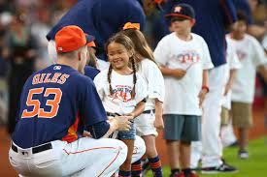
Houston Astros
Strengths
Connection with Community
Access to Downtown
Outspoken Stance Against Domestic Violence
Advocate for Children and Animal’s Rights
Weaknesses
Raising Awareness for Minority Issues
More External Community Outreach
Threats
Lack of Substance Abuse Programs
Opportunities
Diversity within Organization
Investment in Nearby Communities
Community Programs Offered
Astros Foundation Scholarship, Astros Foundation Grant Program, Astros Youth Academy, Astros Golf Foundation, Astros RBI Program

Slide 5
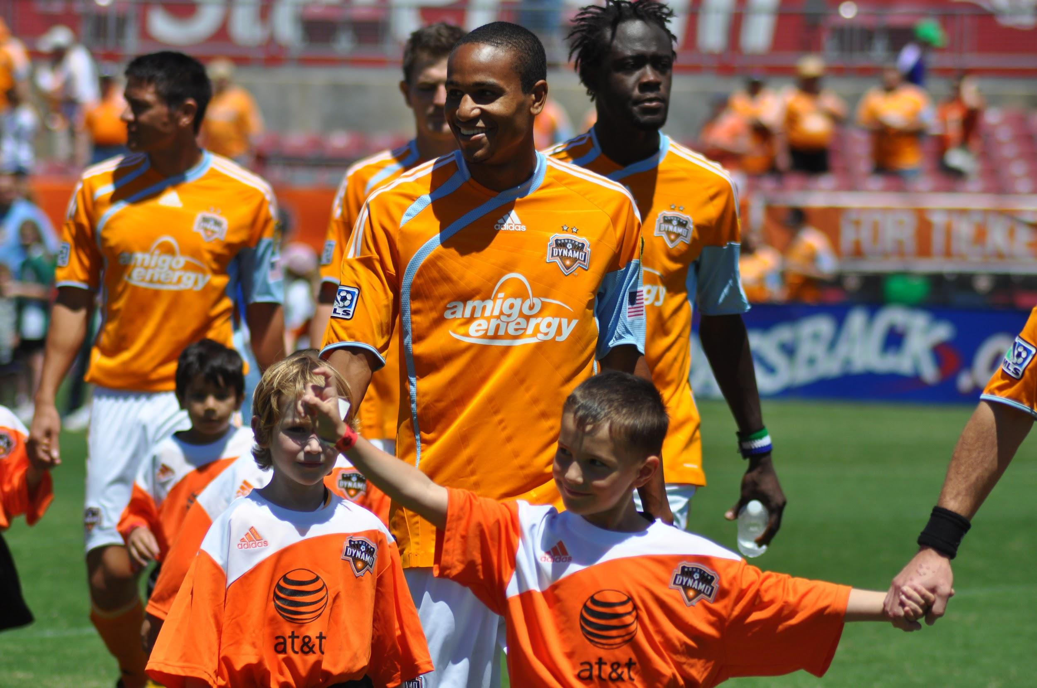
Houston Dynamo
Strengths
After school programs
Community collaborative charities
Focus on Health and Fitness
Weaknesses
Proximity to lower class neighborhoods
Lack of cheap year round fun
Threats
Lack of Minority Interest
Location
Local competition
Opportunities
Ownership Diversity
Relatively Young
New Branding Opportunities
Community Programs
Futbolito in the City, Dynamo Goals, Lunch and Learn, In-Kind Donation Requests, and Dynamo Dash Youth

Slide 6
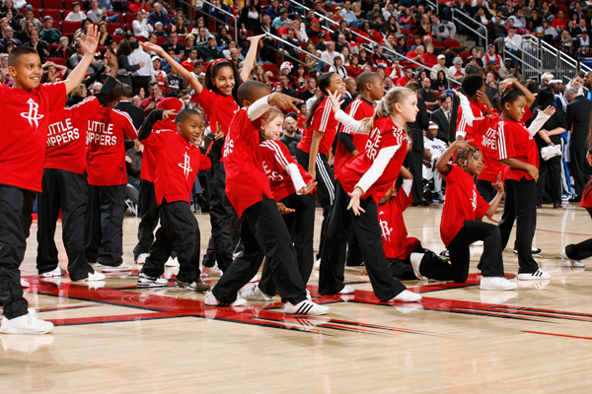
Houston Rockets
Weaknesses
Developing programs for lower income families
Increase HBCU partnerships
Mental health awareness
Threats
Gun Violence Awareness and Drug Abuse
Strengths
College Prep Programs
Huge Minority Support
Front Office Diversity
Opportunities
Expansion into Higher Education opportunities
Community Programs Offered
Best shot program, Jr. Rockets Program, Clutch City Foundation , Nike Game Growers, Season Giving , and charity of the month.

Slide 7
Recommendations/Summary
Short Term Strategies - Social media postings and simply getting out in the community on off days would go a long way with connecting with local communities.
Long Term Strategies - Show support crucial minority issues and lay down the foundation for culture that is more in tune with the communities that need to be nurtured and supported.
Social consciousness is one of the biggest and most important of sports administration strategies, “that’s because sports aren’t apart from society; they are part of society.”
Fiscal and Budgetary Concerns - To fund the programs that can make a real effect in the community not much money is needed at all. Putting the effort forward is the first and most important step.

Slide 8
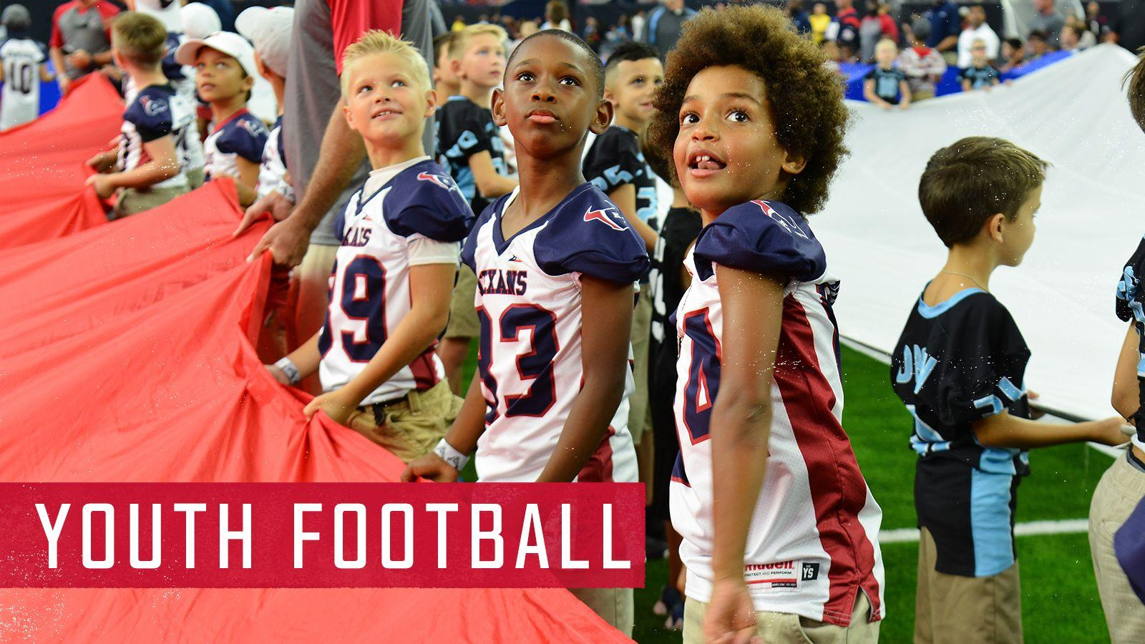
Houston Texans
Weaknesses
Free Resources for Youth
Better use of Social Media Platform
Threats
More Drunk Driving Prevention
More Sexual Assault Prevention
Strengths
Market to Minority Communities
Connection with Youth
Opportunities
Utilize Huge Fanbase
Established brand
Community Programs Offered
School Programs : Stats Challenge, Get Fit with Toro Houston Texas Foundation : Donates money to the community frequently Community Programs : Salute to Service, First Responders, and Play 60

Slide 9
References
ASO. (2021, July 12). Colleges, Universities &amp; Online Colleges in Houston: ASO. Accredited Schools Online. Retrieved February 3, 2022, from https://www.accreditedschoolsonline.org/texas/houston-tx/
“Astros in the Community: Houston Astros.” MLB.com, https://www.mlb.com/astros/community.
Astros. (2019). 2019 community report: Houston Astros. MLB.com. Retrieved January 28, 2022, from https://www.mlb.com/astros/community/foundation/community-report
Houston Dynamo FC. (2022). Community Relations. houstondynamofc. Retrieved February 1, 2022, from https://www.houstondynamofc.com/community/
Mkamla. (2022, January 3). Rockets community programs. Houston Rockets. Retrieved January 28, 2022, from https://www.nba.com/rockets/community/programs#:~:text=Charity%20of%20the%20Month%20recipients,Charity%20of%20the%20Month% 20partners.
Person. “Astros Players Known to Give Back on and off the Field.” ABC13 Houston, KTRK-TV, 23 Oct. 2019, https://abc13.com/houston-astros-charity-on-the-field-off/5635277/.
“Help Wanted: Social Responsibility in Sports - the Sports Column: Sports Articles, Analysis, News and Media.” The Sports Column | Sports Articles, Analysis, News and Media, 18 Feb. 2015, https://www.thesportscol.com/2015/02/help-wanted-social-responsibility-sports/.

Slide 10
https://youtu.be/-grjIUWKoBA
The Colin Kaepernick Nike commercial, is just one example of how a player or sport’s team foundation could show that one is not just a player. The athletes and administration represent not just where they are now, but where they come from as well. It’s all about the growth from where you start and the continuance of good deeds, to where you are trying to be.

