Slide 1
Leveraging Sport Management on an Innovation Campus
G. Clayton Stoldt, Mark Vermillion, Wonyoung Kim & Jeff Noble

Slide 2
Overview
Illustrate ways sport management programs can leverage opportunities with innovation campus
Trend toward innovation
Evolution of the presenters’ campus
Sport-management-specific initiatives
Data regarding student perceptions
Future directions

Slide 3
Relevant Trends
Broad criticism of higher education
Reduced public funding
Steady increase in tuition and fees
Technological transformation of society
More students, traditional and nontraditional
Emergence of online competition
(Hanover Research, 2013; Wildavsky, Kelly & Carey, 2011)

Slide 4
Innovation
Way systems are organized and managed
Instructional techniques or delivery systems
Ways faculty are recruited, compensated
(U.S. Department of Education, 2004)

Slide 5
Innovation
“…it is a fundamental responsibility of all faculty and staff at public colleges and universities to foster problem-solving skills and applied technological solutions to promote economic prosperity and the cultural enrichment of their regions” (Dunfee, 2014, p. 28).
Notes:
Richard Dunfee, American Association of State Colleges and Universities

Slide 6
WSU Mission (WSU, 2013)
“…essential educational, economic, and cultural driver for Kansas and the greater public good”
Notes:
The mission of Wichita State University is to be an essential educational, cultural and economic driver for Kansas and the greater public good.
Wichita State University is internationally recognized as the model for applied learning and research.

Slide 7
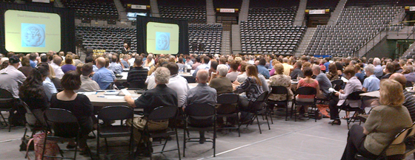
Strategic Planning Goals
Applied learning
Capitalize on trends
Accelerate transfer of new knowledge
And more…
Notes:
Guarantee an applied learning or research experience for every student by each academic college.
Pioneer an educational experience for all that integrates interdisciplinary curricula across the university.
Capitalize systemically on relevant existing and emerging societal and economic trends that increase quality educational opportunities.
Accelerate the discovery, creation and transfer of new knowledge.
Empower students to create a campus culture and experience that meets their changing needs
Be a campus that reflects—–in staff, faculty and students—–the evolving diversity of society.
Create a new model of assessment, incentive and reward processes to accomplish our vision and goals.

Slide 8
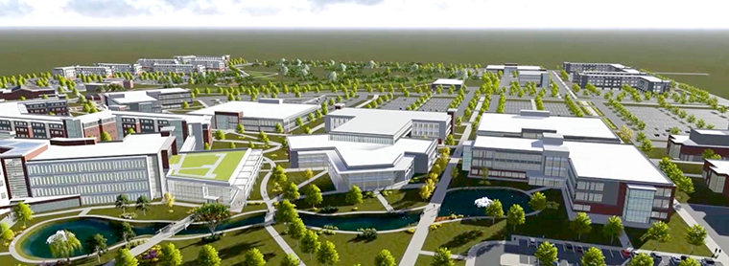
Notes:
Wichita State University is becoming the Innovation University, transforming the world through innovation, applied learning, entrepreneurship and economic impact.
Innovation – Bringing university researchers, students and industry together to share the ideas that will drive change.
Applied Learning – Breaking down walls and going beyond the books to provide real-world experience for real-world results.
Entrepreneurship – Fostering an environment where risk-taking is encouraged and big ideas can become big business.
Economic Impact – Creating new avenues for financial growth while infusing existing industries with the resources needed for future success.
The Wichita State Innovation Campus concept was created as a mechanism to achieve the goals of the university’s Strategic Plan.
Current partners: Airbus, NetApp, and ABI

Slide 9
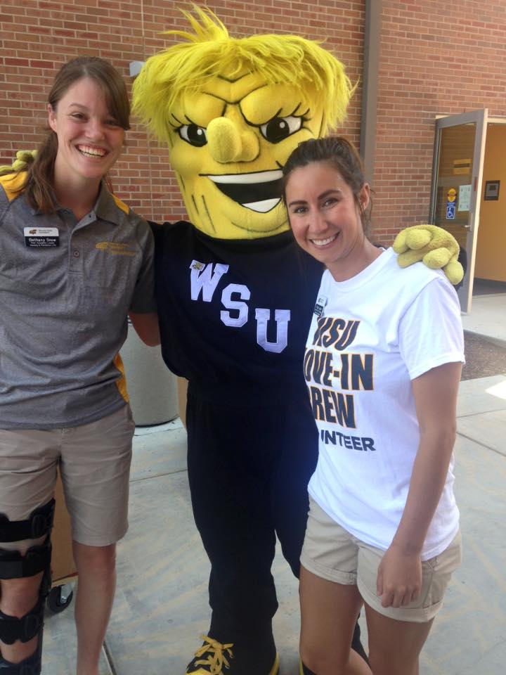
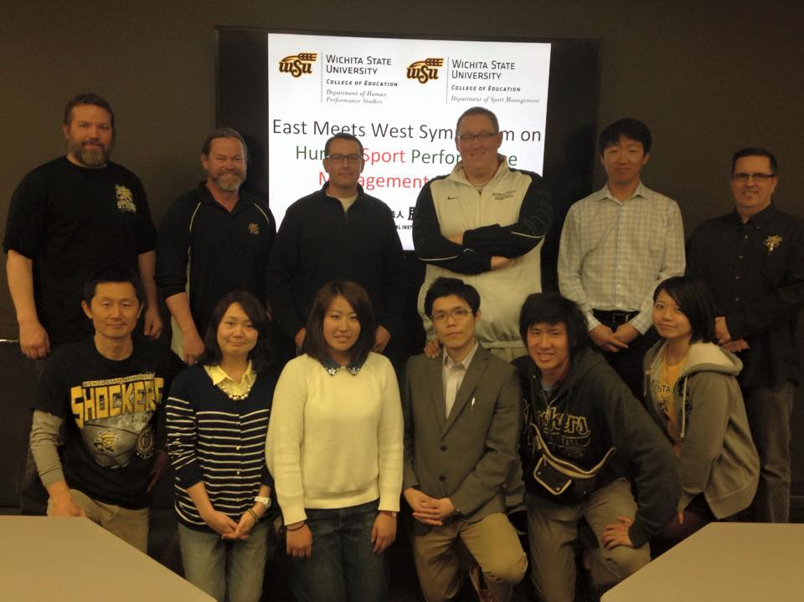
WSU Sport Management
Strategic priorities (WSU, 2014)
Expanding partnerships
Technology emphasis
Graduate research
Notes:
Mission Statement: The Department of Sport Management’s mission is to serve its students, community, and profession through its teaching, research, and service. Valuing both theory and practice, department members emphasize applied learning, enabling sport management students to develop into well-educated, ethical, capable sport management professionals.

Slide 10
Partnerships
Notes:
Air Cap Classic – Web.com tour event
Cherry Oaks – Municipal golf course in community 20 miles
Derby Rec – Community recreation commission with multiple facilities in south suburb

Slide 11
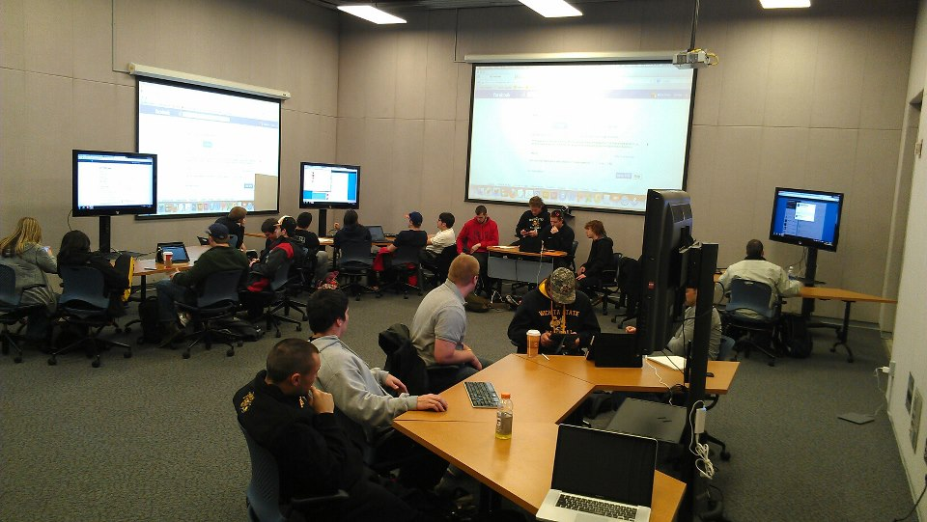
Technology Education
Analytics / Decision-Making
Technology in Sport Management
Notes:
The department has developed and implemented sport management-specific technology classes at both the bachelor’s and master’s levels and a data analytics course for its graduate students.
SMGT 300. Technology in Sport Management (3). Students gain a greater appreciation for the applications of current technology in the area of sport management, including but not limited to: the fundamentals of com- puters and their use, the application of commercial software to the sport management setting, the ethical issues sport managers face in using computers to conduct research and work with various social media platforms in sport settings.
SMGT 800. Analytics and Decision Making in Sport (3). Highlights various data applications in sport management as professional tools to make informed decisions. Topics include understanding how to col- lect, interpret, represent and disseminate data in an organizational setting, and to better understand how data informs decision-making processes within sport.
SMGT 809. Sport Management Technology (3). Stu- dents gain a greater appreciation for applications of current technology in the area of sport management including but not limited to: the fundamentals of com- puters and their use, the application of commercial software to the sport management setting, and ethical issues sport managers face in using computers to conduct research and work with various social media platforms in sport settings

Slide 12
Graduate Research
Notes:
Over the last two years, the department has also established research-specific partnerships with four organizations, ranging from a local recreation commission to a major-level professional sport property. Each of these partnerships has involved faculty and students working in coordination with practitioners to plan, execute, and disseminate research to the benefit of each stakeholder group. Students participating in these projects gain applied learning experiences that complement the internships they are required to complete as part of their programs of study

Slide 13
Partnership for the Advancement of Sport Management

Slide 14
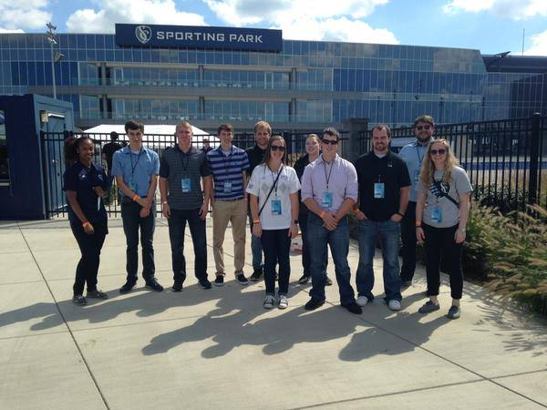
Student Perceptions
Integrate coursework with applied learning and research experiences
More than 100 students involved in partnership projects
Preliminary survey with items based on Bennet, Henson & Drane (2003) and Sotiriadou (2011)
Notes:
As of fall 2015, an estimated 100 students have been involved in these projects. The presenters are currently conducting brief surveys of students involved with two of these initiatives regarding their perceptions of their experiences. The results of those surveys will be included in the presentation.
17 items under 4 broad categories from Bennet et al
The experience allowed me to grasp theoretical concepts in a more realistic way.
All sport management students should have to go through a similar experience.
Six items from Sotiriadou
This experience has enhanced by employability.
I made some important professional contacts during this experience.

Slide 15
Student Perceptions (n=24)
Categories (# of items) | Mean (based on 1-7 Likert scale) | Mean % - Somewhat agree or more
Commitment to serve (5) | 5.62 | 78.4
Exposure to the discipline (4) | 5.24 | 68.0
Theoretical application (6) | 5.50 | 76.0
Personal enjoyment/fulfillment (2) | 5.36 | 68.0
Career and skill development (6) | 5.16 | 66.0
Notes:
17 items under 4 broad categories from Bennet et al
The experience allowed me to grasp theoretical concepts in a more realistic way.
All sport management students should have to go through a similar experience.
Six items from Sotiriadou
This experience has enhanced by employability.
I made some important professional contacts during this experience.
-Age: 23.32 years
-Race: 88% white, Caucasian
-Student level (year) 80% graduate students and sr.s
-Gender: 72% male
-Industry: 68% want to go into professional sports (either major or minor league level) and 24% want to work in collegiate athletics.

Slide 16
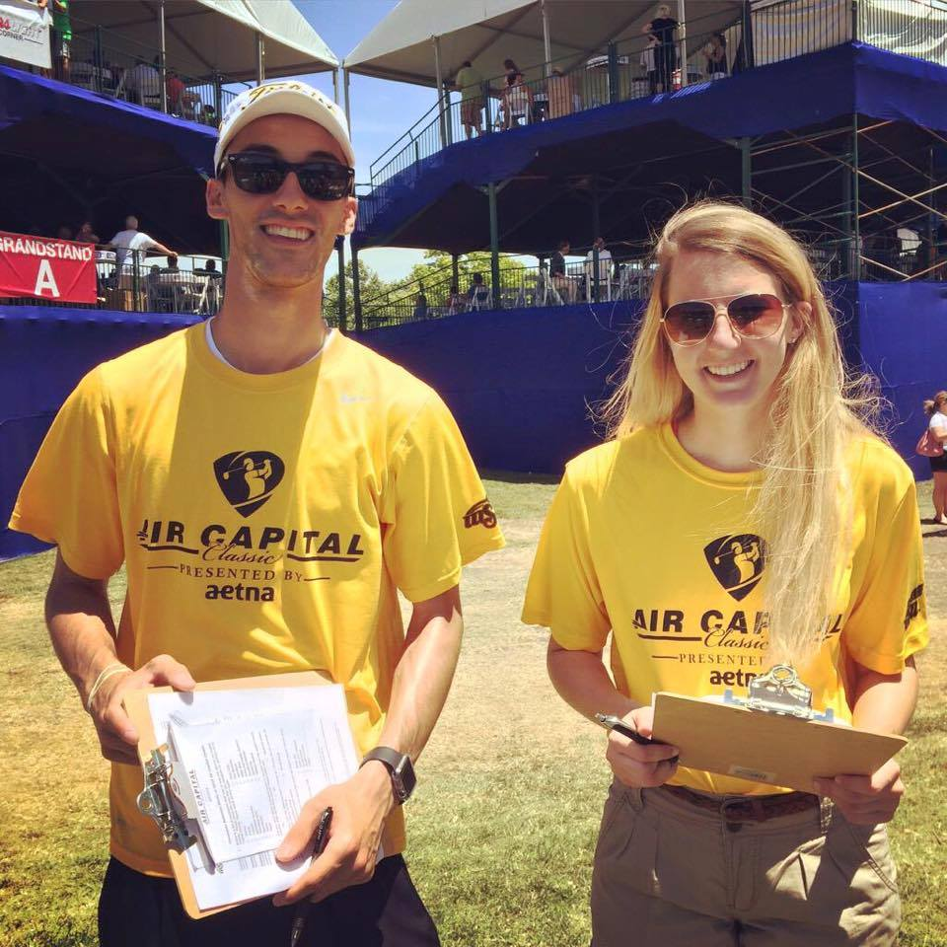
Future Directions
Expansion of partnerships
Greater integration across the curriculum
Steady enrollment growth

Slide 17
Sources
Bennett, G., Henson, R. K., & Drane, D. (2003). Student experiences with service-learning in sport management. The Journal of Experiential Education, 26(2), 61-69.
Christensen, C., & Eyring, H. (2011). The innovative university: Changing the DNA of higher education from the inside out. San Francisco: Josey-Bass.
Dunfee, R. (2014). Engagement in regional prosperity. In Domagal-Goldman, J., Dunfee, R., Jackson, A., Stearns, P.N., & Westerhof, J. Becoming a steward of place: Four areas of institutional focus. New York: American Association of State Colleges and Universities.
Hanover Research. (2013). Institutionalizing innovation in higher education. Retrieved from http://www.hanoverresearch.com/wp-content/uploads/2013/06/Institutionalizing-Innovation-in-Higher-Education.pdf
Sotiriadou, P. (2011). Improving the practicum experience in sport management: A case study. European Sport Management Quaterly, 11 (5), 529-550.
U.S. Department of Education. (2004). What do we mean by “innovation” Retrieved from http://www2.ed.gov/about/offices/list/oii/about/definition.html
Wichita State University. (2013) Real-world ideas for real-world impact. Wichita, KS: Author.
Wichita State University. (2014). Department of Sport Management Strategic Plan. Wichita, KS: Author.
Wildavsky, B., Kelly, A.P., & Carey, K (eds.). (2011). Reinventing higher education: The promise of innovation. Cambridge, MA: Harvard.

Slide 18
Thank You for Attending!

