Slide 1
Redesigning Practice Regiments
The Influence of Temperaments and Constraints on Soccer Performance
Dr. Timothy Hinchman, Dr. Carrie Taylor - MSU-Texas
Notes:
Understanding ones motivation can assist enhance their performance – overarching question for this study-do designed constraints affect the performance of collegiate II soccer players mediating through temperament.

Slide 2
Introduction
This study aims to help coaches enhance practice performance by matching a designed constraint to a player’s temperament.
Constraints creates a boundary or limit, which makes some actions possible and leaves other to the learner–are restriction that help guide individuals towards successful task completion
Input constraints define how an individual solves a problem-defined by coach
output constraints restrict acceptable resolutions by defining the problem's resolution (goal) (Stokes, 2013)-identify what is the acceptable results-foot used or where ball is placed
Improving performance necessitates properly matching constraint types to an individual's temperament (Roskes, 2015).
Notes:
The input is the extra requirement a coach puts into the play, the output is how the athlete responds to the new parameter –meaning the placement of the ball or the foot that has to be used
Input Constrainsts are the materials Magyver used to build the bomb Output called product or goal is identified what what is an acceptable result (magyver’s bomb must blow a whole in the wall or any other result would be a fail /tasks constraints are like number of players, rules, touches, which foot you pass with NecessitES FORCE OR COMPEL

Slide 3
Output Constraints-solves the problem
Input Constraints-redefines the acceptable result
Touch the ball three times (or two)
Use a specific foot-(dominant or non-dominate)
Expand or Construct the Drills boundary
Conduct the drill for a specific amount of time
Targeting passes (diagonal passes only) or shots
Finishing technique (can only shoot by…or must control the pass via…)
Maintain a specific body position or movement during the drill

Slide 4
Introduction
Temperament is a person's basic, heritable trait (Abrams, 2012).
"temperament is primarily what an infant acquires from his or her parents (including genes), and the rest is attributable to the mother's surroundings during pregnancy" (Abrams, 2012, p. 58).
Temperament and personality share significant components, they are generally agreed to be physiologically linked (Deal, Halverson, Havill, & Martin, 2005).
Temperament qualities are distinct and typically consistent over the lifespan (Strelau, 1987; Thomas & Chess, 1977), while personality traits are learnt via experiences. Allport (1961) says temperament is largely inherited.

Slide 5
Temperaments
Temperament is defined by Littauer (1992) as a “personality profile that define your emotions, work performance, and relationships" (p. 1)
classified as sanguine, choleric, melancholy, or phlegmatic.
Personality is inherited, and much of it is shaped and influences by our unique environments (Ekstrand ,1995)
Knowing a player’s temperament can help the coach in communication between the coach and the player (Romillia, Teodorescu, and Tonita (2020)
Temperament’s traits are represented by a) the ability of the individual to process information -quickly or slowly; b) the ability of the individual to withstand stress or different types of effort; c) the balance of the individual; d) manifesting the affective (thoughts, feelings, beliefs) processes under different conditions (Romillia et al, 2020 pg. 70)
Notes:
Litt-tower

Slide 6
Wired That Way Personality Profile Littauer & Littauer Choleric, Sanguine, Phlegmatic, & Melancholy
Choleric-dominate and extroverted
”Type A” or “the doer”
Born leader
Fixes problems
Loves a challenge
Excels in crisis
Production oriented
High energy and passionate
Requires quick decisions
Desires control
Sees the big picture
Insists on productivity (bossy)
Quick tempered
Confident (overconfident)
Aggressive
Workaholic
Production oriented
Must be in charge
Performs quick and explosive movements
Galen’s 4-Factor Temperament Traits- date back to 460 BC
Notes:
3 defender 2 midfielders and 1 forward

Slide 7
Sanguine
Sanguine – - Strong, Balanced, and Mobile- Extroverted
High energy and practical solutions
“Type B” –”the talker”
Influence their environment through encouragement
Most versatile
Adapts to new situations quickly
Impulsive
Competitive
Center of attention
Creative
Excellent Teammates
Enthusiastic+
Easily Distracted
Confidence fades fast
Undisciplined
Looks for credit
Makes excuses

Slide 8
Phlegmatic
Phlegmatic-tranquil and pleasant-introverted
“the observer”
Service-oriented
Passive-cooperating
Patient
Agreeable
Easiest people to get alone with as long as you do not ask them to change
Make good team players
Good mediators
Will of iron
Not highly ambitious
Lazy & Careless
Indecisive
Strongly resist change
Resist making quick decisions
Can be too patient-procrastinate
Need direct motivation
Force them to make decisions
Selfish
Would rather watch

Slide 9
Melancholy
Melancholy-Analytical-deep thinkers-introverted
“the thinkers”
Do things right
Quality –oriented
Driven to figure out what is right
Can be aggressive to restore peace
Logical
Analytical
Need information, time, and detailed plan
Self-sacrificing
Perfectionist-sets very high standards
Tentative
Follows rules
Do not like anxiety or stress
May appear unsure-low self-esteem
Takes time to make decisions
Low energy
Very sensitive
Not-people oriented
Depressed over imperfections
Standards are to high
Moody

Slide 10
Research Questions
Will there be a statistical difference between the means of the rubric scores of the input-constraint, output-constraint, and the control in terms of performance of NCAA Division II soccer players?
Will there be a statistical difference between the means of the rubric scores of the input-constraint and the control in terms of performance?
Will there be a statistical difference between the means of the rubric scores of the output-constraint and the control group in terms of performance?
To what extent are constraints related to constraint effectiveness in NCAA Division II soccer players and is this relation moderated by their temperament.

Slide 11
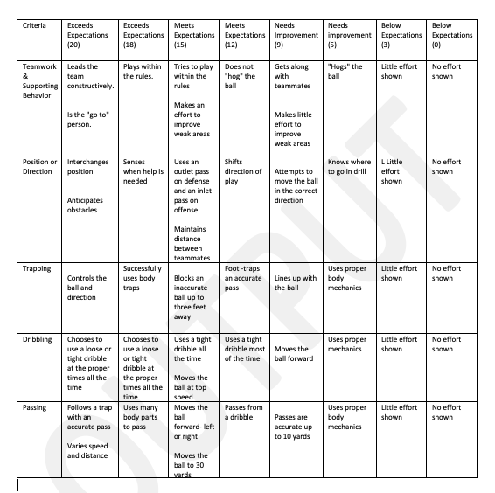
Measures
GPAI and LPP
This study used a modified Game Performance Assessment Instrument (GPAI; Oslin et al., 1998) to test soccer abilities (Harvey, 2003). The updated rubric measures each of the five criteria: Teamwork & Supporting Behavior, Position or Direction, Trapping, Dribbling, and Passing. After evaluating each criterion, participants received a total score by aggregating the five subcomponents.
Personality Plus (LPP; Littauer 2007) measures temperament. The exam has 40 questions divided into four columns. Individuals circle the adjective that best characterizes them. After the test, answers are transferred to a sheet and recorded. The column with the most replies determines if a person’s is: sanguine, choleric, melancholy, or phlegmatic temperament.
The four LPP personality categories were combined to create two categories of Introverts (Melancholy & Phlegmatic) and Extroverts (Sanguine & Choleric) for final assessment (Littauer, 1992).
Notes:
aggregating-form a group or cluster

Slide 13
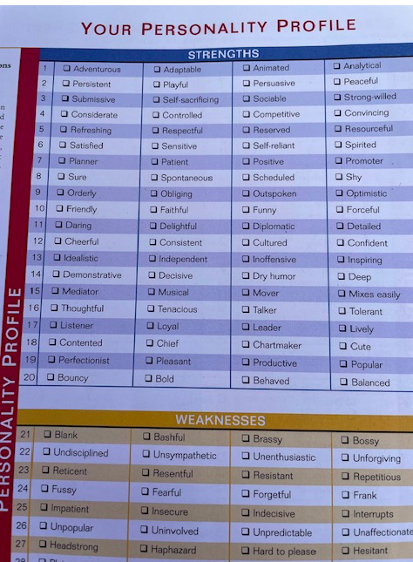
Wired That Way
The Comprehensive Personality Plan (Marita Littauer & Florence Littauer)

Slide 14
Procedure/Constraints
GPAI data was collected over three practices one-day each week for three weeks.
The first data collection round involved the coach observing each attending player conduct warm-up and structured drills like a Rondo similar to keep away with no constraints (control) for approximately 35 minutes.
The second data collection round (week 2) occurred five days later and involved a Passing Box drill with input constraint condition (limiting the number of touches and prescribing the passing sequence).
Finally, the third data collection round (week 3) occurred six days from the control and involved a 10 v 7 drill that featured the output constraint (prescribing distance between players, angle of support, type of pass, and number of touches).
The LPP test was administered by the researchers twice to the participants, once at the beginning of the study (week 1) prior to the first GPAI and then again after the final GPAI data was collected (week 3).

Slide 15
Year 1 results
18 soccer players' LPP data were used to evaluate temperament. Nine soccer players were Introverts (Melancholy = 3, 15.8% & Phlegmatic = 6, 31.6%) and nine were Extroverts (Sanguine = 4, 21.1% & Choleric = 5, 26.3%).
A two-way mixed ANOVA was utilized to assess if temperament affects GPAI change (RQ 4). Boxplots showed no outliers. Shapiro-Wilk test showed normal distribution (p >.05). F(2, 32) = 1.814, p =.179, partial 2 =.062; no interaction between constraints and temperament.
Notes:
35 took the profile, but only 18 were included in the study for various reasons.

Slide 16
Results
A non-parametric Friedman test was used to determine (RQ 1) if GPAI teamwork subcomponents differed during a constraint intervention. Bonferroni correction was used for pairwise comparisons.
During the constraint intervention, teamwork and trapping were statistically significant at different times. Post hoc analysis (RQ 2 & RQ3) found no difference in cooperation between the control (Mdn = 16) and input (Mdn = 8), p =.105 and p =.370. Table 1 shows GPAI sub-component median difference. Was improvement when coach used constraints
We are picking up from this study’s data and are seeing positive results
Notes:
Was imporvemtn when coach used constraints – but we do not know which one or why

Slide 17
Table 1
Skill | Control | Input | Output | p | Post-hoc significance
Teamwork | 16 | 8 | 8 | 0.005 | No
Trapping | 8 | 16 | 8 | 0.020 | No
Positioning | 16 | 16 | 16 | n/a | n/a
Passing | 16 | 8 | 8 | 0.368 | n/a
Dribbling | 6 | 6 | 8 | 0.529 | n/a
Table 1
GPAI Sub-Components Median Difference Scores

Slide 18
Results
A one-way repeated measures ANOVA was done to ascertain (RQ 1) if constraint intervention affected GPAI total. Boxplot and Shapiro-Wilk test (p >.05) showed no outliers and regularly distributed data. As examined by Mauchly's sphericity test, 2(2) = 8.494, p =.014. Greenhouse-Geisser adjustment ( = 37.605) applied.
The constraint intervention improved GPAI from the control (M = 42.36, SD = 11.88) to the output (M = 52.74, SD = 9.69) to the input (M = 55.37, SD = 10.44)
Post hoc analysis with a Bonferroni adjustment showed that GPAI total increased from control to input (M = 12.105, 95 percent CI [6.87, 17.34], p .01) and from control to output (M = 9.474, 95 percent CI [4.53, 14.42], p .01), but not from output to input (M = 2.632, 95 percent CI [-.108, 5.37], p =.062).
Total: See the constraints work- but the stats did not indicate which one

Slide 19
Results
18 soccer players' LPP data were used to evaluate temperament. Nine soccer players were Introverts (Melancholy = 3, 15.8% & Phlegmatic = 6, 31.6%) and nine were Extroverts (Sanguine = 4, 21.1% & Choleric = 5, 26.3%).
A two-way mixed ANOVA was utilized to assess if temperament affects GPAI change (RQ 4). Boxplots showed no outliers. Shapiro-Wilk test showed normal distribution (p >.05). F(2, 32) = 1.814, p =.179, partial 2 =.062; no interaction between constraints and temperament.

Slide 20
Discussion
Instructional leaders can use a planned constraint approach to maximize performance (Hinchman, 2021).
This study provides coaching staffs with tool to increase performance productivity by using design constraints.
Using designed constraints targeting younger players (Roskes, 2015; Rosso, 2014) has the potential to increase performance and problem solving (Caniels & Rietzschel, 2015; Eckert et al., 2012; Haught, 2015; Haught-Tromp, 2017; Medeiros et al., 2014; Torrents-Martin et al., 2015).
One proven strategy for improving productivity involves extended and alternating practice using varied constraints to simultaneously promote productivity (Atay & Ashlock, 2018), new skill acquisition (Stokes, 1995, 1999), task persistence (Eisenberger, 1992), and learning transference (Schmidt & Bjork, 1992).
Notes:
Use designed constraints to get the best
We give a tool for them to use-need to remove certain things in practice to incearse productivity shorten the field, decrease pass times more

Slide 21
Discussion
Professional development can assist veteran coaches in identifying and beneficially using constraints to improve their players' productivity.
The direct practice involves identifying how productive individuals use constraints to change the overall domain (Stokes, 2008).
Indirect practice includes the “constraint-finding” (Stokes, 1999) by negotiating the ill-structured problem’s framework by imposing constraints that promote novel and limit standard solutions (Stokes, 2008).
Specifically, coaches should look to add input and output constraints to existing practice drills and tasks that challenge players directly (through the activity) and indirectly (unconsciously) with the goal to improve player performance.
Notes:
More practice with constraints the better the player becomes. Take away or more obstacles last two minutes of football practice getting down the field in 2 minutes
DO them over and over again. In practice they deal with more constraints it slows the game down when they play in a game.

Slide 22
Questions?

