Slide 1
A Survey of COSMA Accreditation Programs
Gil Fried, Professor/Chair, University of New Haven-
COSMA Finance Director
Brittany Jacobs, Sport Administration Doctoral Candidate, University of Northern Colorado – COSMA Student Director
Jennifer Kane, Ph.D., Associate Dean/Professor, University of North Florida –
COSMA Secretary Director
Clay Stoldt, Ed.D., Associate Dean/Professor, Wichita State University –
COSMA Program Director, Chair
Mark Vermillion, Ph.D, Chair/Associate Professor, Wichita State University

Slide 2
What is COSMA?
The Commission on Sport Management Accreditation (COSMA) is a specialized accrediting body whose purpose is to promote and recognize excellence in sport management education worldwide in colleges and universities at the baccalaureate and master’s levels through specialized accreditation.

Slide 3
What year was your program COSMA accredited?
Of the programs that responded to the survey, responses ranged from the years 2010 to 2017, as well as candidacy status.
Candidacy Status: 3
2010: 1
2011: 0
2012: 2
2013: 2
2014: 1
2015: 2
2016: 0
2017: 2

Slide 4
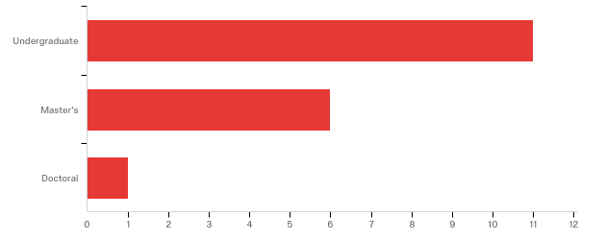
Which program level is COSMA accredited?
Respondents were asked to indicate which of the program(s) were COSMA accredited. The majority had Undergraduate accreditation (61%). 33% of the programs had Master’s accreditation, and only 6% (1 program) had Doctoral accreditation.

Slide 5
In which of the following ways has COSMA accreditation impacted your program(s)?
“Greater Prestige” was the most common response to the question. The least common response was “Higher Faculty Salaries”.
Increased enrollment: 2
Increased faculty lines: 4
Graduates find employment opportunities after graduation: 2
Higher faculty salaries: 1
Increased resources (i.e. administrative assistance): 5
Greater prestige: 8
Other: 4

Slide 6
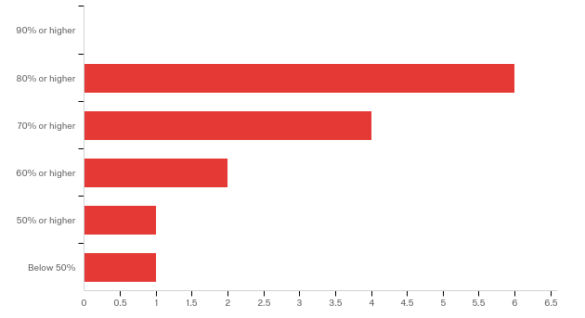
What percentage of your graduates are employed in the sport industry?
Nearly half (6) of the respondents indicated that at least 80% of their graduates held employment in the sport industry.

Slide 7
Do you believe COSMA accreditation assists your graduates in obtaining employment in the sport industry?
More than half of the respondents were not sure whether or not COSMA accreditation helped their program’s graduates obtain employment in the sport industry, indicated by the selection of the response “might or might not.” None of the respondents selected the option “definitely yes.”
Definitely yes: 0
Probably yes: 2
Might or might not: 7
Probably not: 3
Definitely not: 2
Participants were then asked to elaborate…

Slide 8
Do you believe COSMA accreditation assists your graduates in obtaining employment in the sport industry?
I’m not sure if people in the industry know the value of COSMA accreditation. Alumni from our program that work in the sports industry do, however.
Employers have never stated any knowledge of COSMA.
Not sure if the general public understands what “accreditation” really is for value of a degree.
As we go through the accreditation process, I think the administrators are gaining a better understanding of the sport management discipline…
I’m not sure how employers would know that students come from an accredited program. It’s not printed on their diploma, transcript, or resume…
Our students want to learn more from practitioners than academics…all employment gains for our students have come from the practitioners.

Slide 9
Do you believe COSMA accreditation assists your graduates in obtaining employment in the sport industry?
Industry professionals and students do not inquire about COSMA—many do not know what it is—if students are assisted in obtaining employment it is because of faculty, our relationships in the community, and our location.
Our graduates and faculty use it as a selling point, but I’m not sure if it resonates with the practitioners. They’re focused on capabilities and experience, which are of course related to having been in a COSMA program.
Unfortunately we have not collected data directly linking COSMA accreditation to job/career attainment.
Our students do not include on their resume that we are accredited.

Slide 10
What specific resources have been leveraged directly from obtaining COSMA accreditation?
Resources specifically related to faculty were most commonly cited. Also common were responses regarding funding.
New faculty line
None
More full time faculty hired, independent budget allocated
Leading up to accreditation—developing a Sport Management Advisory Board and then funding that board was leveraged and continues to be
Funding for work experience site visits; funding for industry speakers; funding for travel to annual COSMA conferences

Slide 11
What specific resources have been leveraged directly from obtaining COSMA accreditation?
Resources specifically related to faculty were most commonly cited. Also common were responses regarding funding.
Director of the graduate program that is separate from the undergraduate program
Release time for faculty, supplemental pay for accreditation duties, faculty line made a priority at the dean’s level
Two new faculty lines (search beginning for the second this year) directly tied to COSMA accreditation…

Slide 12
In what ways can COSMA assist sport management programs in leveraging resources?
Do a public relations campaign to the sport public (especially parents and high school students) about the value of COSMA accreditation
Continue developing research on accredited programs—faculty, salary, professional development resources, faculty lines within a program, etc.
Consider “release time” as a mandate for those in charge of accreditation; Make a statement supporting the use of full-time vs. affiliate faculty
I don’t believe COSMA can leverage resources…
Faculty, space, fiscal support, and/or autonomy
Feedback from review teams and BOC regarding number of faculty/staff, salaries, and program support. Beyond self-studies, annual reports and informal dialogue between COSMA and programs serve as critical exchanges in identifying program needs and resource issues
COSMA accreditation can provide an external and reputable voice for the faculty when dealing with university politics and resource allocation

Slide 13
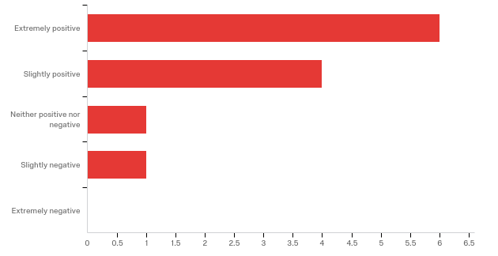
To what degree has COSMA accreditation had a positive impact on your programs?
Overwhelmingly, more than half (10) of the respondents felt that COSMA accreditation had a positive impact on their programs. Only 1 program felt that it had a negative impact.

Slide 14
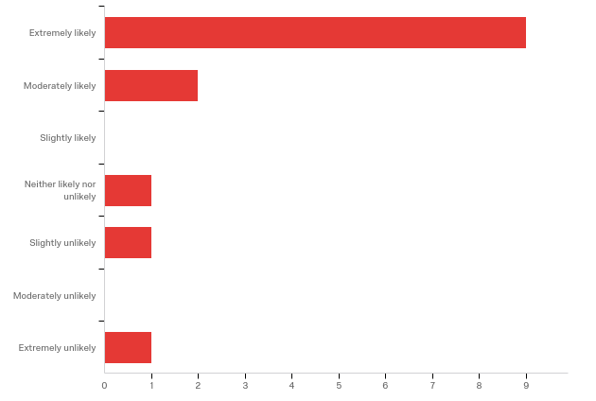
How likely are you to recommend COSMA accreditation to other sport management programs?
Of the programs, 11 responded that they would recommend COSMA accreditation to other programs. 2 responded that they would not.

Slide 15
What is the view of your university administration on COSMA accreditation?
The vast majority of programs indicated that COSMA accreditation was “highly encouraged.”
It is mandatory: 2
It is highly encouraged: 11
It is nice but not really recognized by university administration: 1

Slide 16
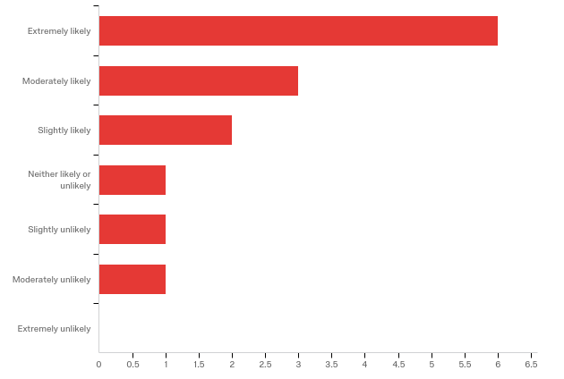
The CHEA recognizes institutional and programmatic accrediting organizations, like COSMA. How likely is it that CHEA recognition of COSMA would increase the value of COSMA accreditation?
The majority of respondents (11) felt that CHEA recognition of COSMA would likely increase the value of COSMA accreditation.

Slide 17
If your program(s) is accredited, by what methods do you advertise your accreditation status?
Most respondents indicated that they advertised their accreditation status via their website, social media, and student information sessions. Only 1 reported the utilization of paid advertisements.
Website: 13
Newsletter: 6
Social media: 8
Paid advertisements: 1
Student information sessions: 11
Other: 2

Slide 18
Provide any additional information on COSMA accreditation valuation you wish to share.
Prestige—value added for our university and sport management college of business
I think that it is very important that COSMA provide clear data about there being a relationship between having it and students getting jobs. Are employers seeking out students that attended schools with the distinction? I am still not clear on the advantages, it feels like our program is less creative now…
…I still think the linkage between COSMA accreditation and valued program outcomes is often indirect. Many prospective students and parents don’t know much about accreditation, but are more likely to recognize the quality associated with a program that is accredited…The same goes for grads getting jobs. Practitioners usually aren’t highly knowledgeable about accreditation or COSMA specifically, but they do often know which programs are better than others…
I think the biggest value is in having programs review and assess what they are doing—the accountability in providing outcomes assessment data.

Slide 19
Key Takeaways
Prestige provided by COSMA must be leveraged by institutions
Variety of gains in institutional resources
Linkage to graduate employment may be present but likely indirect

Slide 20
Key Takeaways
Work to do in advancing COSMA brand with employers
Institutions
COSMA

Slide 21
Ideas for Consideration
Better frame expectations of COSMA members
COSMA presence at industry events
Increase COSMA social media engagement with practitioners/hiring organizations
Business membership as a tool to increase awareness and engagement

Slide 22
What Can You Do?
Get involved
Reviewers
Board (directors, commissioners) service
Volunteer (conference, CSM)
Advocate
Students
Faculty/administrators on campus
Peers in sport management
Industry partners

