Slide 1
2 for 1: The effective use of double-dipping to provide real-world application in a sport management curriculum
Jennifer L. VanSickle
Isabell Mills

Slide 2
I currently teach at least one course that incorporates a service-learning or experiential learning project with an outside organization?
Notes:
1minute

Slide 3
How many service-learning or experiential learning projects will be a part of your curriculum this year?
Notes:
1 minute

Slide 4
I currently involve multiple classes with one partner/service-learning project in the same semester
Notes:
1minute

Slide 5
Background
Notes:
4 minutes
We currently have a partnership with SOIN that provides experiential learning experiences for 2 different courses.
Background of the partnership with SOIN
Started with discussions during an internship site visit
SOIN decided what they needed – UIndy decided the course/parameters
Signed MOU in December 2009; 1st class in 2010

Slide 6
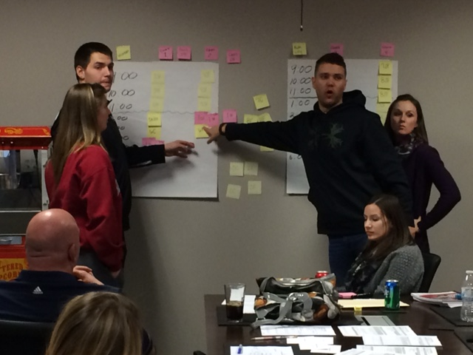
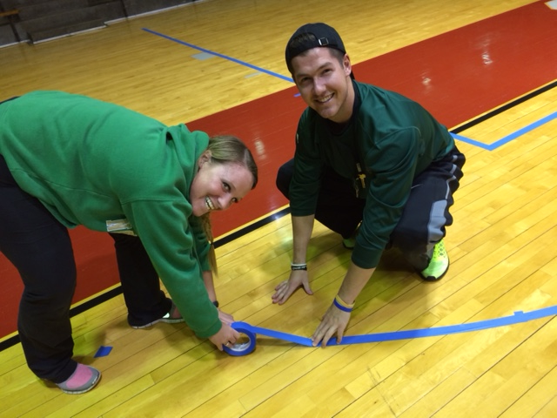
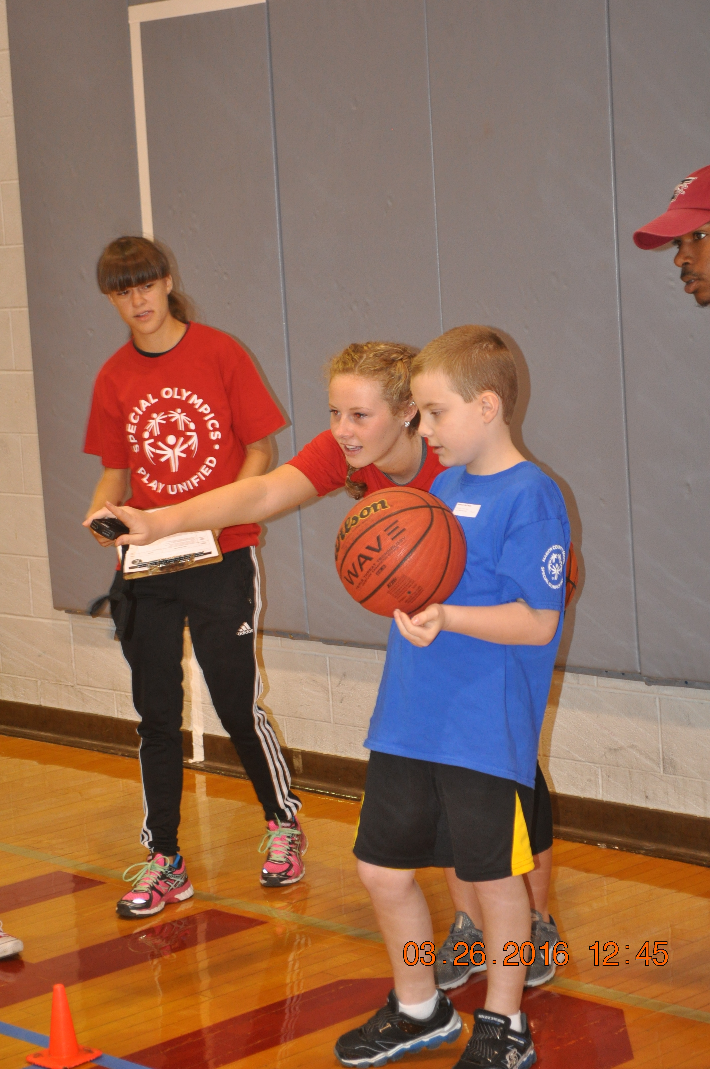
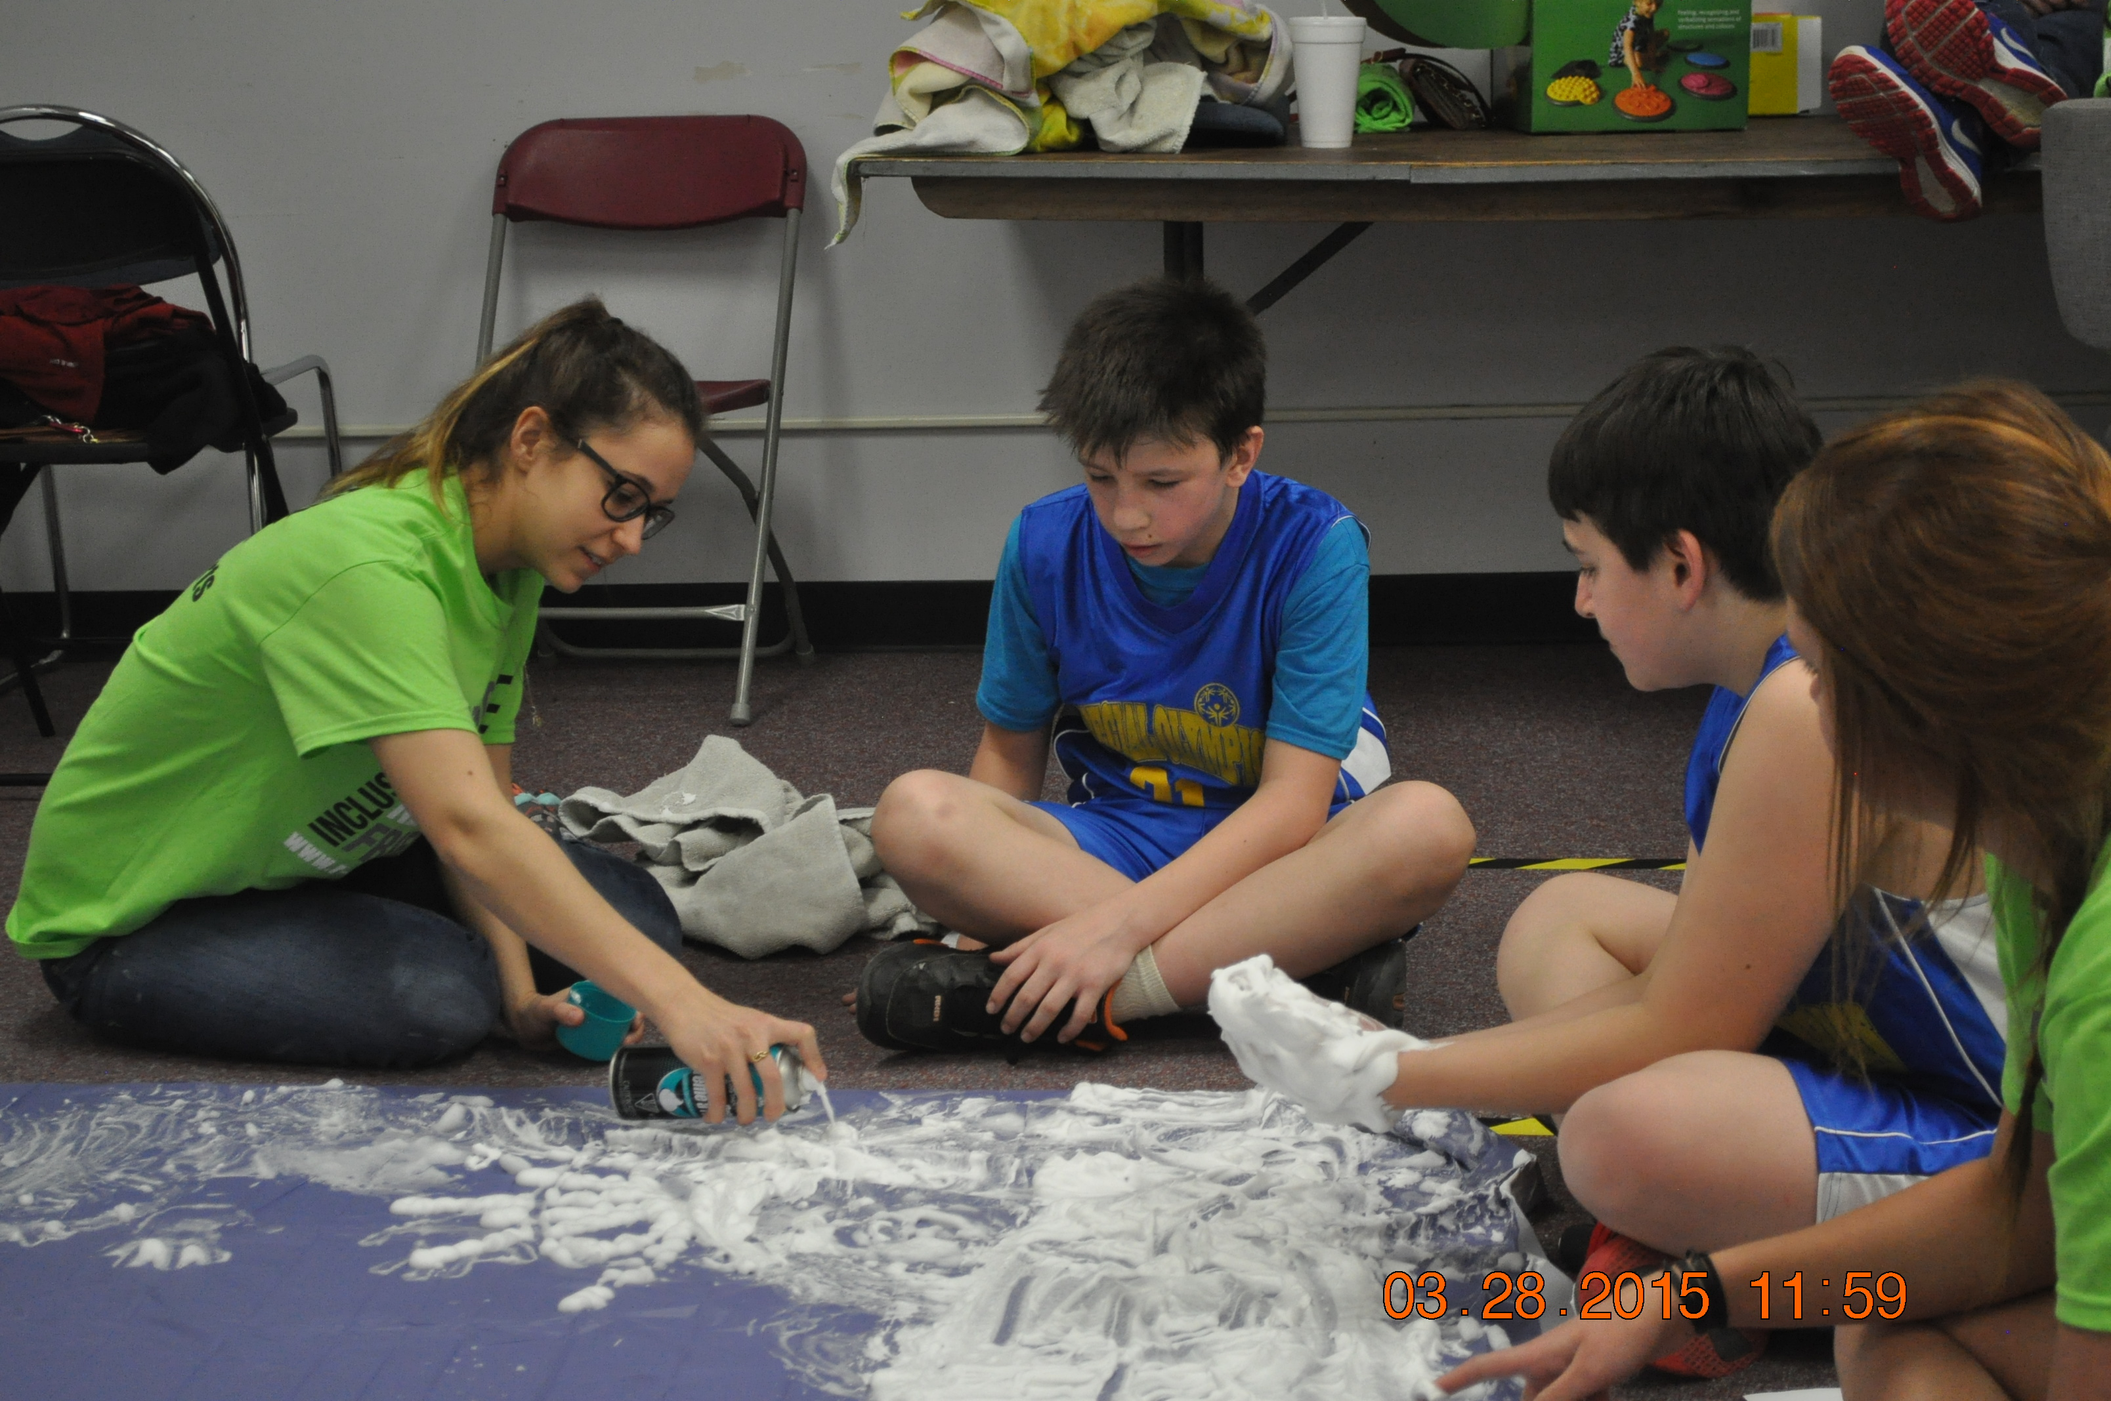
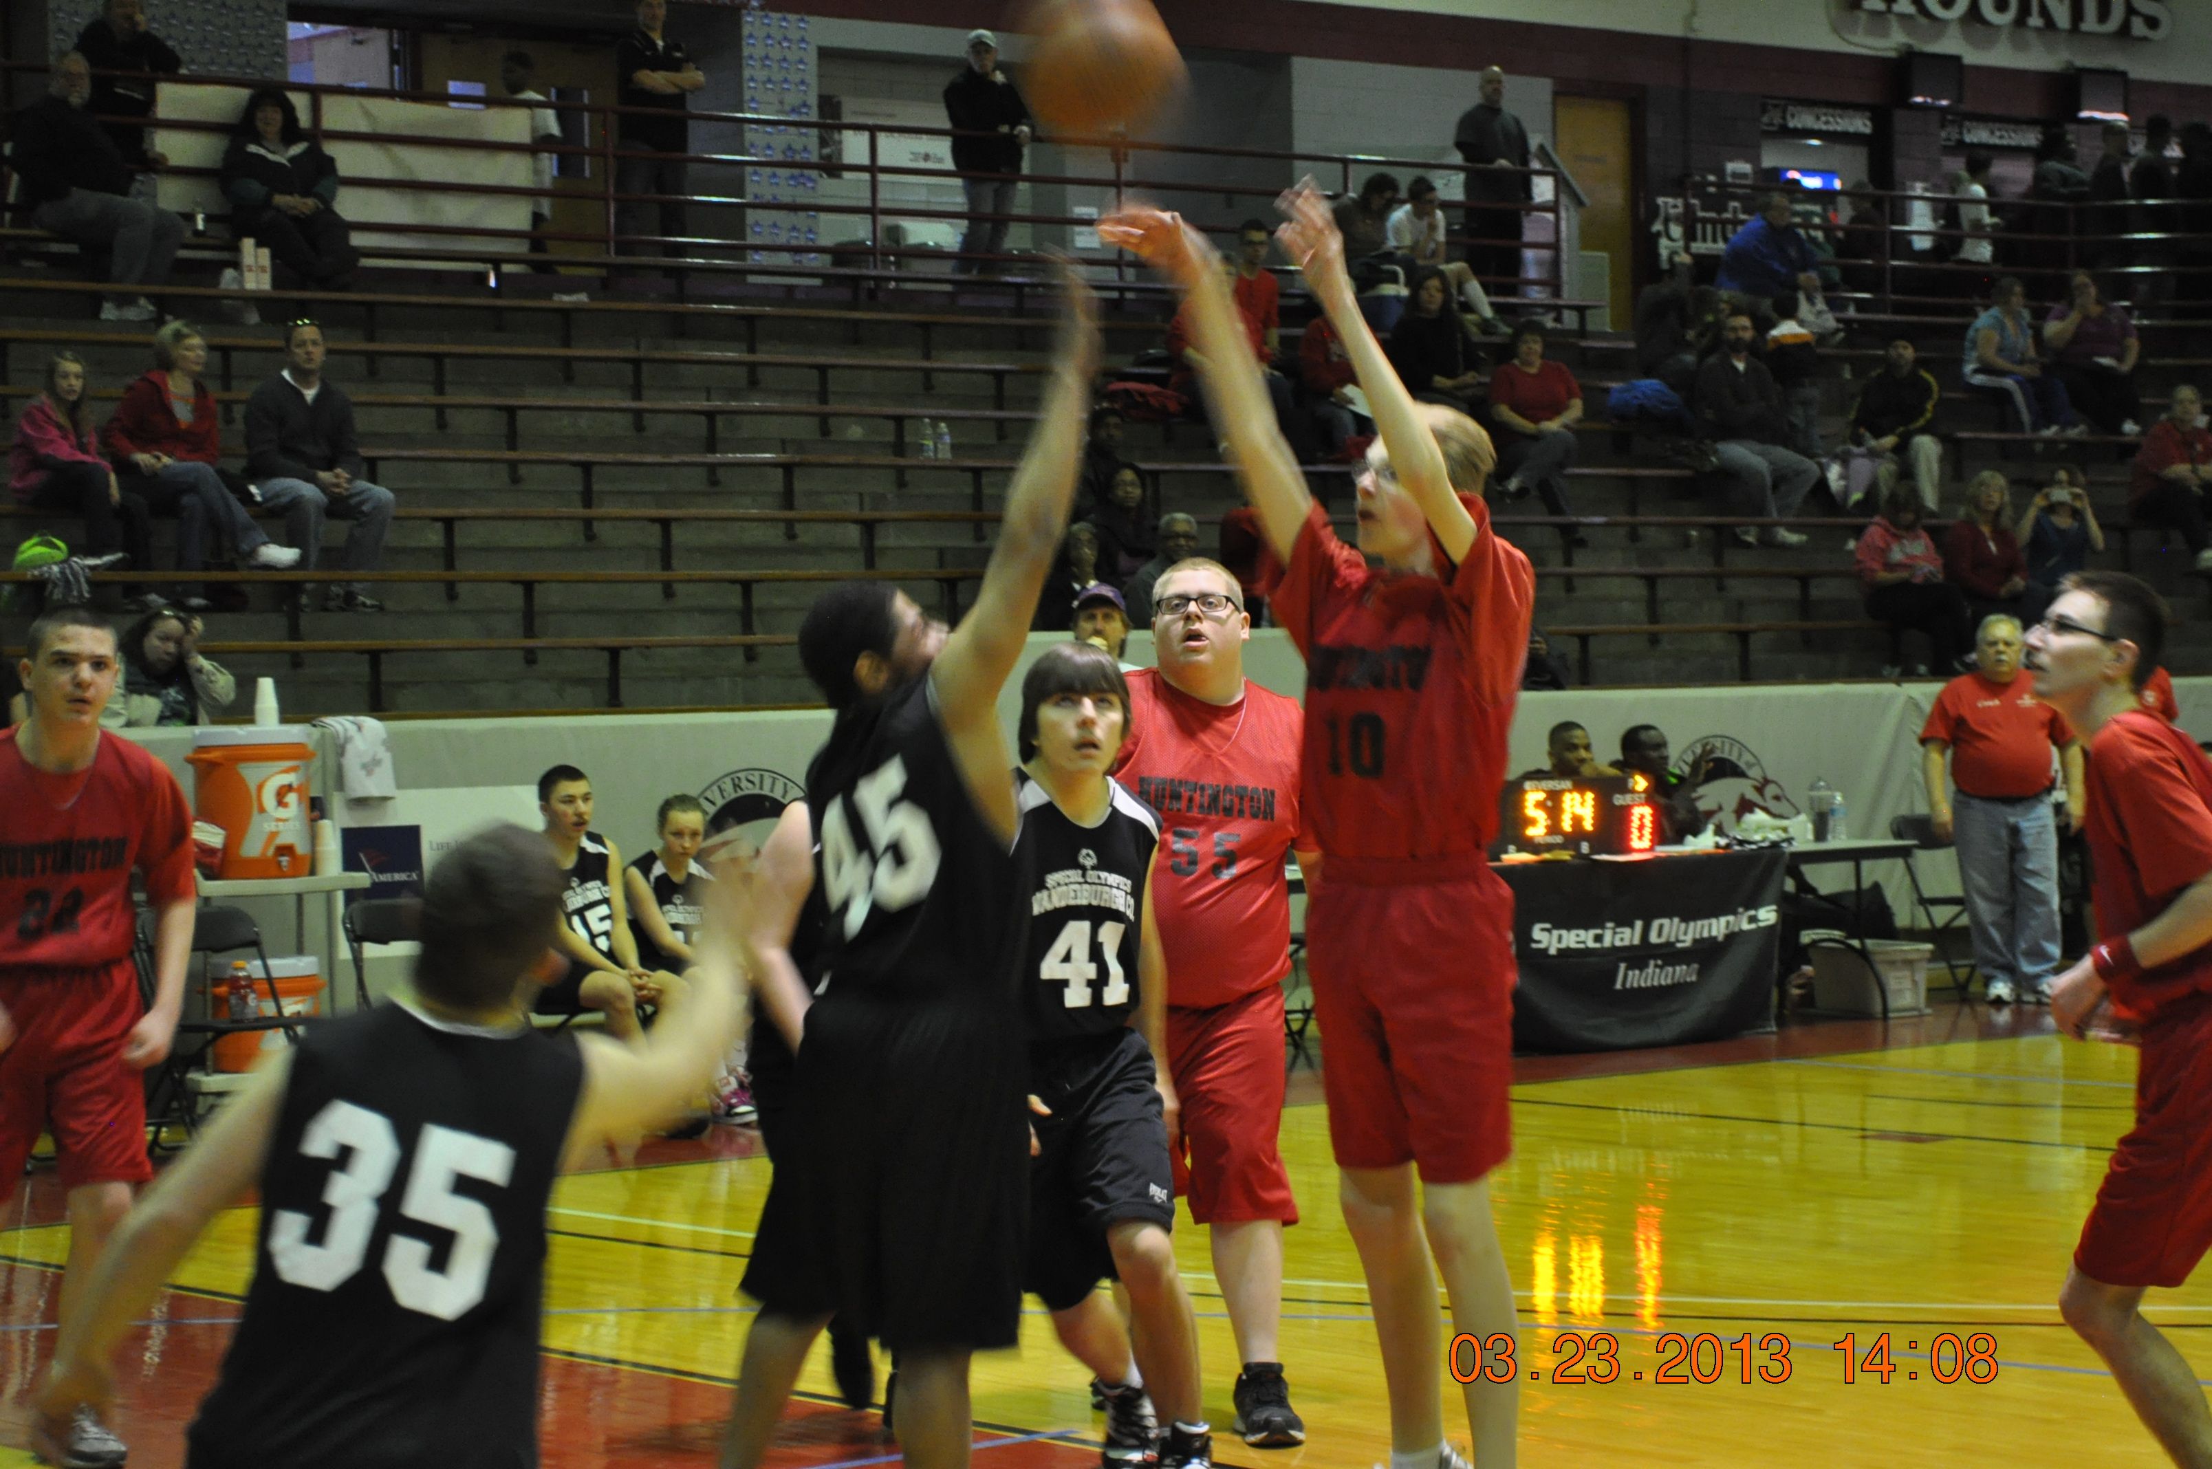
Applied Event Management course
Notes:
4 minutes
Class is responsible for planning & organizing Special Olympics State Youth Basketball Tournament
Special Olympics Indiana provides teams/athletes for the tournament; guidance on SO rules and policies; pays facility costs
1 day event
UIndy students create game & referee schedule, recruit and manage volunteers, solicit donations for hospitality, manage facility needs/issues, gather all needed equipment, implement the event, and evaluate the event.

Slide 7
Governance/Ethics project
Project reflection comments:
“….. having an individual that was one of the Special Olympics Basketball Tournament Directors the previous year come to the class and share their experiences, as well as answer questions about how the tournament is conducted. “
“This projected helped me see the overall importance of having a code of conduct in place for those “sticky” but sometimes inevitable situations that no one may expect.“
“I felt it worked on our cooperation and communication skills, and this allowed for some of us to step outside our comfort zone to work with others. I felt it gave me a real experience scenario that might be found at a job.”
Notes:
4 minutes
Class is responsible for developing a code of conduct handbook for the Special Olympics State Youth Basketball Tournament
The contents of the handbook include:
Mission statement for the event
A code of conduct for volunteers
A mock presentation for volunteer training which includes potential unethical scenarios
Code of conduct violation form to document and report incidents that go against the codes that are created for the handbook.
The students present their mock volunteer training session to the Applied Event Sport Management Course and Special Olympics employees
Project reflection

Slide 8
Results
A variety of students (upper and lower level) are exposed to service-learning projects
Positive student feedback
Including suggestions for next class
The lower level project creates awareness of the event and upper level course opportunity
Students allowed to display knowledge and oral communication skills to partner employees
Networking opportunity
Notes:
3 minutes

Slide 9
Your turn
Notes:
2 minutes
Questions???
Go back to the poll – ask anyone using multiple classes to briefly share
Identify 2 courses in your curriculum that might be able to share a project
brainstorm/share about current service-learning (experiential learning) projects – how could you spread this project across your curriculum? Or brainstorm a new project idea that might lead to use in multiple classes.

Slide 10
Jennifer VanSickle – jvansickle@uindy.edu;
@DrJenVanSickle
Isabell Mills – millsi@uindy.edu;
@IzzyBizzy11

