Slide 1
Efficacy of Sport Management Faculty
Eddie Hebert PhD, Ashley Bowers, PhD., Jill Sharp MS, Nicholas Smith MA*, Jessica Royen
*

Slide 2
Introduction
Self-efficacy has been defined as people’s judgements of their capabilities to organize and execute courses of action required to attain designated types of performances (Chang, Lin, & Song, 2011).
Efficacy is a synonymous term for effectiveness, success or productiveness. Teaching, mainly in higher education, revolves around aspects such as teacher-student interactions, assessment and feedback to students, and learning opportunities (Chang et. al, 2011).
J

Slide 3
Online Teaching and Learning
With online courses, areas such as teacher-student interactions occur less often, feedback is delayed, and learning opportunities are left up to the student, whom may feel less obligated to study.
According to Horvitz et al., “deficits in online teaching self-efficacy present a challenge that threatens the quality of educational offerings to today’s and future students” (2014, pg. 310).
N

Slide 4
Accreditation
Further, many faculty are charged with the task of engaging in accreditation processes. According to the Chronicle of Higher Education (2012), “…faculty should engage in accreditation processes, and accrediting bodies make it clear that faculty participation is expected and valuable.” While the academic community is aware of the importance and relevance of engaging in accreditation processes, many faculty are left feeling “unqualified” to handle both the general duties of faculty, along with pressures of engaging in the accreditation process.
A

Slide 5
Gaps in Literature
There is a gap in the literature that produces a scale that specifically addresses the degree of efficacy sport management faculty hold in reference to their general duties as faculty (assessment, feedback, planning, faculty-student interactions) as well as the degree of efficacy they feel toward their abilities to engage in the COSMA accreditation process.
The purpose of this study is two-fold: 1. To determine the degree of efficacy of sport management faculty – in terms of general faculty duties, and 2. To determine the degree of efficacy of sport management faculty – in terms of engaging in the COSMA accreditation process.
A

Slide 6
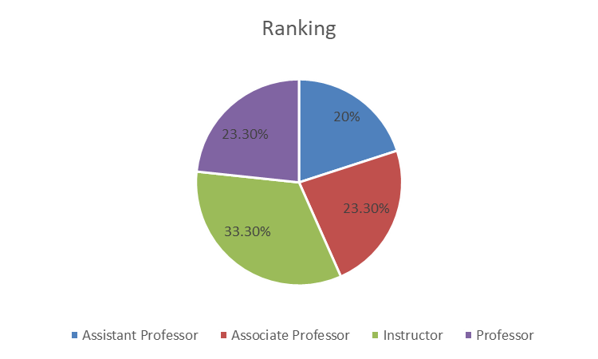
Participants
Participants
30 University Faculty Members
40% Female; 60% Male
Average age 44
Ranged from 29-67 years
Ranged from 14 different states
27% Florida
7% Louisiana
N

Slide 7
Survey
Composed of 63 questions
Q. 1-8
Personal Characteristics
Demographics, Education, Professional Experience, etc.
Q. 9-14
University Characteristics
Size, Classification, COSMA accreditation, etc.
J

Slide 8
Survey
Q. 15-25
Confidence to Teach Content/Courses
Score range 0-100, represented as a percentage
Q. 26-35
Confidence in Aspects of Teaching
Score ranging from 0-100; represented as percentage
J

Slide 9
Survey
Q. 36-44
Confidence to Prepare Students for Careers
Q. 45-52
Confidence in Scholarship and Administrative Functions
J

Slide 10
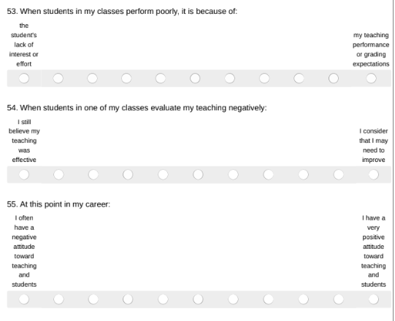
Survey
Q. 53-55
Q. 56-63
Training and Mentoring
Graduate assistantship, research collaboration
Previous observation of and from peers, superiors
Leadership positions
J

Slide 11
Confidence to Teach Content/Courses
A

Slide 12
A

Slide 13
A

Slide 14
Findings
Negative correlation between years of professional sports management experience and reason for students performing poorly.
r=-.551, p=.008
Positive correlation between years of professional sports management experience and helping low-achieving students improve their performance.
r=.400, p=.035
N

Slide 15
Findings
Negative correlation between years of professional sport management experience and..
Confidence to engage in research in sport management
r=-.466, p=.016
Confidence to present at professional conferences
r=-.564, p=.003
Confidence to publish in academic journals
r=-.498, p=.010
A

Slide 16
Conclusion
Based on this small sample, we have concluded that sport management faculty overall felt competent in their jobs in educating the next sport management practitioners. Yet further studies should be done in more depth to develop training modules to assist sport management faculty.

Slide 17
Questions? Contact Info
Eddie Hebert ehebert@southeastern.edu
Ashley Bowers abowers@southeastern.edu
Jill Sharp jill.sharp@southeastern.edu
Nicholas Smith nismith@fiu.edu

