Slide 1
COSMA Conference 2017 Tampa, FL
Classroom/Field Linkages

Slide 2
Introduction
It is standard practice for sport management programs to develop formal and informal partnerships with a variety of organizations the sport industry (Caffyn, 2000; Jacoby, 2003; Solnet, Robinson, & Cooper, 2009).
While the focus of most academic research in the recent past focuses on partnerships with entities in sport business, there are also advantages from partnering with K-12 schools as well (Gullatt & Jan, 2003; Jeffers, Safferman & Safferman, 2004).

Slide 3
Introduction
Experiential learning, considered to be a vital component of student learning for professional development for students by the Commission on Sport Management Accreditation (COSMA).
The purpose of this presentation is to highlight the benefits of establishing partnerships between university sport management programs secondary schools. Specifically, this research focuses on the development of partnerships with area schools to provide an experiential learning opportunity for students and develop an avenue for student recruitment.

Slide 4
Introduction
Sport Management academic programs are proliferating in secondary schools
Academics, magnet programs, and other initiatives such as student clubs.
Fertile ground for partnership building and recruiting future students.

Slide 5
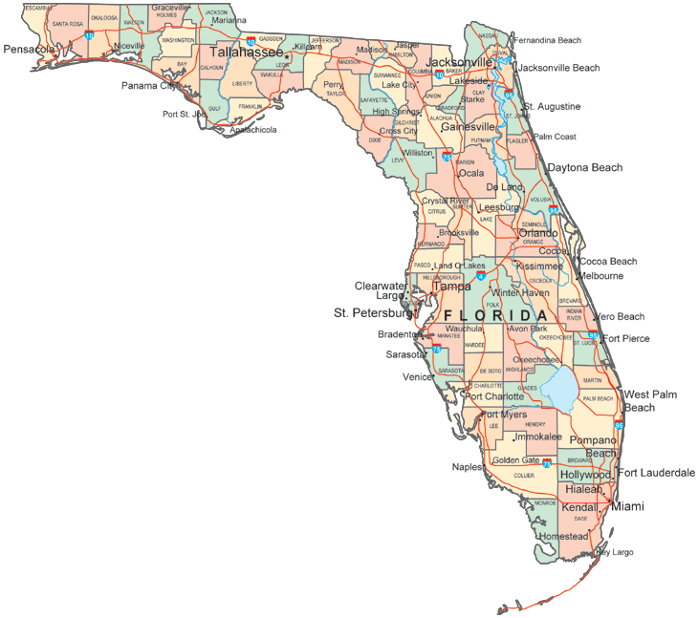
Casting a Wide Net
When partnering with schools you may go local or regional
Regional partnership with a school 1.5 hr away
Opens up avenues for further program development and recruitment

Slide 6
The Sport Science Academy (SSA) at Mainland High School
Mainland High School’s SSA in Daytona Beach, Florida offers a special academy for students with career interests in the sport.
SSA is comprised an initiative that comprises a “school within-a-school” while integrating English, science, mathematics, physical education, and health into a wide-ranging academic curriculum (Sports Science Academy, 2016).
This program provides both academic and vocational experiences in various sport–related fields including sport management, athletic training, and strength and conditioning.
Utilizing a focus that integrates these sport-based fields, seeks to aid students by preparing them for entrance into college programs in such areas.

Slide 7
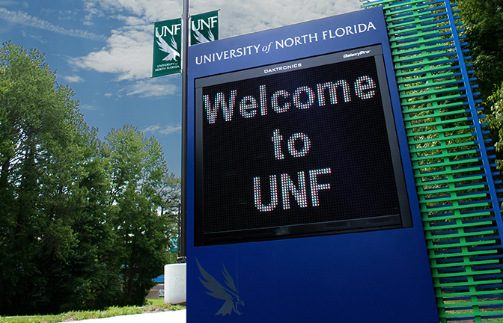
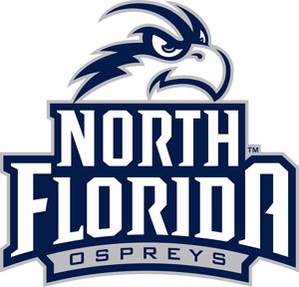
The Sport Science Academy – Learning at UNF
A group consisting of sports administration students and athletic training student aides to meet with a Sport Management professor.
The groups was comprised of approximately 20 students where were able to learn about both academic areas at the University while also getting to take part in intercollegiate sport involvement at the school’s athletic department.
During this session, students were able to learn from the professor’s experiences in cultivating a collegiate sport management program, developing curriculum, building partnerships with those in the local sport community, and professional preparation strategies.

Slide 8
Staying Local
Various benefits of staying in your own backyard
More connections can be made
A more specific target
Assorted programs in area
Some more established
Some new
New initiatives being cultivated

Slide 9
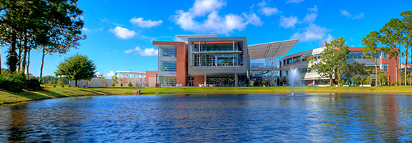
On the Field of Play
Includes - involvement with the university athletic department
Connection to institutional Community Based Learning & Service Learning initiatives
Embedded in Sport Management curriculum
Can benefit from other initiatives on campus
CAMP Osprey
UNF Meet & Greet

Slide 10
C.A.M.P. OSPREY
C.A.M.P. Osprey is an innovative leadership mentoring program that pairs collegiate student leaders from the UNF with Duval County public school students.
Includes an on-campus immersion program and provides weekly mentoring sessions for K-12 students.
The success of other programs like C.A.M.P. Osprey has had a great impact in the state of Florida and has helped to develop the leadership skills of hundreds of students.
C.A.M.P. OSPREY
Collegiate Achievement Mentoring Program

Slide 11
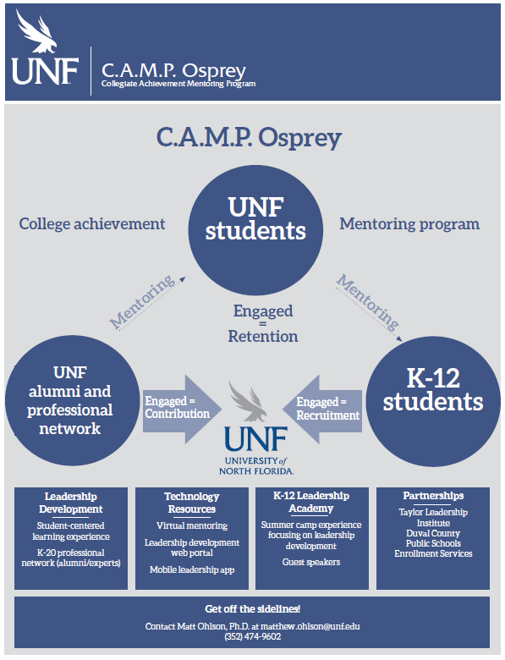
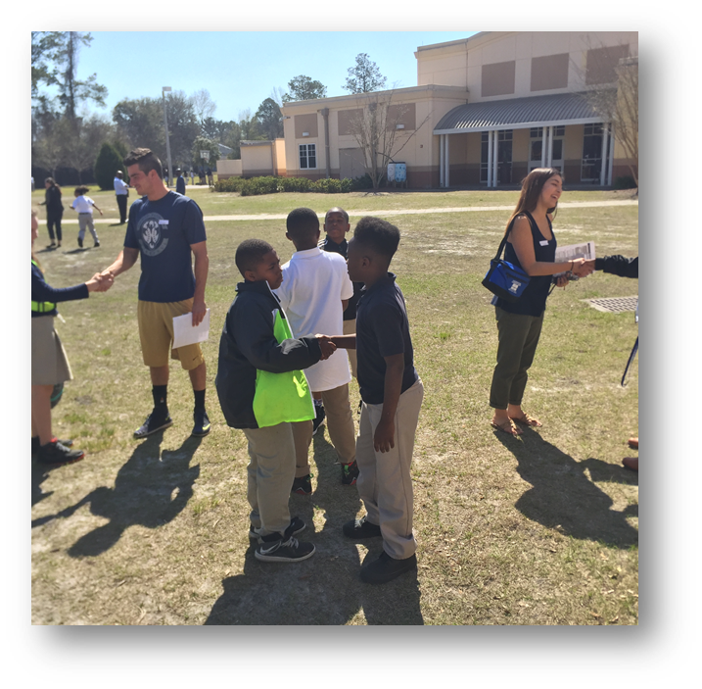
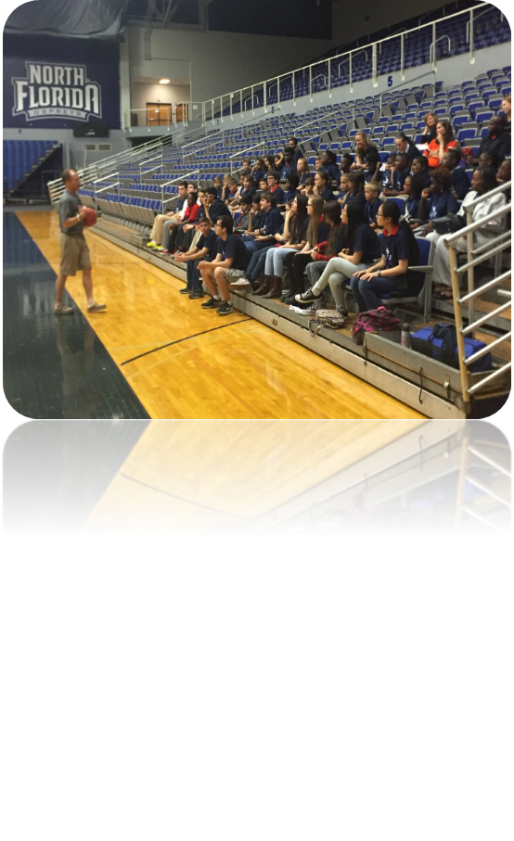
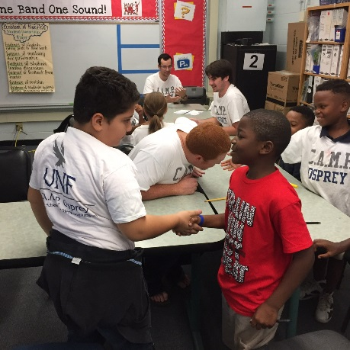
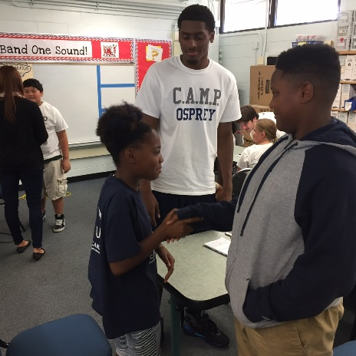
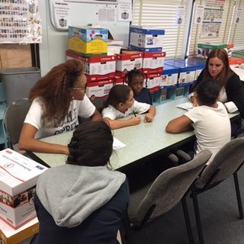
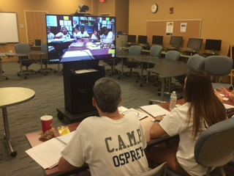

Slide 12
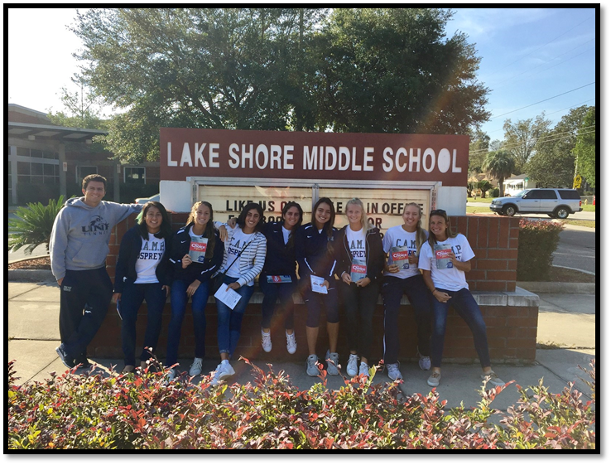
UNF Women’s Tennis
CAMP's latest installment of CBL opportunities offers a unique evolution of the initiative through providing an innovative partnership involving intercollegiate student-athlete mentorship.
The NCAA states that effective learning experiences for collegiate students should encourage the development of character, integrity, and leadership skills (NCAA, 2014).
Fits into the mission of UNF & its athletic department.

Slide 13
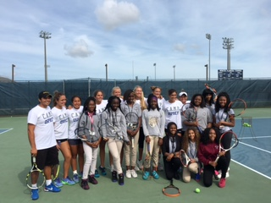
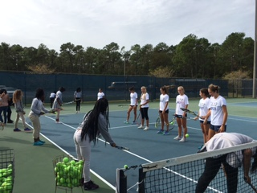
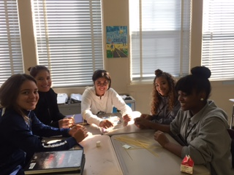
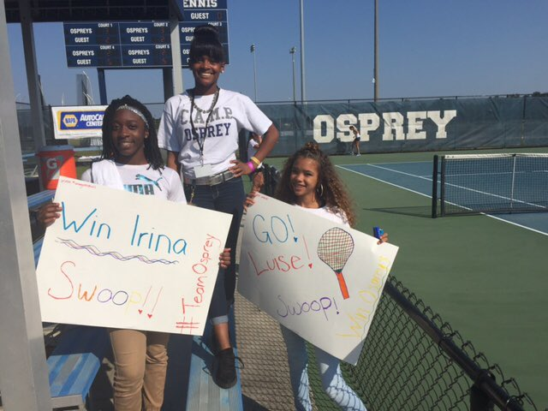
UNF Women’s Tennis
UNF + Lake Shore Middle School = Success
Campus immersion
Mentorship
Service
Growth – Hope – Encouragement

Slide 14
Conclusion
The future is bright
Various new initiatives being explored
Educational opportunities
Research opportunities
Further partnership building opportunities

