Slide 1
Examining the Importance of Professional Development:
Promoting, Encouraging, and Documenting Impactful Scholarly and Professional Activities
Dr. Jason W. Lee & Dr. Jeff Briggs

Slide 2
Professional Development & Principle 5
COSMA
Notes:
Introduction to the issue at hand: Principle 5

Slide 3
ABOUT US
Varied Experiences…
Working with COSMA
Program Development & Administration
Professional Development
Notes:
We can tell a bit about ourselves, our experiences with COSMA and related areas…

Slide 4
WHY WE ARE HERE
TO DETAIL PRINCIPLE 5…
Identify
Examine
Open Dialogue
Notes:
Here we can introduce the importance of this topic and why we are here today (this will set up the background info)

Slide 5
Background
COSMA has provided a strong impact of the field of sport management for more than a decade
Sport management accountability and accreditation is “necessary to ensure academic rigor and can serve as vehicles by which sport management educators examine and enhance the academic quality of their programs” (Yiamouyiannis, Bower, Williams, Gentile, & Alderman, 2013, p. 51).

Slide 6
Background
COSMA’s accreditation Principles have provided a structure recognizing and encouraging meaningful professional development (PD) opportunities.
This session will address the significance of Principle 5 to academicians/administrators and the value of impactful scholarly and professional development activities.

Slide 7
Background
The session will examine a variety of PD (“scholarly” and other “professional”) activities that will be beneficial to programs going under self-study as well as beneficial to administrators and faculty seeking to enhance their careers
Furthermore, related concepts such as mentorship and networking will be detailed.

Slide 8
This session will:
Provide a forum for the discussion and examination of COSMA’s Principle 5
Address Boyer’s scholarship domains and its application to sport management accreditation
Examine impactful ways to promote, encourage, and documenting PD activities
Identify ways in networking and mentorship can assist programs in engaging in meaningful scholarly and professional activities

Slide 9
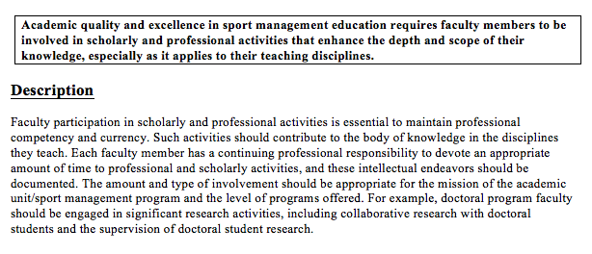
Discussing & Examining Principle 5
COSMA’s Principle 5 espouses the importance of PD activities including scholarly and professional activities.
“Academic quality and excellence in sport management education requires faculty members to be involved in scholarly and professional activities that enhance the depth and scope of their knowledge” (COSMA, 2016, p. 35).

Slide 10
Discussing & Examining Principle 5
The type and amount of professional development is to be aligned with an institution’s mission and vision
Are to allow faculty to engage in scholarly and professional activities is essential to maintaining professional competency and currency and documented this involvement accordingly (COSMA, 2016).

Slide 11
Discussing & Examining Principle 5
COSMA presents a classification system that is based largely on Boyer’s (1990) domains.
Boyer’s Scholarship Domains
The scholarship of teaching (and learning)
The scholarship of discovery
The scholarship of integration
The scholarship of application

Slide 12
What does it mean to be a “scholar”?
Faculty’s work life encompass a range of “competing obligations”
Do we define scholarship in a way that reflects “new realities”?
A broader vision of scholarship is needed
One that promotes full intellectual life of academe
Notes:
Defining Scholarship:
Boyer’s 4 Models and
The new digital scholarship:
A Faculty Conversation
Joseph McNabb, PhD and Nancy Pawlyshyn, PhD
Faculty Fellows in Higher Education Administration
March 13, 2014
Faculty Professional Development Day
Retrieved from: https://www.northeastern.edu/cpsfacultycentral/wp-content/uploads/2013/03/Defining-Scholarship-with-Boyers-Four-Areas-of-Scholarship-Explored-and-the-New-Digital-Scholarship-A-Faculty-Conversation.pdf

Slide 13
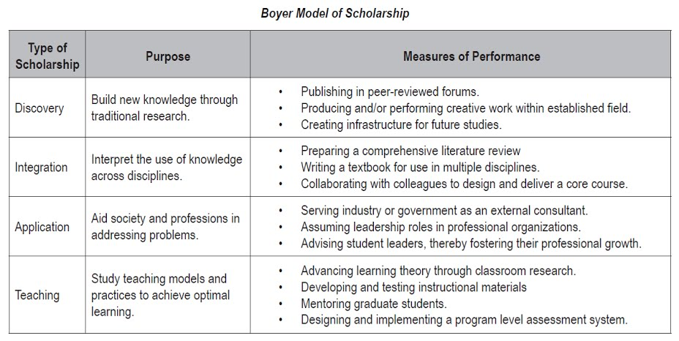
Boyer’s Scholarship Domains
Notes:
Providing a further detailed look into this model (we can use something different)

Slide 14
The Scholarship of Discovery
Seeking new knowledge
Traditional definition of “scholarship”
Discovery of new information and models
Sharing discoveries through scholarly publication
Notes:
“..the commitment to knowledge for its own sake, to freedom of inquiry”

Slide 15
The Scholarship of Integration
Integration of knowledge from different sources
Presenting overviews of findings of a resource topic
Bringing findings together from different disciplines to discover convergence
Identifying trends and seeking knowledge in new forms
Notes:
“Bringing insight to bear on original research” with “interpretive,
integrative, interdisciplinary” approaches

Slide 16
The Scholarship of Application
Discovering ways new knowledge can be used to solve “real world” problems.
New intellectual problems can arise out of the very act of “application”
This is very applicable to Higher Education
Notes:
“Higher education must serve the interests of the larger community”
with the application of knowledge to real world problems.

Slide 17
The Scholarship of Teaching
Involves the search for innovative approaches and best practices to develop skills and disseminate knowledge
Notes:
“Aristotle said: ‘Teaching is the highest form of understanding.’”

Slide 18
Boyer’s Scholarship Domains
There is a need for a more inclusive view of what it means to be a “scholar”
—Recognizing that knowledge is acquired through research, through synthesis, through practice, and teaching
Notes:
Boyer’s scholarship domains and its application to sport management accreditation

Slide 19
Discussing & Examining Principle 5
Beyond “Scholarly Activity” COSMA identified “Professional Activities” as actions “related to a faculty member’s recognized area of disciplinary expertise for the purposes of providing professionally-related service; developing, maintaining, or enhancing content expertise, skills, or professional standing; or supporting professional organizations” (COSMA, 2016, p. 35).

Slide 20
Promoting, Encouraging & Documenting PD Activities
“Scholarly”
Other Professional Activity
These include activities such as:
Publishing articles
Presenting at academic conferences
…and much more
These include activities such as:
Professionally related consulting and other related service activities,
Engagement in professional development or enrichment activities (e.g., seminars, symposia, workshops, or professional meetings),
Membership in professional organizations, serving in a leadership role in relevant professional organizations)
The BEST examples are yet to come!!!!!
Notes:
Promoting, Encouraging & Documenting PD Activities
We can examine impactful ways to promote, encourage, and documenting “scholarly” and other “professional” PD activities
We can list different items here as needed:
These include activities such as professionally related consulting and other related service activities, engagement in professional development or enrichment activities (e.g., seminars, symposia, workshops, or professional meetings), membership in professional organizations, serving in a leadership role in relevant professional organizations).

Slide 21
Appropriate Involvement?
“The amount and type of PD should appropriately align with the mission of the academic unit/sport management program and the level of programs offered” (COSMA, 2016, p. 32).
Doctoral program faculty should be engaged in significant research PD, including collaborative research with doctoral students and the supervision of doctoral student research.
Program Coordinators/Chairs might need to engage in more administratively-oriented PD (Program Marketing, O&S Development, or Technological Innovation Ideas).
Notes:
Note: This is where we can address different nuances associated with different institution types with different expectations.
The amount and type of involvement should be appropriate for the mission of the academic unit/sport management program and the level of programs offered.
For example, doctoral program faculty should be engaged in significant research activities, including collaborative research with doctoral students and the supervision of doctoral student research.
This is where we can address different nuances associated with different institution types with different expectations

Slide 22
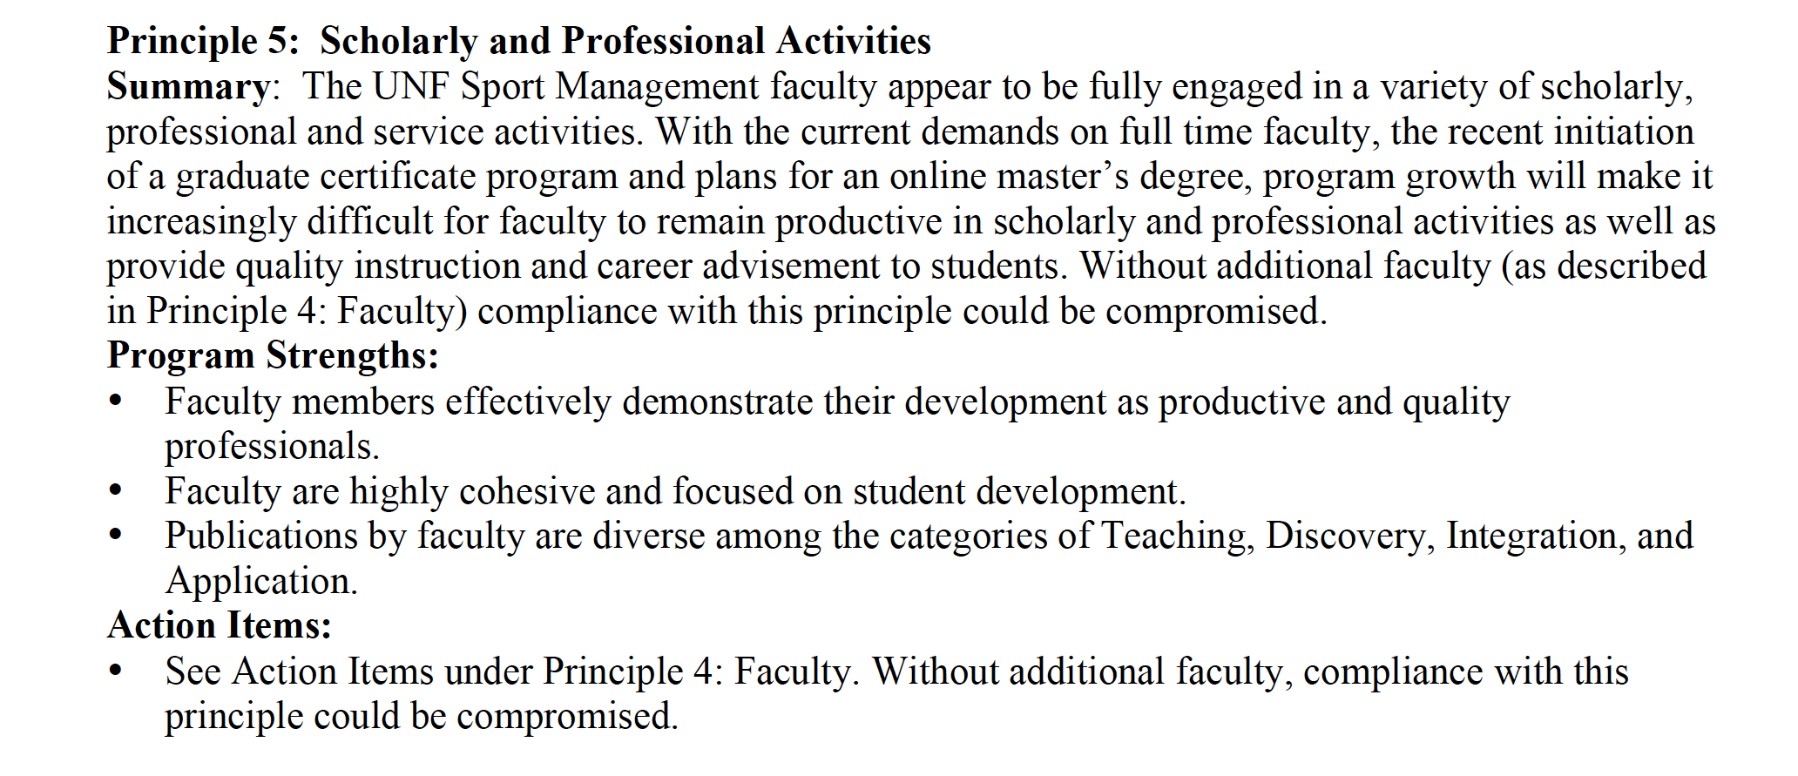
Consider this…
Notes:
This is from UNF report several years ago…
This is a table that used to be utilized
Should we use this as an example of what was used and walk through the opportunities and challenges of developing this…
From Post Site Visit Summary feedback from April 30, 2014

Slide 23
Appropriate Involvement?
Not all institutions are built alike.
Not all faculty are built alike.
PD should expand well beyond the Scholarship of Discovery, into more of the Scholarships of Integration and Application.

Slide 24
PD Necessity
PD is necessary since Faculty wear multiple hats, operate in inter-disciplinary fields, and often do the job of many university individuals:
1. Teacher
2. Adviser
3. Administrator
4. Project Developer
5. Writing Instructor
6. Technologist
7. Event Producer
8. Fundraiser
9. Marketing “Overseer”
10. Club Sponsor
PD in the forms Scholarship of Integration and Scholarship of Application address more of these facets of the Faculty member. Hence varied PD is largely necessary to accomplish comprehensive Faculty Development.

Slide 25
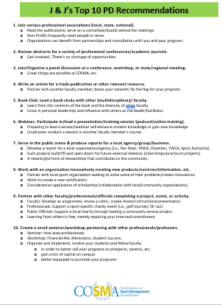

Slide 26
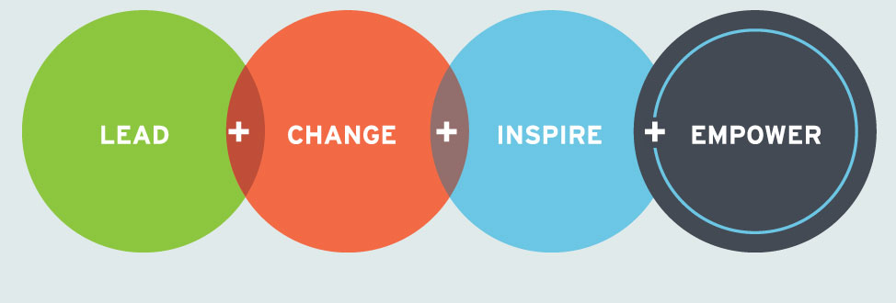
Networking & Mentorship
Notes:
Here we can identify ways in mentorship and networking can assist programs in engaging in meaningful scholarly and professional activities
We can introduce the importance of mentoring and networking…and the elaborate on the subsequent slides

Slide 27
Networking
Find your tribe…
Notes:
Here we can detail opportunities for networking, building and expanding a network, and the associated benefits
Finding your tribe: https://www.entrepreneur.com/article/340058

Slide 28
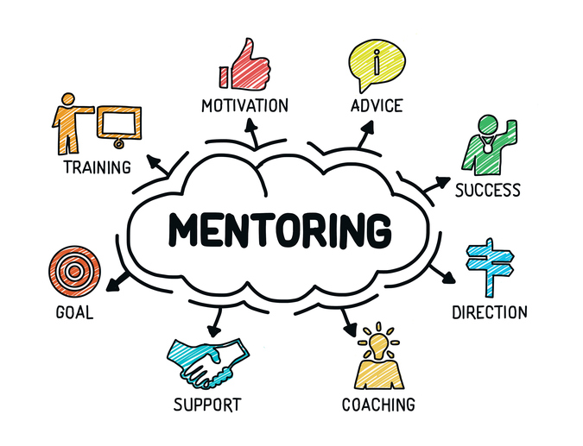
Mentorship
Notes:
I think the notion of mentorship is key to this discussion. There is a lot that we can do to explain the importance of mentoring, offer prospects for how to mentor and give success stories from mentoring relationships
Something to consider: https://hbr.org/2016/10/start-networking-with-people-outside-your-industry

Slide 29
SUMMARY
COSMA Principle 5
Professional Development in Action
The importance of engagement
Many ways to be involved
Mentorship and Networking are key!

Slide 30
THANK YOU!
Email:
Jason.Lee@unf.edu
Jeff.Briggs@ngu.edu

