Slide 1
A Global and Diverse Perspective: Taking an Introspective Look at Faculty Diversity within Sport Management
B. Nalani Butler Ph.D. University of Tampa
Ryan Turcott Ph.D. Adelphi University

Slide 2
COSMA and Diversity
Recognize and promote excellence in sport management curriculum world-wide
Importance of Common Professional Components (CPC‘s)
To offer classes that cover issues in diversity and international sport management (Principle 3)
To focus on policies regarding diversity and the global sport environment (Principle 7.5 & 7.6)

Slide 3
Purpose
Review faculty diversity for all COSMA accredited institutions.
Discuss:
How COSMA can be proactive in identifying faculty diversity and inclusion within the self-study and accreditation process
How COSMA can promote and integrate progressive strategies to create dialogue within the sport management departments and on faculty diversity
How departments can effectively recruit and mentor minority faculty and students within sport management

Slide 4
Literature: Gender and Faculty Diversity
Gender of an instructor can have a distinct impact on the educational experiences of undergraduates in terms of both how classes are taught and course content.
Female faculty are much more inclined than male faculty to require cooperative learning, experiential learning or field studies, and group projects in some or most of their courses.

Slide 5
Literature: Race and Faculty Diversity
Greater structural diversity among faculty leads to an increased use of effective educational practices (Umbach, 2006)
There is a significant relationship between student growth on various educational outcomes and activities during college associated with having a diverse student body and faculty (Hurtado, 2001)

Slide 6
Methodology
Collected data on faculty race and gender on all COSMA accredited institutions
Referred to the Race and Gender Report Card (Lapchick, 2012) and modeled data collection off of study
Data Collection took place from December 2018 to January 2019

Slide 8
Race and Gender Report Card
The Institute for Diversity and Ethics in Sport has a grading scale to better reflect current demographics.
The change in the nation’s demographics has been dramatic with the most recent census making all people of color and minorities closer to 35 percent (within their organization).
To get an A for race:
the category now needs to have at least 30 percent people of color
to get an A for gender, 45 percent is necessary
Some faculty names did not provide images
guessed gender based on names

Slide 9
Race & Gender Scale (Lapchick, 2018)

Slide 10
COSMA Accredited Institutions
Total # of Institutions: 32 Colleges and Universities
55 Accredited Programs ( as of January 2019):
34 Bachelors
18 Masters
3 Doctoral

Slide 11
151 Participants By Sex Male = 87 Female= 59 Not Listed = 5
26 Full Professors (12 Female & 14 Male)
54% Male
64 Associate Professors (23 Female & 41 Male)
64% Male
46 Assistant Professors (25 Male & 21 Female)
54% Male
9 Lectures (6 Male & 3 Female)
66% Male
1 Juris Doctorate (1 Female)
100% Female
5 Not Listed

Slide 12
151 Participants By Race 117 = White, 13 = Asian, 12 = Black, 2 = Latino 7 = No Image
26 Full Professors
21 White (81%)
2 Asian
2 No Image
1 Black
64 Associate Professors
50 White (78%)
7 Asian
5 Black
2 Latino
46 Assistant Professors
36 White (78 %)
6 Black
4 Asian
9 Lecturers
(100% White)
1 J.D.
(100% White)
5 Images Not Listed

Slide 13
Results with Grades

Slide 14
Sport Management Faculty: Gender Report Card
26 Full Professors
12 Female & 14 Male
54% Male
Grade: A+
64 Associate Professors
23 Female & 41 Male
64% Male
Grade: A+

Slide 15
Sport Management Faculty: Gender Report Card
46 Assistant Professors 21 Female & 25 Male
1
54% Male
Grade: A+
9 Lectures
3 Female & 6 Male
2
66% Male
Grade: A+

Slide 16
Participants By Race
26 Full Professors
21 White (81%)
2 Asian
2 No Image
1 Black
GRADE: B+
64 Associate Professors
50 White (78%)
7 Asian
5 Black
2 Latino
GRADE: B+

Slide 17
Participants By Race
46 Assistant Professors
36 White (78 %)
9 Lecturers
9 White (100%)
GRADE: F
6 Black
4 Asian
GRADE: B+

Slide 18
Limitations
Assumption based on appearance and not self-identification
Some programs did not have faculty images on website
Some did not have faculty names listed on website
Some did not have ranks or positions listed

Slide 19
Discussion
How can COSMA can be proactive in identifying faculty diversity and inclusion within the self-study and accreditation process?
How can COSMA promote and integrate progressive strategies to create dialogue within the sport management departments and on faculty diversity?
How departments can effectively recruit and mentor minority faculty and students within sport management?

Slide 20
How can COSMA can be proactive in identifying faculty diversity and inclusion within the self-study and accreditation process?
Record gender, race, and rank within sport management departments
Have departments incorporate an action approach for recruitment and retention of minority faculty and students within strategic plan
Should the diversity within the student population be recorded?

Slide 21
How COSMA can promote and integrate progressive strategies to create dialogue within the sport management departments and on faculty diversity?
Establish a caveat for continued education on minority recruitment and retention
Have discussions at the COSMA annual conference about minority recruitment and retention

Slide 22
How can departments effectively recruit and mentor minority faculty and students within sport management?

Slide 23
The Compact for Faculty Diversity (25 years)
Four-day conference that has become the largest gathering of minority doctoral scholars in the country.
Gives the issue of faculty diversity a national focus
Provides minority scholars with the strategies necessary to
Survive the rigors of graduate school
Earn the doctoral degree
Succeed as a member of the professoriate.

Slide 24
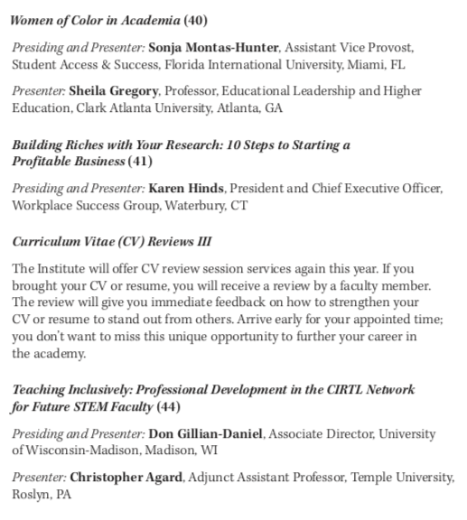
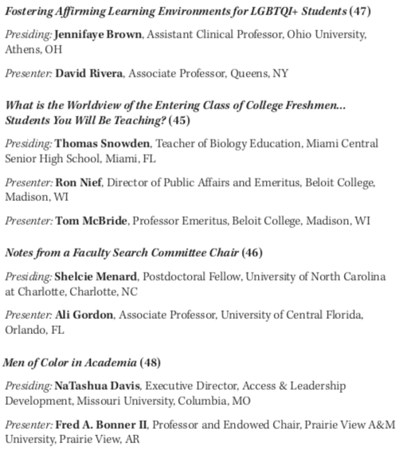

Slide 25
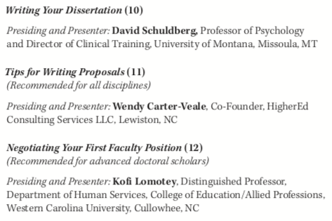

Slide 26
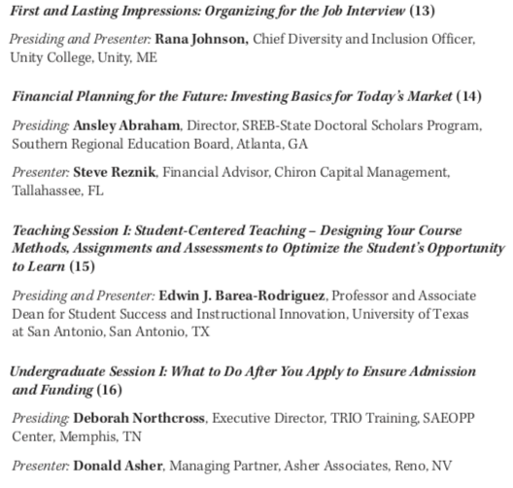

Slide 27
Basic Recommendations to Promote Faculty Diversity (American Federation of Teachers, 2010)
Taking an in-depth look at what is happening on the diversity front on your campus
Initiating a discussion with your leaders and membership about possible plans of action, including ways to incorporate diversity activities into the collective bargaining contract

Slide 28
B. Nalani Butler Ph.D. University of Tampa bbutler@ut.edu
Ryan Turcott Ph.D. Adelphi University rturcott@adelphi.edu

