Slide 1
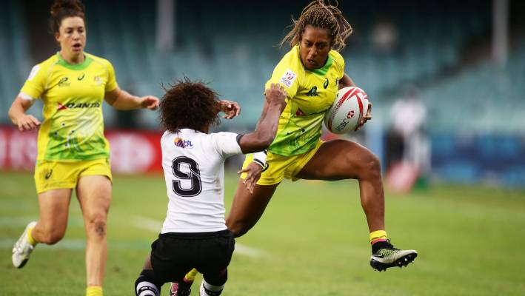
Gender Equity in Sport Management Academic Program Enrollment: Generating a Dialogue through Faculty Perspectives

Slide 2
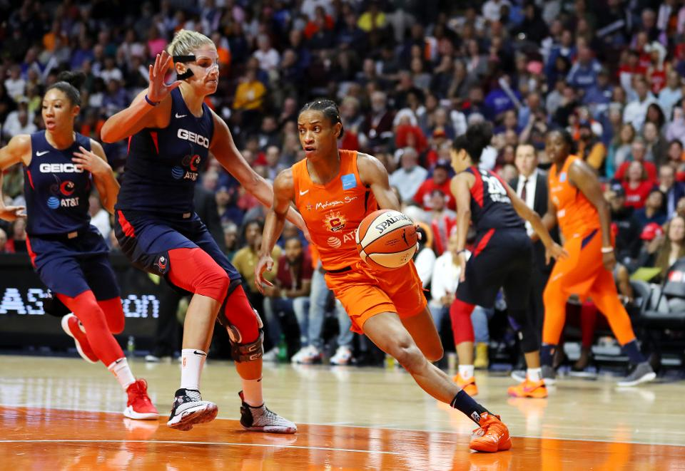
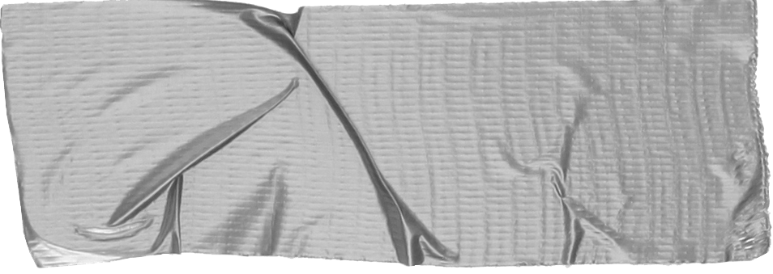
Question 1
Current State of Affairs:
How many females are in your respective program?
What are the sport enrollment trends at your university?

Slide 3
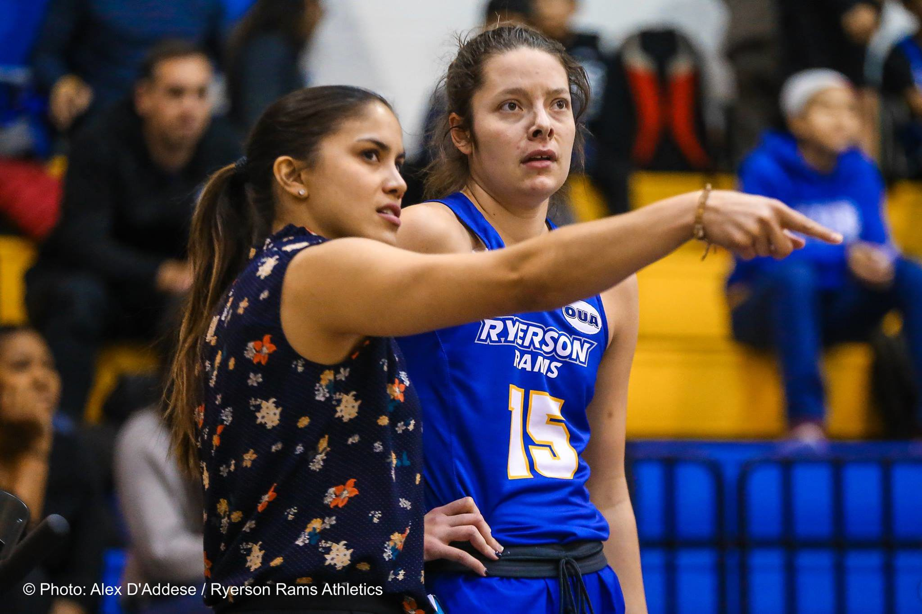
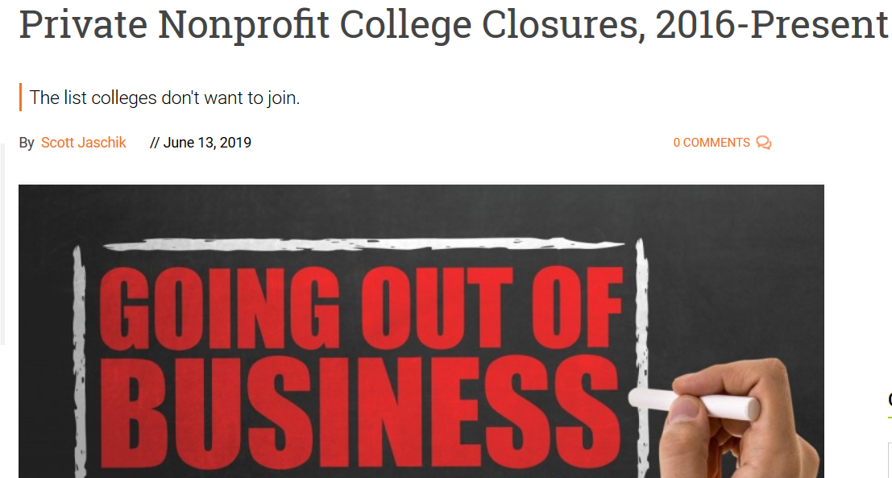
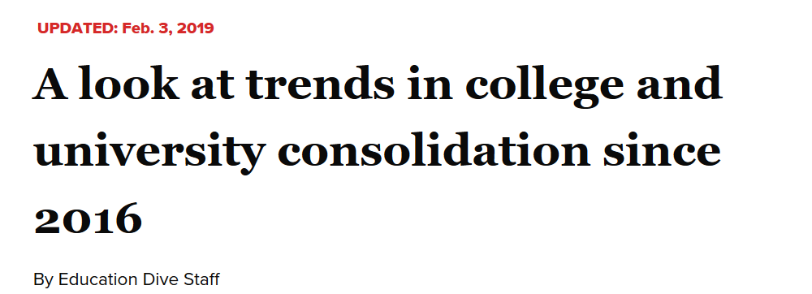
Trends...

Slide 4
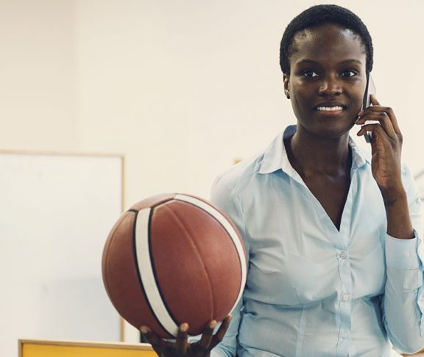
Trends...
Women represent between 30-40% of SMGT students (Hancock & Hums, 2011)
Female college enrollment (in general) has increased 195% over the past several decades (US Dept. Of Education, 2009)
Women hold about 23% of all NCAA head coaching, athletics director and conference commissioner positions

Slide 5
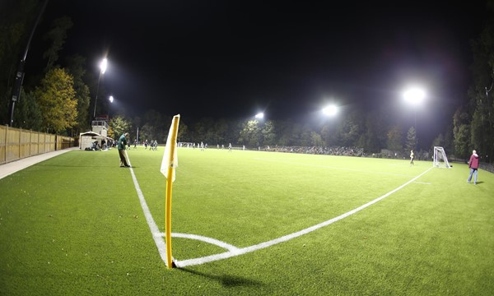
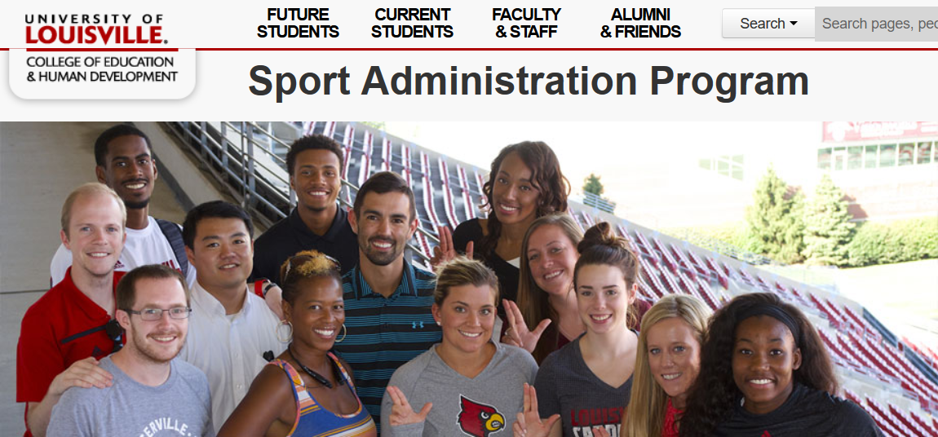
Question 2
How do we proactively recruit women to sport management academic programs?

Slide 6
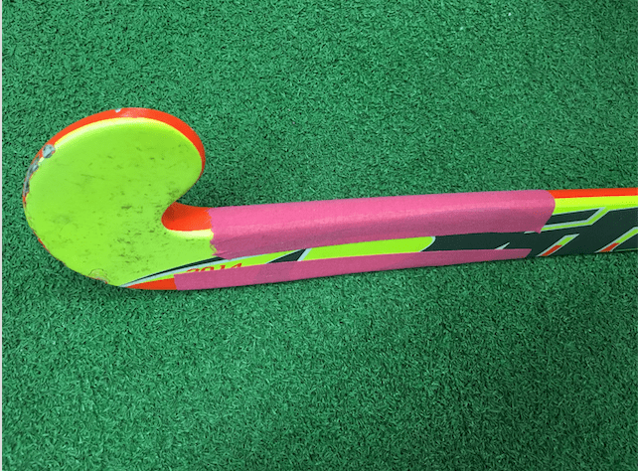
Question 4
What steps should be taken in order to retain existing female sport management students?
Question 3
What obstacles (barriers to entry) exist that limit female enrollment in sport management programs?

Slide 7
What role should other stakeholder groups play (faculty, staff, coaches, administration, advisory boards, etc.)?
Question 5
Question 6
What are some ways faculty can facilitate professional development opportunities for women on campus or in the community?

Slide 8
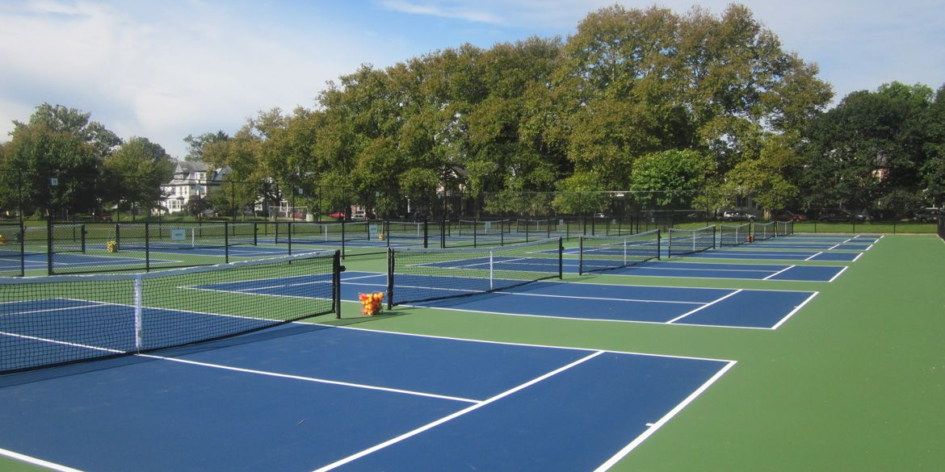
Question 7
What resources do you need to enact your ideas?
Question 8
What other questions should we be asking?

Slide 9
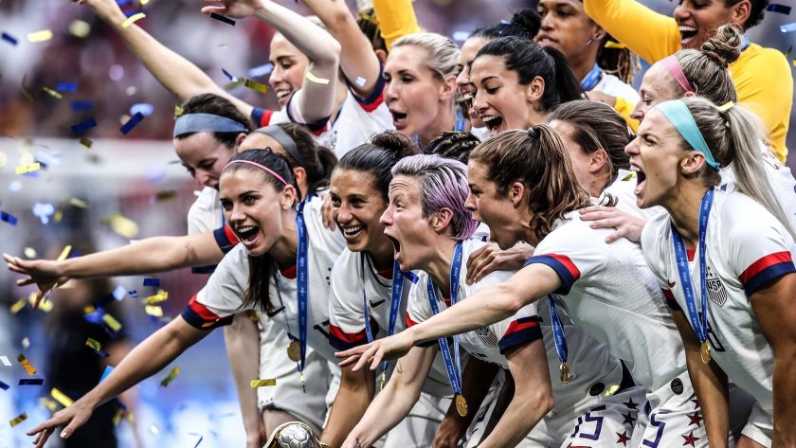
Implementing potential strategies...

