Slide 1
"Hoop Dreams": Black Male College Students Perceptions of Post Collegiate Play and the Effects on Their Mental Health
Niesha C. Douglas Ed.D
Fayetteville State University
Department of Health, Physical and Secondary Education

Slide 2
Introduction
According to the NCAA, only 1 in 4,233 high school players go from high school to college to professional sports.
Black men were 2.4% of undergraduate students enrolled at the 65 universities, but comprised 55% of football teams and 56% of men’s basketball teams on those campuses.
A staggering 57% of individuals who deal with mental illness have not received any professional help (National Institute of Mental Health; NIMH, 2017).
33% of student-athletes identify with symptoms of depression (Cox, Ross-Stewart, & Foltz, 2017)
Black student-athletes experience a higher rate of suicide (Rao et al., 2015)
Division I student-athletes are at greater risk of suicide when compared to other NCAA classifications, and male student-athletes are more likely to commit suicide than female student-athletes (Rao et al., 2015)

Slide 3
Review of Literature
In 1994, a sports documentary by the name of “Hoop Dreams” followed to two Chicago basketball players: William Gates and Arthur Agee. The film crew documented their journey to the pro’s from the time they were scouted.

Slide 4
Hoop Dreams

Slide 5
Review of Literature (cont.)
Scholars have recently examined how Black men are socialized to value sports over academics at a young age (e.g., Beamon & Bell, 2006; Benson, 2000)
The ways in which colleges and universities reap enormous financial benefits at the expense of Black male student-athlete success (e.g., Beamon, 2008; Donnor, 2005; Harper, 2009a); and the long-term effects of sports participation on Black men’s psychological wellness and post-college career transitions (e.g., Beamon & Bell, 2011; Harrison & Lawrence, 2003: Harper, 2006; p.4)
There is a growing disconnect between black male athletes’ dreams and reality.
These statistics fail to reach the many families whose livelihood depend solely on the players’ ascension to the pro’s.
The fact of the matter is that due to centuries of injustices toward Black Americans including: education segregation, housing discrimination and employment discrimination, leads black families into feeling that their path to financial freedom is through sports.

Slide 6
Research question
What are the effects on Black Male College Athletes Mental Health, when “going pro” is no longer an option?

Slide 7
Methodology
The methodology used in this research study will be an embedded qualitative case study (Yin, 2014), that will use focus groups and interviews in the collection of data.
Phenomenology is also a possible method that can be used to understand the lived experiences of the participants in this proposed study (Rossman & Rallis 2012)
This study is an effort to develop a new framework or model for understanding BMCA’s perspectives and experiences that can inform colleges or university athletic departments to offer strategies that will help BMCA’s on how to emotionally cope with “dream loss”.

Slide 8
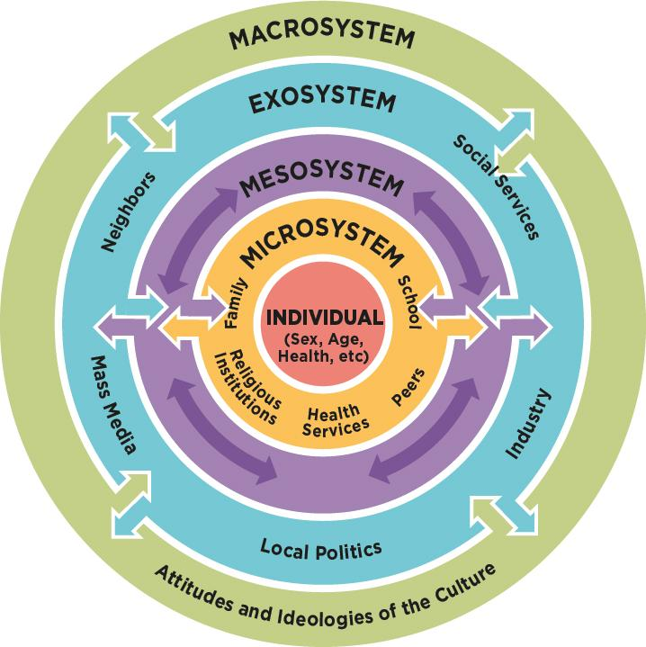
Theoretical Framework
This proposed study draws on Bronfenbrenner s Ecological Theory (1993) of Human Development.
Bronfenbrenner explains that “behavior is a function of the interactions of the person and the environment to development is a function of the interaction of the person and the environment (Evans et al., 2010, p.161).
Bronfenbrenner’s theory provides a link to towards an individual’s behavior and their environment. BMCA’s environment and culture can explain why their tunnel vision to a career path is influenced by their surroundings.

Slide 9
Other options
Write and produce a 2022 version of “Hoop Dreams”.

Slide 10
Why is the important?
To better understand our student-athletes and to identify signs of mental distress.
1
To petition colleges’ and universities to require that all student-athletes to receive counseling starting with their freshman year.
2
To bring awareness to the community i.e high school coaches, recruiters, parents and athletic adminstrators on why it is important to provide realistic expectations to BMCA’s.
3

Slide 11
Questions?

Slide 12
References
Beamon, K. K. (2008). Used goods: Former African American college student athletes’ perception of exploitation by Division I universities. Journal of Negro Education, 77(4), 352-364.
Beamon, K. K., & Bell, P. A. (2006). Academics versus athletics: An examination of the effects of background and socialization on African American male student athletes. Social Science Journal, 43(3), 393-403.
Beamon, K. K., & Bell, P. A. (2011). A dream deferred: Narratives of African American male former collegiate athletes’ transition out of sports and into the occupational sector. Journal for the Study of Sports and Athletes in Education, 5(1), 29-44
Cox, C. E., Ross-Stewart, L., & Foltz, B. D. (2017). Investigating the prevalence and risk factors of depression symptoms among NCAA division 1 collegiate athletes. Journal of Sports Science, 5, 14-28.
Evans, N., Forney, D., Guido, F., Patton, L., & Renn, K. (2010). Student Development in College: Theory, Practice and Research. San Francisco: Jossey Bass.
Lapchik, R. E. (2018). College sport: racial & gender report card. TIDES: The Institute for Diversity and Ethics in Sport.
Lapchik, R. E. (2017). The 2017 racial and gender report card: Major League Baseball. TIDES: The Institute for Diversity and Ethics in Sport.
Lapchik, R. E. (2018). The 2018 racial and gender report card: National Basketball Association. TIDES: The Institute for Diversity and Ethics in Sport.
Lapchik, R. E. (2017). The 2017 racial and gender report card: National Football League. TIDES: The Institute for Diversity and Ethics in Sport.
National Institute of Mental Health (NIMH). (2017). Mental health services received in past year among U.S. adults with any mental illness 2017. Retrieved from https://www.nimh.nih.gov/health/statistics/mental-illness.shtml
Rao, A. L., Asif, I. M., Drezner, J. A., Toresdahl, B. G., & Harmon, K. G. (2015). Suicide in National Collegiate Athletic Association (NCAA) athletes: a 9-year analysis of the NCAA resolutions database. Sports health, 7(5), 452-457.
Rossman, G. & Rallis, S. (2012). Learning in the Field: An Introduction to Qualitative Research. Thousand Oaks, CA: Sage Publishing.
Yin, R.K. (2014). Case study research designs and methods (5th ed). Thousand Oaks, CA: Sage Publishing.
Wilkerson, T., Stowkowsi, S., Fridley, A., Dittmore, S., and Bell, C. (2020). Journal of Issues in Collegiate Athletics, 55-81.

