Slide 1
SPORTS MANAGEMENT CASE SIMULATIONS
Jodi Robinett
Knowledge Matters, Inc
robinett@knowledgematters.com
816-806-0585

Slide 2
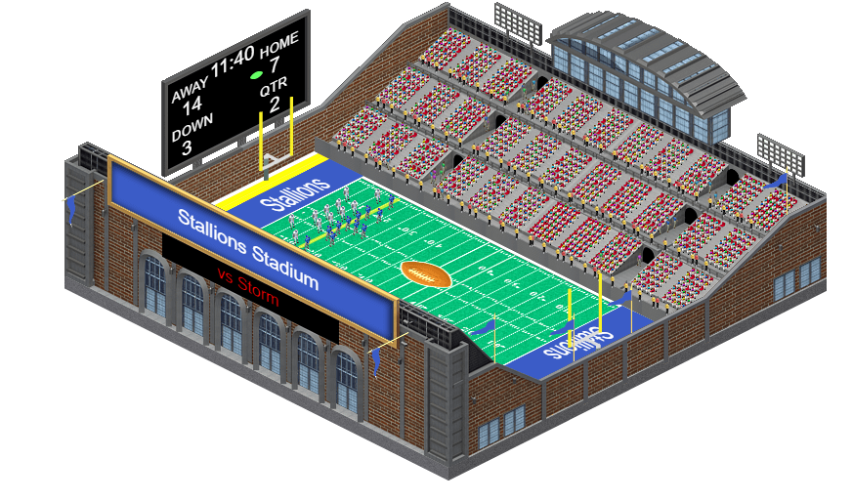
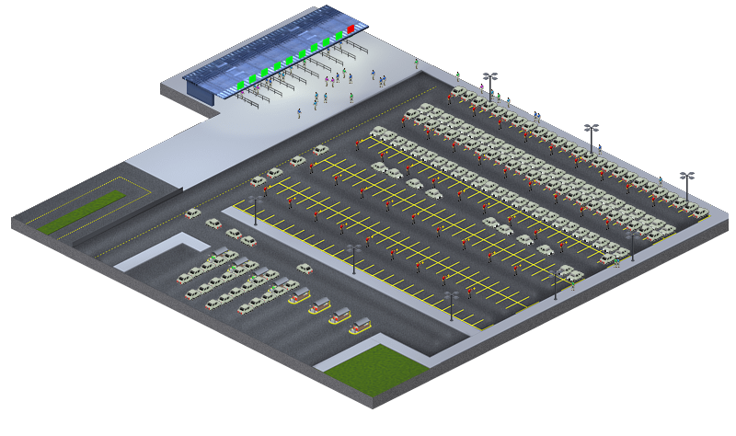
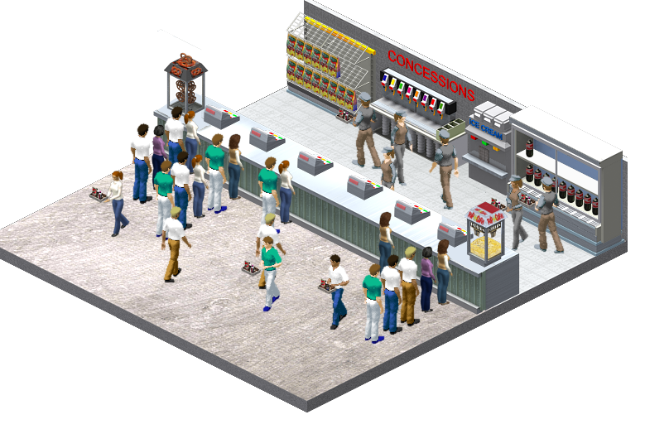
Students Learn by Doing
Knowledge Matters Case Simulations
2021
Put Your Students In Control Of Their Own Virtual Stadium and Franchise

Slide 3
Knowledge Matters Inc.
Knowledge Matters Case Simulations
2021
Established in 1997
Used in 50% of high schools and growing
Restaurant Management – 2012
Principles of Marketing– 2017
Hotel Management - November 2018
Sports Management – September 2019
Partnerships with DECA, ICHRIE, Marriott
Over 3,750,000 simulations delivered last year with 99.999% up time.

Slide 4
Accessible
Cloud-Based
Virtual Bridge
Knowledge Matters Case Simulations
2021
The Sports Management Collection is a perfect bridge between textbooks and lectures for your Sports Management classes.

Slide 5
The Sports Mgt Sim Topics
Ticket Pricing
Advance Pricing Strategies
Event Security – Ingress & Egress
Parking & Revenue
Concessions
Concessions – Capital Spending
Sponsorships
Promotion – Media & Measurement
Social Media Advertising
Television & Ticket Sales
Player Management
Ethics in Sports Management
General Manager – Sports Franchise
General Manager – Advanced Sports Franchise
Notes:
Hospitality Collection is 11 simulations and 3 longer GM projects

Slide 6
Online or In-Class
Knowledge Matters Case Simulations
2021
Enrich your course offerings beyond videos & lectures.

Slide 7
Designed to Support You!
Knowledge Matters Case Simulations
2021
| Reduce your Workload
| Integrates with Canvas, Moodle, Blackboard
| Discussion slides and teaching notes
| Automatic Grading

Slide 8
Designed for Your Students
Knowledge Matters Case Simulations
2021
| Improve engagement and retention
| Appeal to digitally-native students
| Make management decisions

Slide 9
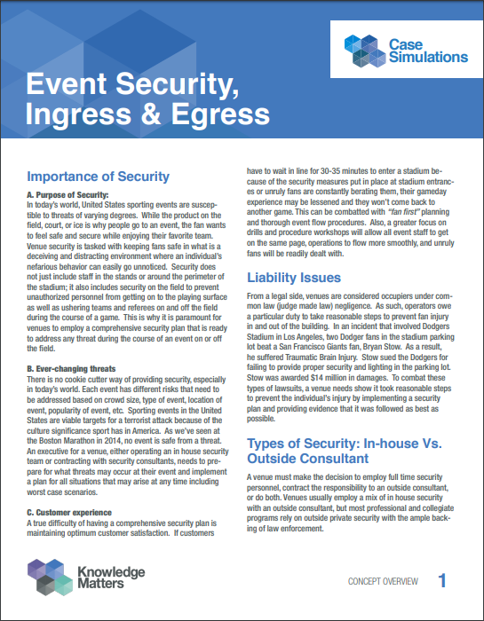
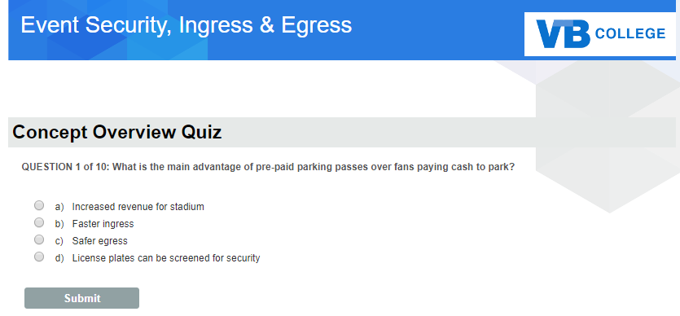
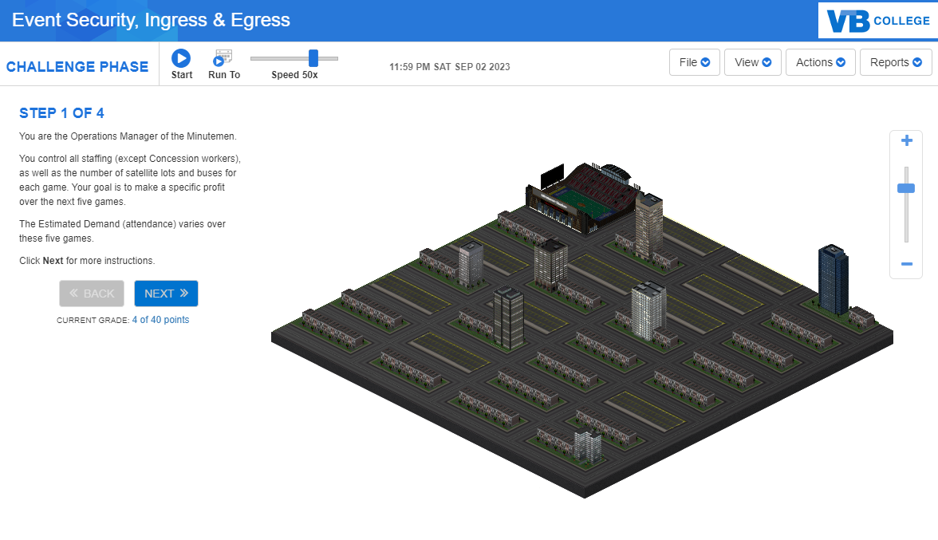
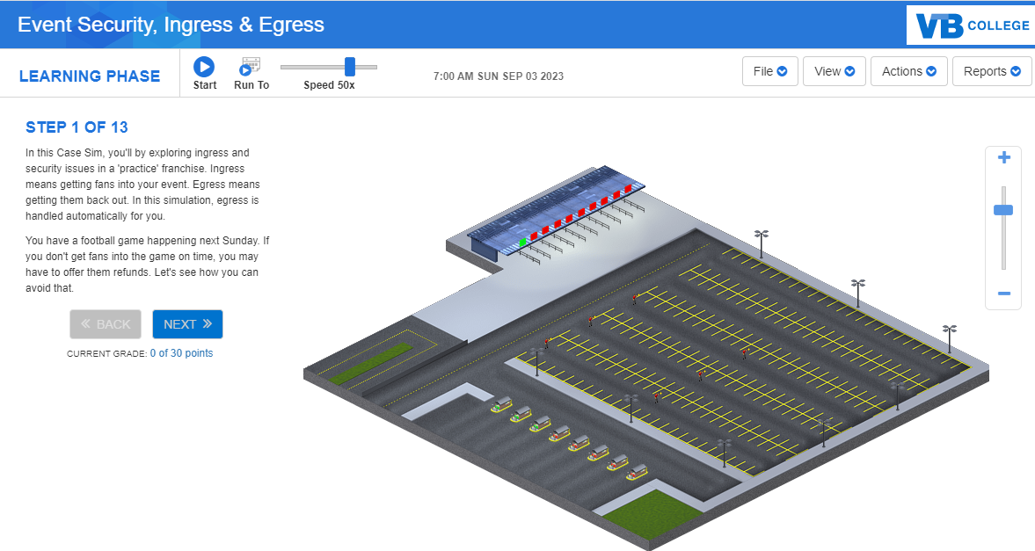
Designed for Learning
Knowledge Matters Case Simulations
2021
01 | Concept Overview
02 | Quiz
03 | Learning Phase
04 | Challenge Phase

Slide 10
Knowledge Matters Case Simulations
2019
“
This simulation has set the bar high for future classes.
“
I found the simulations much easier to understand and keep track of the concepts as opposed to an online lecture or textbook reading.

Slide 11
Knowledge Matters Case Simulations
2021
Knowledge Matters Sports Management Case Sims Clients

Slide 12
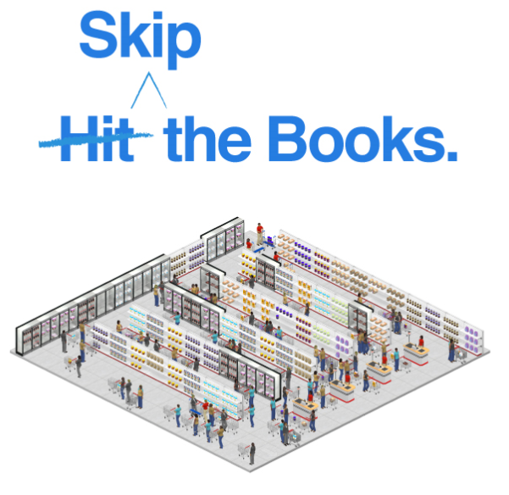
Savings
Knowledge Matters Case Simulations
2021
Transition your course and students into the digital age.

Slide 13
PRICING
Knowledge Matters Case Simulations
2021
Full access - 12 1-2 hour lessons plus 2 Projects
Per student/Per Semester
Option 1 - with reading material, quiz & Sims - $69.95
Option 2 – SIMS Only (learning and challenge phases) $39.95

Slide 14
Thank you
for your time
Learn More Jodi Robinett
robinett@knowledgematters.com 816-806-0585

