Slide 1
Looking into your crystal ball: A guide to strategic planning
Dr. Margaret L. Tudor, CMPC
The University of Tampa
College of Natural and Health Sciences
Department of Sport Management

Slide 2
COSMA’s Principle 2.0: Strategic Planning
Excellence in sport management education is enhanced through an effective strategic planning process. This requires the academic unit/sport management program to have developed and implemented a strategic plan, and to be using the plan to improve the educational and operational effectiveness of the academic unit/sport management program with input from the results of the outcomes assessment process.

Slide 3
Needs to include the following elements:
The mission of the academic unit/sport management program is consistent with the institution’s mission, and guides decision-making toward defined goals and outcomes.
The strategic planning process includes processes for developing action items for continuous improvement in the academic unit/sport management program’s activities and operations.
The strategic planning process includes methods for tracking the progress of action items and monitoring the extent to which the academic unit/sport management program’s goals and outcomes are being achieved. These methods include the process of outcomes assessment.
If possible, the strategic planning process should be connected to the institutional budgeting process.
The strategic planning process involves multiple stakeholders both inside and outside of the academic unit.

Slide 4
Where to begin?
Contemplate your organization's vision
Write a mission statement
Evaluate your current standing
List factors necessary to success
Develop a strategy for accomplishing each success factor
Prioritize strategies according to viability and growth goals
Notes:
Contemplate your organization's vision. Identify what your organization stands for, what it hopes to accomplish, what its responsibilities are, what segment of the population it wishes to cater to and work with, how it wants to be viewed and what type of growth it wants to experience.
Write a mission statement. The purpose of your mission statement is to summarize your organization's underlying purpose, or vision. Strategic plans are extensions of the mission statement, as it is the mission statement that guides the goals and serves as a means of measuring an organization's success.
Evaluate your organization's current standing. In order to plot out a course for reaching your goals, you must first understand where you are in the process of reaching those goals.
Consider the following:
Determine what your strengths and weaknesses are. You will need to develop a strategic plan that makes use of your strengths in order to minimize your weaknesses.
Identify opportunities for growth. Whatever your organization's purpose, you must be able to list viable opportunities for reaching your goals so that you can include in your strategic planning
Pinpoint threats to the success of your strategic plans. Your plan must address these threats and counter them with a viable strategy.
List factors necessary to success. Strategic plans must include specifics about the types of circumstances that will lead to the accomplishment of goals.
Develop a strategy for accomplishing each success factor. This should be in the form of a step-by-step plan, and should outline exactly what needs to be done, in what time frame, for how much of an investment and by which responsible party.
Prioritize your strategies according to viability and growth goals. Taking into account all of the steps that are necessary to achieving each of your goals, as well as the order of importance in reaching those goals, itemize your strategic plan chronologically.

Slide 5
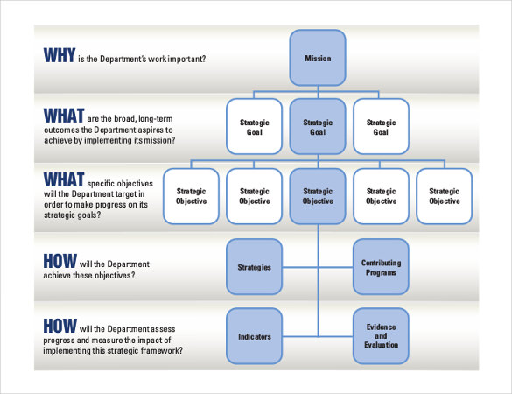

Slide 6
A note on strategic goals and objectives
Goal – connotes specific achievement; a target reached & ”checked off”
Objective – more general in connotation; helps set a course by giving a general direction
Final caution: TIMING & Phasing

Slide 7
Gap Analysis
Assess the “gap” between the current status and specific features of the vision (using SWOT & Vision Statement)
Identify what actions need to be taken to close the gap.
The Gap
Current State
Envisioned State

Slide 8
What the strategic plan COULD provide
Enrollment goals & enrollment management initiatives
Student population goals
Educational initiatives, changes in pedagogy
Changes in staffing levels
Goals or initiatives from department plans that rise to the institutional level
All have a direct bearing on coordination & use of resources: funding, facilities, personnel, and time

Slide 9
Making the Plan Work [Center for Organizational Development & Leadership]
Leadership – Defining leadership roles and responsibilities is essential to a plan’s effectiveness.
Unless a project’s leaders are successful in creating a commitment to the initiative, a plan that’s impressive on paper may fail to achieve its goals.

Slide 10
Making the Plan Work [Center for Organizational Development & Leadership]
Communication – Without careful communication planning, organizational change is likely to meet with resistance by colleagues.
Successful communication requires attention to each individual and group likely to be affected by the planning process and the plan’s goals.

Slide 11
Making the Plan Work [Center for Organizational Development & Leadership]
Assessment – Ongoing attention to assessment is necessary to monitor a plan’s progress and assess its outcomes.
These appraisals provide guidance for developing preplanning strategies, monitoring the planning process, and judging whether a plan’s activities and strategies are successful in fulfilling the organization’s goals.

Slide 12
Why are these important?
Create a diverse leadership team
Foster readiness, receptivity, & shared sense of need for change
Gain a historical perspective on efforts to change
Anticipate concerns & develop strategies
Engage faculty, staff, & other groups
Identify needed resources

Slide 13
Link Assessment & Planning
Assessment is not about people, it is about process
Learning outcomes are a component that should be guided by & integrated into the strategic plan
Also provide process improvement data to inform the planning process

Slide 14
Questions? Share any of your experiences? Thank you!
Dr. Margaret L. Tudor, CMPC
University of Tampa
mtudor@ut.edu

