Slide 1
Peer review is not enough: CrossFit, Inc. v. NSCA and the perils of publishing
COSMA 2019
Anne L. DeMartini, JD

Slide 2
Introduction
Objectives
Peer Review Experience?
Case
Peer Review Sufficiency
Solutions
Recommendations

Slide 3
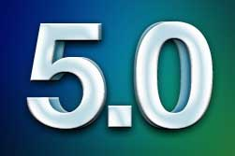
Introduction
Notes:
Introduce self
The court found that the editorial review process of a respected academic journal actually caused the research misconduct, an academic journal’s erratum misled the public, and that the misconduct has commercial implications.
Combined with the finding that an academic journal’s erratum misled the public, these rulings have the potential to change conventional thinking around academic publishing in the sport, recreation and exercise science discipline
COSMA accreditation principles require faculty participation in scholarly and professional activities in order to maintain professional competency and currency. Each faculty member has a continuing professional responsibility to devote an appropriate amount of time to professional and scholarly activities, and document these intellectual endeavors. In order to fulfill that obligation, faculty members must make decisions regarding their amount and type of involvement, ensuring it is appropriate for the mission of the sport management program. Should faculty publish? If so, in what type of publications? If in peer reviewed academic journals, which ones? Should faculty serve the profession as a journal reviewer or editor? If so, at what journal? While serving, how can faculty perform well? This study on CrossFit, Inc. v. NSCA and the perils of peer reviewed publishing assists sport management faculty in making those decisions. The study highlights problems in peer reviewed academic publishing, allowing faculty to think more critically about the review and editorial process and suggesting methods for improvement.
Methods:
This study conducted legal analysis of California state and United States federal law cases and secondary research on peer review.

Slide 4
Objectives
IDENTIFY
IMPROVE
Notes:
To identify and explain a complex, wildly interesting sport law case involving research misconduct, sport science academic publishing, and fitness industry commercial competitors
To compile data on the efficacy of peer review and articulate arguments for and against the standard editorial process in peer reviewed academic publishing
To apply the findings of the case to provide suggestions for improvement in the standard editorial process in peer reviewed academic publishing

Slide 5
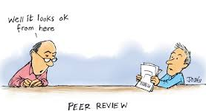
Peer review Experience?
Notes:
What have been your experiences with peer review as an author? As a reviewer? As a journal editor? What do you see as the challenges?

Slide 6
Case
CrossFit
NSCA
v.
Notes:
In May 2014, CrossFit, Inc. filed claims against the National Strength and Conditioning Association (“NCSA”), for false advertising under the Lanham Act and false advertising and unfair competition under California state laws. The lawsuit arose from a journal article published in the NCSA’s Journal of Strength and Conditioning Research that found high injury rates in study on CrossFit conducted by exercise science researchers at the Ohio State University (CrossFit, Inc, 2016). CrossFit argued these injury claims were false and the NCSA intentionally acted to disparage CrossFit by inserting the claims during the editorial process. In their investigation of the publication, CrossFit carefully scrutinized the study’s methodology, data collection, analysis and conclusions and found significant problems (Green & Berger, 2015).
In September 2016, the U.S. District Court (S.D. Ca) held a reasonable fact finder could conclude the injury data was commercial speech, and would not be shielded by the First Amendment because it was presented in an academic journal (CrossFit, Inc., 2016, p.12). The court granted CrossFit’s motion on the element of falsity, noting CrossFit presented evidence showing the injury data was in fact false— regardless of whether the authors knew it at the time (CrossFit, Inc., 2016, p.20). In May of 2016, the NCSA filed a separate civil suit against CrossFit in California state court for trade libel, defamation, and unfair business practices which provided another opportunity for discovery (National Strength and Conditioning Association, 2016, p. 5-8). That discovery produced significant documents that the NSCA had not disclosed in the federal case.
In June 2017, the federal court found that there was ample evidence of bad faith on the part of the NSCA by withholding documents that clearly indicated the NSCA considered CrossFit a competitor and lying under oath in federal proceedings (Berger, 2017). The order significantly narrowed the issues remaining for trial, stipulating (1) the NSCA had a commercial motivation for making the false statement, (2) the NSCA and CrossFit are in commercial competition, (3) the NSCA made the false statement with the intention of disparaging CrossFit and thereby driving consumers to the NSCA, (4) the NSCA was aware of the misleading nature of their correction, (5) the correction statement misled the public and harmed CrossFit, (6) the NSCA’s false statement was disseminated sufficiently to the purchasing public to constitute advertising or promotion, (7) the NSCA caused the false statement to enter interstate commerce, (8) it was foreseeable that the false statement would be circulated to the media (9) a loss in CrossFit’s certification revenue was the natural and probable result of the false injury data (Order at 11-12, CrossFit, Inc. v. National Strength and Conditioning Association, 2017).

Slide 7
Case - TIMELINE
May 2014
May 2016
Sept 2016
Feb 2017
May 2017
2017 - 2018
March 2019
Notes:
May 2014, CrossFit, Inc. - filed claims against the National Strength and Conditioning Association (“NCSA”), for false advertising under the Lanham Act and false advertising (FAL) and unfair competition (UCL) under California state laws
journal article published in the NCSA’s Journal of Strength and Conditioning Research that found high injury rates in study on CrossFit conducted by exercise science researchers at the Ohio State University
CrossFit argued these injury claims were false and the NCSA intentionally acted to disparage CrossFit by inserting the claims during the editorial process.
September 2016 - the court granted CrossFit’s motion for partial summary judgment on the element of falsity
noting CrossFit presented evidence showing the injury data was in fact false— regardless of whether the authors knew it at the time
May of 2016 – MEANWHILE, the NCSA filed a separate civil suit against CrossFit in California state court for trade libel, defamation, and unfair business practices
provided another opportunity for discovery
produced significant documents that the NSCA had not disclosed in the federal case.
contradict assertions NSCA deponents had made
CrossFit then deposed Nick Clayton—the NSCA’s “Education Coordinator”—in the state-court case, admitted that several of the statements in his federal-action declaration were false.
CrossFit then “ran several controlled searches in the state-court production” which “yielded hundreds of documents material to the issues in this action and that the NSCA should have produced in response to CrossFit’s
Documents that affirmatively demonstrate Mr. Clayton’s perjury.
shared his certification-created documents—which he titled “Competitive Analysis”—with many members of NSCA leadership,
NSCA in fact paid for Mr. Clayton to attend the CrossFit certification after Mr. Clayton submitted a detailed “Project Proposal” noting that CrossFit “is quite possibly the hottest trend in training and conditioning,”
A 2013 “Executive Summary” prepared for an NSCA Board of Director’s “strategic planning retreat.” The Executive Summary notes that “the greatest challenge facing the NSCA” is “[c]ompeting organizations and third-party fitness programs, including CrossFit” and that “[t]he long overdue modernization of military training protocols will leave a vacuum of expertise that if the NSCA doesn’t pro-actively get involved in, some idiotic organization like CrossFit will
An email from the NSCA’s Media Relations Manager to many high-ranking NSCA officers. The email was issued several days after the NSCA published the Erratum and notes that “the point of confusion on the erratum is mostly based on the two people mentioned who stated injury/medical condition for not completing.” “Because we did not clarify that the injury and medical condition were not associated with their workouts at the club people are assuming that they were.”
Several emails and internal NSCA documents titled, for example, “More CrossFit Media,” that tracked media coverage of the Devor Study or the Erratum and updated various NSCA team members on the same
Feb 2017 - CF moved for “terminating sanctions” or in the alternative, “Evidentiary and monetary sanctions” (CF’s arguments)
NSCA’s leadership expressly instructed the NSCA team to withhold key documents relating to the NSCA’s efforts to compete with CrossFit
irrefutable proof that a meaningful search was never done for plainly responsive terms such as “crossfit,” “devor” or “erratum.”
NSCA also withheld the identity of at least five NSCA employees with important knowledge relevant to the instant litigation and the key role several NSCA Directors played with respect to the NSCA’s efforts to unfairly compete with CrossFit,
two representatives central to the NSCA’s certification business made false representations to this Court and CrossFit in order to create the illusion that the NSCA fulfilled its discovery obligations in this action.
NSCA also withheld in this action material documents relating to its defenses.
wrongfully withheld emails reveal—among other incriminating concessions—that its Publications Director was briefed by the NSCA’s Marketing Team that the Erratum was misleading the public:
NSCA chose to take no action to address the consumer confusion that continued to harm CrossFit.
By failing to produce such highly-relevant documents bearing on CrossFit’s claims and the NSCA’s anticipated defenses, CF couldn’t meaningfully prepare for trial.
CrossFit was forced to defend a summary judgment motion without the benefit of these withheld documents, many of which directly contradict claims and representations made by the NSCA relating to the NSCA’s commercial intent to disparage CrossFit.
CrossFit was also unable to file a summary judgment motion on issues that the newly-produced documents reveal the NSCA can no longer reasonably dispute.
May 2017 - Court ordered
ample evidence of willfulness, bad faith, or fault.
NSCA didn’t even address a lot of it – including perjury and email about erratum
Court thought evidence weighed in favor of terminating sanctions, but didn’t
the sheer breadth of the misconduct and public’s interest in expeditious resolution of litigation would be served by terminating sanctions.
court’s need to manage its dockets counsels in favor of termination, especially given the tremendous resources this case has already taken away from other, deserving litigants, and the numerous discovery issues already presented and continuing to be presented
weighs slightly in favor of terminating sanctions given the sheer breadth of misconduct and Defendant’s refusal to accept responsibility
Plaintiff should rightly wonder whether documents have been—or will now be— destroyed.
public policy favoring disposition of cases on their merits, slightly weighs in favor of terminating sanctions in the present case. Specifically, “[t]here is no point to a lawsuit . . . if it merely applies law to lies[,]” id., and here, it is only largely by luck that Plaintiff discovered this expansive catalog of highly relevant documents mere weeks before pretrial deadlines came due
evidentiary sanctions the Court ultimately awards, significantly narrow the issues remaining for trial, and there is currently no indication that the NSCA has actually destroyed evidence.
Sanctions
(1)Plaintiff SHALL commission a neutral forensic analysis of the NSCA’s servers and Defendant SHALL pay all costs relating to such forensic analysis; (2)Defendant SHALL within fourteen days, under penalty of perjury, acquire declarations from all relevant NSCA personnel either (a) assuring or reaffirming that no documents relevant to this litigation have been destroyed or (b) admitting to any destruction; (3)If at the conclusion of the neutral forensic evaluation it appears that documents have been destroyed, or that the discovery misconduct is substantially greater than the scope of which Plaintiff is currently aware, Plaintiff is GRANTED LEAVE TO RENEW its Motion for Terminating Sanctions and present the newly discovered evidence
awarding CrossFit issue and adverse inference sanctions as follows, stipulating:
(1) the NSCA had a commercial motivation for making the false statement in the Devor Study,
(2) the NSCA and CrossFit are in commercial competition,
(3) the NSCA made the false statement in the Devor Study with the intention of disparaging CrossFit and thereby driving consumers to the NSCA,
(4) the NSCA was aware of the misleading nature of the Erratum,
(5) the Erratum’s statement misled the public and harmed CrossFit,
(6) that the NSCA’s false statement in the Devor Study was disseminated sufficiently to the purchasing public to constitute advertising or promotion,
(7) the NSCA caused the false statement in the Devor Study to enter interstate commerce,
(8) it was foreseeable that the false statement in the Devor Study would be circulated to the media
(9) a loss in CrossFit’s certification revenue was the natural and probable result of the false injury data in the Devor
GRANTED LEAVE TO FILE AN AMENDED COMPLAINT addressing alleged lost revenue from military certifications and the NSCA’s allegedly intentional defamatory conduct. CrossFit—is GRANTED LEAVE to reopen fact and expert discovery on all relevant claims
October 2017 – court denied NSCA’s motion for reconsideration of the sanctions
the evidence cited by Defendant does not constitute “new” evidence, Defendant had an opportunity to rebut the evidence and failed to do so. October 2017 – both parties motion to continue for discovery
Goodyear holding only applies to awarding attorney’s fees as sanctions. Defendant has specifically stated it is not asking for reconsideration of the $73,550.83 in attorney’s fees awarded to Plaintiff.
Defendant did not address the number of unproduced documents in its Prior Opposition. Defendant has missed its chance to do so and cannot argue it here, Court finds no clear error in its reliance on the volume of unproduced documents in determining sanctions.
Defendant failed to address Mr. Clayton’s perjury in its Prior Opposition and cannot now argue the Court erred in relying on the evidence.
Defendant’s argument that it is “possible” there was no bad faith or willfulness in its actions does not demonstrate clear error
Defendant’s nit-picking and attacking of singular words and documents within the Court’s Order disregards the big picture: numerous discovery documents
Court finds it did not decide liability against Defendant and issued no default or dismissal sanctions, nor are the issue and evidentiary sanctions equivalent of a dismissal. And even if these sanctions were construed as a dismissal, and it has been held a court “should consider lesser sanctions before resorting to dismissal or default” a
Court finds there is a basis for its issuance of sanctions number 9-14 (which allow the jury to infer various issues from Defendant’s spoliation of documents).
Based on the evidence of concealed documents, the Court finds no clear error in its issuance of sanctions number 9-14. The Court also finds no basis to reconsider its issuance of sanctions 1-8 and 15-17; Defendant has not argued the issuance of the sanctions was clear error (only that the sanctions are “not necessary”)
sanctions are related to Defendant’s discovery misconduct. Defendant has not proven any clear error or manifest injustice in the Court’s issuance of sanctions
Summer 2017 – lots of discovery
October 2017 – joint motion to continue
December 2018 – joint motion to extend discovery period
March 2019 – earliest possible trial

Slide 8
Peer Review sufficiency
Notes:
Does it work?
researchers report being satisfied with peer review
can potentially serve as an important mechanism for identifying and responding to some forms of scientific misconduct; offered as a complement to institutional self-policing in ferreting out and correcting scientific misconduct. ^{n230}
For/against
arguments for:
journals are both uniquely situated to detect suspect research, to correct the scientific record, and - through a form of public shaming - deter future misconduct. ^{n231}
Arguments against:
not clear that even after an article has been retracted or refuted, the scientific literature is meaningfully "purged" of the effects of the bad research. – NSCA published an erratum, that enough to convince people that CrossFit doesn’t have higher injury rate?
evidence suggests that even absent "misconduct", a substantial portion of published scientific data cannot be replicated;.
journals have neither the authority to compel institutions to investigate suspect research nor the resources to conduct such investigations themselves
rising number of grant applications submitted to funding agencies, and manuscripts submitted for journal publication each year, puts research administrators and journal editors under increasing pressure to find enough peer reviewers to assess the quality and validity of these applications or manuscripts.
not every peer reviewer may be an expert in the specific methodologies proposed or used nor, in many instances, might they be experienced researchers.
journals have limited resources to check authorship, conflicts of interest and so on, although technology has made detection of plagiarism more feasible
active researcher in the same domain will possess the greatest expertise, that person also is likely to be a direct competitor (Smith, 2006). This raises the possibility that limiting the dissemination of an author’s findings could be in a reviewer’s best interests
anonymity undermines accountability and promotes both irresponsibility and malice
controversial work is more likely to receive harsh reviews
peer review rewards the prominent (i.e., senior scientists and research from prestigious institutions) while holding junior authors and those from less elite institutions to a higher standard.
peer reviewers make uninformed, nitpicky, or unsupported comments, authors can feel stifled, obstructed, and hurt
Most journals seek reviews from multiple individuals, but unfortunately, reviewer recommendations are often incongruent
decisions of authors, reviewers, and editors are more influenced by impressive results than they are by the validity of the study design

Slide 9
Peer review sufficiency
Notes:
researchers report being satisfied with peer review

Slide 10
Peer review sufficiency
Schroter, Black, Evans, Godlee, Osorio & Smith (2008)
Notes:
Peer-review does not prevent research misconduct and reviewers often lack the ability to identify errors (Mulligan, Hall & Raphael, 2013; O’Leary, 2015; Schroter, et. al, 20
08; Wager, 2011).
peer review only correctly identified 25%-33% of errors

Slide 11
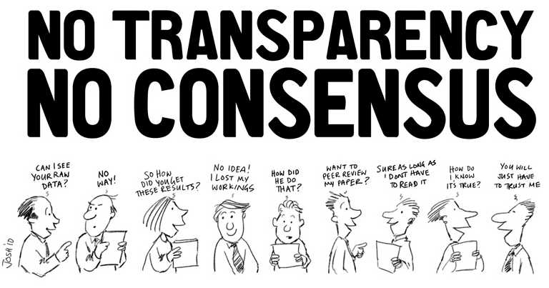
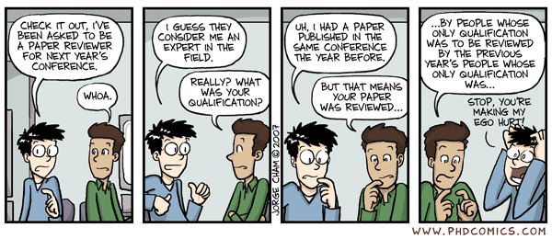
Peer Review sufficiency

Slide 12
Peer Review sufficiency
replication
retractions
Enforce-ment
authority
numbers
Limited
resources
expertise
Conflicts of interest
anonymity
prominence
controversy
Incon-gruence
results
Notes:
Arguments against:
not clear that even after an article has been retracted or refuted, the scientific literature is meaningfully "purged" of the effects of the bad research. – NSCA published an erratum, that enough to convince people that CrossFit doesn’t have higher injury rate?
evidence suggests that even absent "misconduct", a substantial portion of published scientific data cannot be replicated;.
journals have neither the authority to compel institutions to investigate suspect research nor the resources to conduct such investigations themselves
rising number of grant applications submitted to funding agencies, and manuscripts submitted for journal publication each year, puts research administrators and journal editors under increasing pressure to find enough peer reviewers to assess the quality and validity of these applications or manuscripts.
not every peer reviewer may be an expert in the specific methodologies proposed or used nor, in many instances, might they be experienced researchers.
journals have limited resources to check authorship, conflicts of interest and so on, although technology has made detection of plagiarism more feasible
active researcher in the same domain will possess the greatest expertise, that person also is likely to be a direct competitor (Smith, 2006). This raises the possibility that limiting the dissemination of an author’s findings could be in a reviewer’s best interests
anonymity undermines accountability and promotes both irresponsibility and malice
controversial work is more likely to receive harsh reviews
peer review rewards the prominent (i.e., senior scientists and research from prestigious institutions) while holding junior authors and those from less elite institutions to a higher standard.
peer reviewers make uninformed, nitpicky, or unsupported comments, authors can feel stifled, obstructed, and hurt
Most journals seek reviews from multiple individuals, but unfortunately, reviewer recommendations are often incongruent
decisions of authors, reviewers, and editors are more influenced by impressive results than they are by the validity of the study design

Slide 13
solutions
Results publishing policies
Discoverable raw data
Open access publication
Ethical standards
Publish research protocols
Notes:
The Role of Publication Practices in– improving peer review
Publishing Policies on Reporting of Research Results
need to develop policies to publish not only both positive and negative results, but both statistically significant and statistically non- significant ones. This would address distortion of research data reporting and could also incentivise researchers to do more replication studies.
Publishers could also require all studies to be registered and all research protocols to be published
Discoverable raw data
Requiring researchers to make the raw data supporting their journal publications discoverable and accessible has many benefits: for other researchers seeking to build on the work; for institutions seeking to respond to the mandates of policy makers and regulators; and for funding agencies seeking to improve transparency and ensure wider impact of the research that they fund. Discoverable studies and data also facilitate the validation of that data, making manipulation less likely to go undetected
Moving to Open Access Publication
The move to make peer review journal papers openly and freely available through Open Access (OA) has been one of the most significant and positive developments in publishing in recent years
OA has the potential to reduce misconduct in research. It creates a more transparent and open system that allows researchers to share research findings and reach a much larger audience compared to traditional subscription-based journals
Editors should follow the COPE flowcharts13 where applicable.
Editors should first seek a response from those suspected of misconduct. If they are not satisfied with the response, they should ask the relevant employers, or institution, or some appropriate body (perhaps a regulatory body or national research integrity organization) to investigate.
Editors should make all reasonable efforts to ensure that a proper investigation into alleged misconduct is conducted; if this does not happen, editors should make all reasonable attempts to persist in obtaining a resolution to the problem. This is an onerous but important duty.
Flow chart to indicate what to do
http://publicationethics.org/files/Fabricated%20data%20A.pdf

Slide 14
Solutions - Publication ethical standards
Notes:
Ethical Standards in Publication - SLIDE
The International Committee of Medical Journal Editors (ICMJE)
is a highly influential group that has developed standards (the Uniform Standards) for manuscripts submitted to member medical journals for publication.
The Uniform Standards provide guidance in areas such as authorship, conflicts of interest, confidentiality, and editorial independence.
The IC MJE states that "[i]f substantial doubts arise about the honesty or integrity of work, either submitted or published, it is the editor's responsibility to ensure that the question is appropriately pursued, usually by the authors' sponsoring institution. However, it is not ordinarily the task of editors to conduct a full investigation...", n133 although the editor may elect to conduct an independent investigation if the investigation by the institution is inadequate.
If scientific misconduct is established, ICMJE standards require retraction of the publication. If scientific misconduct is not clearly established, but substantial concern regarding the validity of the publication persists, the editor may issue an "expression of concern." n134 Once an author's work is brought into question, the validity of other publications also may be unclear. In that case, the editor may request that the institution ensure the validity of other publications; if that is not possible, an expression of concern regarding those publications also may be merited.

Slide 15
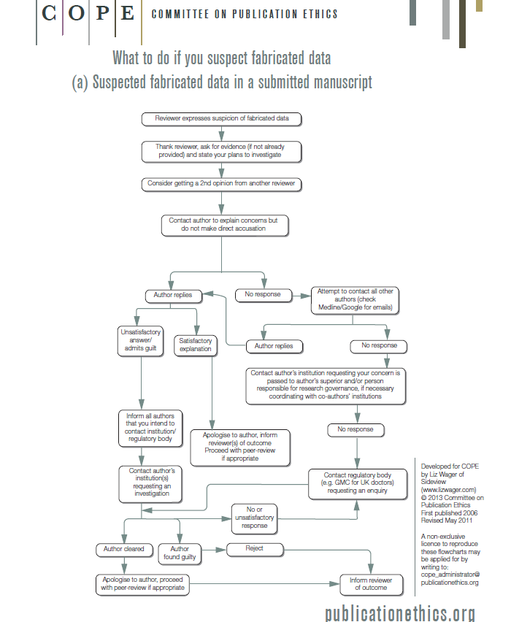
Notes:
The Committee on Publication Ethics (COPE) SLIDE established in 1997 and provides a forum for editors and publishers of peer-reviewed journals to discuss all aspects of publication ethics and offer advice to editors on how to handle cases of research and publication misconduct.
COPE has developed excellent guidelines on good publication practice and other on-line resources for both editors and researchers
COPE provides advice to editors and publishers on all aspects of publication ethics and, in particular, how to handle cases of research and publication misconduct. It also provides a forum for its members to discuss individual cases. COPE does not investigate individual cases but encourages editors to ensure that cases are investigated by the appropriate authorities (usually a research institution or employer).
COPE CODE OF CONDUCT AND BEST PRACTICE GUIDELINES FOR JOURNAL EDITORS
Dealing with possible misconduct
Editors have a duty to act if they suspect misconduct or if an allegation of misconduct is brought to them. This duty extends to both published and unpublished papers.
Editors should not simply reject papers that raise concerns about possible misconduct. They are ethically obliged to pursue alleged cases.

Slide 16
recommendations?
Notes:
What do you think would be good ways to deal with the problems in peer reviewed publishing?
How to do better? What are the solutions?
What do you think would be good ways to deal with problems with peer review?

Slide 17
other solutions
Hybrid process
Research on peer review
Adversarial approach
Open peer review
Notes:
open peer-review policy, whereby all reviews must be signed
combined traditional peer review with open exchange
Upon submission, relevant members of the standing editorial board are asked to give a submission a quick look for any technical problems. If the paper meets the basic standards, it is posted on ACP’s Web site.
Registered researchers can then post either signed or anonymous comments online, to which the authors can publicly re spond. The action editor moderates the online discussion and edits out any personal attacks or inflammatory comments.
After 8 weeks, the authors have the option of revising the paper or submitting it for traditional peer review. The reviewers for this latter stage are selected before the paper goes online, and they can also comment during the initial stage, albeit anonymously.
Manuscripts that survive the entire process are officially accepted for publication and made immediately available. To provide a lasting record of reviews and to secure the authors’ and reviewers’ publication precedence, the editorial board permanently archives every discussion paper and interactive comment and keeps them individually citable
adversarial approach
asks reviewers to ‘‘. . . make every effort to challenge and refute’’ the authors’ claims Reviewers essentially play the role of prosecuting attorneys. The action editor then asks the authors, who are responsible for representing the paper’s virtues, to submit a rebuttal (i.e., they play the role of defense attorneys).
The action editor makes the final decision regarding the submission’s disposition with the manuscript, reviewer attack, and author rebuttal in hand.
Bornstein thinks that redefining the role of the reviewers as prosecutors would make them ‘‘. . . stay close to the methods and results because they would be held accountable for their assertions and be aware the author will soon be rebutting their criticisms’’ (p. 457).
Even a reviewer who was highly motivated to prevent a particular manuscript from being published could not hinder publication simply by asserting that the manuscript is flawed or trivial.
Bornstein also thinks that anonymity of reviews would be less important in the context of exclusively negative reviews
Research on peer review itself
Research Integrity and Peer Review is an international, open access, peer reviewed journal that encompasses all aspects of integrity in research publication, including peer review, study reporting, and research and publication ethics. Particular consideration is given to submissions that address current controversies and limitations in the field and offer potential solutions. We welcome research into peer review and editorial decision making, however reports of individual journal or publisher decisions or actions will not be considered.

Slide 18
other solutions
Checklists
Reviewer training
Reviewer feedback
Junior scholars
Results free review
Notes:
). Academic publishers should take additional steps to minimize research misconduct and protect themselves from legal liability. These include making the review process more systematic and consistent by using feedback forms, checklists, or scorecards, conducting reviewer training sessions, sending information back to reviewers regarding the quality of their critiques, recruiting well-trained junior scholars, and instituting a results-free’ peer-review process (Haines, Baker, & DiDomenico, 2017).
To improve the quality of peer reviews, there are several tactics journals should implement (Table One strategy is to make the process more systematic and consistent by using feedback forms, checklists, or scorecards.
conduct reviewer training sessions.
development programs need to be multimodal and longitudinal. Journals should therefore consider implementing a series of reviewer training programs in conjunction with other quality-improvement strategies
structured mechanisms that send information back to reviewers regarding the quality of their critiques may lead to modest behavior changes.
For example, editors could score the quality of each review and, at periodic intervals, provide reviewers a scorecard, enabling them to compare their performance to the mean score of all reviewers.
continually recruit well-trained junior scholars and practitioners to serve as peer reviewers. Based on a study performed by Black and colleagues, 17 the best peer reviewers—those who provide the most detailed and critical analyses— appear to be junior members of the field or discipline
results-free’ peer-review process, whereby editors and reviewers are blinded to the study’s results, initially assessing manuscripts on the scientific merits of the rationale and methods alone. The aim is to improve the reliability and quality of published research, by focusing editorial decisions on the rigour of the methods, and preventing impressive ends justifying poor means.

Slide 19
Anne L. DeMartini, JD
Flagler College
ademartini@flagler.edu

Slide 20
References
“About Research Integrity and Peer Review” (2017). Retrieved from https://researchintegrityjournal.biomedcentral.com/about
Bedeian A.G., Taylor S.G. and Miller A.N. (2010), Management science on the credibility bubble: Cardinal sins and various misdemeanours. Academy of Management Learning and Education, 9(4):715-725
Berger, R. (June 2, 2017). Court confirms NSCA staff hid documents, committed perjury. CrossFitJournal. Retrieved from https://journal.crossfit.com/article/berger-june-2017-2
Committee on Publication Ethics (2011). Code of conduct and best practice guidelines for journal editors. Retrieved from
http://publicationethics.org/files/Code_of_conduct_for_journal_editors_Mar11.pdf
CrossFit, Inc. v. National Strength and Conditioning Association, Case No. 14-CV-1191 JLS (KSC)(S.D.Cal July 20, 2015)
Geggie D. (2001), A survey of newly appointed consultants’ attitudes towards research fraud. Journal of Medical Ethics, 27:344-346.
Green, R. and Berger, R. (March 24, 2015). CrossFit’s case against the NSCA: The facts. Retreived from http://therussells.crossfit.com/2015/03/24/crossfits-case-against-the-nsca-the-facts/.
Green, R. and Berger, R. (September 21, 2015). NSCA admits to publishing false claims about CrossFit injuries. Retrieved from http://therussells.crossfit.com/2015/09/21/nsca-admits -publishing-false-claims-about-crossfit-injuries/
Haines, S.T., Baker, W.L. and DiDomenico, R.J. (2017). Improving peer review: What journals can do. American Journal of Health System Pharmacy, 74 (4), 2086 – 2089.
Hiney, M. (December, 2015). Research Integrity: What it Means, Why it Is Important and How we Might Protect it. Science Europe Working Group on Research Integrity . Retrieved from http://www.scienceeurope.org/wp-content/uploads/2015/12/Briefing_Paper_Research_Integrity_web.pdf
International Committee of Medical Journal Editors (2015). Scientific misconduct, expressions of concern, and retraction. Retrieved from:
http://www.icmje.org/recommendations/browse/publishing-and-editorial
issues/scientific-misconduct-expressions-of-concern-and-retraction.html
Markey, M.L. (2007). Scientific misconduct in research. Journal of Health and Life Sciences Law, 1(1), 63.
Mulligan, A., Hall, L., Raphael, E. (2013) Peer review in a changing world: An international study measuring the attitudes of researchers. Journal of the American Society for Information Science & Technolog, 64 (1), 132-161
National Strength and Conditioning Association v. Glassman, et. al, Case No. 37-2016-00014339-CU
DF-CTL (Ca. Sup. Ct., May 2, 2016)
O’Leary, P. (2015). Policing research misconduct. Albany Law Journal of Science & Technology 25, 39
– 93.
Order at 20, CrossFit, Inc. v. National Strength and Conditioning Association, Case No. 14-CV-1191 JLS (KSC) (S.D.Cal September 21, 2016)
Order at 2-13, CrossFit, Inc. v. National Strength and Conditioning Association, Case No. 14-CV-1191 JLS (KSC) (S.D.Cal May 26, 2017)
Schroter, S., Black, N., Evans, S., Godlee, F., Osorio, L., Smith, R. (2008). What errors do peer reviewers detect, and does training improve their ability to detect them? Journal of Royal
Society of Medicine, 101(10), 507 – 514.
Smith, M.M., Sommer, A.J., Starkoff, B.E., & Devor, S.T. (2013). CrossFit based high-intensity powertraining improves maximal aerobic fitness and body composition. Journal Of Strength &Conditioning Research, 27 (11), 3159-3172.
Suls, J. and Martin, R. (2009). The air we breathe: A critical look at practices and alternatives in the peer review process. Perspectives on Psychological Science, 4 (1), 40 – 50.
Titus S.L., Wells J.A. and Rhoades L.J. (2008), Repairing research integrity. Nature, 435:980-982. Pryor E.R., Haberman B. and Broome M.E. (2007), Scientific misconduct from the perspectives of research co-ordinators: a national survey. Journal of Medical Ethics, 33:365-369.
Wager, L. (2011). Suspected fabricated data in a submitted manuscript. Retrieved from http://publicationethics.org/files/Fabricated%20data%20A.pdf
Wager, L. (2015, September 28) Why we need a journal on research integrity and peer review, BioMedCentral Blog. Retrieved from
http://blogs.biomedcentral.com/bmcblog/2015/09/28/journal-research-integrity-peer-review/

