Slide 1
Project Based Learning: Developing Best Practices with Corporate Partnerships and Faculty
Tim Liptrap and Brittany Jacobs, Nichols College

Slide 2
Goals of today
Introduce the concepts of our best practices
Create a discussion and learn from each other

Slide 3
Nichols College Sport Management Program
located in Central MA
20 min outside of Worcester
1 hour from Boston
1 hour or so from the New England Patriots!
1 hour from Providence, RI
Enrollment
1180 day students
260 in Sport Management
We recruit the average student

Slide 4
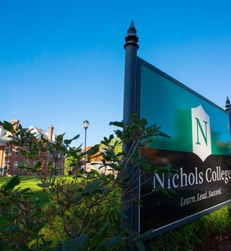
Curriculum
BSBA Business Administration
Intro to Sport (3 credits)
Sport and Society(3 credits)
Sport Practicum (3 credits)
Sport Marketing (3 credits)
Sport Finance (3 credits)
Sport Law (3 credits)
Sport Seminar (3 credits)
Sport Internship (9 credits)

Slide 5
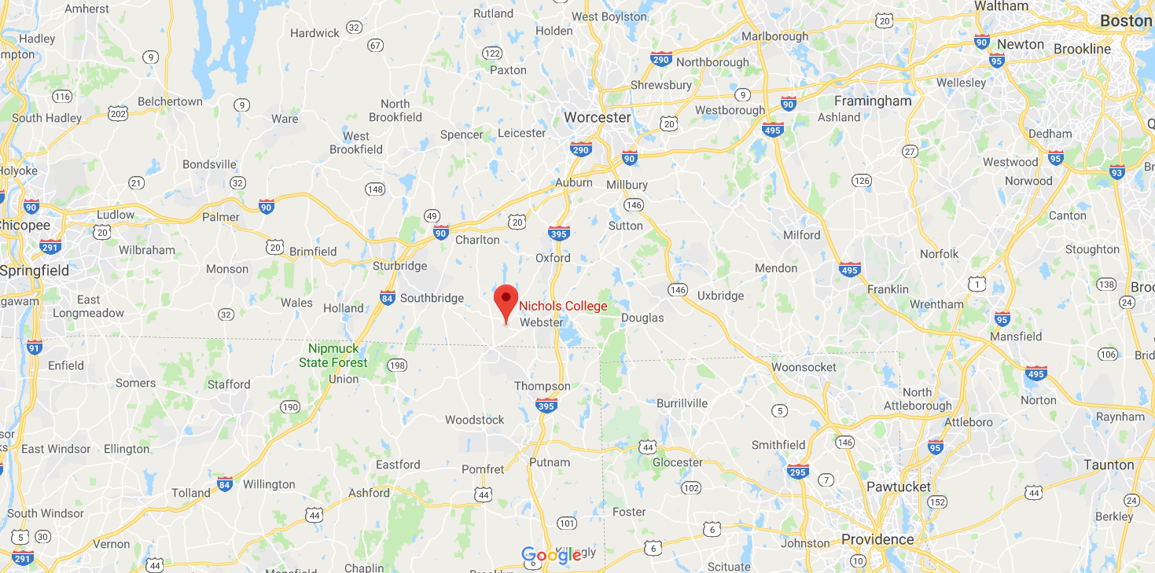
Program & College Concerns
Location
Enrollment
Retention
Job Placement Rates

Slide 6
Project Based Learning

Slide 7
Examples
Executive Training Classes
Event Management Projects
Corporate projects (surveys, research)

Slide 9
Best Practices - Sourcing Partnerships
Look to alumni in the marketplace
Look to advisory board recommendations
Mutual benefit
Win-Win-Win
Not all partners know they are a good fit
Not all partners are a good fit
Willing to change / not renew partnerships
Non-exclusive partnership

Slide 10
Best Practices - Administrative
Must be "sold" to Academic Dean
Tied to directly and curriculum and employability​
Partner must be willing to work with mission and purpose as well
Notes:
'sold to dean Allocate resources
Provide support
Won't cancel the course

Slide 11
Best Practices - Implementation
Pre-sell with partner in the classroom
Student 'buy-in' is a priority
Multiple interactions with the partner
Partner as part of the academic design
Partner must dedicate time and staffing to classroom and site
Help determine needs of the marketplace
Students held accountable by partner for a portion of their grade
Costs must be considered for student

Slide 12
The Ideal Partnership
Partners that are willing to work with students to teach skill-based learning
Partners are willing to provide:
Projects that have a potential job / internship outcome associated
Project that give "real world" experience
Projects that give exposure to employees and management of a company
Can be classed based or full semester in length

Slide 13
Student Benefits
Branding for students – means to stand out
Feeling part of something bigger than themselves or college
Resume building experience
Variable learning locales/instructors
Applicable 'real world' training & skills

Slide 14
The Feedback
That far outweighs sitting in a classroom for 75 minutes getting overwhelmed by terms
At our school we teach the concepts of event management, but you do it for real – Pickleball participant and faculty member
Building a broader network and getting different insights than that of the professor
The class gives so many opportunities for a student to open the door for themselves.
This class made me realize how unstable this place is too work at
If anything, this helped me sell myself better

