Slide 1
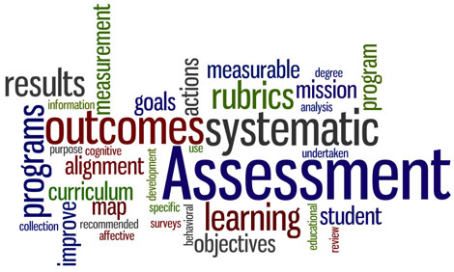
Presenter: Dr. Molly Hayes Sauder
Notes:
Welcome: Glad to be here.
Background: Wrote YCP’s self-study for COSMA accreditation; involved with on-going assessment efforts in the program as well as general education
Purpose: Asked to provide information about writing and improving rubrics; urged to include relevant examples and discussion from the audience.
Summarize results of initial questions to provide overview of presentation.

Slide 2
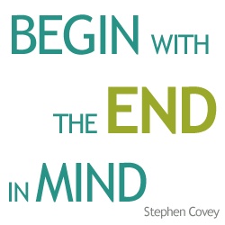
Rubric Basics
What?
Why?
A scoring tool that lays out the specific expectations for an assignment
Clarify vague goals
Help students understand expectations
May inspire better performance
Help students self-improve
Make scoring easier, faster, and possibly more consistent and accurate
Provide info to others
(Stevens & Levi, 2005) (Suskie, 2009)
Notes:
What? I love this quote because it really captures the idea of backward design for instruction and rubrics play a part in that.
Why? For the benefit of both parties…for the benefit of students...for the benfit of faculty and the institution
Note: Rubrics can be helpful at both the course and program levels of assessment

Slide 3
Creating a Rubric
Reflect/Brainstorm
Categorize
Describe Proficiency
Obtain Feedback
Implement
Explain to students; assess; use results to guide teaching.
From peers, past sample work, etc.
Think about what the words convey at each level.
Intuitive names can be helpful; points can vary.
What does success look like?
(Adapted from Stevens & Levi, 2005 & Suskie, 2009)
Notes:
Step 1: Reflect if this or a similar assignment has been used before; brainstorm for a new assignment.
If having trouble at Step 1: Group could all brainstorm what success for an effective presentation looks like.
Step 2: Keep in mind that if you are using this to grade, you can assign different points for different aspects to show importance.
Step 3: Think about positive wording and student-friendly language.

Slide 4
Various Types of Rubrics
Simple
Complex
(University of Virginia Office of Institutional Assessment and Studies)
Notes:
Simple: Checklist/rating scale
Complex: Analytic rubric
Both have their purpose, but obviously an analytic is going to show more about strengths and weaknesses

Slide 5
Common Concerns
Problem: Rubrics cause students to only meet the minimum required.
Solution: Build the rubric to achieve the vision you have with the descriptors you choose; carefully select instructional techniques.
Notes:
Has anyone had this experience? What did you do?
Remember that grading and assessing are two different things and you are able to manage both. Words like “creative” or “insightful” can help students understand that you really want “above and beyond.” And, you can always adjust your grading as needed.
Also think about your teaching strategies. A lot of how students perceive rubrics has to do with what we tell them.
Scaffold
Give formative feedback
Get buy-in and help them see the big picture
Example: Service-learning project with YMCA and a sophomore class and what I wanted them to produce was a product that was professional in its written and visual communication and that had properly applied theory and research into a practical product. It was a reach. Conferences, drafts, materials about what employers want in the real world, self-evals with rubric, etc.

Slide 6
Common Concerns
Problem: The “real world” does not have rubrics.
Solution: Include students in
the development process.
(Adapted from Stevens & Levi, 2005)
Notes:
How many of us would agree with this statement? Why or why not?
Rubrics are describing a product and I agree the real world does not generally have them. But, the real world does have expectations. So, part of what we need to do is help students understand how to recognize and meet those expectations through effective processes.
Example: When I use our program-level oral communication rubric I usually start by asking students to explain what good communication will look like on the project and try to tie that back to specific statements in the assignment. Then, I usually ask them how they will achieve this.
Can simply ask for feedback, can use post-its, can have groups create them, etc.

Slide 7
Common Concerns
Problem: Rubrics are supposed to be objective, yet they are still subjective.
Solution: Engage in a “norming session” where faculty get together to individually judge the same samples of student work and then discuss; calibrate as needed.
(Personal Communication, C. Crimmins; Bean, 2011)
Notes:
Does anyone have an example of this concern?
You could also consider inviting professionals to look at what you are doing and provide feedback.

Slide 8
Common Concerns
Problem: Rubrics take a lot of time and effort to develop.
Solution: Look for examples and ask for help from colleagues; remember that they get faster with practice.
(Stevens & Levi, 2005; Suskie, 2009)
Notes:
Who has developed a lot of rubrics? How long did the first few take? How long do they take now?
Part of this is a thinking style that can easily be learned with practice.

Slide 9
References & Image Citations
References:
Bean, J. C. (2011). Engaging ideas. San Francisco, CA: Jossey-Bass
Stevens, D. D., & Levi, A. J. (2005). Introduction to Rubrics. Sterling, VA: Stylus Publishing.
Suskie, L. (2009). Assessing student learning: A common sense guide. San Francisco, CA: Jossey-Bass.
Image Citations:
Slide 1: http://assessment.uconn.edu/wp-content/uploads/sites/1804/2016/06/homepage03.jpg
Slide 2: http://blog.boombox.com/wp-content/uploads/2015/11/Begin-with-the-end-in-mind-.png
Slide 4: http://www.web.virginia.edu/iaas
Slide 5: http://ninjamarketingdojo.com/wp-content/uploads/2013/07/easy-button.jpg
Slide 6: http://4.bp.blogspot.com/-dU9T1gPPzbg/Ugco1EiG8_I/AAAAAAAABXI/-vv7safnr8k/s1600/too-many-choices.jpg
Slide 7: https://www.projectsmart.co.uk/img/objective.png
Slide 8: http://www.arniedahlke.com/images/Timely%20Tips%20Men%20Running%20On%20Clocks.jpg

