Slide 1
WHAT’s NEW at MSU Denver
Assessing Student Learning During Short-Term Study Abroad Courses
Dr. Colleen Colles, Metropolitan State University of Denver

Slide 2
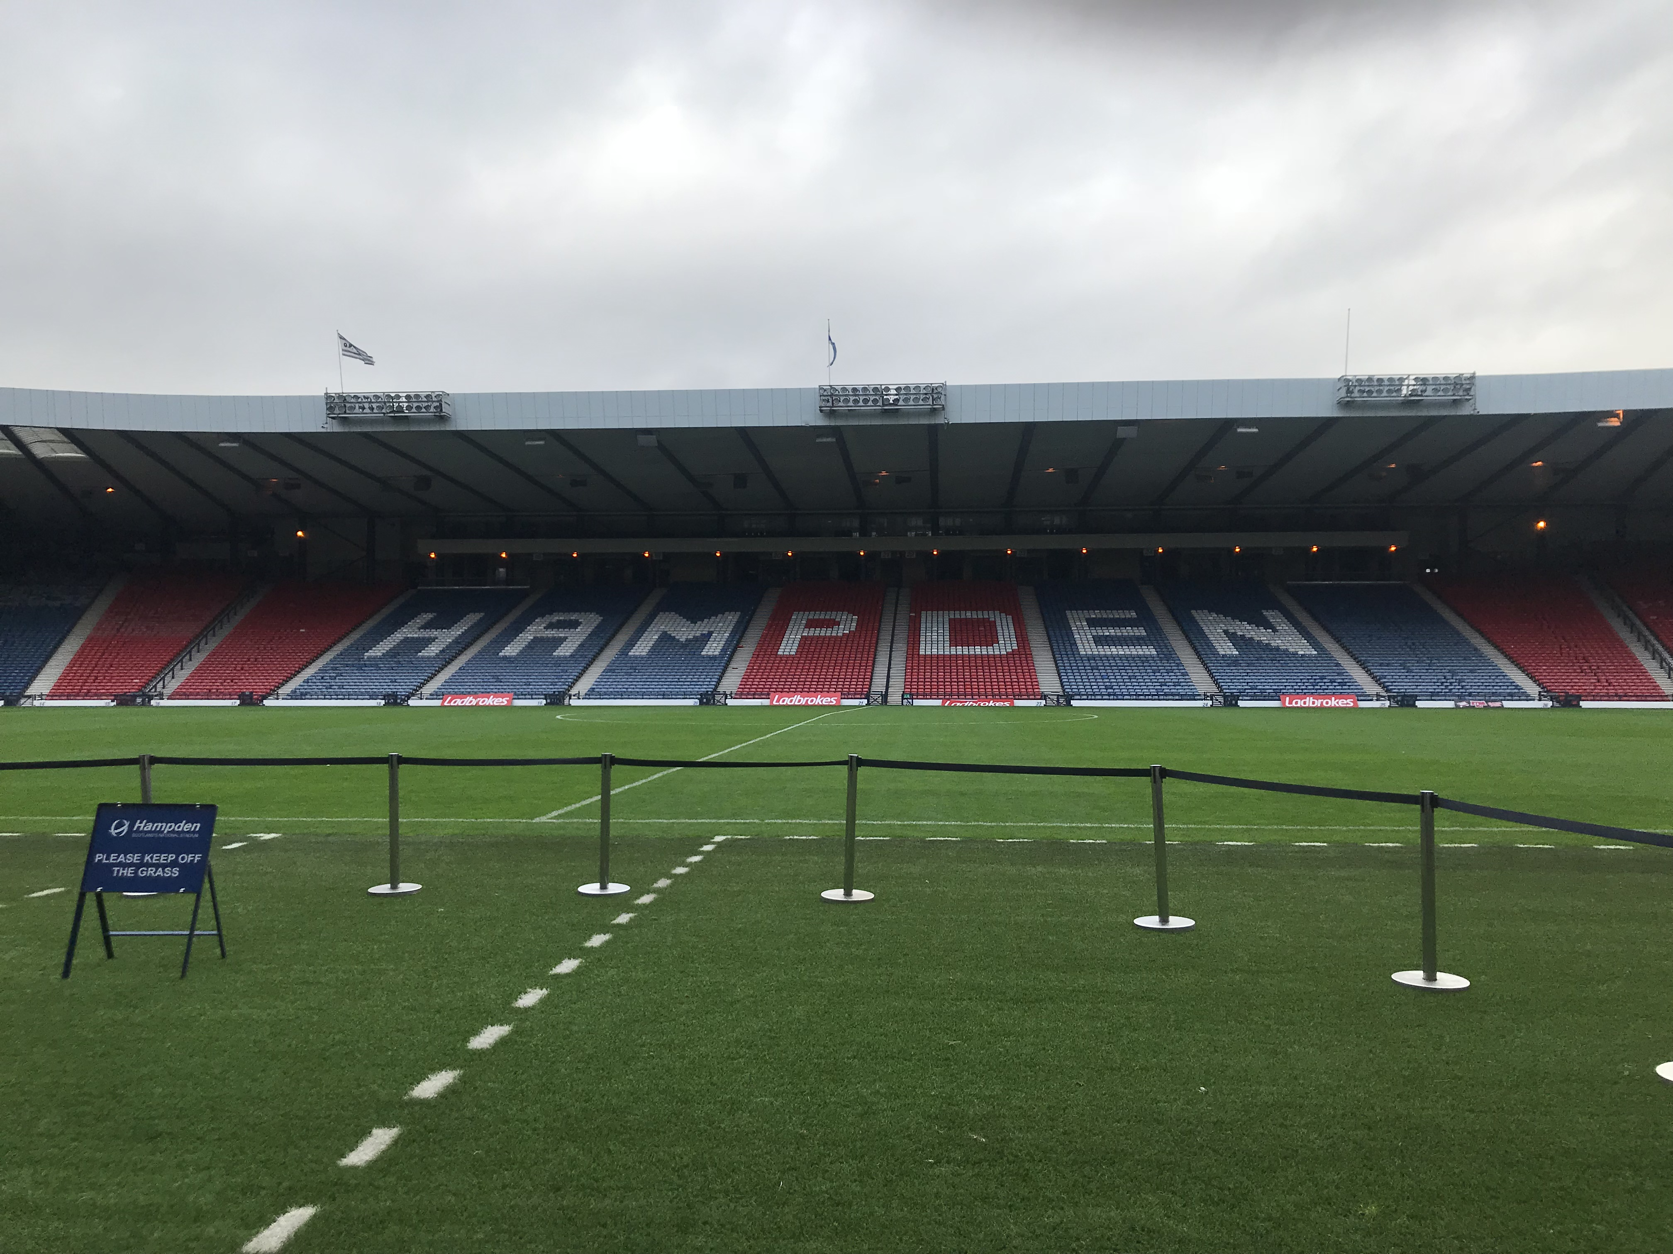
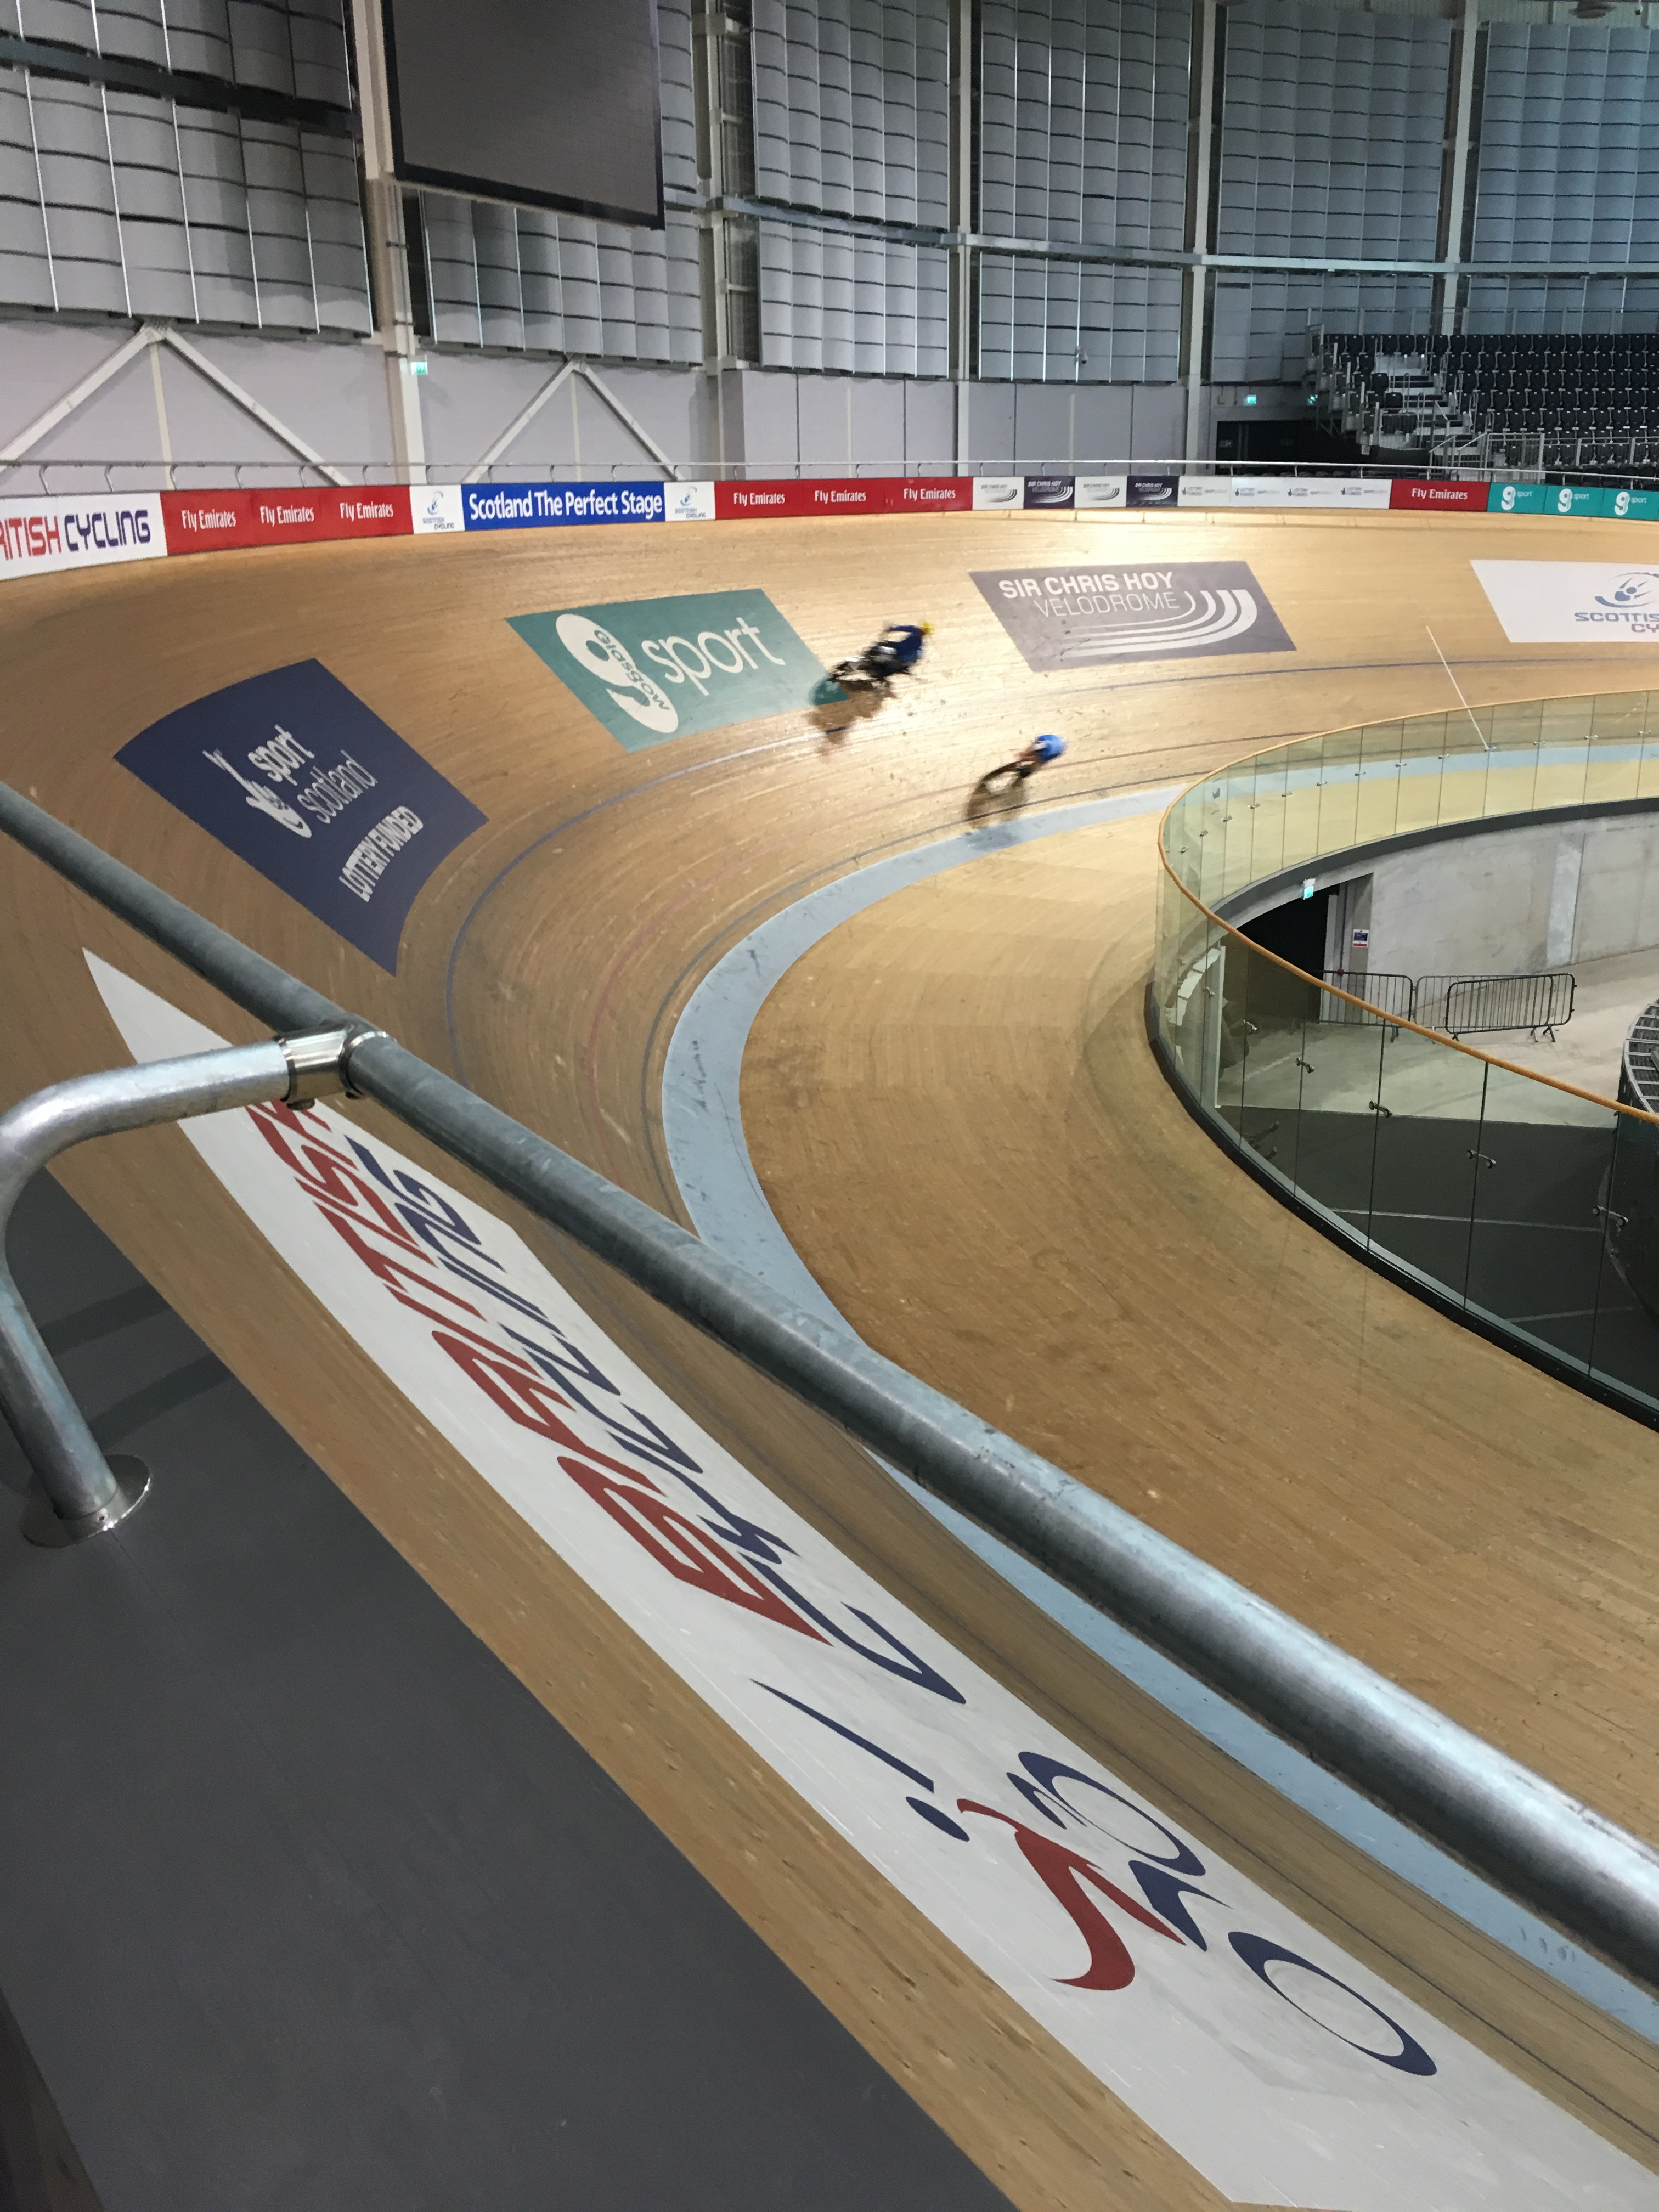
COSMA Principle 7.5 requires that we address International Sport Management within our programs.

Slide 3
Study Abroad
According to the 2016 Open Doors Report on International Educational Exchange data released by the Institute of International Education (IIE), more than 313,000 U.S. students received credit for study abroad during 2014-15, an increase of nearly three percent over the year prior.
Because American culture is so pervasive, students often assume that all other cultures must conform to the American customs. Our students have much more to gain from their SA experiences!
To produce graduates capable of working in this global sport industry, sport management programs and faculty members are increasingly offering study abroad opportunities.
Notes:
Undoubtedly, students will have difficulty relating to a global sport industry if they lack exposure to, and experience with, countries and cultures from around the world.
Study abroad programs and students participating in them are at record numbers.

Slide 4
Goals for Study Abroad
Objectives (specific measurable steps) for SA programs vary; however, Goals (desired achievement) that are are universal to almost all programs include Intercultural and Academic Competencies
Intercultural Competencies: Broad goal of enhancing student appreciation of differences among cultures.
Michigan State SA goals include:
Develop students’ skills for relating to culturally different others
Enhance students’ self-awareness and understanding of their own culture
Contribute to the internationalization of the student’s home department, college or university
MSU Denver International Education Objectives/Learning outcomes:
Assess how the host country experience contributed to personal growth and awareness of self as a member of the global community
Recognize different cultural practices and explain why other cultures value these practices
Academic Competencies: Broad goal of enhancing student understanding of international sport
Explain the international dimensions of sport / sport management
Compare and contrast aspects of the host country and that of the U.S. as related to sport/sport management

Slide 5
Specific Learning outcome examples: Students will be able to…
Compare the United States sports systems and exercise science programs with Scotland’s sport systems and exercise science programs.
Identify and analyze the varying historical foundations between US systems and programs and Scotland’s systems and programs.
Contrast the socio-cultural impact on human performance and sport systems and programs in United States with the impact in Scotland.
Analyze and compare relevant statistics and research findings regarding sport participation, governmental support, exercise & fitness initiatives in the US v. Scotland and draw conclusions.

Slide 6
Assessing value of SA
*Assessments that demonstrate learning are essential to increasing our understanding of the value and effectiveness of international education.
However…
Some students feel conflict between social opportunities and the academic obligations of the SA experience.

Slide 7
Tools and methods Explain the international dimensions of Sport/Sport Management…
Pre-post surveys related to expected outcomes (direct)
Journals (indirect)
Focus groups upon return (indirect)
Faculty observations (indirect)
Faculty evaluation of case study reports or applied assignments (direct)
Students will be engaged in various applied assignments which require transference of knowledge to newly encountered international situations
Notes:
sport business operations

Slide 8
Surveys
Commonly contain questions regarding the following factors:
Language learning (N/A, focused on Short-term SA)
Academic performance (sport & cultural related content)
Personal growth*
Intercultural awareness*
Professional development*
**“Worldmindedness”: the extent to which individuals value global perspectives on various issues (Douglas & Jones-Rikkers, 2001)
Notes:
* are measured by our Office of International Education with post-trip survey.
Examples of statements:Study abroad has increased my ability to cope with unfamiliar situations
My study abroad experience has increased my level of comfort with people different from myself
As a resut of my study abroad experience, I have become more open-minded.
Study abroad has contributed to my understanding of other cultures.
Intercultural awareness: Plays an important role in managing cultural diversity within organizations.

Slide 9
World-mindedness and Intercultural sensitivity survey options
Sampson & Smith (1957) Scale to measure World-minded attitudes
Intercultural sensitivity:
Hammer & Bennett’s (2002) Intercultural Development Inventory (IDI)
Kelley and Meyers’ (1995) Cross Cultural Adaptability Inventory (CCAI)
Shimp and Sharma’s (1987) Consumer Ethnocentric Tendencies Scale (CETSCALE)

Slide 10
Journals & Focus Groups
Assign daily discussions or reflection topics
Must address how experience relates to their specific research or topic of interest
Hold meeting soon after return
Use best practices for focus group
http://bit.ly/2DvRp4P

Slide 11
Case Studies and Assignments
Case studies online offers great options
Complete with partner school
Joint assignments.
Our students will complete ahead of time, share our recommendations and conclusions with their students.
Joint discussions
Notes:
Compare and contrast what would be appropriate in USA but not in Scotland.

Slide 12
Noteworthy Observations…
Benefits of SA can be sustained over many years following the experience.
”Intercultural awareness is, of course, not limited to improving one’s understanding and acceptance of cultures outside of the US. By increasing students’ intercultural sensitivity, it is reasonable to expect that they will also be better prepared to address different cultures within the US-including those on their college campus.” Anderson Lawton, Rexeisen and Hubbard (2006) p. 467
SA programs generally lack the hard data to justify their worth. The challenge is to determine whether students learned more or differently while studying abroad than they would have if they had studied the same material on campus.
We could help this by participating in assessment and sharing our results.
Notes:
***Short term 1-3 weeks, with a group of fellow students / colleagues , limits opportunities for much “personal growth”, but still believe in its value! How can we assess the value given these limitations?

Slide 13
WHAT’s NEW at MSU Denver
Comments and Questions?
Thank you for attending!
Dr. Colleen Colles, Metropolitan State University of Denver

