Slide 1
Sport Management Doctoral Granting Institutions:
Curriculum, Focus, and
Job Placement
Brittany Jacobs, Jiyoung Park, Jacob Augustin, Dr. Dianna Gray
University of Northern Colorado
2017 COSMA Conference, Tampa

Slide 2
CONTENTS
Rationale & Research Questions
Methodology
Results
Discussion & Future Research

Slide 3
Ⅰ. Rationale
Why?
Sport management – as a field of study - has become an area of increased scholarly interest, within the last few decades
Explosive growth of Sport Management programs in US, including a number of doctoral programs
It is important to understand an overview of Sport Management doctoral programs
Interest in considering programmatic focus within the larger institution
Notes:
Include some citations
Discuss how many programs there now are as compared to 10 years ago
With such growth it is important to understand the programmatic landscape in order to better serve constituents and faculty
When looking at doc programs specifically, how does their programmatic focus impact other elements of the program?

Slide 4
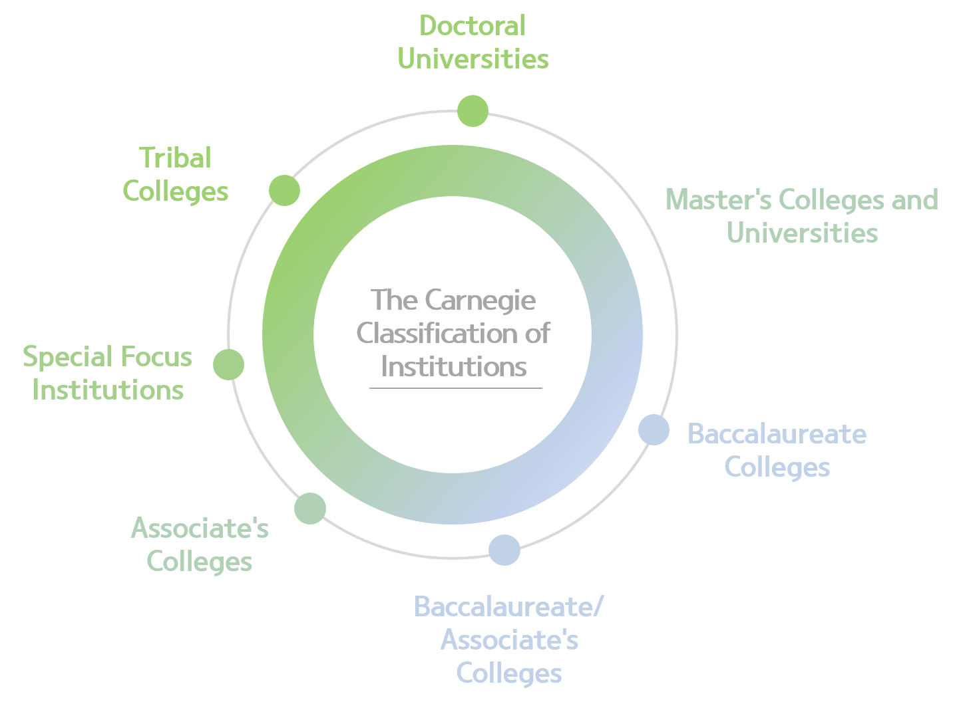
Ⅰ. Rationale
The Carnegie Classification of Institutions
Notes:
The Carnegie Classification has been the leading framework for recognizing institutional diversity in U.S.
Starting in 1970, this framework has been widely used in the study of higher education
It was from this framework that we became interested in how doctoral programs define themselves within the context of their institution. While most Sport management doctoral programs are housed at Doctoral universities (######s), we wanted to consider the program within the context of the institutions. Do all doctoral programs consider themselves to be primarily researched focused? If so, how does this impact their curriculum, graduation requirements, alumni job placement, etc.?

Slide 5
Ⅰ. Research Questions
What characteristics define doctoral Sport Management programs?
How does self-defined program type (Research, Hybrid, Teaching) align with programmatic goals and operational indicators?
Does the focus of doctoral programs impact alumni job placement (within the first five years of graduation?)
Notes:
Over view of sport management doctoral programs – faculty numbers, student, funding, admissions, etc.
Alignment of program with programmatic goals and operational indicators (admissions, graduation, funding types available, etc. )
Does focus of program impact alumni placement (are graduates from a specific school type more likely to end up working at a specific type of school – EX: Graduate from resaerch school, work at research school.)

Slide 6
Ⅱ. Method
Population: N = 47
Population derived from NASSM list of doctoral programs
Both international and online programs were included in population
Regarding Carnegie Classification, specific program details, and degree requirements.
Survey
Sample: n = 20
26 responses, 6 incomplete
42.6% response rate for complete
55.3% response rate total
Notes:
Quantitative methodology
Non-experimental design
Because the population, and thus the sample is so small, descriptive statistics provide a detailed description of the data – no real statistical power for analyses
Types of questions asked during the survey – admission requirements, funding, faculty, students, graduation requirements, focus of the program, etc.
Compare population to sample… seemingly pretty representative…

Slide 7
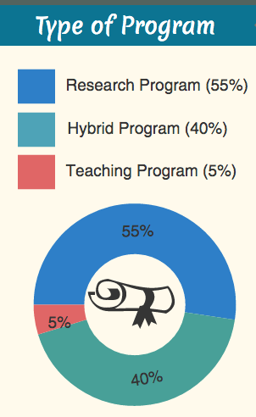
Ⅲ. Results

Slide 8
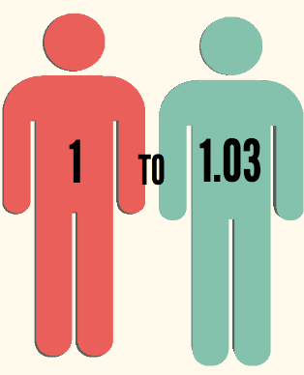
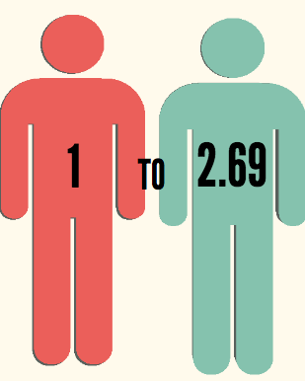
Ⅲ. Results: Faculty to Student Ratios
Research Programs
Hybrid Programs
Notes:
** teaching excluded as only one program defined itself as teaching - averages could not be taken
Average number of faculty:
Resaerch- 5.5
Hybrid- 4.8
Teaching – 6
Average number of students per program:
Research- 5.7
Hybrid- 12.9
Teaching – 176
Average number of international students per program
Research- 1.5
Hybrid- 1.4
Teaching – 2

Slide 9
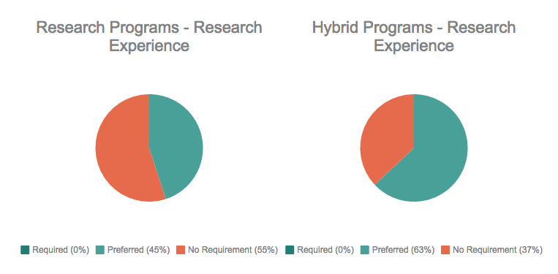
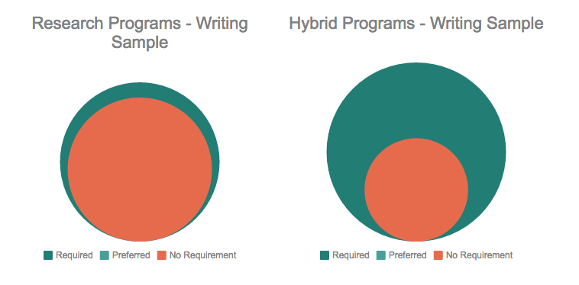
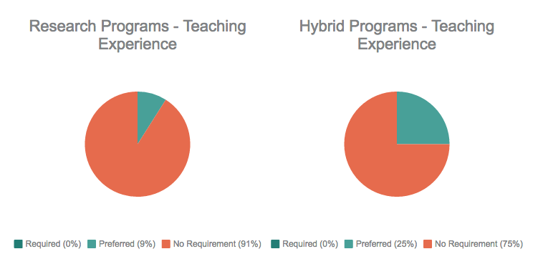
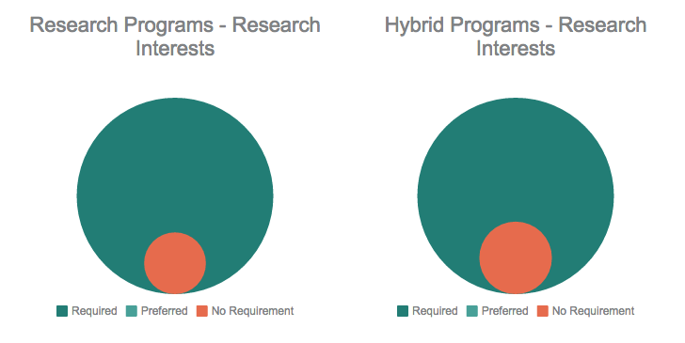
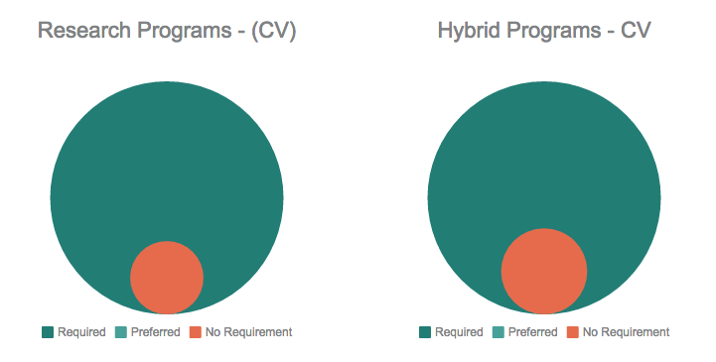
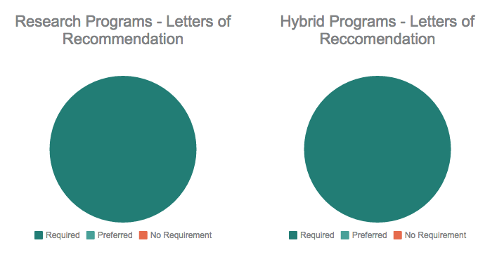
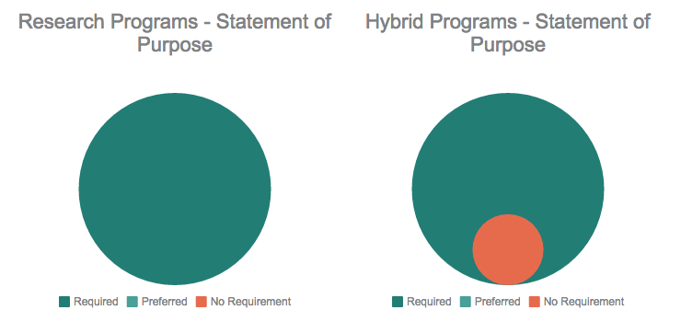
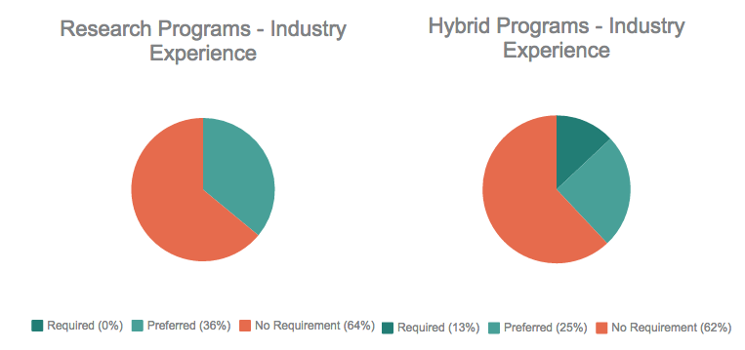
Ⅲ. Results: Admissions Requirements
Notes:
Interestingly, while most of the requirements are very similar across the board no matter the program type (research or hybrid). Hybrid programs are more likely to prefer research experience than research programs and are also more likely require a writing sample.

Slide 10
Ⅲ. Results: Funding & Assistantships
56%
Hybrid Programs
59%
Research Programs
39%
28%
16%
2%
Research
Other
Other
Teaching
Research
Teaching
Notes:
In order to receive funding at most doctoral institutions, the student undertakes teaching responsibilities- teaching assistantships make up the majority of funding for students at both research and hybrid programs.
Not surprisingly, at research programs, a larger percentage of students also take on research assistantship roles.

Slide 11
Ⅲ. Results: Graduation Requirements
88%
36%
Research Programs
Hybrid Programs
Doctoral Minor Requirement for Graduation
Notes:
One incredibly interesting finding was the dramatic difference in the requirement for doctoral minor as part of graduation requirements. When considering one’s perceptions regarding the difference between a doc and hybrid program, this may make sense as a hybrid program seeks to provide a holistic learning experience where the program may highlight the importance of out-of-major course work via a doctoral minor.
Research Programs – Grad requirements
36% require submission of manuscript for publication/ 9 % require teaching/ 37% require conference presentation
9% prefer submit manuscript / 9% prefer teaching/ 9% prefer conference presentation
55% no requirement for manuscript/ 82% no requirement for teaching/ 36% no requirement for conf presentation
Hybrid
38% require manuscript/ 25% require teaching/ 50% require conf. prez
25% prefer manuscript/ 25% require teaching/ 13% prefer conference prez.
37% no requirement/ 50% no requirement/ 37% no requirement for conference prez.

Slide 12
Ⅲ. Results
Admissions Requirements
Program Focus
Funding Opportunities
Graduation Requirements
Notes:
Admissions requirements, funding opportunities, grad requirements do not seem to indicate program type, nor does program type indicate Admissions requirements, funding opportunities, grad requirements
Admissions requirements are very similar for both hybrid and research programs, the two slight differences being the hybrid programs tend to have a slightly greater preference for research experience, while Interestingly, while most of the requirements are very similar across the board no matter the program type (research or hybrid). are also more likely require a writing sample.
Funding opportunities – research programs seem to have a slightly greater percentage of available funding based on research. Both hybrid and research schools fund more than half of doc students with teaching assistantships.
Grad requirements-
Hybrid programs are more likely to require or prefer manuscript submission and conference presentations for graduation, while th expectation may be that these outcomes may align for appropriately with Research programs.

Slide 13
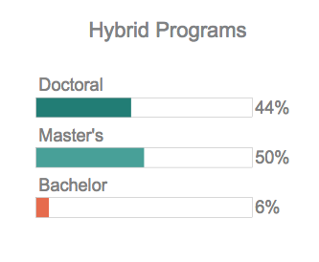
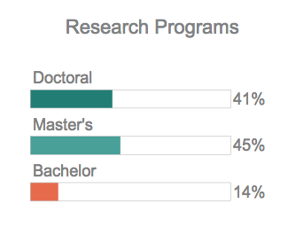
Ⅲ. Results: Alumni Job Placement
Notes:
Interestingly hybrid programs seem to place slightly more alumni at doctoral granting institutions (as designated by the carnegie classifications) and master’s programs.
Again, surprisingly, research programs place more alum at bachelor’s degree institutions.
Surprised by these results, we decided to break down the carnegie categorizations to their smallest segments and see what the results looked like…

Slide 14
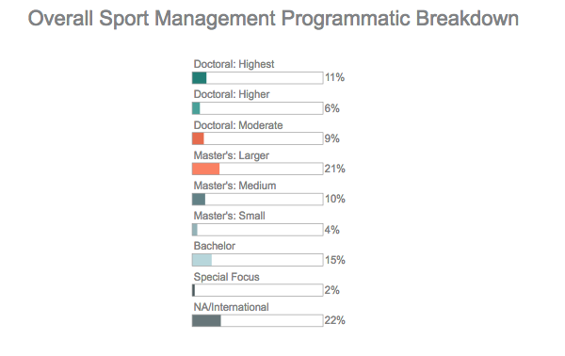
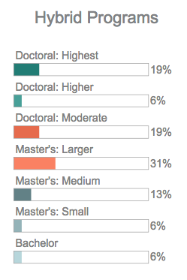
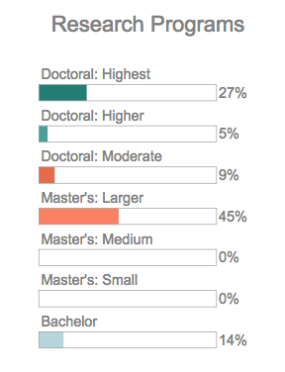
Ⅲ. Results: Alumni Job Placement
Notes:
Here it becomes more clear why hybrid programs had more doc and master’s program representation in terms of job placement from their alumni. Many of their alumni have found themselves in doctoral moderate programs – some may argue that these are less research intensive and are more focused on a hybrid methodology, the same could also be said for doc higher.
Here we find that research programs place 6% more of their alumni at doc highest than hybrid programs. This seems to make sense based on their programmatic focus. Though the placement of 8% more alums at bach schools than hybrid programs, too, is an interesting finding.
When compared to the overall number of programs available in sport management – it makes sense that a good percentage of alumnis are places at master’s larger programs – though the placement percentages for this type of program seem a bit high. Additionally, it appears that placement is overrepresented at doc highest by both research and hybrid programs, perhaps this is a function of these programs supporting more professors per program than some of the smaller programs.

Slide 15
Ⅳ. Discussion
No apparent difference in admissions requirements or programmatic outcomes as a result of program focus
Faculty to Student ratio is lower at Research programs
Research programs are placing a greater percentage of alumni at Highest Doctoral (research intensive) programs

Slide 16
Ⅳ. Future Research
Student perceptions of program type and perceived indicators of this program type
Student goals for job placement upon graduation – motivation for selection of program and specific type of program
Further consider alignment of program with program outcomes and admissions requirements – how to differentiate in a populated market

Slide 17
THANK YOU
Brittany Jacobs – Brittany.Jacobs@unco.edu
JiYoung Park – Jiyoung.Park@unco.edu
Jacob Augustin – Jacob.Augustin@unco.edu

