Slide 1
SOCIAL JUSTICE THROUGH SERVICE LEARNING IN PARKS & REC MANAGEMENT
COSMA 2022
Anne L. DeMartini, M.Ed., JD

Slide 2
AGENDA
The need
The method
The practice
The lessons

Slide 3
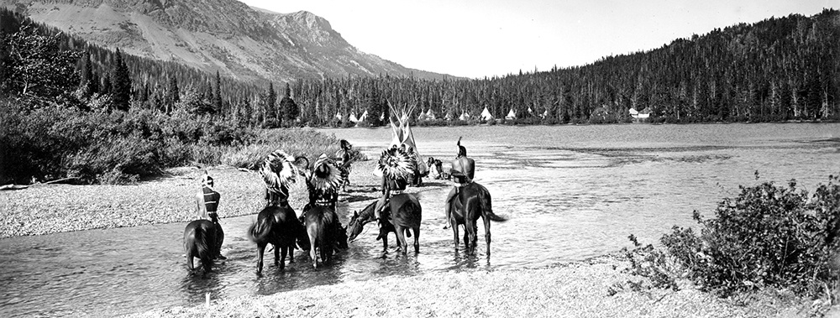
Blackfeet in the Two Medicine Area, Glacier National Park, ca. 1914. Photo by R.E. Marble/ NPS

Slide 4
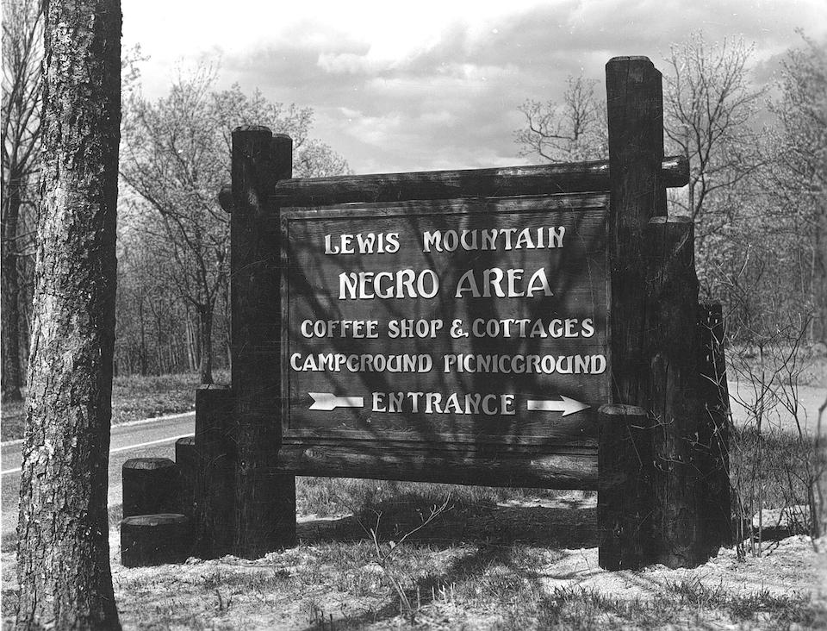
A sign directed blacks to segregated picnic grounds at Lewis Mountain, Shenandoah National Park/NPS archives

Slide 5
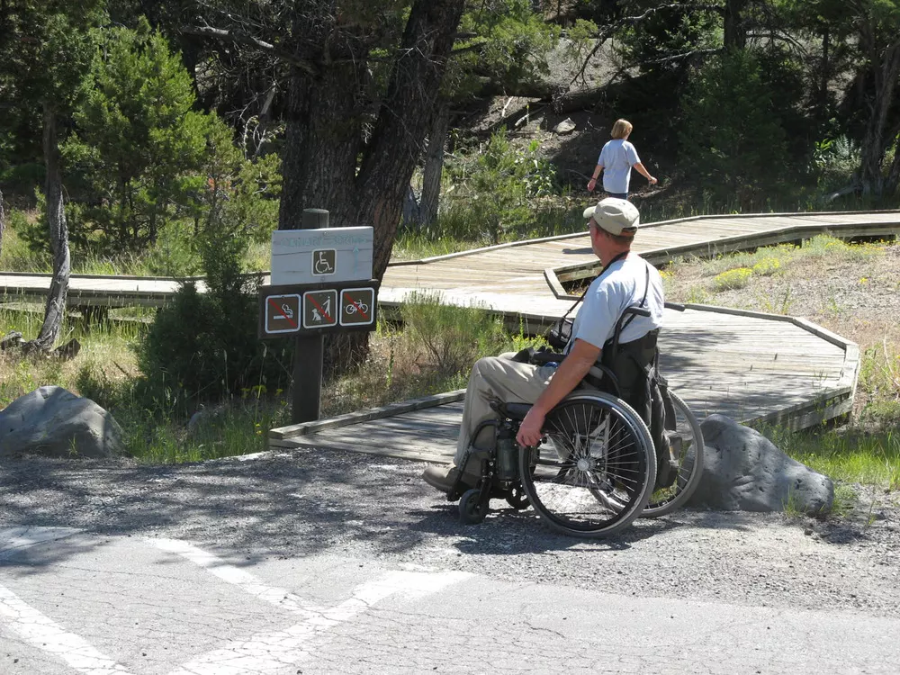
https://www.nps.gov/articles/accessibility.htm

Slide 6
NPS Employees

Slide 7
METHOD
Service learning
Social justice education
Service learning for social justice

Slide 8
PRACTICE

Slide 9
COURSE
Context
Description
Students
Project

Slide 10
Context

Slide 11
Students

Slide 12
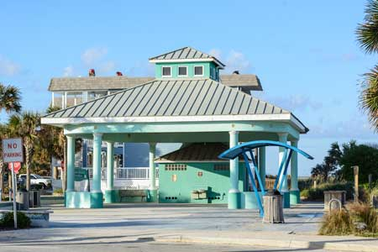
The beach park pavilion: http://www.sjcfl.us/beaches/Gallery/Vilano/index.aspx

Slide 13
OUTCOMES
Content knowledge
Course evaluations
Personal reflection
Student satisfaction

Slide 14
Content knowledge

Slide 15
Course evaluations
80% response rate

Slide 16
LESSONS
Collaboration
Specificity
Student experience
SLOs
Project guidelines
Content units
Reflection exercise
Expectations
COVID 19
Population
Class size
Reflection paper

Slide 17
Questions?
Anne L. DeMartini, M.Ed., JD
Kennesaw State University
ademart1@kennesaw.edu

Slide 18
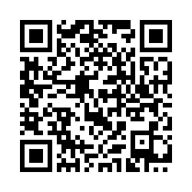
Please take a survey for new project on DEI!

