Slide 1
From Faculty to Administration: Sport Management on the Rise
Dr. Heath Hooper, Dean - Shorter University – Moderator
Dr. Jennifer Kane, Associate Dean - University of North Florida
Dr. Jeff Briggs, Dean - North Greenville University
Dr. Clay Stoldt, Associate Dean - Wichita State University
Dr. Curt Laird, Associate Vice President of Academic Affairs - Columbus State Community College
Dr. Darlene Kluka, Former Dean - Barry University

Slide 2
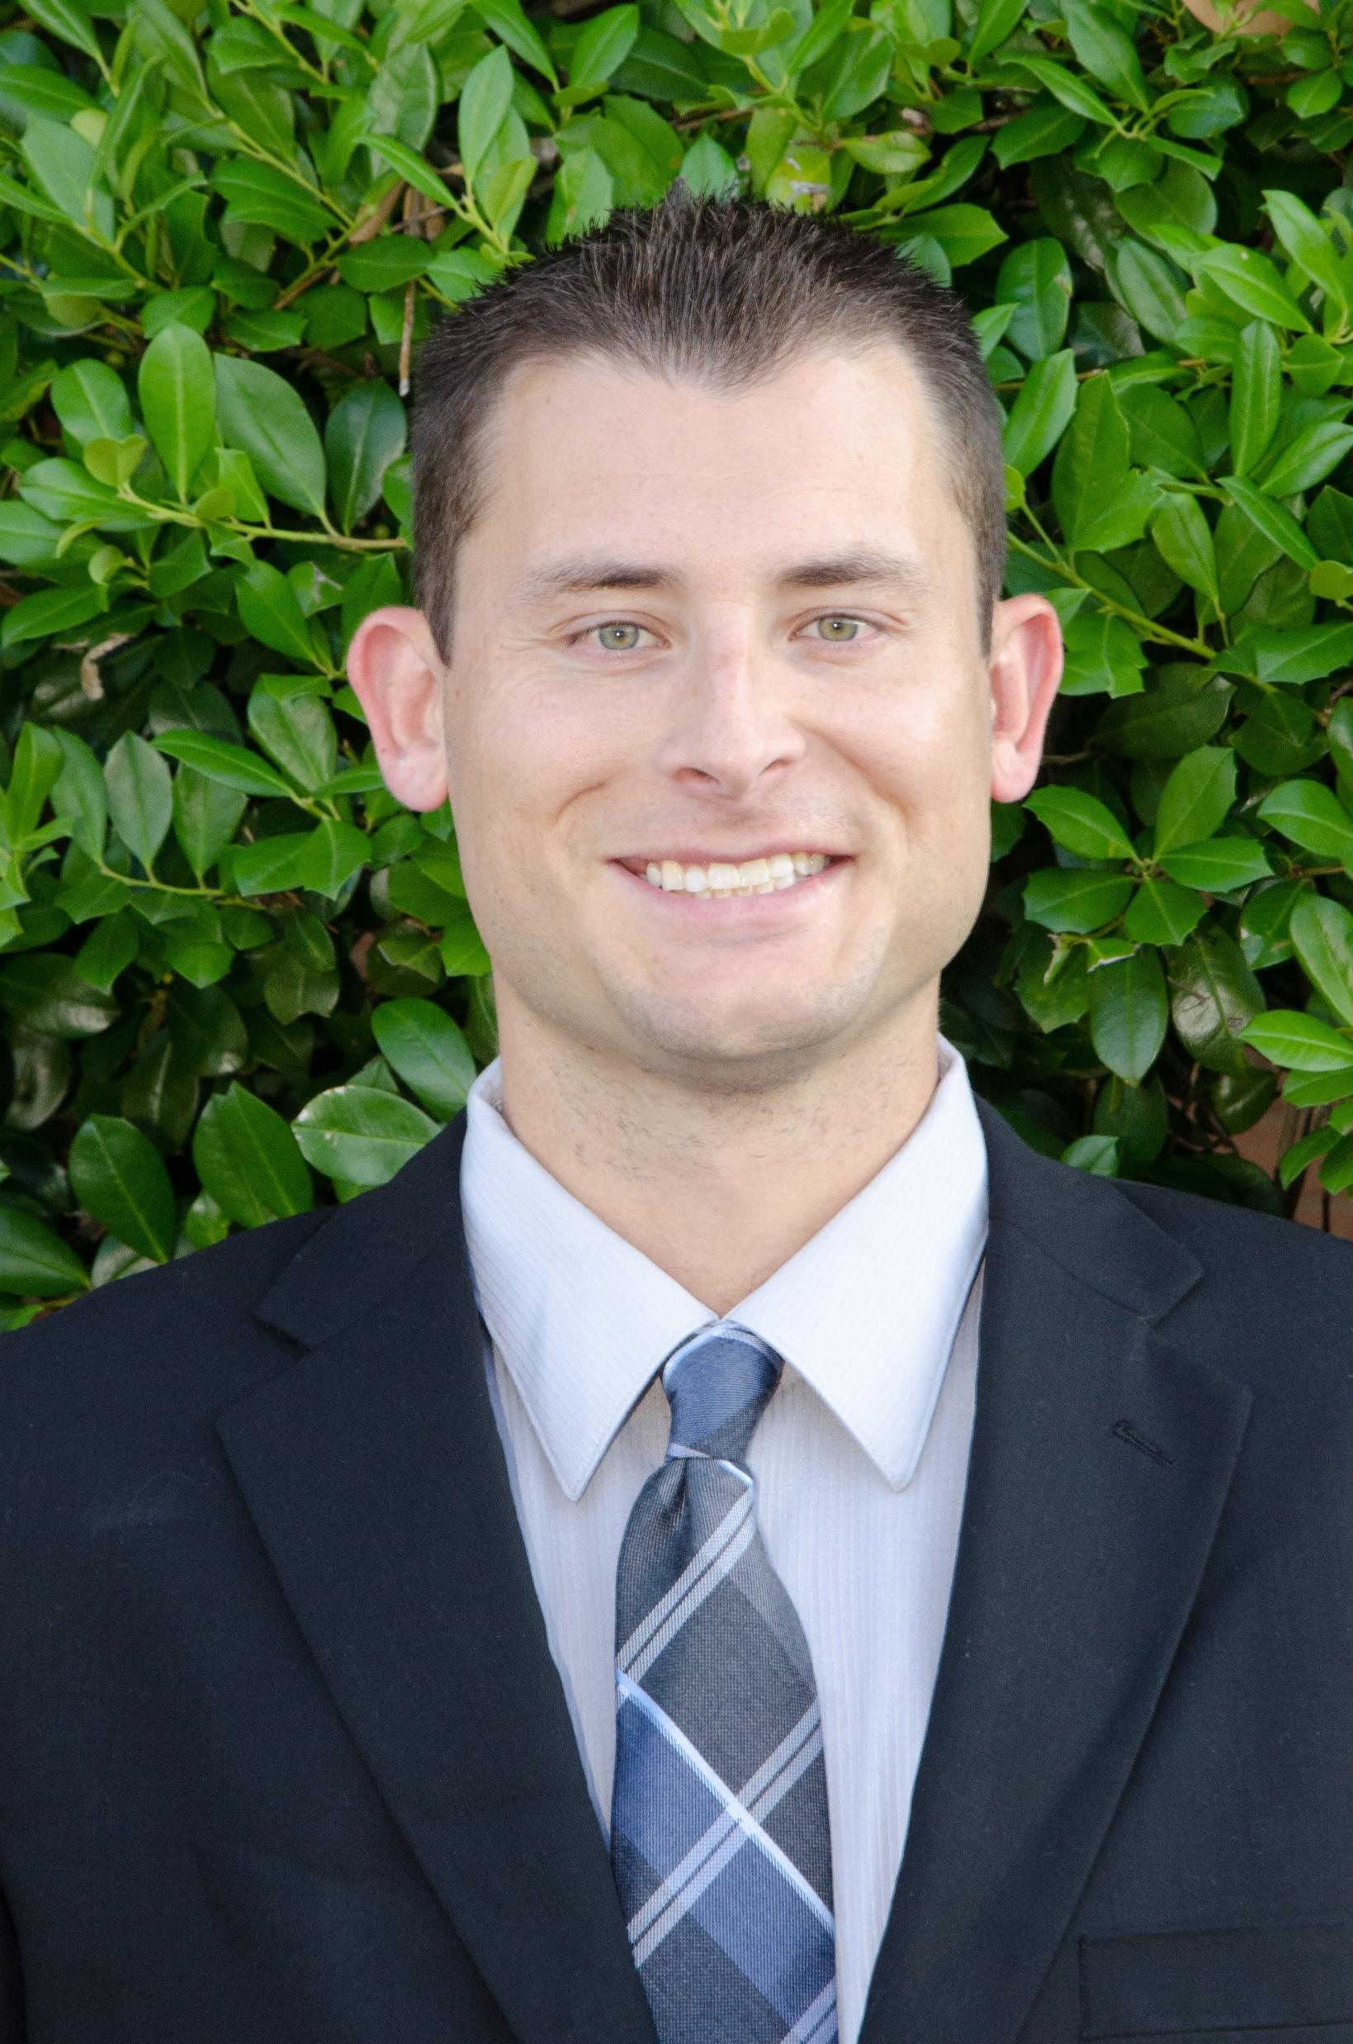
Sport Management on the Rise
The impact Sport Management continues to promote within the hierarchy of higher education.
Dr. Heath Hooper, Dean - Shorter University – Moderator

Slide 3
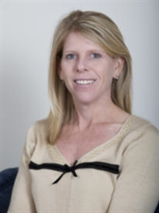
Outcomes & Assessment
S – Specific
M – Measurable
A – Achievable
R – Realistic
T – Time constrained
Dr. Jennifer Kane, Associate Dean - University of North Florida

Slide 4
Assessment Perspective of an Administrator
What does COSMA expect for Assessment Plan?
Mission and Broad-Based Goals
Student Learning Outcomes
Basic Skills Development
Student Personal Development
Methods for Measuring Effectiveness

Slide 5
Administrator Perspective…

Slide 6
Broad Based Goals
Institution
Come from the mission and strategic plan of the institution
Sport Management Program
Should be connected to the institution’s strategic plan and broad-based goals
Examples of other drivers of broad-based goals
State funding metrics
Carnegie classification
Donors
Measurement
How you provide evidence that the goals are being accomplished

Slide 7
Learning Outcomes
Description of what your students are able to do
Clear and measurable
Related to the goals of the institution
Examples of other drivers of learning outcomes:
Work force needs (outcomes that address workforce needs)
Niche development (what do you want employers to know that all of your students can do)

Slide 8
What is the Value?
RESOURCES
Faculty lines
Grants
Technology
RECOGNITION
University recognition for helping the institution meeting its goals
Accreditation
RECRUITMENT
Students to the program
Community partners
Jobs for students

Slide 9
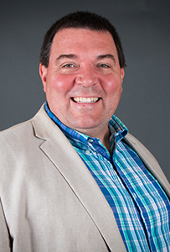
Internal & External Relationships
Building effective working relationships internally and externally of the Institution
Dr. Jeff Briggs, Dean - North Greenville University

Slide 10
Principle 7: Internal & External Relationships
Excellence in sport management education requires effective working relationships with other individuals and units both within the institution and without.

Slide 11
Principle 7: Internal & External Relationships
How do we effectively work with other individuals and units within the institution?
How do we effectively work with other individuals and units outside the institution?
What are some suggestions for implementing a plan to work with other individuals and units?

Slide 12
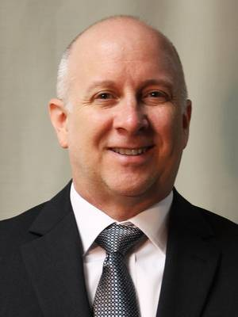
Curriculum
Evaluating and assessing your current sport management curriculum within an evolving culture of Sport.
Dr. Clay Stoldt, Associate Dean, Wichita State University

Slide 13
Curriculum: Addressing the Need for Change
Curriculum typically the domain of faculty
Administrative role
Review and approval of faculty-initiated curriculum change
Admission requirements
Program requirements
Course descriptions
New courses
New majors/minors/other credentials
Review and approval of catalog copy
”Persuasive collaborator rather than authoritative decision-maker” (Little, 2009)

Slide 14
Curriculum: Addressing the Need for Change
Reasons to initiate conversations about needed change
Board mandates
Accreditation requirements
Strategic planning priorities
Enrollment
Declining enrollment in existing programs
Opportunities for new programs, credentials

Slide 15
Curriculum: Addressing the Need for Change
Points of Influence
Mission/vision/core values
Relationship management
All faculty and staff
Department chairs as influencers
Quality assurance/continuous improvement system
Program advisory council
Strategic planning engagement
Budget allocations

Slide 16
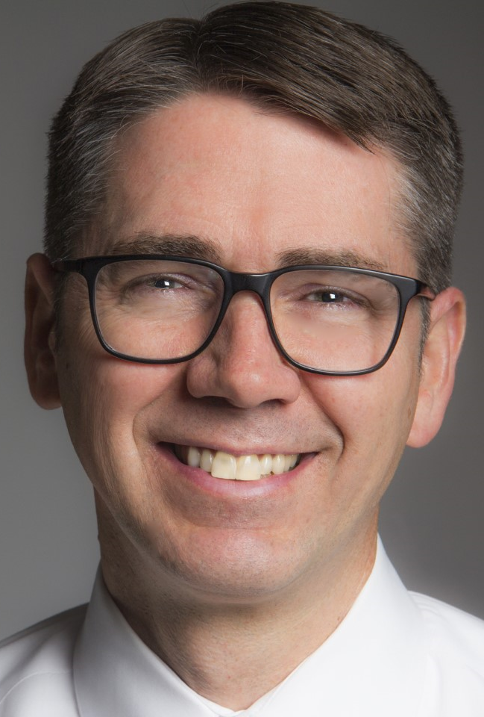
Educational Innovation
Creating a continuous cycle of improvement with program and student excellence.
Dr. Curt Laird, Associate VP of Academic Affairs, Columbus State Community College

Slide 17
Educational Innovation
Administrator Ideas Related to Principle 8
Internship Prep Course
Required Experiential Learning Prior to the Internship
Across Discipline Peer to Peer Teaching Mentorship

Slide 18
Educational Innovation
Administrator Ideas Related to Principle 8
Eight Week Scheduling
Open Educational Resources (OERs)

Slide 19
Outside Resources
The ability to promote and recognize excellent in Sport Management education worldwide.
Dr. Darlene Kluka, Former Dean - Barry University

Slide 20
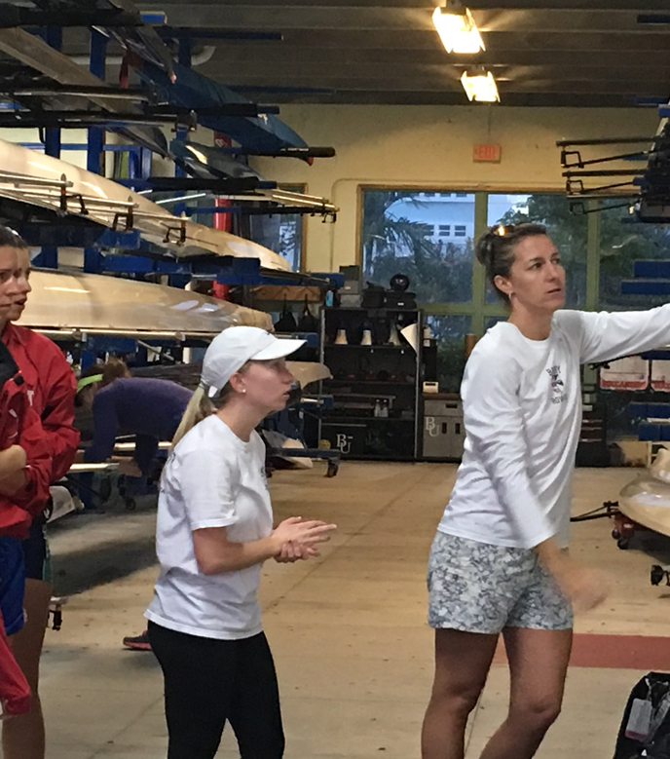
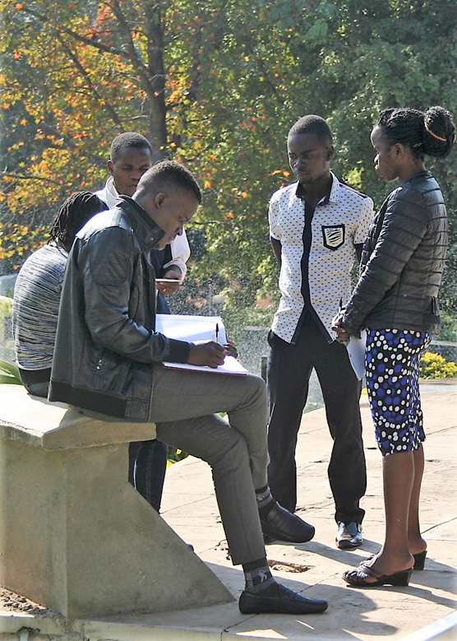
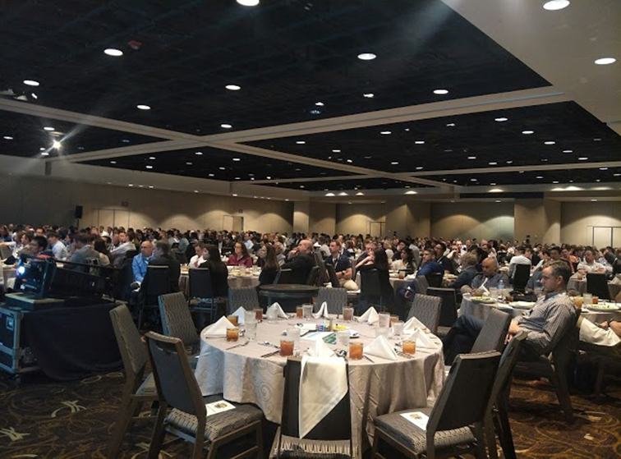
Outside Resources

Slide 21
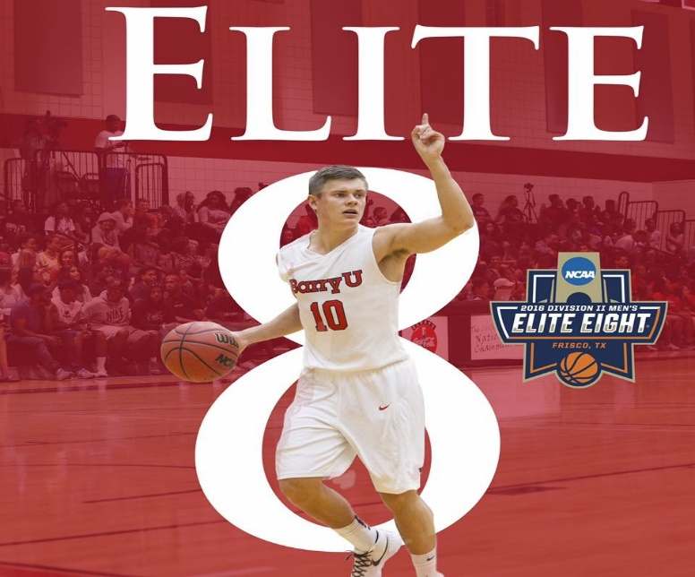
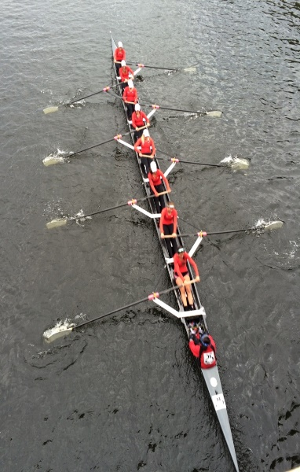
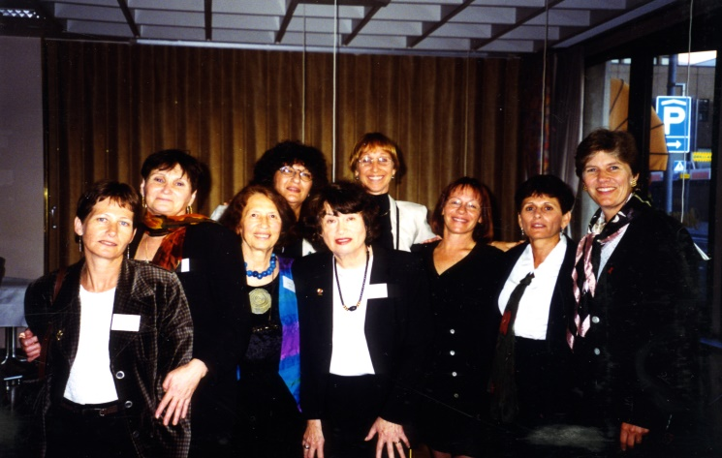
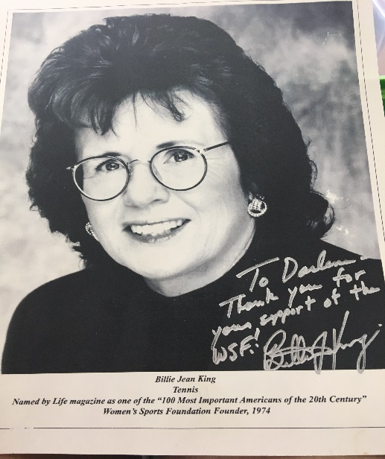
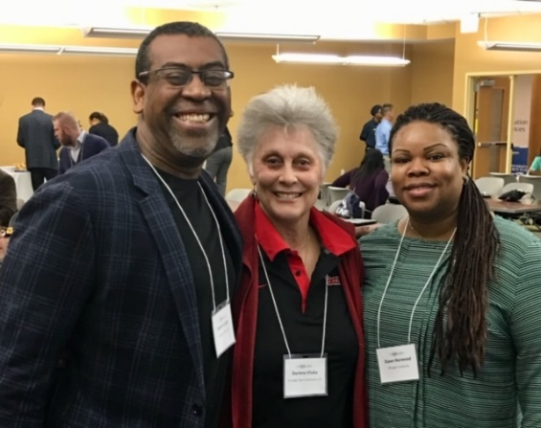
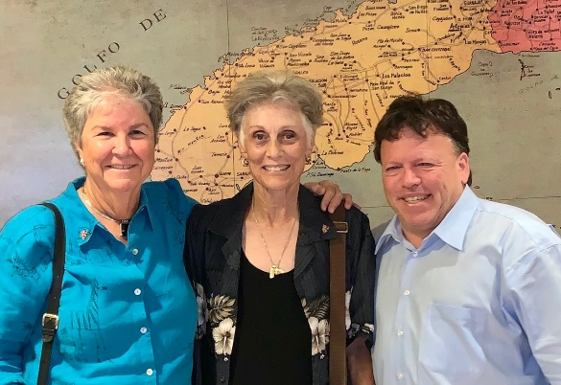
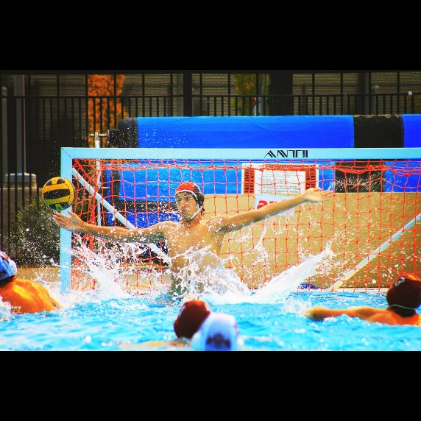
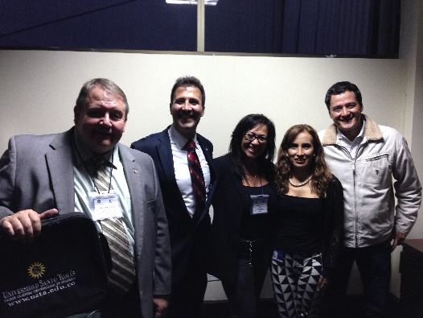
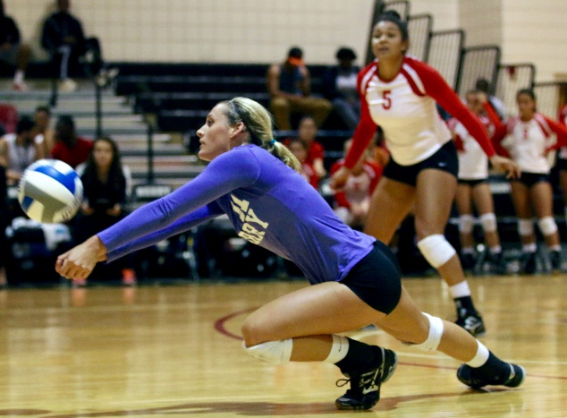
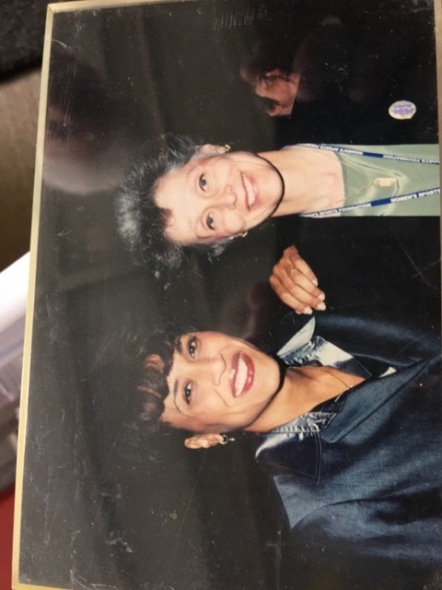
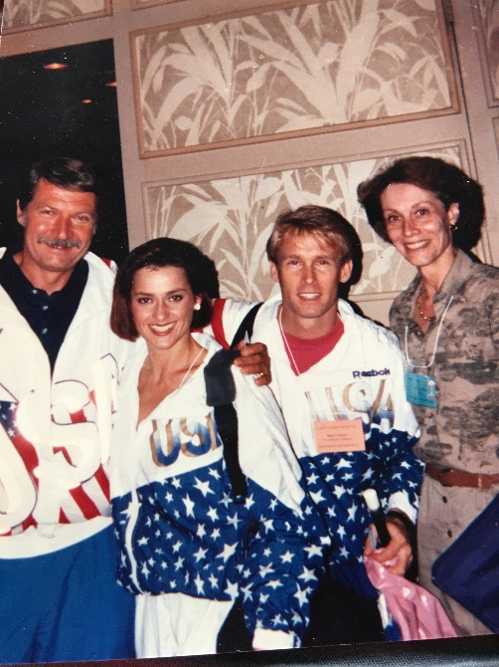
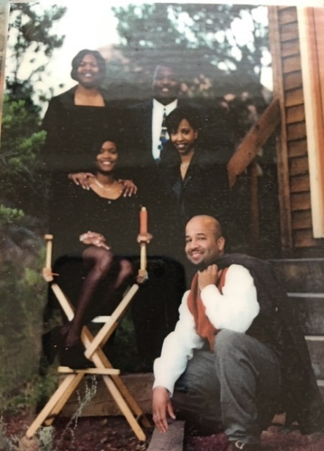
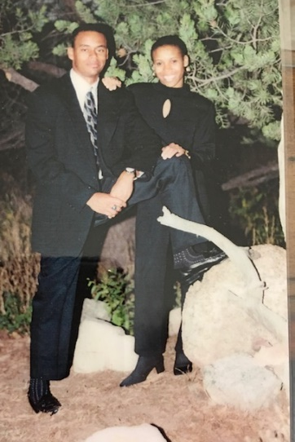
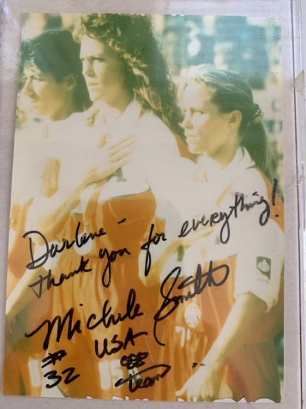
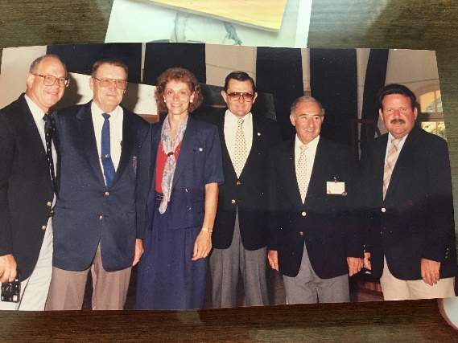
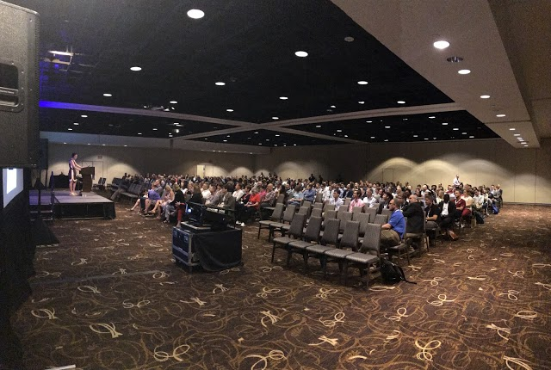

Slide 22
What does it mean to be a professional who works internationally?
Top characteristics when surveying international sport managers (2018)
Neat and clean appearance
Communication skills & Attitude
Fairness
Honesty
Humility
Mastery and Passion
Selflessness
Sensitivity
Teamwork
Decision Making
Trustworthiness

Slide 23
Add a Slide Title - 3
MALAWI SPORT BUSINESS MANAGEMENT CERTIFICATE COURSES

Slide 24
Sport Management on the Rise
Question to ALL Panelists:
Why COSMA?
Getting your administrator to buy in when moving forward with COSMA Accreditation.
Questions from the Audience

