Slide 1
Finding a Naming Rights Partner for the Stump Grinders: A Case Study
Jake Augustin – Northwood University
Brittany Jacobs – University of Northern Colorado

Slide 2
Introduction
Difficulty of teaching financial basics
Financial Statements
Financial Ratios
Financial Risk
Bring Finance to life – real world application!
Notes:
Express the difficulties of teaching the basics of finance to students. Use MSUD as an example, students despise the term finance and do not like learning the basics. It gets easier once you get to Economic Impact and How to Finance stadiums/arenas but the beginning of the course is always the toughest, especially when math comes into play

Slide 3
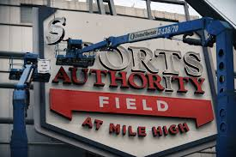
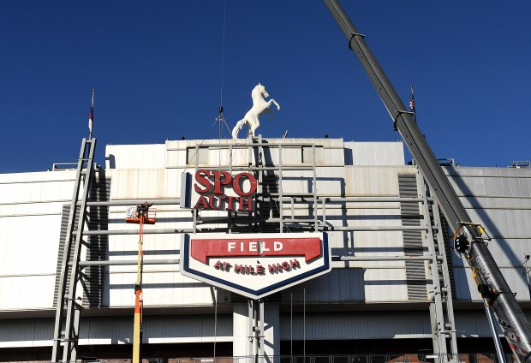
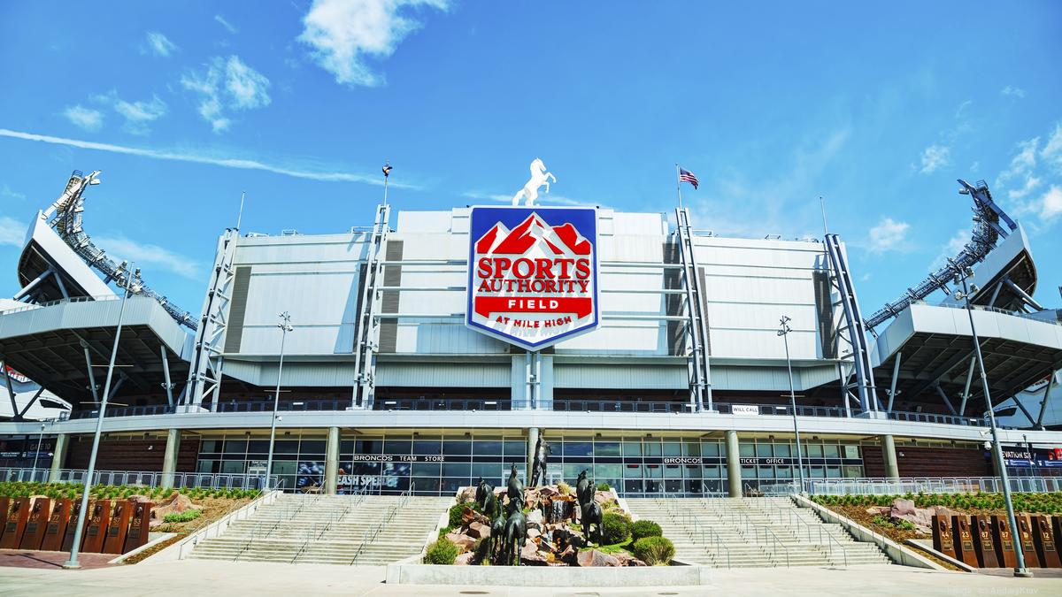
Real World Application
Denver Broncos
Naming Rights Partner
Chuck Olney – Director of Business Development
Invesco Bankruptcy
Sports Authority Bankruptcy (3.2016)
Notes:
Sports authority bought rights in 2011 – filed bankruptcy in 2016 – signage removed in 2018
State importance of naming rights money, quantity of it and its intended purposes (maintenance). Prior mis-management (invesco Bankruptcy, Sports Authority Bankruptcy).
$3 million price to re-brand stadium and merchandise.

Slide 4
Factors Impacting Naming Rights Selection
Organizational fit
Consider ethics
Geographical location
Constituent wants
Terms of Proposed Bid
Financial Health of Company
Consider financial risk
Use financial ratios

Slide 5
The Case
Background on Organization & Facility
Narrative
History of success
Attendance figures
Similar naming rights deals
Bids Provided
Background of company
Varying contract terms to consider
Financial Statements Included
Income & balance sheet for each company
Ratio Analysis for each possible Formulas included
Industry averages provided
Ethical Dilemma
Potential ‘fit’
Notes:
This is time to explain the explanations of the bids
Tabor Financial – Good Financials, Poor time and money on bid. Trick – loss of control of event selection
Victory Athletics – Poor Financials, Good time and money on bid, good fit
Organic Green – Good Financials, Excellent time and money on bid. Trick – Ethical decision on drug company as sponsor
Memorial – good time on bid, low money – would be reasonable

Slide 6
The Case of the Stump Grinders
Tabor Financial
Banking Corporation
Local (geographical fit)
Good financials
Short term contract, low value
Victory Athletics
’Ath-leisure’ brand
Organizational fit
Poor Financials
Long term contract, medium value
Organic Green
Marijuana and paraphernalia distributor
Financial Fit
Ethical concerns
Long term contract, best value
Remain Memorial Stadium
No naming rights sponsor
What the fans want!
Increase occupancy tax to 14%
Long term contract, low value
Notes:
This is time to explain the explanations of the bids
Tabor Financial – Good Financials, Poor time and money on bid. Trick – loss of control of event selection
Victory Athletics – Poor Financials, Good time and money on bid, good fit
Organic Green – Good Financials, Excellent time and money on bid. Trick – Ethical decision on drug company as sponsor
Memorial – good time on bid, low money – would be reasonable
Realization of
o.Vape that bid for Broncos Stadium Naming Rights

Slide 7
Case Tested
MSU Denver
The Sport Enterprise (Sport Finance)
UNCO
Fitness Management
Northwood
Sport Finance
Notes:
Student feedback was positive – students

Slide 8
Typical Results
Focus on Tabor
Lack of understanding of time and money of deal
Focus on Organic Green
Lack of understanding of repercussions
Families/children/older individuals
No Focus on Victory
Lack of understanding of organizational fit
Never Remain Memorial Stadium
Almost always completely ignored as an option
Notes:
Explain that students typically select one of these two, and the importance of emphasizing the negatives of the deals. As well as the positives of Victory Athletics.

Slide 9
Discussion
Ratio Analysis/Financial Risk
Consideration of Contract Terms
Ethical Discussion
Excellent way in which to express financial basics via applicable sport situation
Notes:
This can be applied to multiple classes, specifically sport finance classes, but also classes on sponsorship or ethics alternatively. Students find interest in this case as it demonstrates these financial aspects by simulating a real life scenario.
Any ways in which to add to this case?

Slide 10
Notes:
Any questions?
Any ways in which to add to this case?
Look for it in upcoming issues of CSSM!!

Slide 11
Thank you!
Brittany.Jacobs@unco.edu
AugustiJ@northwood.edu

