Slide 1
Team Meeting 101: Engaging with Academic Content, Building Professional Skills, and Assessing Student Learning
York College of Pennsylvania Department of Hospitality, Recreation & Sport Management
Molly Hayes Sauder, Brian Malcarne,
Fred Becker & Julie Saville
Notes:
Welcome. Thanks.
Purpose of this presentation is to share research that several colleagues and I conducted on an interesting instructional technique and to share the actual technique as well.
Possible opening questions: What do employers want from college grads? What do your students think they want?

Slide 2
Why this activity?
Skill/Quality | Weighted Average Rating (Ranking)
Ability to verbally communicate with persons inside and outside the organization | 4.63 (1)
Ability to work in a team structure | 4.62 (2)
Ability to make decisions and solve problems | 4.49 (3)
Ability to obtain and process information | 4.34 (5)
Technical knowledge related to the job | 3.99 (7)
Ability to sell or influence others | 3.55 (10)
(National Association of Colleges & Employers, 2016)
Notes:
What influences employers’ hiring decisions? According to the annual NACE Job Outlook publications, employers look at major, leadership positions, involvement in clubs, GPA, work experience, etc. There are also attributes/skills that are highly sought.
The weighted average ratings are on a 5-point scale where 1 is not at all important and 5 is extremely important. The rankings are from 1-10 (top ten skills/qualities) is what they give.
It should be noted that the attribute of being able to work in teams took a big jump last year.
In case needed-they survey their members and there was a 20% response rate.

Slide 3
Why this activity?
Students should prepare for twenty-first century challenges by gaining:
Intellectual and practical skills including inquiry and analysis, critical and creative thinking, oral communication, and teamwork and problem solving
Foundations and skills for lifelong learning
The chance to practice with real-world challenges and show application to new settings and complex problems
But, employers seem underwhelmed by college grads, as shown by these ratings:
7/10 in teamwork
6.6/10 in oral communication
6.3/10 in critical thinking
(AAC&U, 2008)
(Peter D. Hart Research Associates, 2008)
Notes:
Lest we fall into a trap of only looking at employers involved with NACE, what do those with strong expertise in higher education say students need to know and be able to do in a 21st century context?
Only 39% thought students were “very well prepared in teamwork” and that was the highest performing skill in the survey.

Slide 4
The challenge:
Can we create an activity that will simulate a frequently occurring real-world situation and require synthesis of many key skills?...Can this be assessed?...How will students perceive it?
Notes:
With this as the backdrop, we started thinking about all kinds of ideas. There’s lots of merit in group projects, student-led discussions, etc. But, can we come up with a really great simulation that…(read challenge)
We are all true devotees of experiential learning...service-learning, internships, etc. We need to give students chances to prepare for this throughout the curriculum.

Slide 5
Key Elements - Team Meeting 101
Present students with a problem-based scenario with no one “right” answer
Should require synthesis of several concepts recently covered in the class; additional outside research is also encouraged
Create questions or prompts to allow students to structure their discussion
Students allowed a 1-page outline as a resource during their conversation
Create groups of 4-5 students...but emphasize this is not a group activity

Slide 6
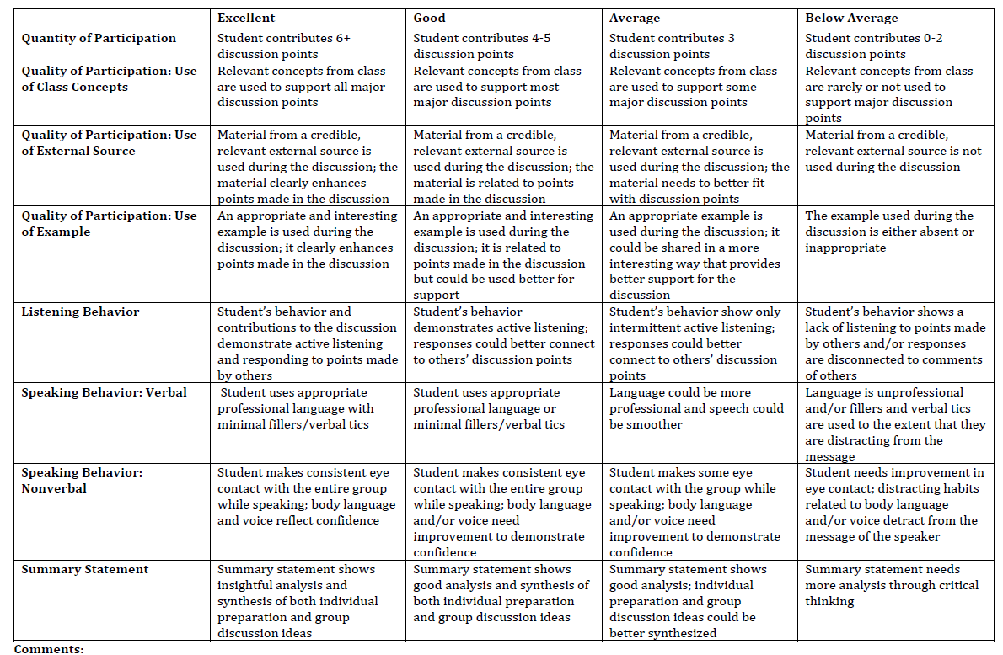
Protocol - Team Meeting 101
2 Weeks Prior
Explain activity, key elements, & purpose
Provide directions & problem-based scenario with question/prompts
Review rubric
Same Day
Expectations/Rubric Reminders
Notes:
Discuss rubric (handout). Explain back of the sheet and how that is used.

Slide 7
Sample Topics: Inequality in Sport
Notes:
Imagine that you are part of an important panel of experts who have gathered to talk about the future of sport. The topics you should be ready to discuss are:
"What are the barriers facing the advancement of women's sports in America?
What can be done to enhance the state of women's sports?
Why are changes necessary?"

Slide 8
Sample Topics: Recreation Funding
Notes:
Due to current economic struggles, the city council where you live has announced they will be significantly reducing their parks and recreation budget. Their newly proposed budget plan will only allow funding for recreation facilities and programs for one age group (e.g., children, adolescents, adults, or older adults) in the community while cutting funding for all other age groups. As a concerned citizen, you attend the next city meeting ready to discuss your perspectives as to:
Pros and cons for funding each group
What age group is the most important to fund for recreation and leisure services and why?
What age group is the least important to fund for recreation and leisure services and why?

Slide 9
Sample Topics: Hotel Sustainability
Notes:
Sustainable or Not? - You are on the management team of a historic 200 room hotel in downtown York that has never implemented sustainability practices. The hotel is currently facing financial challenges but may be experiencing renovations in the near future thanks to new owners. Recycling is required by the state, but there are few other requirements imposed on the hotel. As a team, you are asked to discuss the situation and make recommendations regarding a sustainability effort.
Discussion activity: Think of a class you teach. Think of some of the most important concepts you want students to take away from it. What could your “problem-based learning scenario” be? What kinds of specific prompts could you ask students to discuss?
Discuss assessment.
So, we created the activity. We decided to assess. Now to our third question. What are student perceptions? Self-efficacy, engagement, comparison to other activities.

Slide 10
Survey Results: Engagement
1=Strongly Disagree; 7=Strongly Agree n=119 (Rotgans & Schmidt, 2011)
Time spent preparing for activity: x=2.12 2.0 = Between 1 and 2 hours; 3.0 = Between 2 and 3 hours
I was engaged in the topic | 6.36
I put a lot of effort into the team meeting activity | 6.08
I would have liked the meeting to continue longer | 4.54
I was so involved that I forgot everything around me | 4.74
Notes:
4=neutral

Slide 11
Survey Results: Comparison to Activities
1 = Strongly Disagree; 7 = Strongly Agree n = 117
I worked harder on this activity | 4.97
I enjoyed this activity | 5.60
I found this activity to be more interesting | 5.79
I learned more from this activity | 5.56
I prefer doing this type of in-class activity | 5.68
Notes:
Asked them to compare to an exam, typical oral presentation since these are items that would test academic content and some similar skills.
6=Agree

Slide 12
Survey Results: Self-Efficacy
0 = Cannot do at all; 10 = Highly certain can do n = 117 (Bandura, 2006)
Prepare to explain an issue to a group of peers | 7.73
Discuss an important issue with peers | 8.15
Explain my point of view on an issue | 8.45
Listen to another person’s perspective on an issue | 9.09
Provide support for the comments I make about an issue | 8.21
Use ideas from other people in the group to make a professional decision | 8.44
To make eye contact with my peers during a meeting | 8.67
Notes:
Limitation is that there are lots of studies showing that students have inflated perceptions of their abilities.
Future directions: Pre- and post-test on self-efficacy over this academic year and it looks like “explaining my point of view on an issue” and “providing support for the comments I make about an issue” are most likely going to be significant with paired-sample t-tests. Of course, that is still not an experiment, but it is interesting and more information than we have now.
Other ideas: Comparisons by year in school, gender, etc.

Slide 13
Conclusion
Yes
Can we create an activity that will simulate a frequently occurring real-world situation and require synthesis of many key skills?
Yes
Can this be assessed?
Yes
Do students have favorable perceptions?
Notes:
To conclude: It focuses on academic content, skills for the real world that are needed, but often lacking, and provides some of those new applications in different contexts that AAC&U calls for. It is reasonably easy to assess. Students are engaged by it. They like it. And, they feel they can do the skills. It aligns with COSMA’s Principle #8 which calls for innovation. So, while there’s more we’d like to know from a SOTL perspective, it’s definitely looking promising.
Questions and ideas of similar activities that people have used?

Slide 14
References & Image Citations
References
Association of American Colleges & Universities (2008). College learning for the new global century. Washington, DC. Retrieved from https://secure.aacu.org/AACU/PDF/GlobalCentury_ExecSum_3.pdf
Bandura, A. (2006). Guide for constructing self-efficacy scales. In F. Pajares and T. Urdan (Eds.), Adolescence in education: Self-efficacy beliefs of adolescents, (Vol. 5, pp. 307-337). Information Age Publishing: Greenwich, CT.
National Association of Colleges and Employers (2016). Job outlook 2016. Bethlehem, PA. Retrieved from http://www.naceweb.org/job-outlook/index.aspx
Peter D. Hart Research Associates (2008). How should colleges assess and improve student learning? Retrieved from https://www.aacu.org/sites/default/files/files/LEAP/2008_Business_Leader_Poll.pdf
Rotgans, J.I. & Schmidt, H.G. (2011). Cognitive engagement in the problem-based learning classroom. Advances in Health Sciences Education, 16, 464-479.
Image Citations
Slide 1: http://volumeone.org/uploads/image/event/129/945/129945/header_giant/129945_60212_714_sales_conference.jpg
Slide 2: http://careerservices.erau.edu/wp-content/uploads/2016/04/NACE-logo.png
Slide 3: https://www1.taskstream.com/wp-content/uploads/2015/03/AACU-LOgo.jpg
Slide 4: http://tusiimeschool.com/main/wp-content/uploads/2015/03/staff-Meeting.jpg
Slide 7: http://worldsoccertalk.com/wp-content/uploads/2016/02/usa-womens-team-world-cup-winners.jpg
Slide 8: http://columbusfamilyadventures.com/wp-content/uploads/wow-slider-plugin/49/images/wickliff_playground_1.jpg
Slide 9: http://www.yorktowne.com/images/jqg_14175823151.jpg
Slide 10, 11, 12: https://www.docebo.com/wp-content/uploads/2015/09/10-engaging-elearning-strategies.jpg

