Slide 1
The COSMA Effect
Dr. Dina Gentile
Endicott College

Slide 2
COSMA Accreditation
Preparation
Accreditation
Now what……?

Slide 3
COSMA Accreditation
What end result(s) do you expect your program(s) to gain from COSMA accreditation?
The self-study process gives you an opportunity to examine the full major.
Improved assessment process.
Yields better graduates.
Provides academic quality control.
Increase program recognition, improved brand, and increased student participation.
Faculty credibility and program credibility.
(results from COSMA 2016 presentation)

Slide 4
COSMA Accreditation
How can we increase/maintain student enrollment?
How can we secure more resources for our program?

Slide 5
Enrollment
Accreditation
?
?
Enrolled Sport Management Student

Slide 6
Recruitment
How can we use COSMA Accreditation to recruit high school students into our sport management programs?

Slide 7
How to use COSMA to recruit?
Speak to parents on recruiting trips.
Attend DECA conferences to inform students.
Sell parents on the benefits of accreditation.
Connect with high school guidance counselors.
Faculty collaboration with high school SM programs.
If applicable, post high school scholarships online.
(results from COSMA 2016 presentation)

Slide 8
Recruitment
How can we use COSMA Accreditation to recruit students from high school into our sport management programs?
Branding
Website/Social Media/Admissions Events
Is it working?

Slide 9
Recruiting: Branding
Branding, by definition, is a marketing practice in which a company creates a name, symbol or design that is easily identifiable as belonging to the company.
It is a way of distinguishing yourself from the competitors and clarifying what it is you offer that makes you the better choice.
(Smithson, 2005)
Thrusts of branding:
- differentiating from competing institutions
- building an identity that transcends the physical campus
(Dooley, 2013)
“Colleges and universities, much like their applicants, have to showcase and prove their value to decision makers”
(Sullivan, 2012)

Slide 10
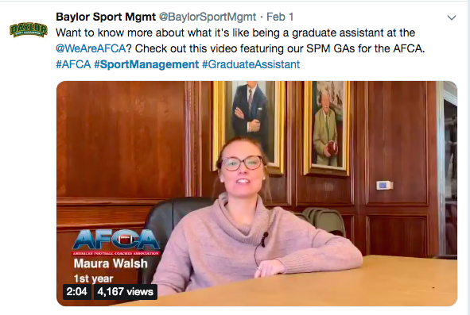
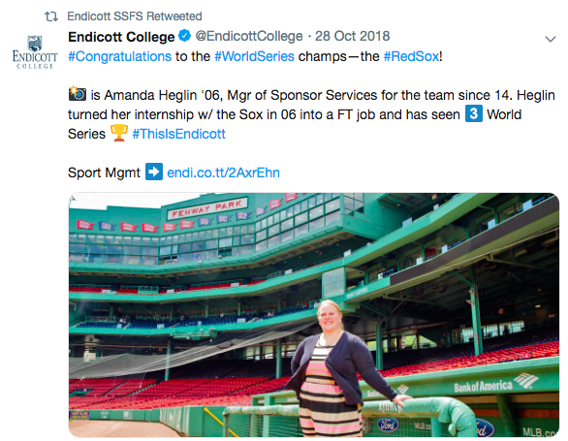
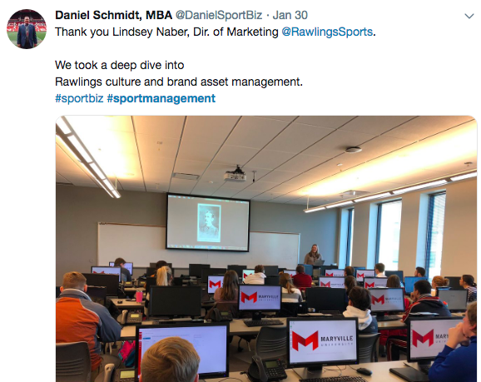
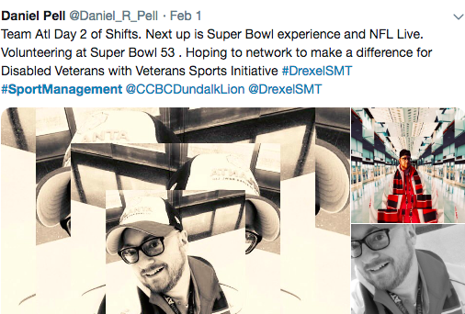
Social Media Models:

Slide 11
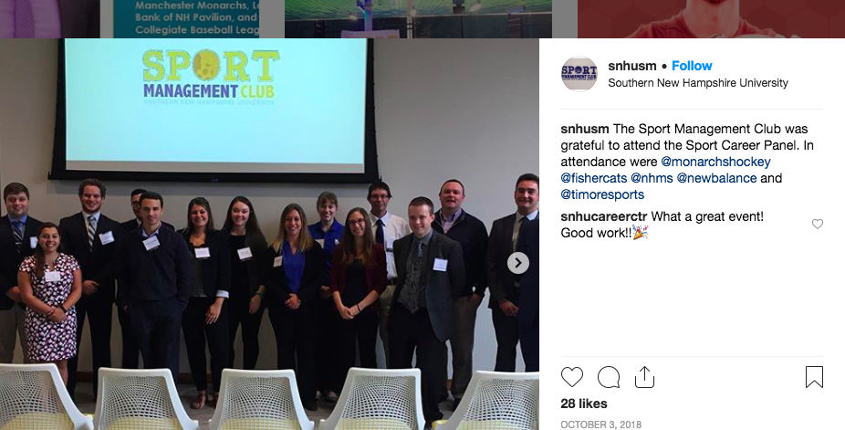
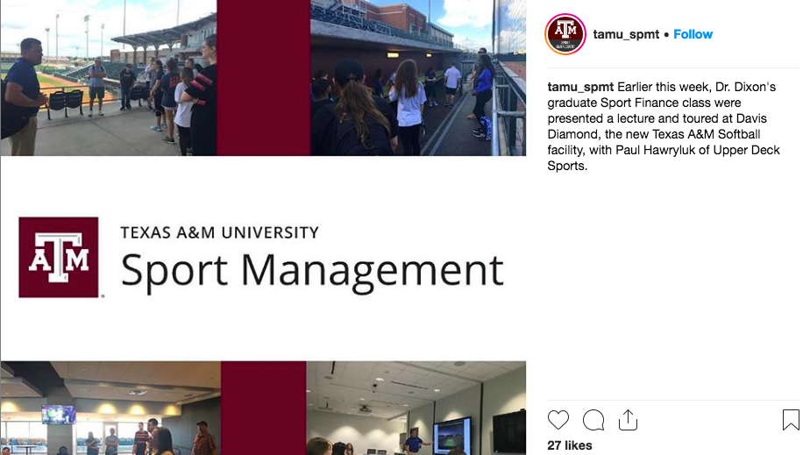
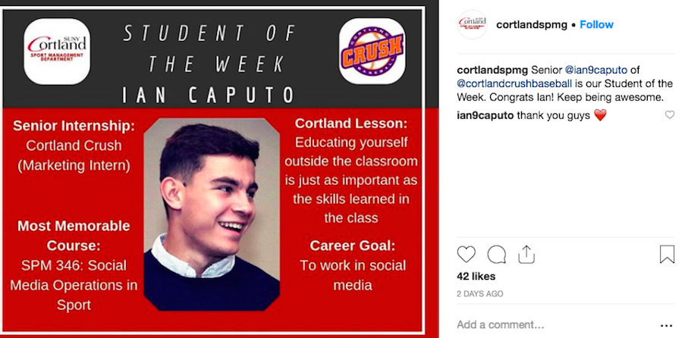
Social Media Models:
Instagram has reported that Stories have encouraged users to stay on the platform longer and visit it more frequently. Users under 25 spend more than 32 minutes per day on Instagram!
104 Million Instagram Users !!!
Notes:
https://www.statista.com/statistics/293771/number-of-us-instagram-users/
https://www.adweek.com/digital/pius-boachie-guest-post-instagram-stories/

Slide 12
Recruitment
What can we learn from other accrediting bodies?
Commission on Accreditation of Athletic Training Education (CAATE)
Schools of Education (State licensures)
Nursing Programs
Business Accreditation (AACSB/IACBE/ACBSP)

Slide 13
Key Advocates
Enrolled Sport Management Student
Admissions Office
Media Department
Internship/Career Services
Coaches

Slide 14
On Campus Challenges
Competition for students (other majors versus sport management).
- How should we manage competing for the same students (athletic training, exercise science, business management)?
Lack of knowledge about sport management and accreditation.
- How can we share ‘who we are’ and ‘what we do’?
Shared resources versus ‘individuality’ as a stand alone major.
- How can we create our own identity?

Slide 15
‘Leveraging’ Accreditation
Impact?
Student Applications
Physical Resources
Faculty Resources
Salaries
Notes:
Elliott, C. (2013). The impact of AACSB accreditation: A multiple case study of Canadian university business schools. Can J Adm Sci Canadian Journal of Administrative Sciences / Revue Canadienne Des Sciences De L'Administration, 30(3), 203-218.
Mahony, D.F., Mondello, M., Hums, M.A., & Judd, M. (2006). Recruiting sport management faculty: Factors impacting job attractiveness and advice for search committees. Journal of Sport Management, 20, 414-430.

Slide 16
Faculty
Each institution seeking COSMA accreditation must ensure that its sport programs are supported by qualified and competent faculty.
Growth of sport management programs equates to concerns about the quantity and quality of faculty.
(Mahony, Hums, & Judd, 2006)
Sport management faculty need to act as the critical conduit between students and the industry, providing preparatory opportunities both within and outside of the classroom with the goal of adding value to the student degrees as well as increasing their employability.
(Braunstein-Minkove & DeLuca, 2015, p. 123)

Slide 17
Strategic Planning
Excellence in sport management education is enhanced through an effective strategic planning process.
Mission Statement
Communication Plan
Review and Revise

Slide 18
Future Studies
Collect data to determine the effect of accreditation on families and high school students.
What do they know and does this play a role in selecting a college/university?
Track methods of communication to brand COSMA accreditation and SM programs of study.
Determine best practices for communicating COSMA stamp of approval.
Investigate changes in staffing and resources post accreditation.
Did COSMA play a role in supporting increased resource allocation?

Slide 19
The COSMA Effect

