Slide 1
The Boldness of Students on Social Media:
A New Way to Facilitate Classroom Discussion
Robert Turick and Dr. Trevor Bopp (Advisor), University of Florida
February 11, 2016

Slide 2
Introduction
Recently, Junco (2014) highlighted the need for informed and balanced approaches toward integrating social media into educational practices.
Higher education faculty and staff are typically behind the curve in incorporating social media into the classroom (Junco & Timm, 2008).
If we want to allow students to learn from each other than teachers need to step offstage to facilitate entire class discussion (Hattie, 2012).

Slide 3
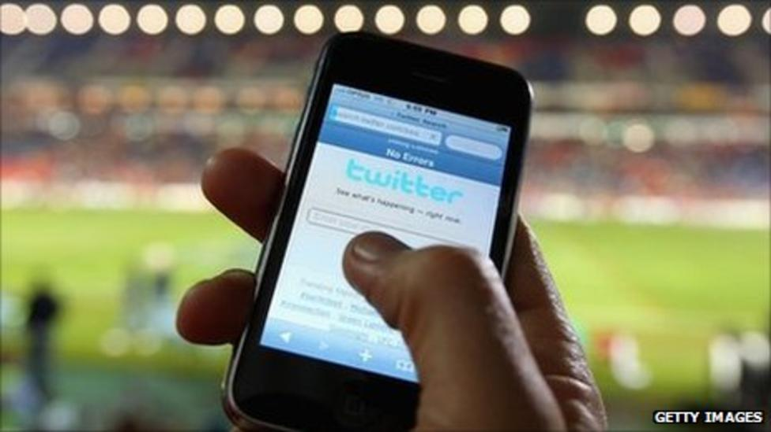
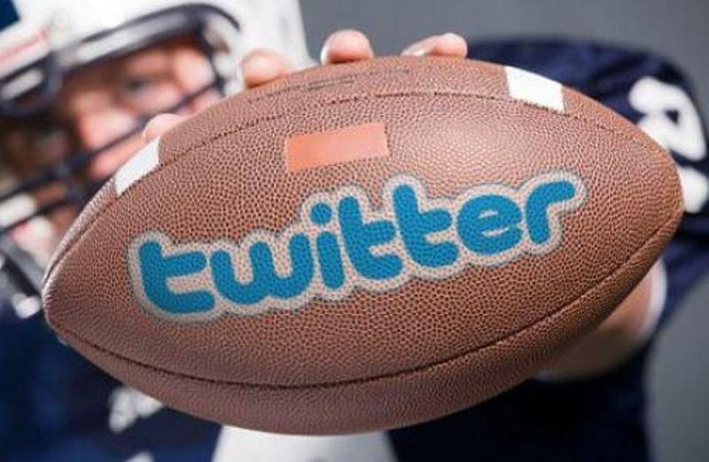
Twitter Popular Social Media Site
Facts About Twitter:
• Founded in 2006
• 316 million active users as of July 2015
• 140 character messages
Twitter Logo

Slide 4
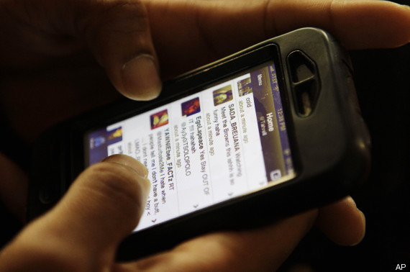
The Modern College Student Strongly attached to social media
Social Media Use:
• 98% of college students spend time on social media platforms
• 27.2%* spending 6+ hours on social media platforms (Eagan et al., 2014; Macale, 2011).
*NOTE: Up from 19.9% in 2007.

Slide 5
Current Literature
Given the prevalence with which Twitter has penetrated the sport industry and the frequency with which college students use social media, Twitter is a complementary and viable classroom component (Sanderson & Browning, 2015).
Twitter has the potential to bring about enhanced community engagement between and within those involved in the classroom (Sanderson & Browning, 2015).
Conducting conversations online allows instructors to track student comprehension of the material (Wynter, 2014).

Slide 6
Current Literature
Twitter can used to send out snippets of information relating particularly to news and contemporary issues (Vogel, 2007).
Many institutions in higher education are making a push to implement technology as part of the classroom culture via “flipped classrooms” or hybrid courses (Marr & DeWaele, 2015).
Twitter would appear to have unique benefits for its adoption for teaching purposes within the University environment as it allows academics and students to engage with each other but more importantly it allows them to engage with industry directly (O’Boyle, 2014).

Slide 7
Our Pedagogy
We sought to determine, through an analysis of in-class observations and comments, the potential effectiveness of using social media to facilitate student learning.
We observed and analyzed student comments via Twitter during group projects in which students prepare and execute a formal debate regarding current ethical or social issues in the sport industry.
Supportive
Critical
Contribution
Personality

Slide 8
Student Tweets: Supportive

Slide 9
Student Tweets: Critical

Slide 10
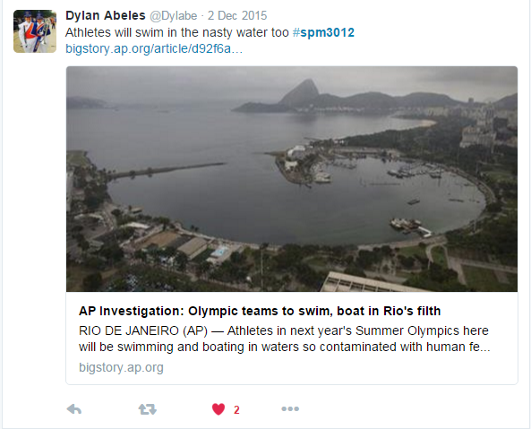
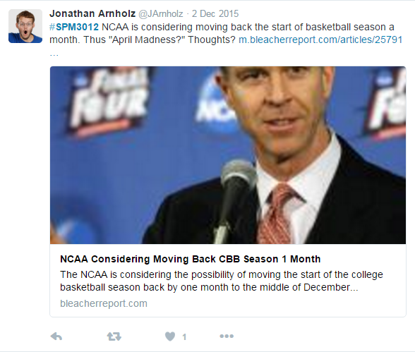
Student Tweets: Contribution

Slide 11
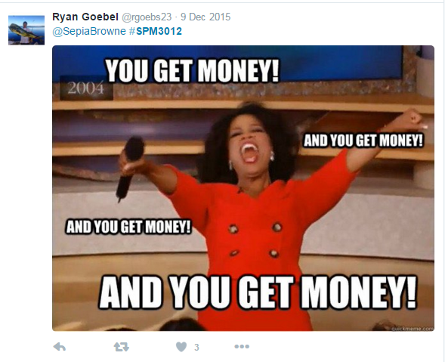
Student Tweets: Personality

Slide 12
Student Reflections
“Loved being able to debate and then go look at what people were saying on Twitter about what I said.”
“Wish more classes did projects like this because it’s better than sitting and just watching people talk.”
“I thought people were sometimes mean, but I guess that was because they could tell when we were not prepared.”
“When you debate in front of your peers you really feel the need to do as much research as possible so you don’t look bad.”

Slide 13
Implications
Data reveal that utilizing social media as a peer evaluation tool creates an environment where students are more engaged in the learning process and more critical of their classmates than with traditional peer/group evaluation forms.
Given that Twitter engages students in a dialogue regarding ethical or social issues in the sport industry, while encouraging them to apply critical thinking to those issues and the suggestions of their peers, provides support for the educational utility of social media use in the classroom.

Slide 14
References
Hattie, J. (2012). Visible learning for teachers: Maximizing impact on learning. London: Routledge.
Junco, R. (2014). Engaging students through social media: Evidence based practices for use in student affairs. San Francisco: Jossey-Bass.
Junco, R., & Timm, D. M. (2008). Using emerging technologies to enhance student engagement. San Francisco: Jossey-Bass.
Marr, J., & DeWaele, C. S. (2015). Incorporating Twitter within the sport management classroom: Rules and uses for effective practical application. Journal of Hospitality, Leisure, Sport & Tourism Education, 17, 1-4.
O’Boyle, I. (2014). Mobilising social media in sport management education. Journal of Hospitality, Leisure, Sport & Tourism Education, 15, 58-60.
Sanderson, J., & Browning, B. (2015). From the physical to the social: Twitter as a pedagogical innovation in the sport communication and sport management classroom. Sport Management Education Journal, 3(2), 124-131.
Smith, C. (2015, July 29). By the numbers: 150+ amazing Twitter statistics. DMR. Retrieved from http://expandedramblings.com/index.php/march-2013-by-the-numbers-a-fewamazing-twitter-stats/
Vogel, H. L. (2007). Entertainment industry economics: A guide for financial analysis (7th ed.). Cambridge, England: Cambridge University Press.
Wynter, A. (2014, September 15). Bringing Twitter to the classroom. The Atlantic. Retrieved from http://www.theatlantic.com/edu cation/archive/2014/09/the-case-for-having-class-discussions-on-twitter/379777/

Slide 15
THANK YOU!
Robert Turick and Dr. Trevor Bopp (Advisor), University of Florida
February 11, 2016

