Slide 1
Community-Based Patchwork- Weaving Partnerships Throughout the Department
Heather Gilmour, Ed.D.
Assistant Professor, Sport Management & Recreation
Springfield College

Slide 2
Mission of Springfield College: Educate the whole person in spirit, mind, and body for leadership in service to others.
https://www.polleverywhere.com/multiple_choice_polls/itbUhV2xA2Ebiz0EQylqM?preview=true&controls=none
Scholar Athletes partners with public high schools to help close the opportunity gap for thousands of young people in grades 9-12 across the Commonwealth. Scholar Athletes’ programs leverage the power of athletics and wellness to cultivate the discipline, confidence and social-emotional skills needed to support success in school, as well as success in life.

Slide 3
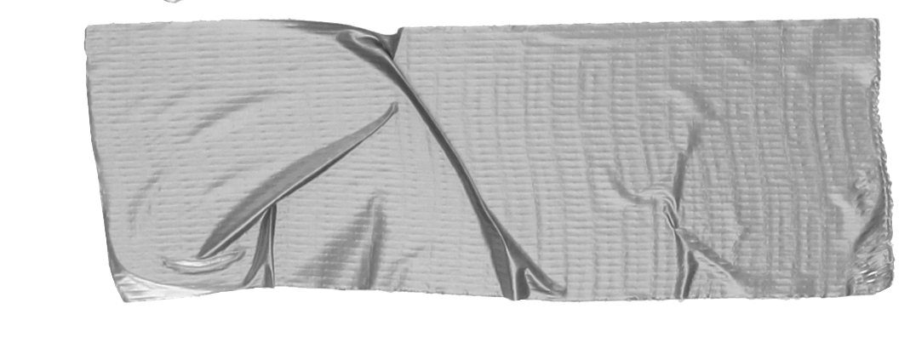
Where it started
Seminar Course Designed proposals for strategic partnership with Sport Management & Recreation Department at Springfield College
Spring Seminar Course Students expanded upon the accepted proposals from previous semester
Presented detailed proposals to Recreation Management Program Director & non-profit
Spring 2020 Event Man. Course Recreation Management faculty working to implement partnership

Slide 4
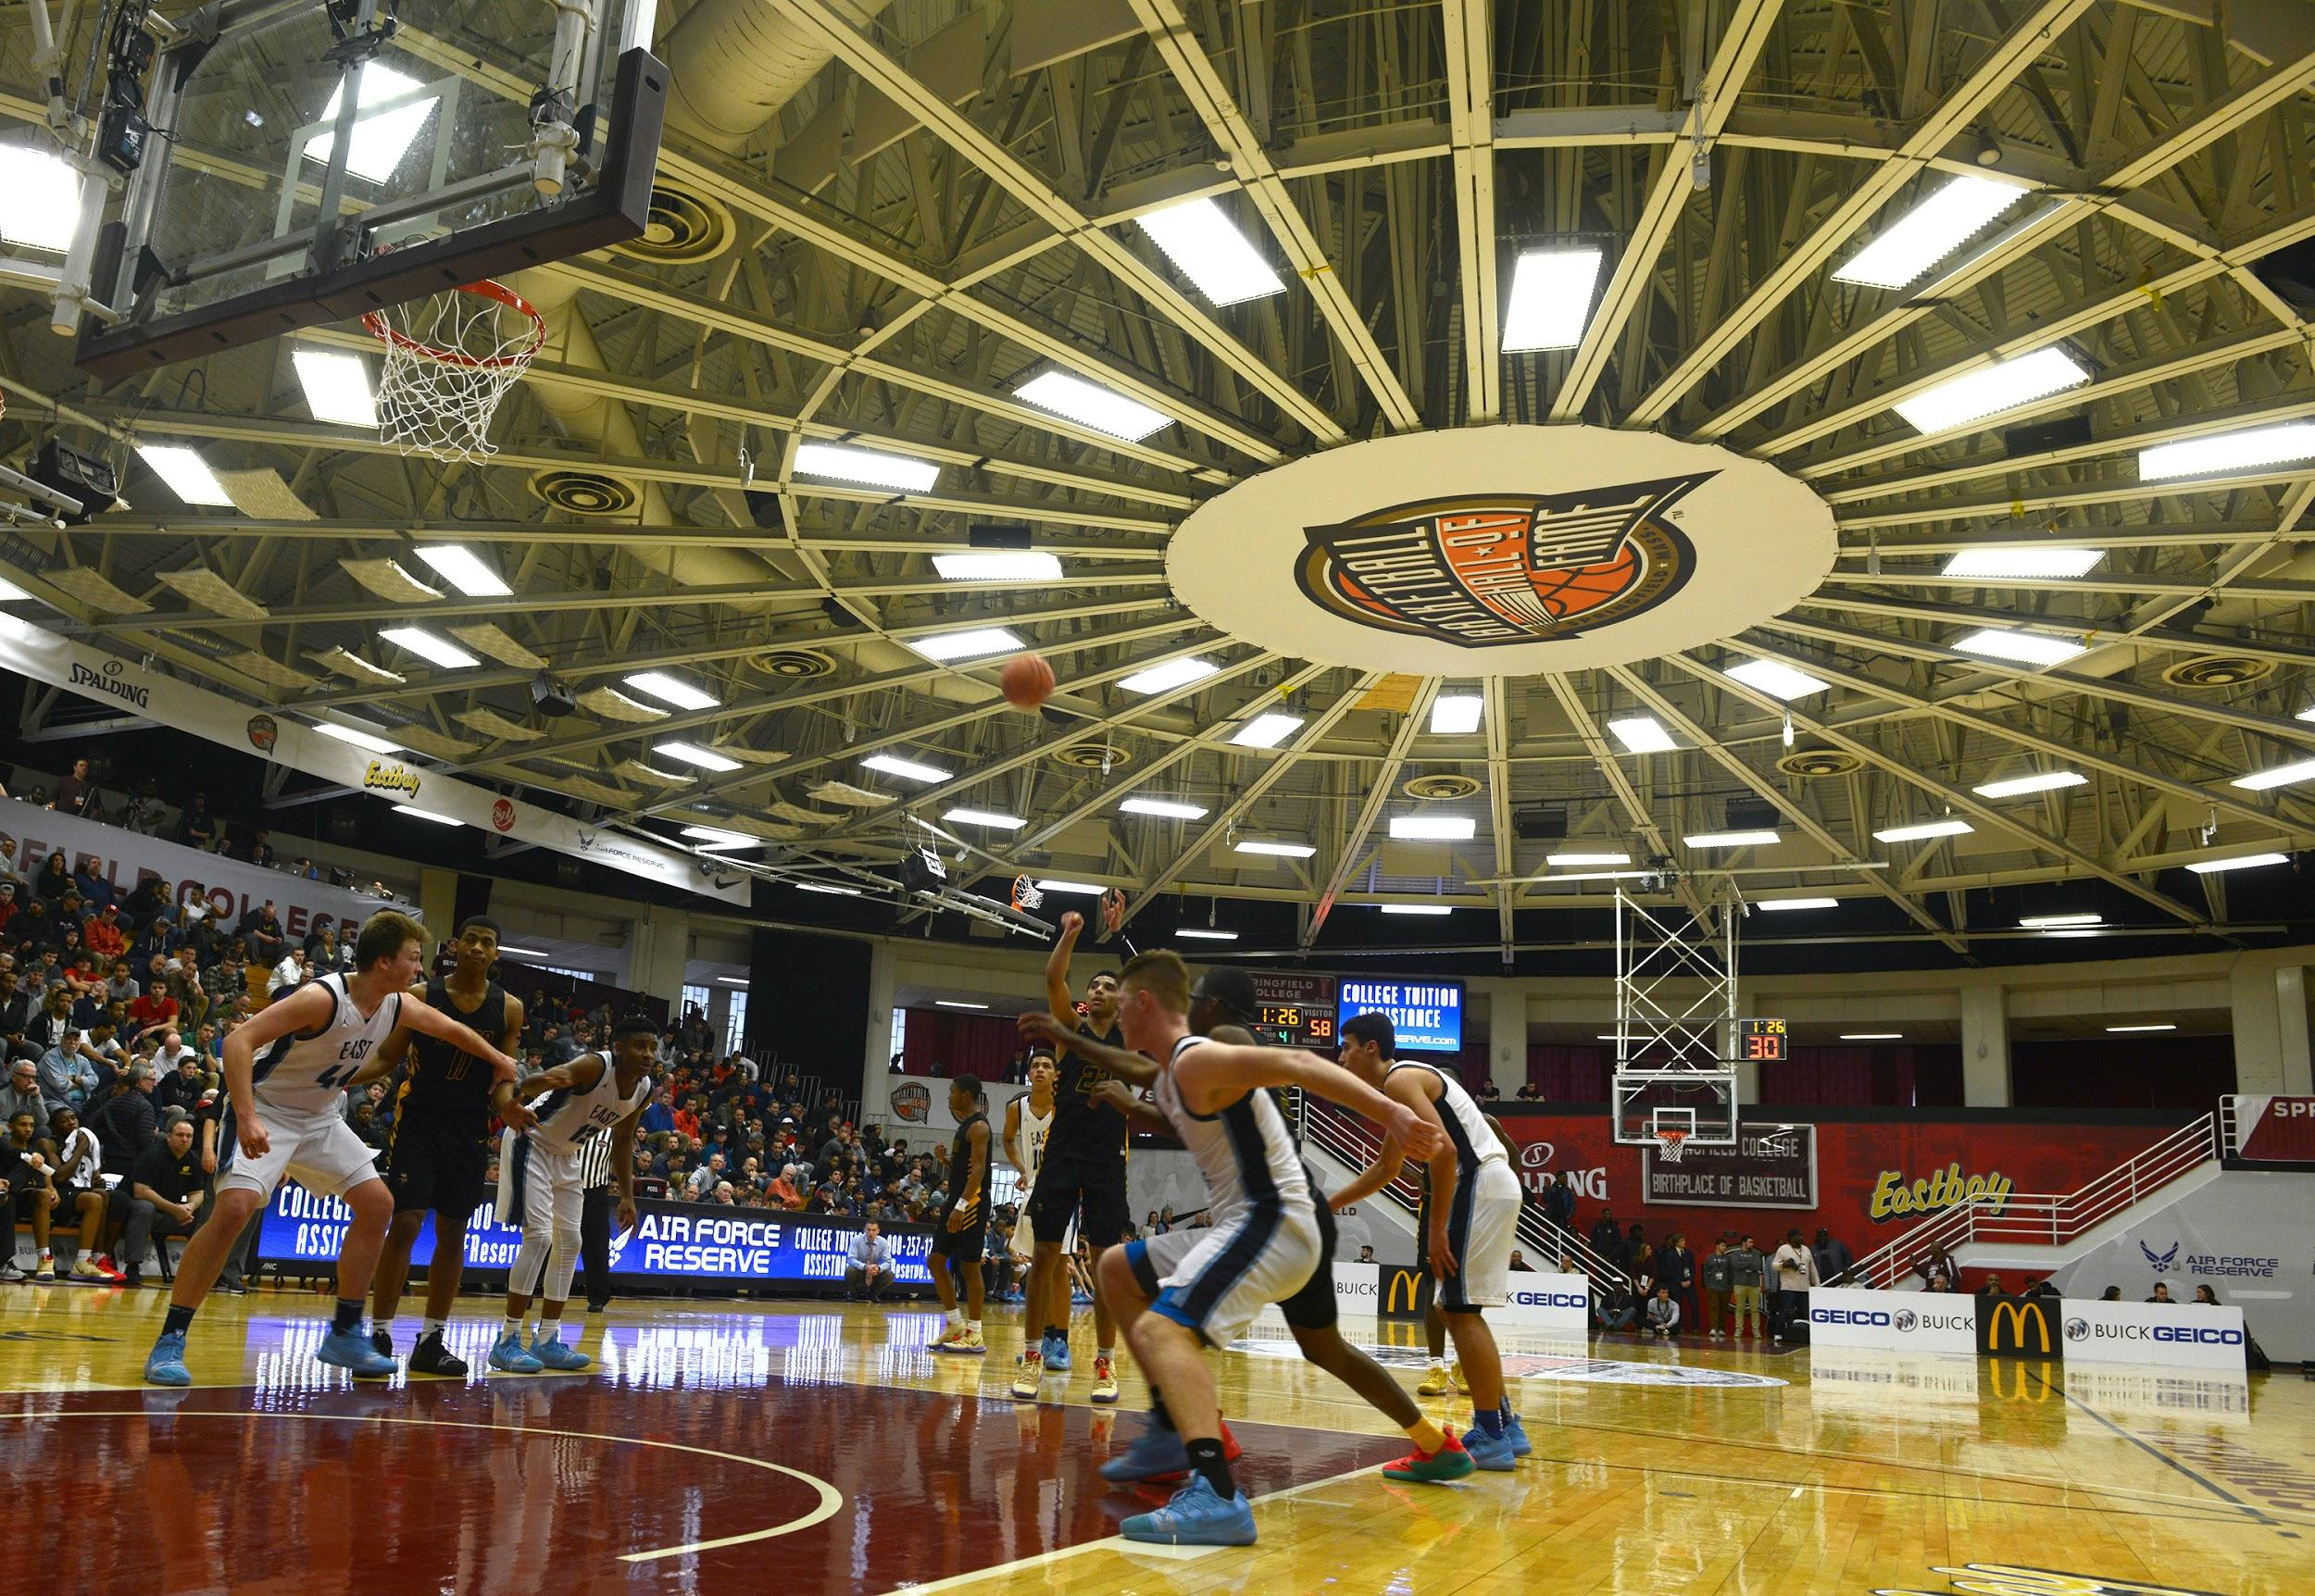
How could we expand for co-curricular opportunities for students within our program?
Work-Study Student
Upper-Class students worked with faculty for the development and planning phases of the event.

Slide 5
Research for faculty.
Analyzed research on:
Youth sport
Leisure motivation
Social emotional intelligence
Self-efficacy
Impacts of service-learning
On community partner & student learning
Communication
Discussed research interests with community partners throughout.

Slide 6
Scholar Athletes Research
Online survey developed using a variety of assessment tools, and administered by Scholar Athletes three times a year.
The Time 1 & 3 Survey will be used to assess:
1) student perceptions of the Scholar Athletes program,
2) their perceptions of exercise,
3) positive youth development indicators.
The Time 2 Survey will explore leisure behavior, life satisfaction, and the effects of service-learning.

Slide 7
Testing Instruments:
The survey instruments used in this study are composed of multiple instruments. The instruments for the Time 1 Survey include: Survey of Academic and Youth Outcomes-Youth Survey (items selected; SAYO-Y, 2019); Teamwork Scale for Youth (Lower et al. 2015); Thinking about the Future, Growth Mindset, and the PYD Short Form: Older Adolescents (Lerner et al., 2005, Phelps et al., 2009); Exercise Stages of Change and Self-Efficacy (Marcus, 1992); Regulation in Exercise Questionnaire (Mullan et al., 1997); and Quality of Recreation Services (items selected; MacKay & Compton, 1990). The Time 1 Survey and Time 3 Survey will be identical.
The instruments for the Time 2 Survey (attached) include: Free-time Motivation Scale (Baldwin & Caldwell, 2003); Leisure Experience Battery for Adolescents (Caldwell, et al., 1992); What am I Like (Lerner et al., 2005, Phelps et al., 2009); Student's Life Satisfaction Scale (Huebner, 1991) with items from the Satisfaction with Life Scale (Diener, 1985); and the Impact of Service Scale developed by Dr. Heather Gilmour (study co-PI).

Slide 8
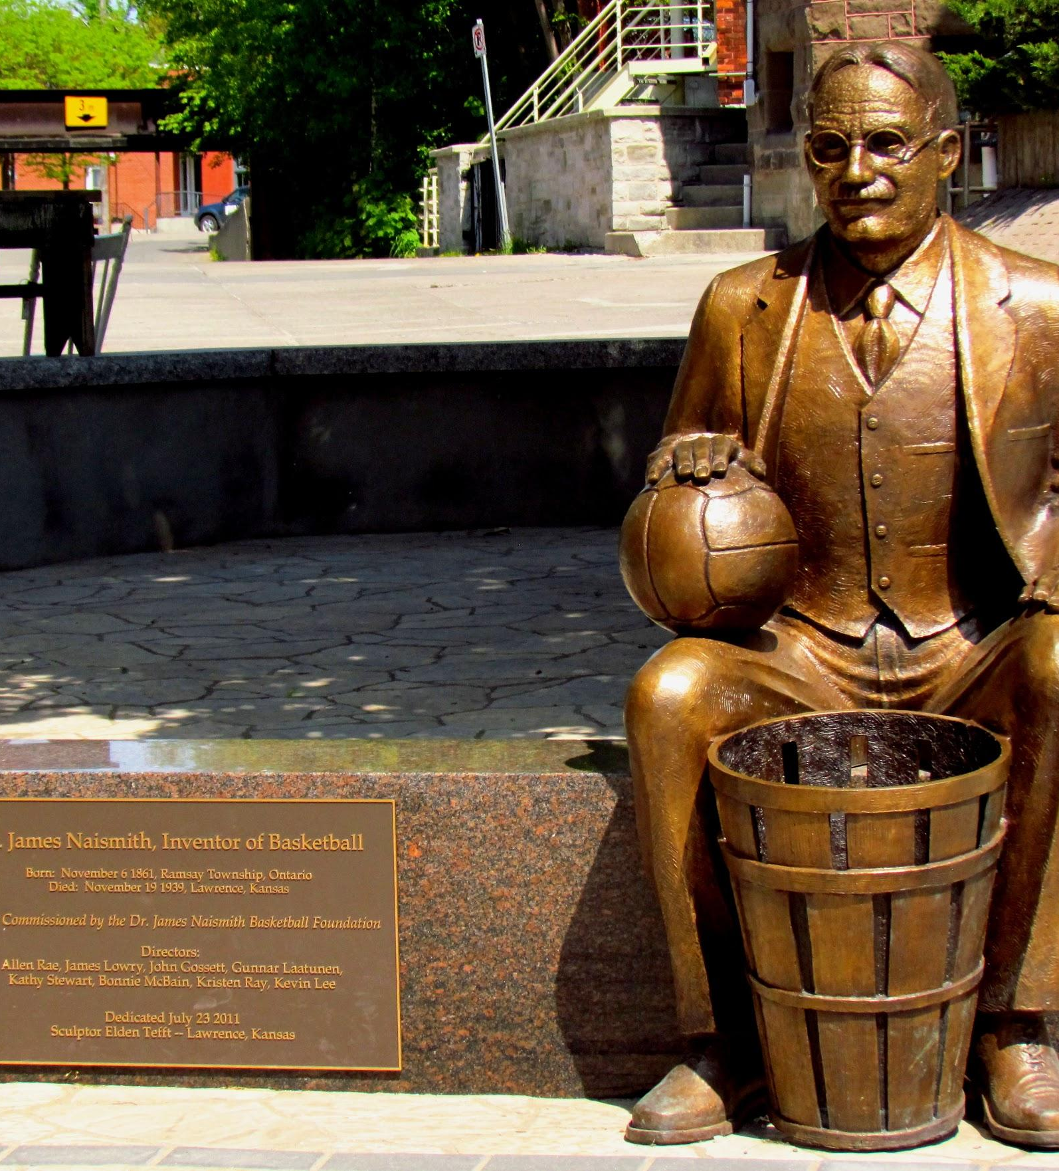
Finding a community partner requires open communication to explain learning objectives, as well as the organization’s mission and needs to create mutually beneficial partnership.
Tip
Integrate the community partner into the course to fully appreciate and understand their needs.
Attended class
Students did visits
Evaluated presentations

Slide 9
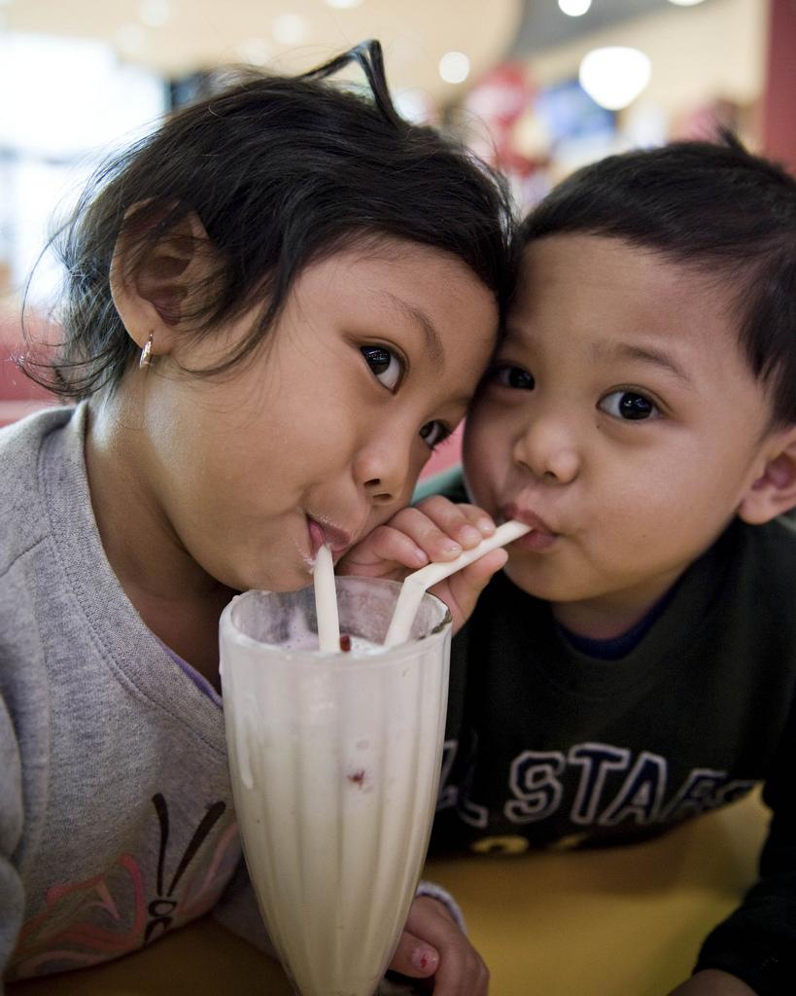
Think outside the box
Began with students...
Time?!?! Build partnership, not sole projects
Share! Provide glimpse of institution, research interests, learning outcomes, syllabus, assessments, etc.
Flexibility

Slide 10
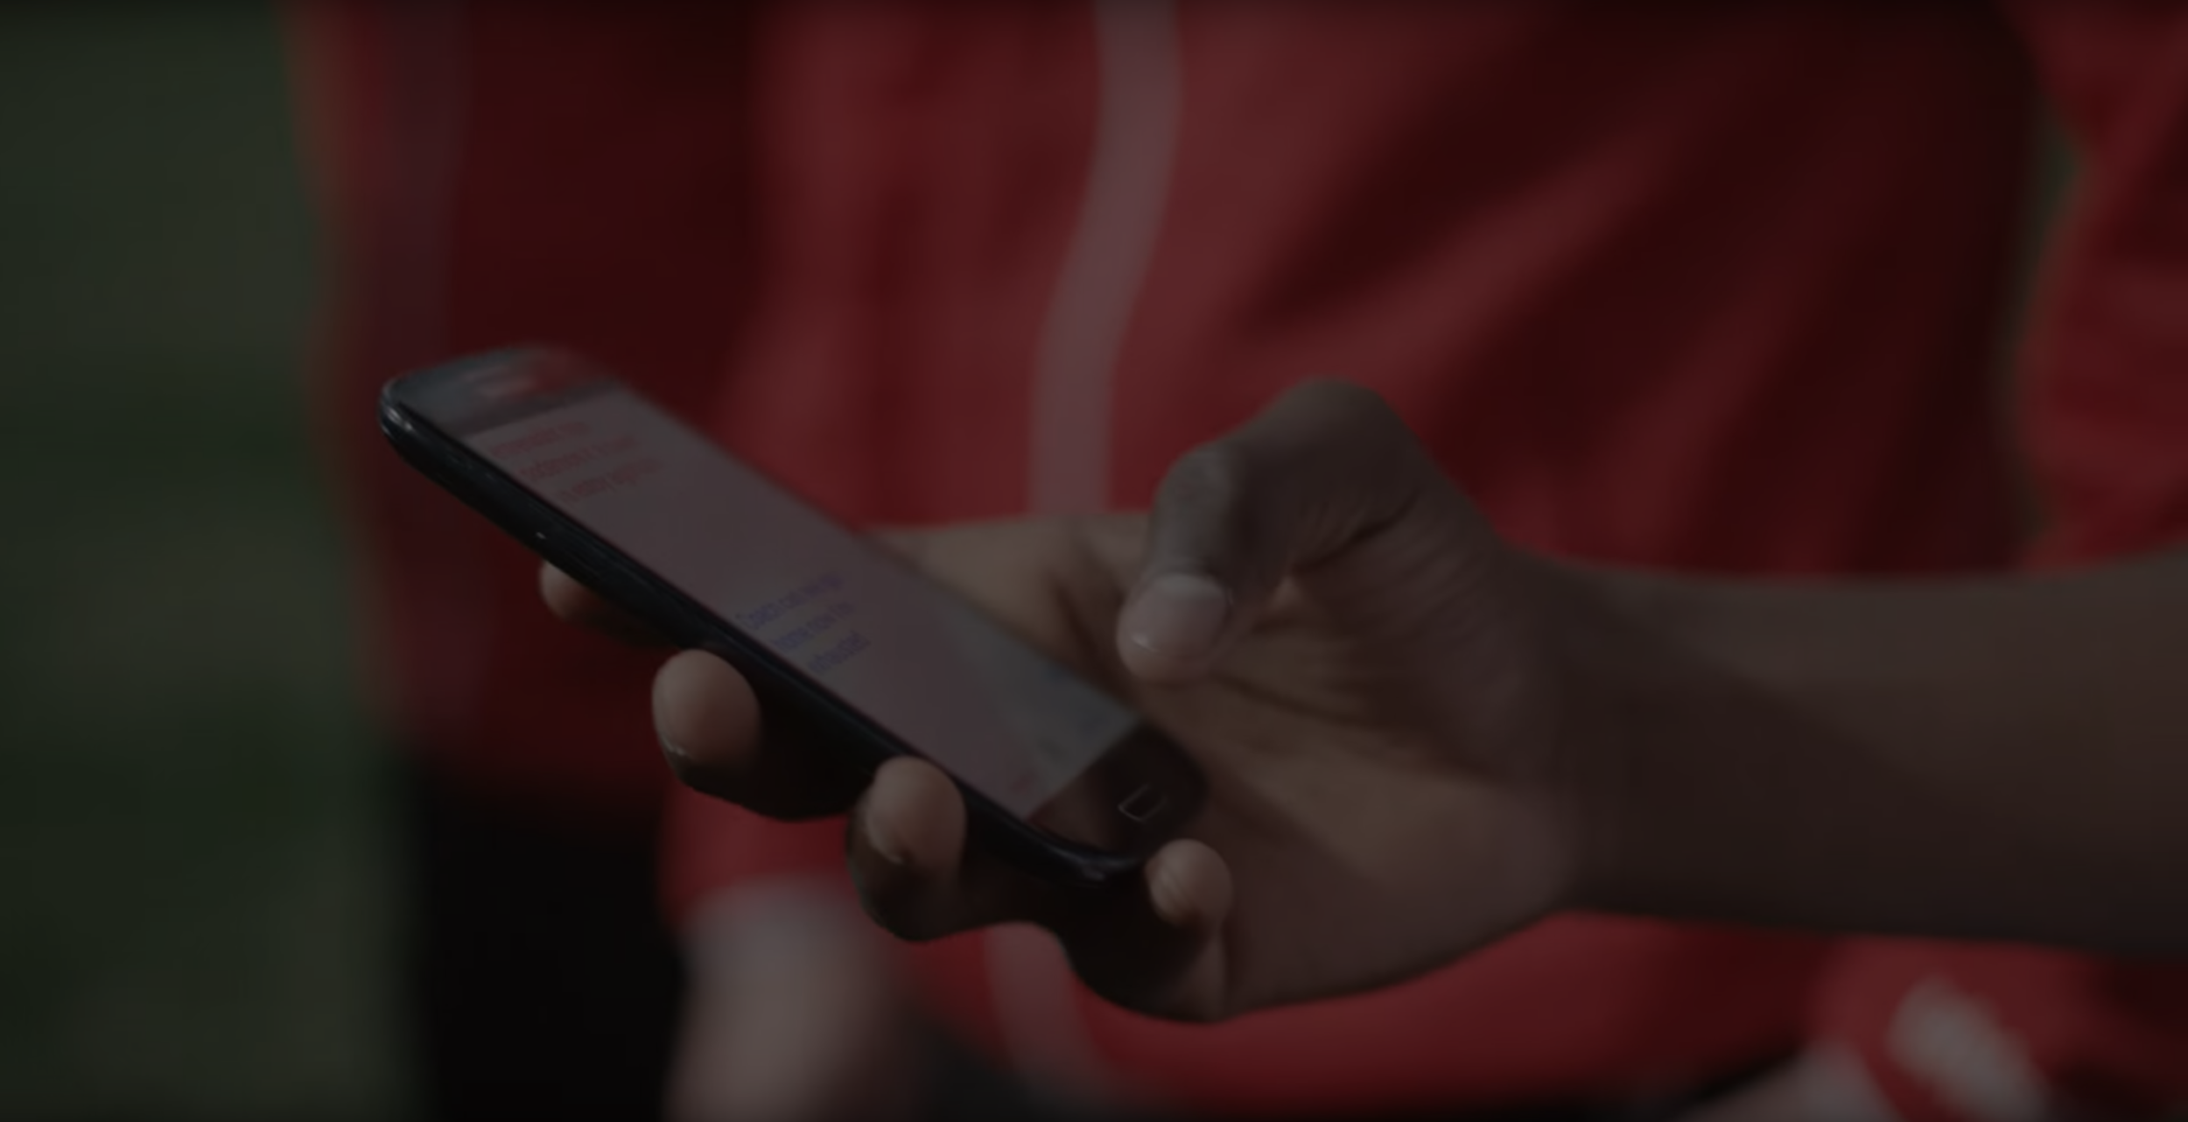
Thank you!
hgilmour@springfieldcollege.edu
Contact:
What more info? Please feel free to reach out for the full list of references or with questions!

