Slide 1
You Can Lead a Horse to Water:
A conversation about motivating undergraduate students to (fill in the blank)

Slide 2
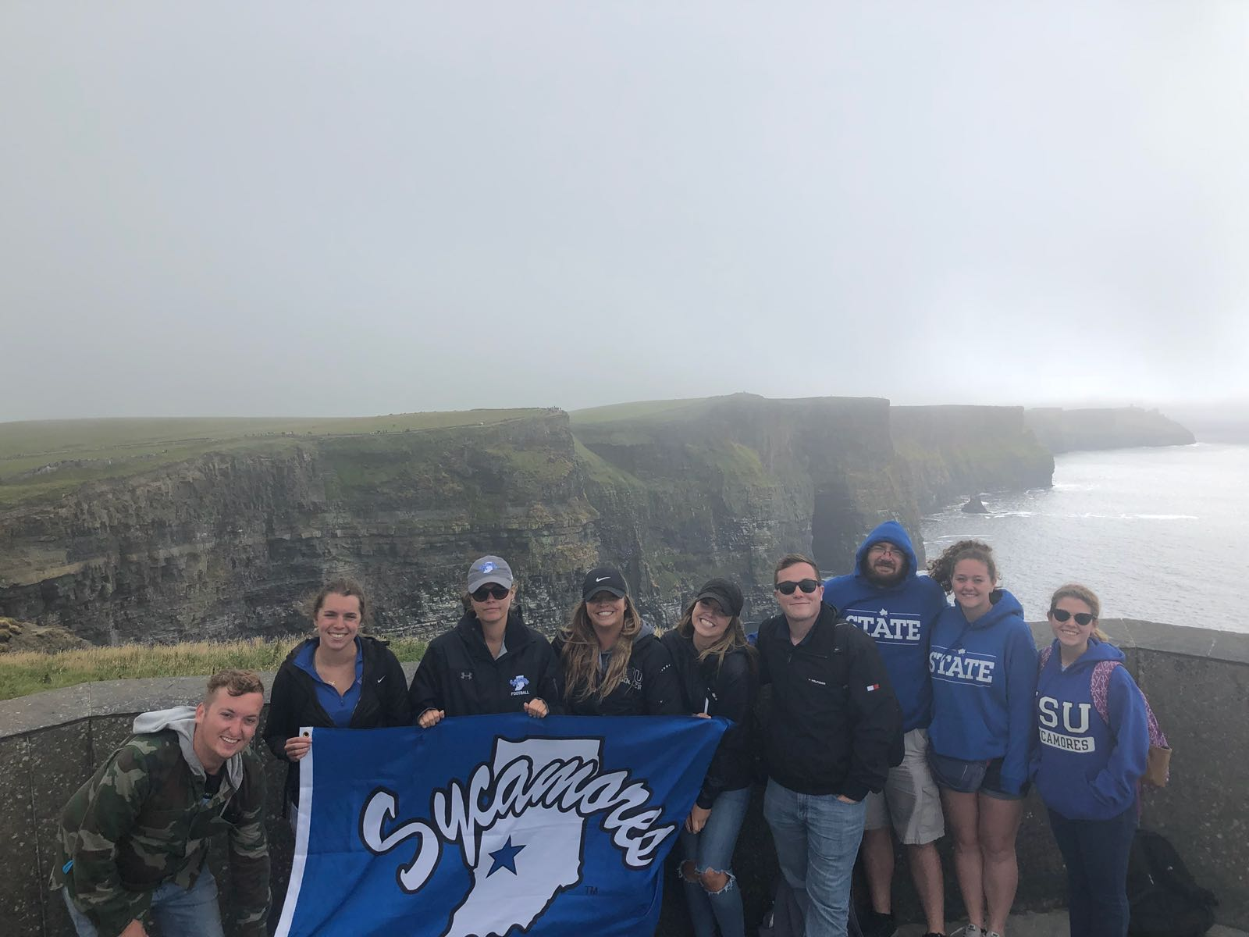
About Us
Presented by:
Chad Witkemper
Craig Morehead
Parker Michael
Indiana State University

Slide 3
The catalyst?

Slide 4
The Problem
Social Loafing
Apathy
Mobile Devices
Pedagogy?
Gender
Other students will pick up the slack
Lack of interest, enthusiasm, or concern
What is responsible?
Who is responsible, the student or the faculty?
Do demographics play a role?

Slide 5
The Method
Case Study
Sashittal et. al, 2012
Content Analysis
Analysis of Sport Management students at Indiana State University
Surveyed, interviewed, and observed UG students
Discover published best practices for engaged classrooms

Slide 6
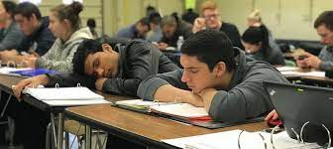
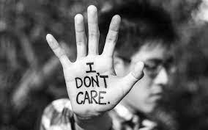
Student Apathy Background
Decades of research
Crumbaugh, 1968
Coffield, 1981
Hatfield, 1995
Jassawalla et al., 2009
Stanton & Knox, 2018
First known look into student apathy
Apathy patterns not increasing in generalized pattern, gender may play a role
Seven principles of action to reduce apathy
Student loafing connected to student apathy
Cell phones and other factors, who is responsible – student or faculty

Slide 7
Research Questions
RQ1
RQ2
Current trends to overcome apathy in the classroom?
Demographics play a role? Other demographics?
RQ3
RQ4
Classroom atmospherics have an impact?
Observational Themes of Sport Management students?

Slide 8
Our Findings
Analyzing the results of the survey, interviews, and observations

Slide 9
Demographics
Gender
Race
Year
Male: n = 94
Female: n = 26
White: n = 67
Black or African American: n = 29
Hispanic or Latino: n = 5
Multi-race/ethnicity: n =17
Prefer not to say: n = 2
Freshman: n = 50
Sophomore: n = 31
Junior: n = 25
Senior: n = 11
Graduate: n = 3

Slide 10
Student Extracurricular Involvement
Extracurricular Activities
Employment
Hours worked
Student Athletes: n = 32
Student Government: n = 2
Student Organizations: n = 9
Greek: n = 23
None: n = 42
Other: n = 7
Working: n = 61
Not working: n = 58
0-10: n = 14
11-20: n = 18
21-30: n = 17
31+: n = 14

Slide 11
Student Testimonial
I think the faculty to student ratio is a lie.
I never bought a book the 4 years I was here and passed all of my classes. College is a scam.
“
”
“
”
…tell us how it will help us in the real world instead of making it feel like busy work
“
”

Slide 12
RQ1: Effective trends
Innovative Practices
Independent Practices
Interactive Practices
Traditional Practices

Slide 13
Surveys, Interviews, and Observations
I do not really care about being a student here.
Attending College is not high on my priority list
I do not care much about what happens in College.
What have we learned about apathy in undergraduate students
RQ2 Demographic Impacts?
RQ3 Classroom atmospherics?
RQ4 Discovered themes?
Race was not found to have a significant
Gender was significant as females expressed lower apathy scores
Employment – more hours meant more apathy
Larger high school size had a positive relationship
GPA & Academic achievement had a negative relationship
Tables facing each causes us to interact more
I am more active in a smaller classroom
Professor more able to connect in smaller classes
Less distractions = better learning experience
Comfortable seating big difference
More busy work
Excessive lecturing
Lack of instructor rapport
Having more fun, being more exciting, more humorous
Discussion & Debates
Interactive classroom activities
Guest Speakers

Slide 14
Discussion
A new way to engage with students to reduce apathy.

Slide 15
Thank You
Indiana State University
Chad.Witkemper@indstate.edu
Craig.Morehead@indstate.edu
pmichael2@sycamores.indstate.edu
www.indstate.edu/health/program/spm
@ISU_SportManagement

